Slide 1
Basic Hydrology & Hydraulics: DES 601
Module XX
Precipitation and Design Storms

Slide 2
Precipitation
Sun
Clouds
Clouds
Precipitation
Transpiration
Surface Runoff
Evaporation
Groundwater Flow
Lake or Stream
Ocean
Surface Water Body
Notes:
Surface water hydrology really begins before the precipitate hits the ground. The form of precipitate is important (rain, sleet, hail, or snow). For example it takes about 10 inches of snow to produce the same water as 1 inch of rain. Other factors of importance are the size of the area over which the precipitation falls, the intensity of the precipitation, and its duration.
Once the precipitation hits the ground several things can happen. It can evaporate immediately, especially if the surface is hot, and relatively impervious. If the surface is dry and/or porous, the precipitate may infiltrate into the ground or may just wet the surface. The process of just wetting leaves and blades of grass is called interception. Some of the infiltrated water is returned to the atmosphere by transpiration by plants. Collectively the return to the atmosphere is called evapotranspiration. The precipitate may be trapped in small depressions (puddles). It may remain in these puddles until it evaporates or until the depressions fill and overflow. Finally it may run off directly to the nearest stream or lake to become surface water. The four “processes” (evapotranspiration, infiltration, interception, and depression storage) that reduce the amount of precipitation available for direct runoff are collectively called abstractions. In drainage engineering, the loss model is how we account for these processes.

Slide 3
Precipitation
There are four variables of engineering interest:
  Spatial: the average rainfall over the area
  Intensity: how hard it rains
  Duration: how long it rains at any given intensity
  Frequency: how often (probability) it rains at any given intensity and duration

Slide 4
Precipitation
Unlike flood frequency the rainfall probabilities are expressed as a combination of frequency (same idea as AEP), depth, and duration.
  The inclusion of depth and duration reflects that different “storms” can produce the same total depth, but deliver that depth over much different times
Module 7

Slide 5
Precipitation
The statistical relationships are expressed in either:
  Depth-Duration-Frequency (DDF curves)
  Intensity-Duration-Frequency (IDF curves)
Module 7

Slide 6
Depth-Duration-Frequency
Depth of rainfall is the accumulated depth (in a gage) over some time interval.
Duration, T_{c} , is that time interval. ()
Frequency is the probability (like AEP) of observing the depth over the given duration.
Module 7

Slide 7
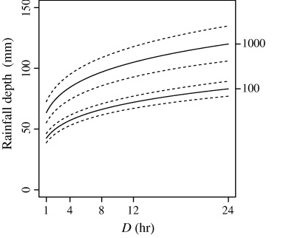
Depth-Duration-Frequency (DDF)
DDF curve
e.q. 12 hour, 100-year (AEP=1%), depth is 70 millimeters
Frequency
AEP; ARI
Depth
Duration

Slide 8

Depth-Duration-Frequency Tools
DDF estimates for a location can be constructed from maps of depth for a given duration and AEP.
Such maps are available from:
  NWS TP40 (online)
  NWS HY35 (online)
  Texas DDF Atlas (online)

Slide 9
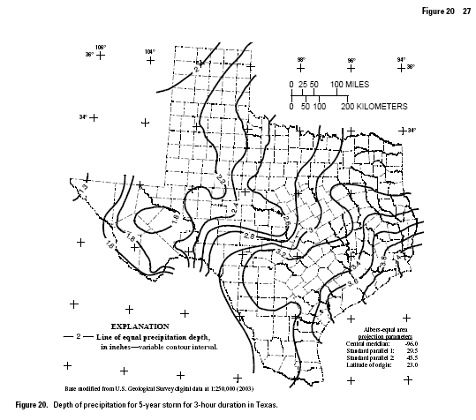
DDF Data Sources
Location
Harris County
3 hour, 5-year (AEP=20%) depth = 3.6 inches
ARI (AEP = 1/5 = 20%)
Duration = 3 hour

Slide 10
Intensity-Duration-Frequency
An alternate form of DDF is to present the magnitude as an intensity (a rainfall rate).
Intensity is the ratio of an accumulated depth to some averaging time, usually the duration.
Intensity is NOT the instantaneous rainfall rate

Slide 11
Depth, Intensity, and Duration
Conversion from Depth-Duration to Intensity-Duration is obtained by the ratio of depth to duration.
Conversion from Intensity-Duration to Depth-Duration is obtained by multiplication.
using same duration!

Slide 12
Intensity-Depth Relationship
Intensity (average rate) from depth
e.q. 12 hour, 100-year (AEP=1%), depth is 70 mm
average intensity is 70mm/12hr = 5.8 mm/hr
Depth
Duration
Module 7
Notes:
Intensity is related to depth and duration. The intensity is the ratio of depth to a particular duration. For example, if the duration or averaging time is 12 hours and the accumulated depth for 12 hours is 70 mm (about 3 inches), then the average rate is 70mm/12hours = 5.8 mm/hour. This average rate, if applied over 12 hours will produce the depth of 70mm.

Slide 13
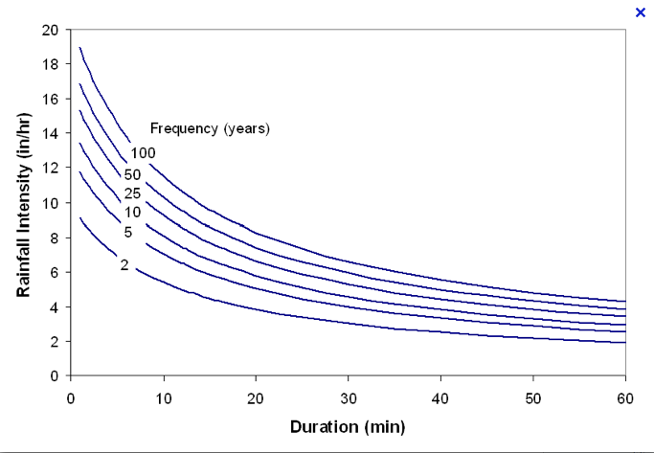
Intensity-Duration-Frequency
IDF curves
e.q. 20 min, 5-year (AEP=20%), intensity is 5.5 in/hr
Frequency
AEP; ARI
Intensity
Notes:
The family of curves that depicts the relationship between the intensity, duration, and frequency of precipitation at a point is a fundamental part of the rational equation method for storm water drainage design.

Slide 14
Example: Intensity for Harris County
Estimate the rainfall intensity for a 50%-chance, 2 hour storm for Harris County using the DDF Atlas
  Step 1: Select the AEP (50% = 2yr storm)
  Step 2: Locate maps for 2-year storm (Figures 4-15 in the DDF Atlas)
  Step 3: Find the map that corresponds to a 2-hour storm.
  Step 4: Locate Harris County, estimate the depth from the contour lines.
  Step 5: Compute the intensity from
Module 7

Slide 15
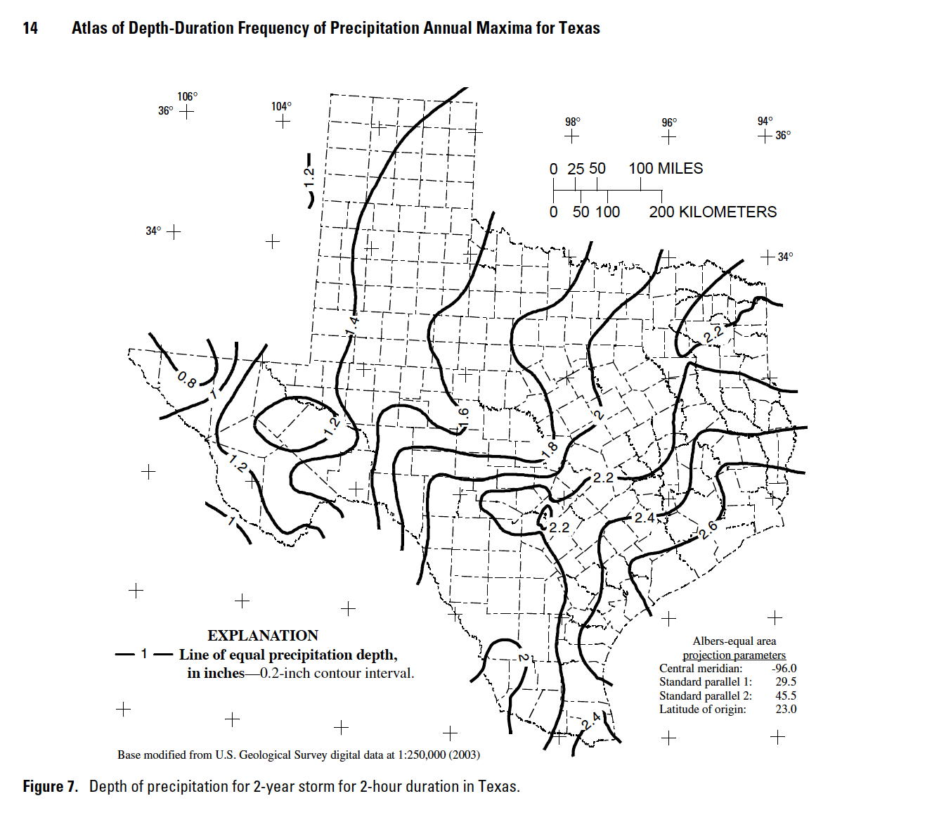
Example: Intensity for Harris County
Step 2: Locate maps for 2-year storm
Step 3: Find the map for the 2-hour storm.

Slide 16
Example: Intensity for Harris County
  Step 4: Locate Harris County, estimate the depth from the contour lines.
D ~ 2.47 inches
Module 7

Slide 17
Example: Intensity for Harris County
  Step 5: Compute the intensity from
Module 7

Slide 18
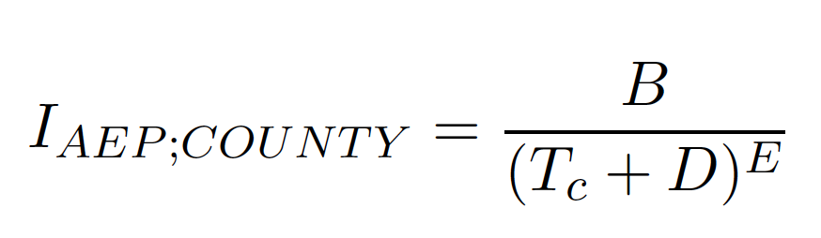
Intensity-Duration-Frequency Tools
EBDLKUP-NEW.xlsx is a spreadsheet tool that represents the rainfall IDF as the power law equation
The coefficients E,B, and D are different for each county and each mapped AEP.
The coefficients, E, B, and D, are based upon the information contained in the DDF Atlas (maps).

Slide 19
Intensity-Duration-Frequency Tools
The coefficient B has different numerical value in US customary and SI unit system.
  The returned intensity is inches-per-hour in the US customary system
  The returned intensity is millimeters-per-hour in the SI system
The duration T_{c} does not need to correspond to a mapped value.
Module 7

Slide 20
EBDLKUP-NEW.xlsx
The spreadsheet is distributed as a .ZIP archive
The archive includes the spreadsheet, the research report, a tutorial video, and a tutorial document.
  The video and tutorial document are hyperlinks within the spreadsheet – the links will not work if the spreadsheet is moved to a different directory from these files; however the spreadsheet itself will function fine without the files, but the user wont be able to access the video or tutorials.
Module 7

Slide 21
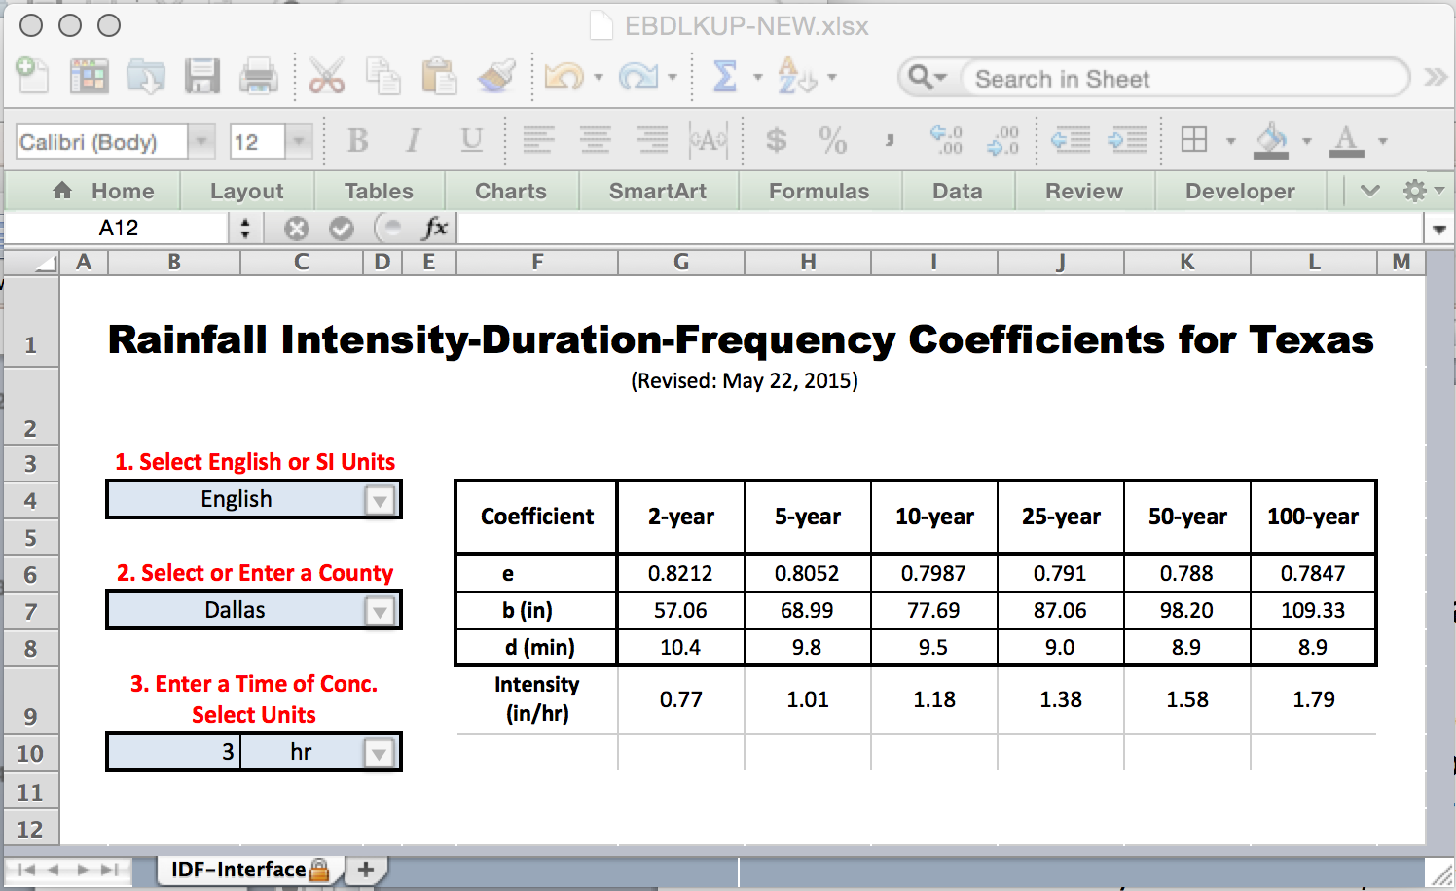
EBDLKUP-NEW.xlsx
Module 7

Slide 22
Example: Intensity for Harris County
Estimate the rainfall intensity for a 50%-chance, 2 hour storm for Harris County using
EBDLKUP-NEW.xlsx.
  Step 1: Select the units (English)
  Step 2: Select HARRIS county from the pull-down menu (or type HARRIS into the dialog box)
  Step 3: Select the storm duration (2 hours) and the time units (hours)
Module 7

Slide 23
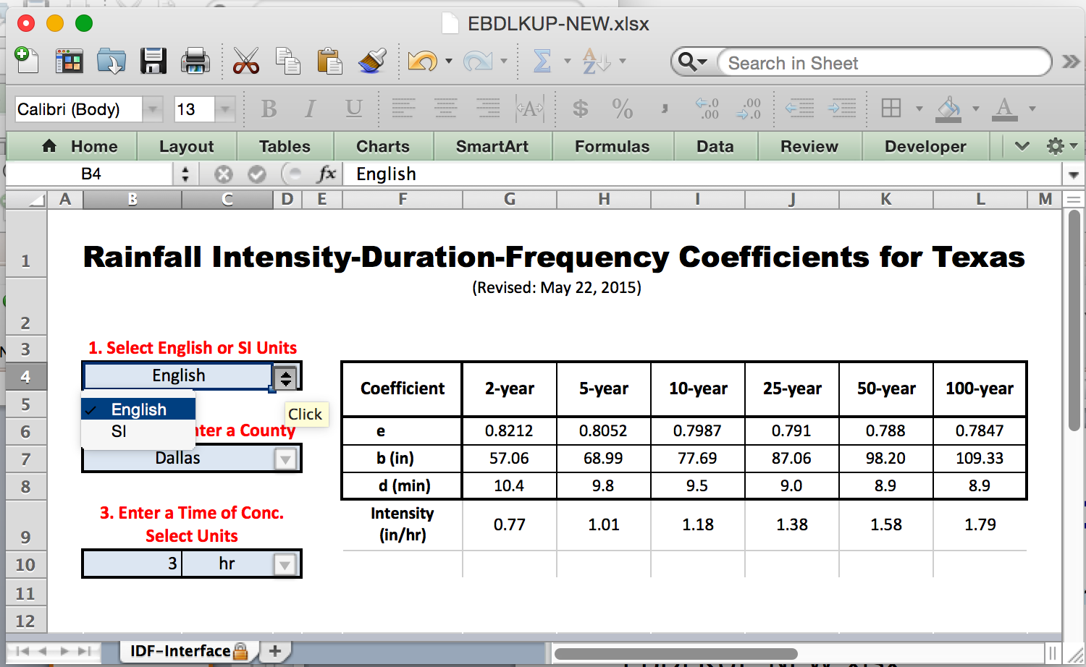
Example: Intensity for Harris County
  Step 1: Select the units (English)
Module 7

Slide 24
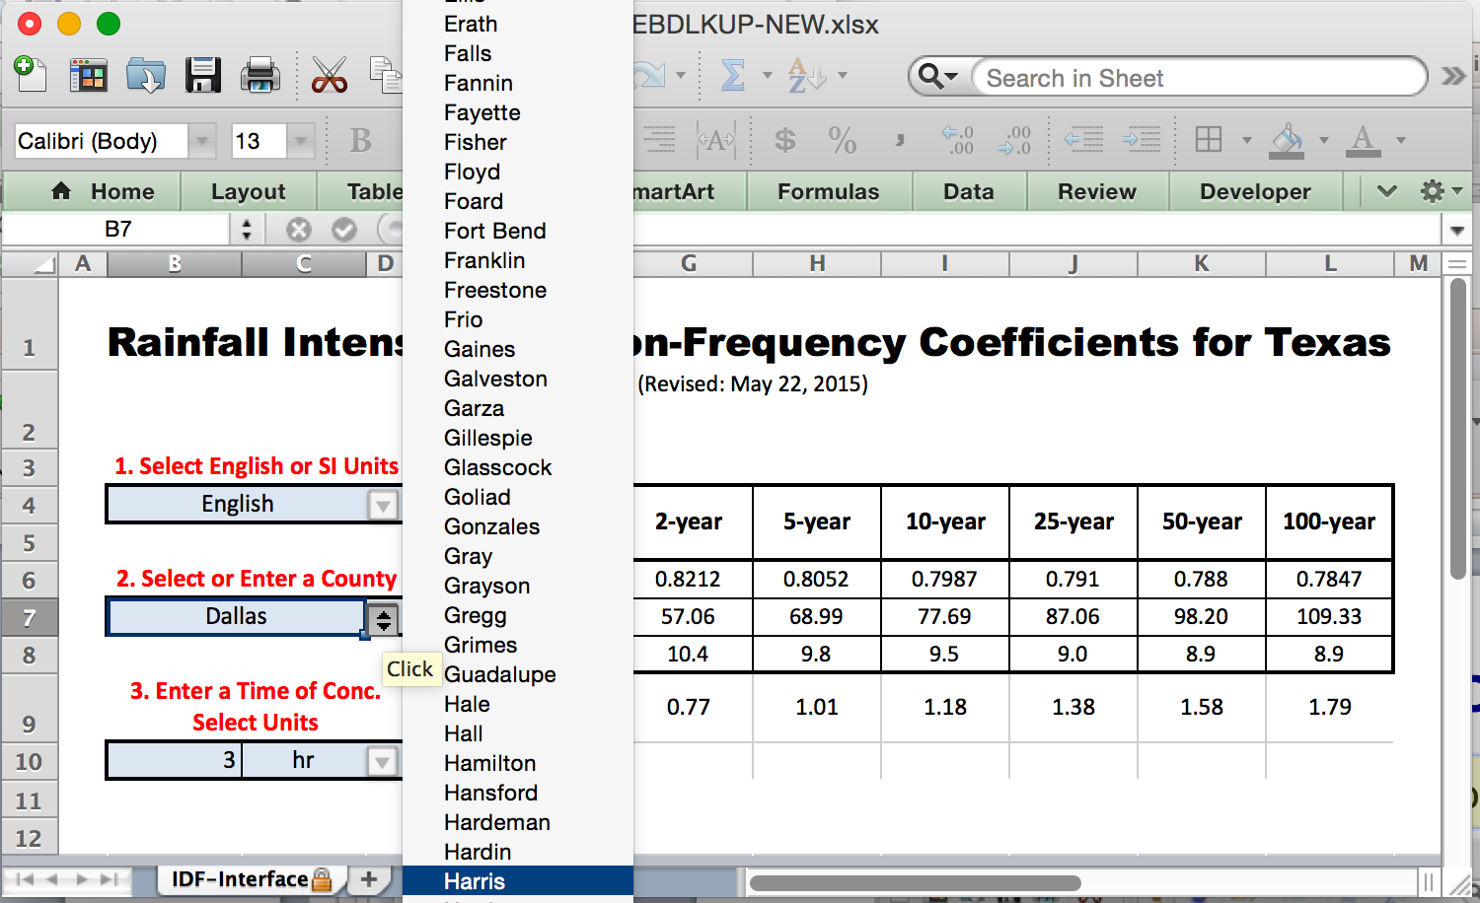
Example: Intensity for Harris County
  Step 2: Select HARRIS county from the pull-down menu
Module 7

Slide 25
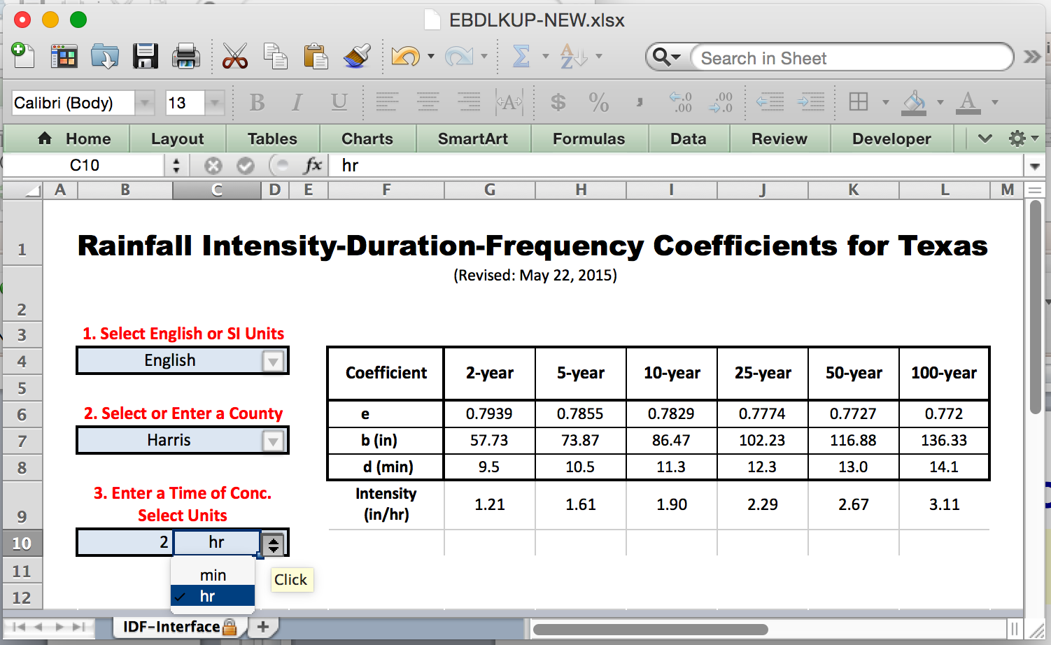
Example: Intensity for Harris County
  Step 3: Enter the storm duration (2 hours) and select the time units (hours)
Module 7

Slide 26
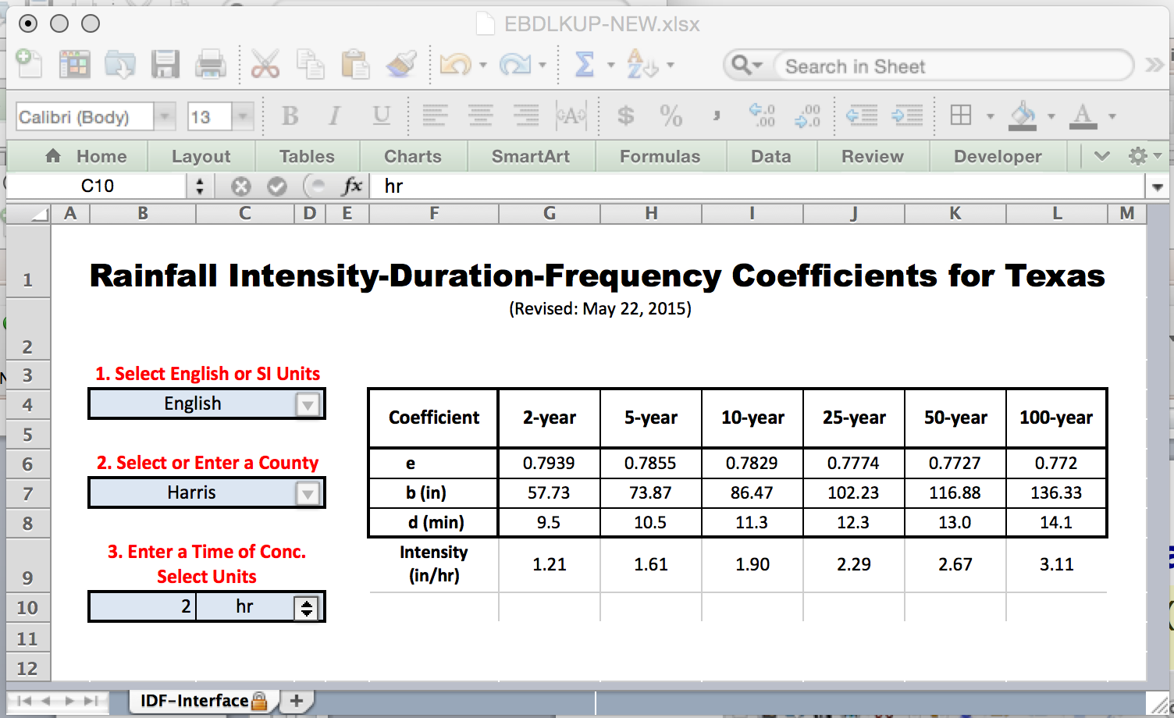
Example: Intensity for Harris County
  Step 4: Find result for desired AEP (2-yr is 50% storm)
Module 7

Slide 27
Purpose of the Tools
The EBDLKUP-NEW tool greatly reduces effort required to interpolate duration values that are not mapped.
The E, B, and D values can be entered into GeoPack Drainage (or WinStorm) for drainage design.
Module 7

Slide 28
Comparison of the Tools
The results from the map and the spreadsheet tool are nearly the same.
The results are not identical because:
  The map requires the designer to estimate a depth based on nearby contour lines
  The EBDLKUP-NEW uses the estimated depth at the county centroid
The EBDLKUP-NEW tool reduces effort required to interpolate duration values that are not mapped
The E, B, and D values can be entered into GeoPack Drainage (or WinStorm) for drainage design.
Module 7

Slide 29
Design Storms
Design storms are rainfall distributions that represent temporal patterns of a storm.
A rainfall distribution is also called a hyetograph.
  Rainfall distributions are used when we need to estimate an entire hydrograph.

Slide 30
Rainfall distributions
Each “block” represents the amount of rainfall for the time interval
The diagram is called “incremental” rainfall
The running sum of the blocks is the “cumulative” rainfall

Slide 31
Rainfall distributions
Design storm (distributions) are created from historical storms and analyzed to generate statistical models of rainfall.
Design storm distributions are typically dimensionless hyetographs
  NRCS Type Storms
  Empirical Texas Hyetographs

Slide 32

Texas Empirical Hyetographs
Alternative to SCS Type Curves is the Texas Empirical Hyetographs
  Based on Texas data.
  Reflects “front loading” observed in many real storms.
  Rescales time and depth.

Slide 33
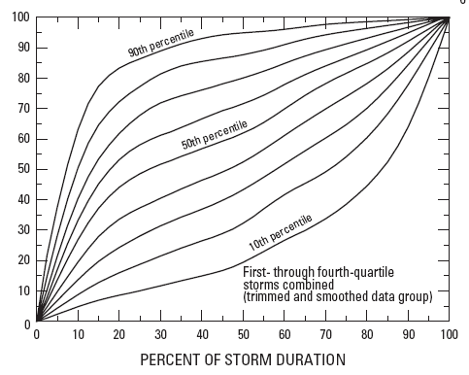
Texas Empirical Hyetographs
Rescale Depth
Average Intensity
Rescale Time

Slide 34
Texas Empirical Hyetographs
The 50th percentile curves represents the median behavior of observed storms in Texas that were known to produce runoff.
To use the curves:
  Select a desired AEP.
  Select the desired storm duration.
  Use DDF Atlas or EBDLKUP-NEW to estimate the storm depth for the selected AEP and duration.
  Multiply the time axis by the storm duration.
  Multiply the depth axis by the storm depth.
Result is a cumulative design storm distribution for given duration and AEP.

Slide 35
Example: Texas Empirical Hyetographs
Construct a design storm for the 3-hour, 2-year rainfall in Harris County using the Texas Empirical Hyetograph
  Obtain the depth from the DDF Atlas
  Rescale the depth and time using the Texas Empirical Hyetograph
Module 8

Slide 36
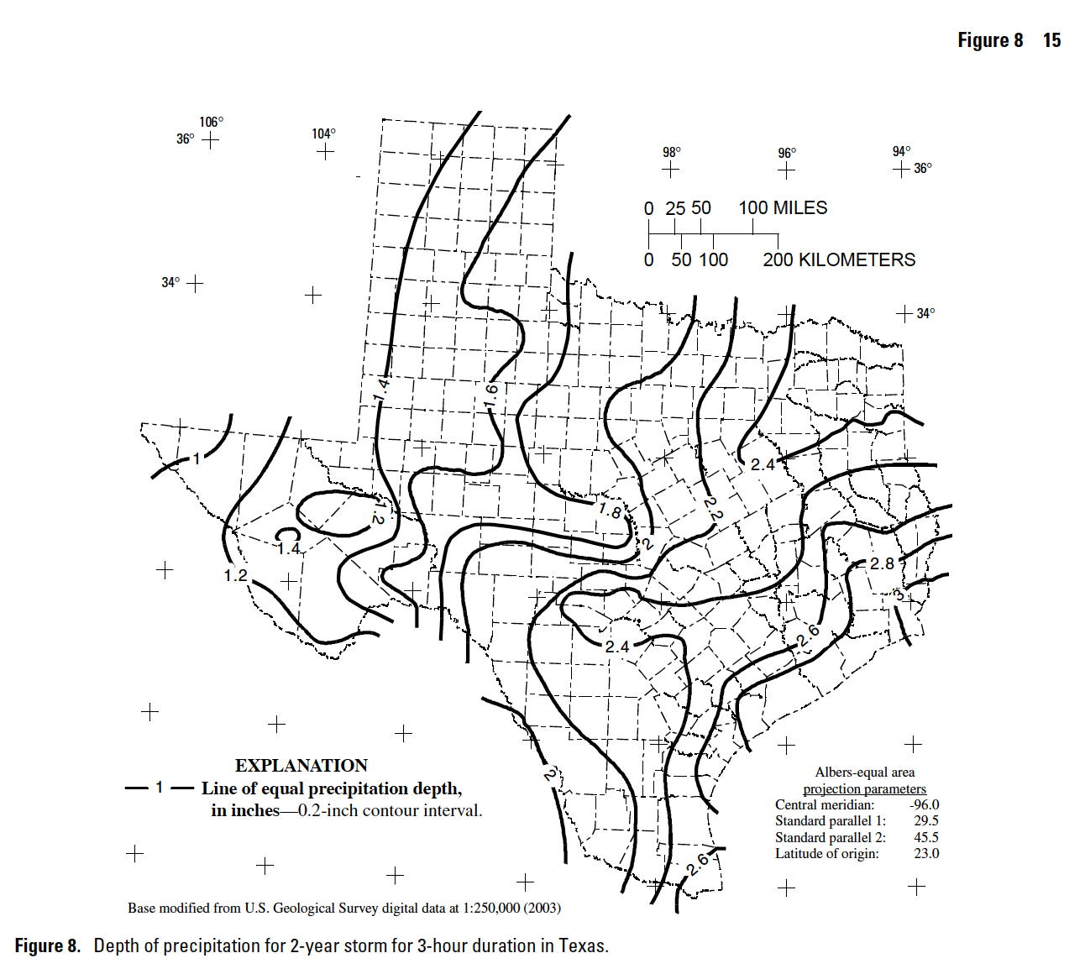
Example: Texas Empirical Hyetographs
  Obtain the depth from the DDF Atlas
D ~ 2.6 inches
Module 8

Slide 37
Example: Texas Empirical Hyetographs
  Rescale depth and time using the Texas Hyetograph
2.60 inches
1.93 inches
1.36 inches
1 hours
2 hours
3 hours

Slide 38
Texas Empirical Hyetographs Tools
The empirical hyetograph is tedious to generate from the curves if short time intervals are desired (say every 10 minutes).
TXHYETO.xlsx is a spreadsheet tool that approximated the 50th percentile curve and the 90th percentile curve using a distribution-mixture function model.

Slide 39
Texas Empirical Hyetographs Tools
The empirical hyetograph is tedious to generate from the curves if short time intervals are desired (say every 10 minutes).
TXHYETO.xlsx is a spreadsheet tool that approximates the 50th percentile curve and the 90th percentile curve using a distribution-mixture function model.
TXHYETO.xlsx can be used stand-alone, but it was built to be used in conjunction with EBDLKUP-NEW.xlsx

Slide 40
TXHYETO.xlsx
The spreadsheet is distributed as a .ZIP archive
The archive includes the spreadsheet, the research report, a tutorial video, and a tutorial document.
  The video and tutorial document are hyperlinks within the spreadsheet – the links will not work if the spreadsheet is moved to a different directory from these files; however the spreadsheet itself will function fine without the files, but the user wont be able to access the video or tutorials.

Slide 41
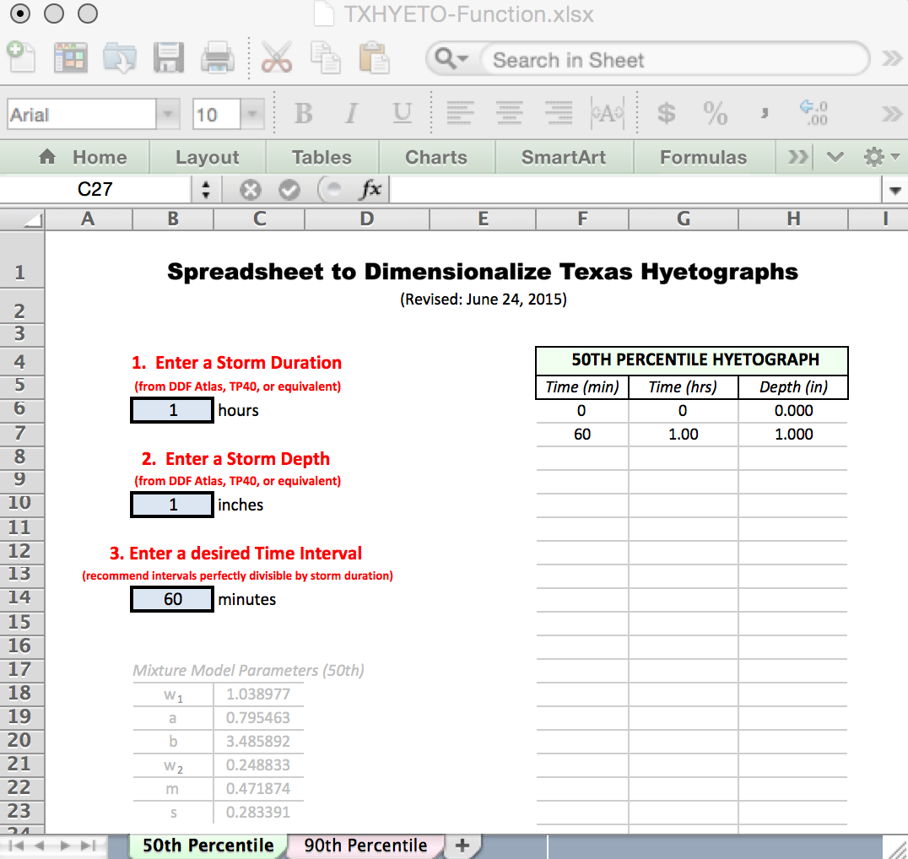
TXHYETO.xlsx

Slide 42
Example: Texas Empirical Hyetographs
Construct a design storm in 10 minute increments for a 3-hour, 2-year rainfall in Harris County using the TXHYETO.xlsx and EBDLKUP-NEW.xlsx
    Obtain the intensity value from EBDLKUP-NEW.xlsx
    Multiply this value by the duration (3 hours) to obtain the storm depth.
    Enter the total duration into TXHYETO.xlsx
    Enter the total depth into TXHYETO.xlsx
    Enter time step size into TXHYETO.xlsx
Result is a design storm for specified AEP, depth, and duration.

Slide 43
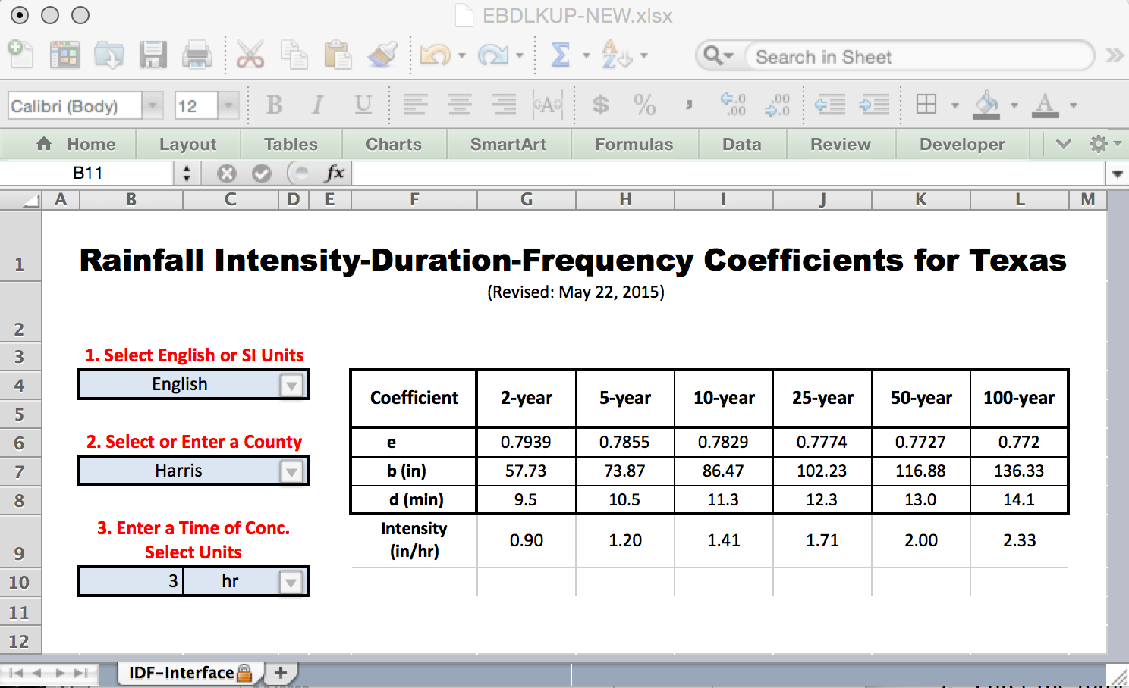
Example: Texas Empirical Hyetographs
    Obtain the intensity value from EBDLKUP-NEW.xlsx

Slide 44
Example: Texas Empirical Hyetographs
    Multiply this value by the duration (3 hours) to obtain the storm depth.

Slide 45
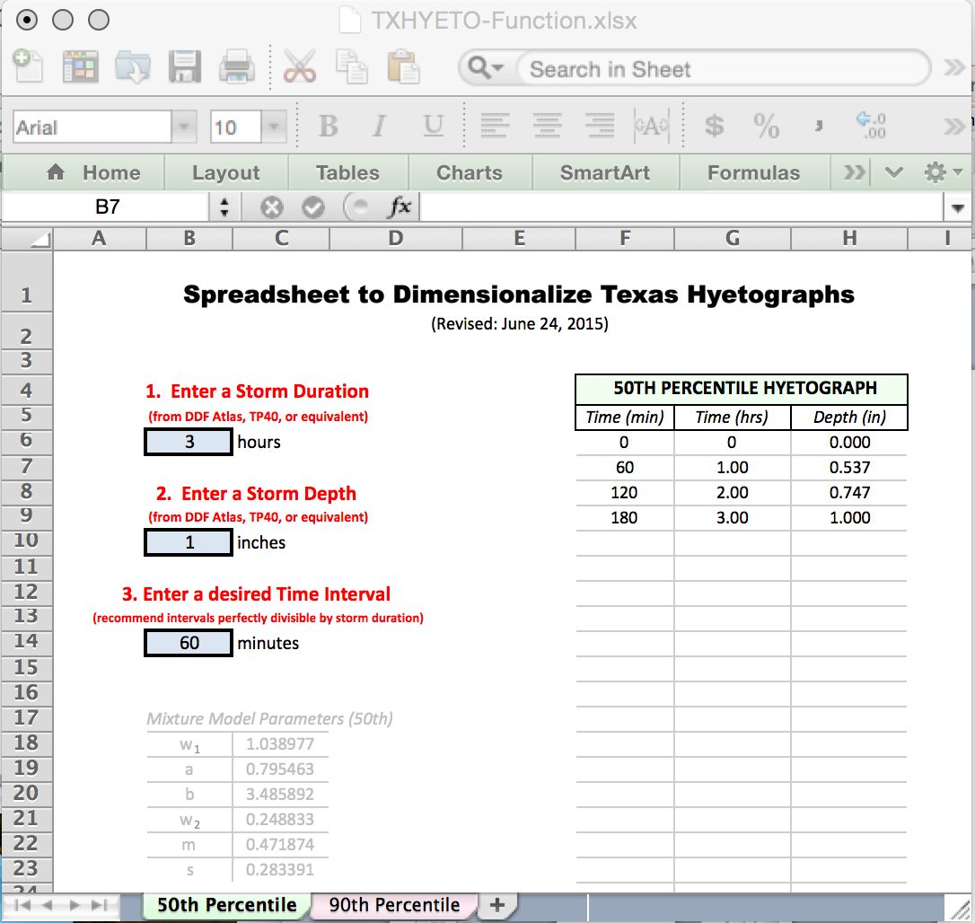
Example: Texas Empirical Hyetographs
Enter the total duration into TXHYETO.xlsx

Slide 46
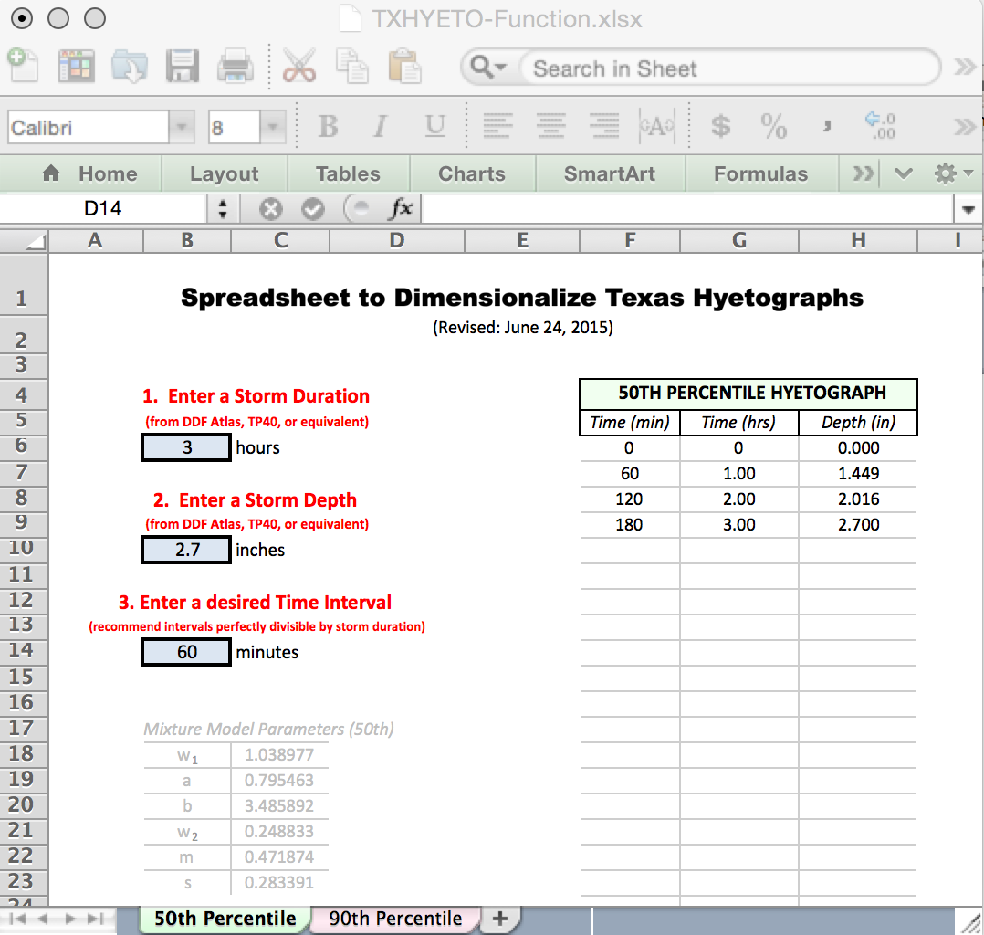
Example: Texas Empirical Hyetographs
    Enter the total depth into TXHYETO.xlsx

Slide 47
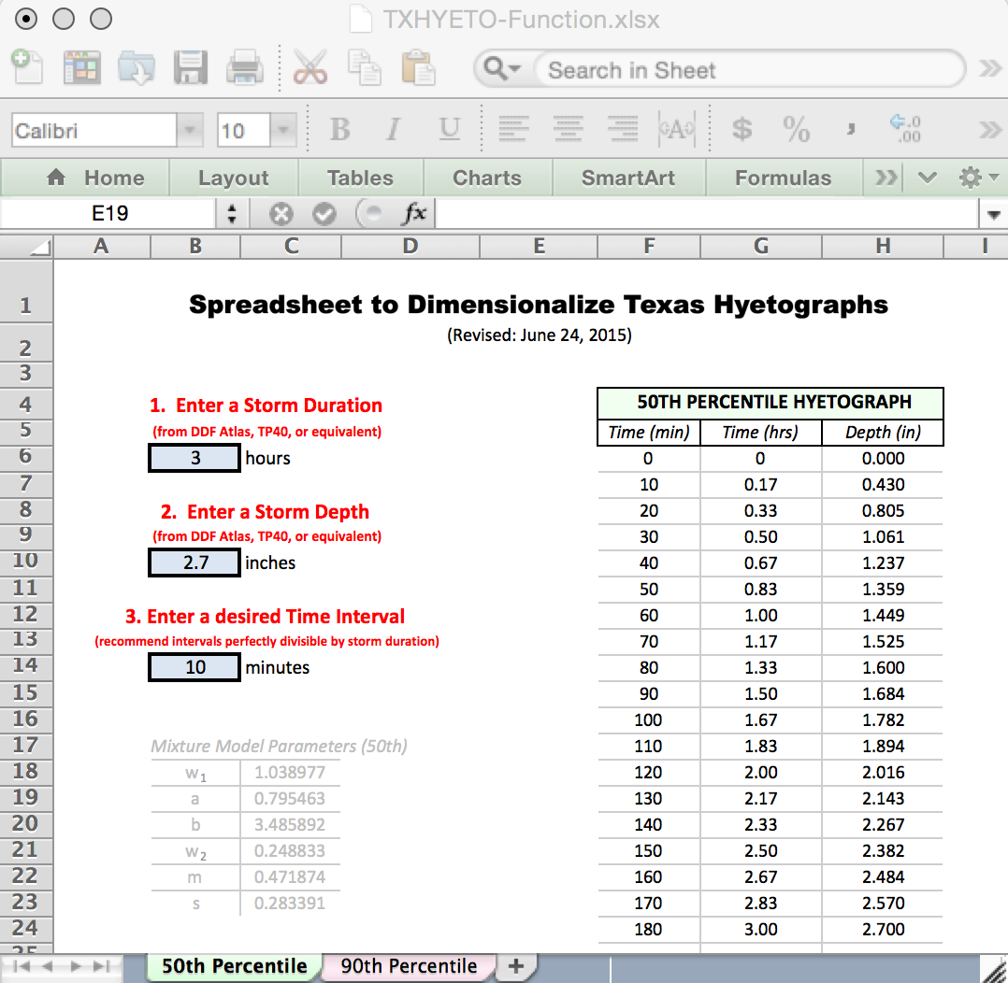
Example: Texas Empirical Hyetographs
    Enter time step size into TXHYETO.xlsx
      The spreadsheet automatically fills the depth column with the cumulative depths for each time increment

Slide 48
Texas Empirical Hyetographs
The result is then ready to paste into HEC-HMS or similar tools that make use of a design storm.
The next example illustrates using the two tools to input a design storm into HEC-HMS

Slide 49
Integrated EBDLKUP, TXHYETO and HEC-HMS Example
The result is then ready to paste into HEC-HMS or similar tools that make use of a design storm.
The next example illustrates using the two tools to input a design storm into HEC-HMS

Slide 50
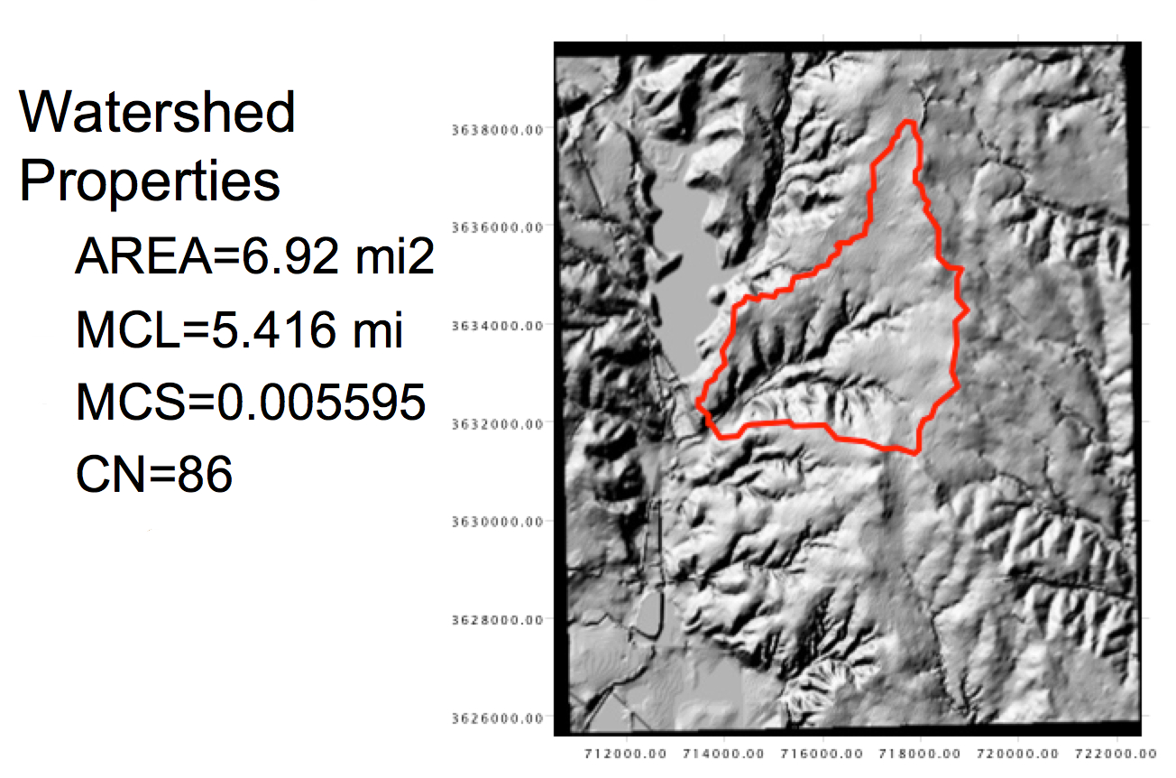
Integrated EBDLKUP, TXHYETO and HEC-HMS Example
Consider a watershed with the properties in the figure.
The watershed is located in Dallas County, Texas
Estimate the response of a 5-year, 3-hour storm using HEC-HMS

Slide 51
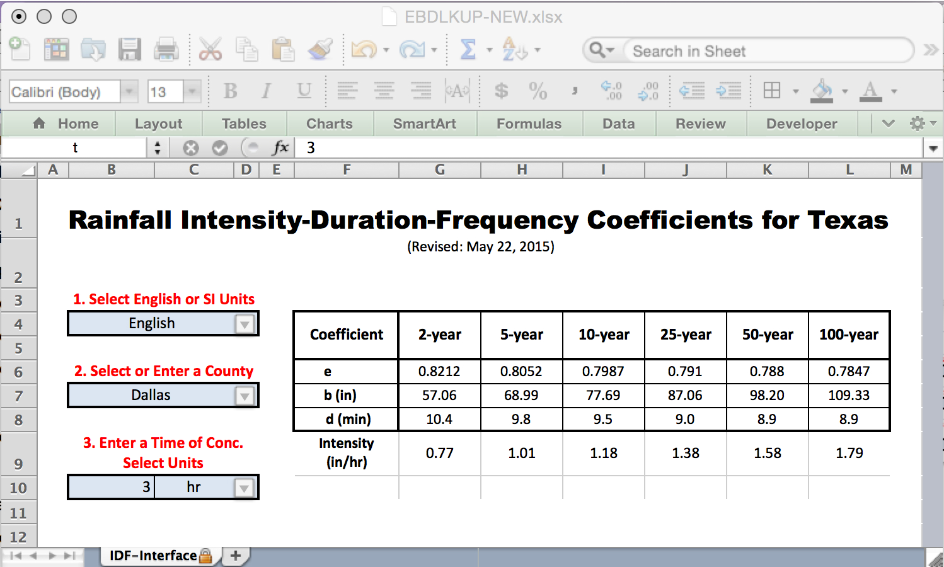
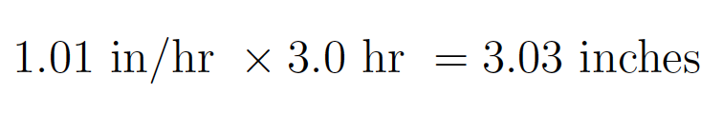
Integrated EBDLKUP, TXHYETO and HEC-HMS Example
Estimate the response of a 5-year, 3-hour storm using HEC-HMS
EBDLKUP-NEW estimates the intensity as
1.01 in/hr
The product of that intensity and duration estimates the depth as 3.03 inches

Slide 52
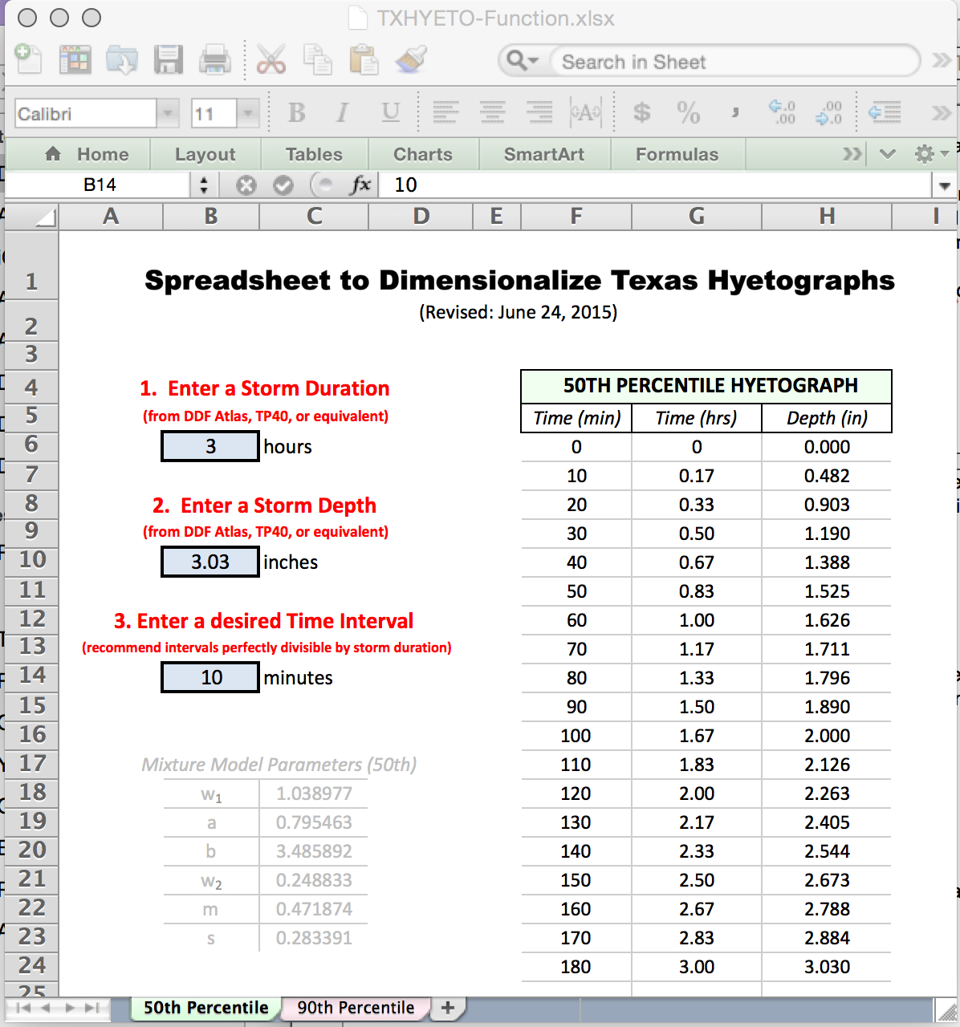
Integrated EBDLKUP, TXHYETO and HEC-HMS Example
Enter the duration and depth into TXHYETO
Enter the desired simulation time step (10 minutes this example)
Result is a design storm that can be supplied to HEC-HMS

Slide 53
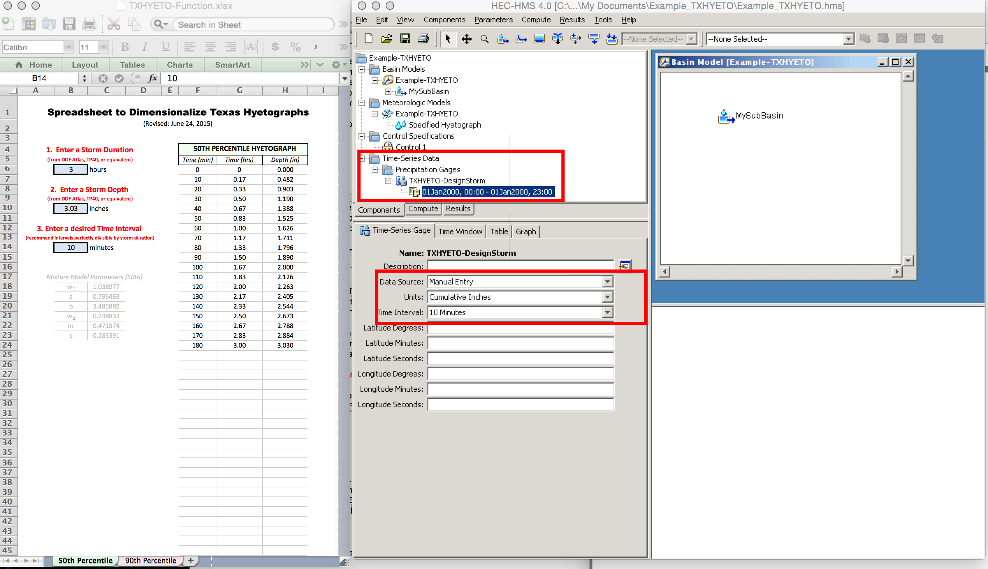
Integrated EBDLKUP, TXHYETO and HEC-HMS Example
HMS model ready to receive the hyetograph
(How to build model is covered in DES-606)

Slide 54
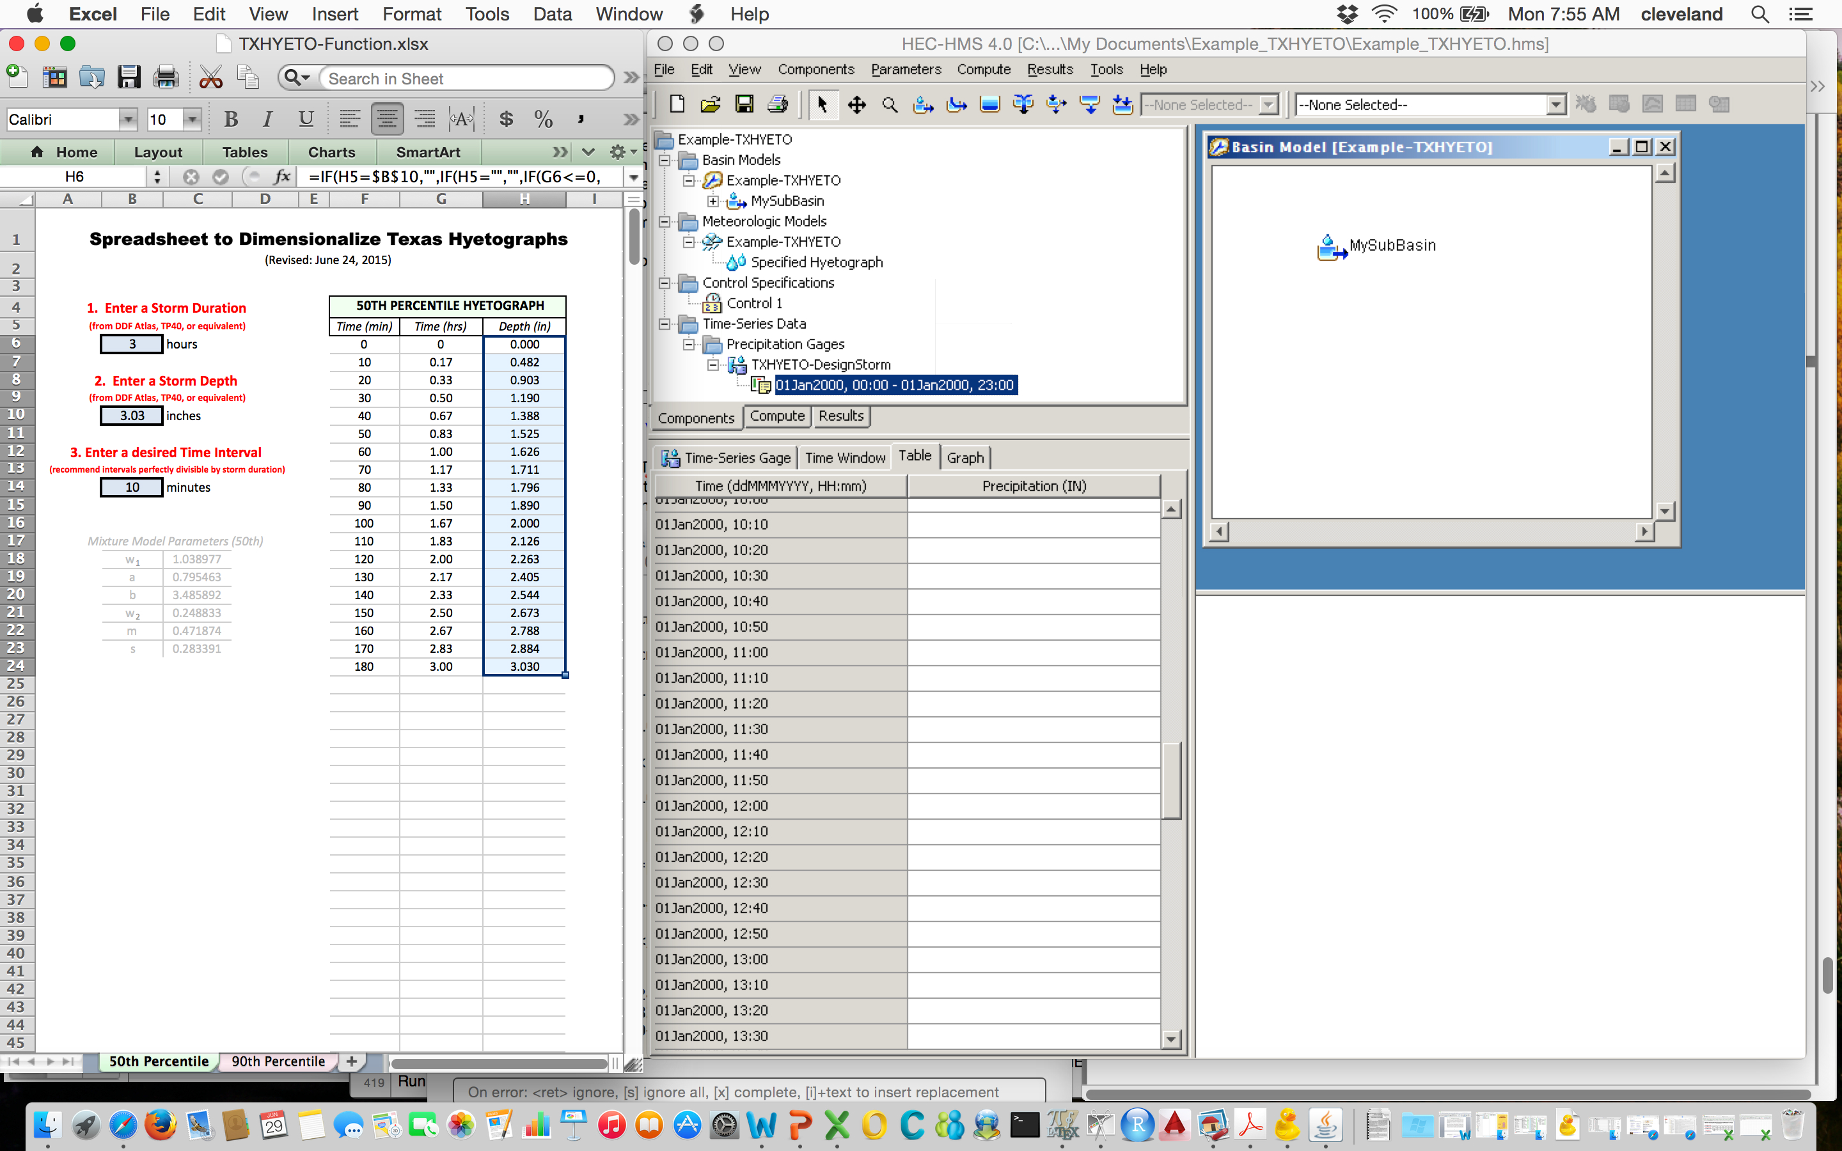
Integrated EBDLKUP, TXHYETO and HEC-HMS Example
Select the design storm from TXHYETO

Slide 55
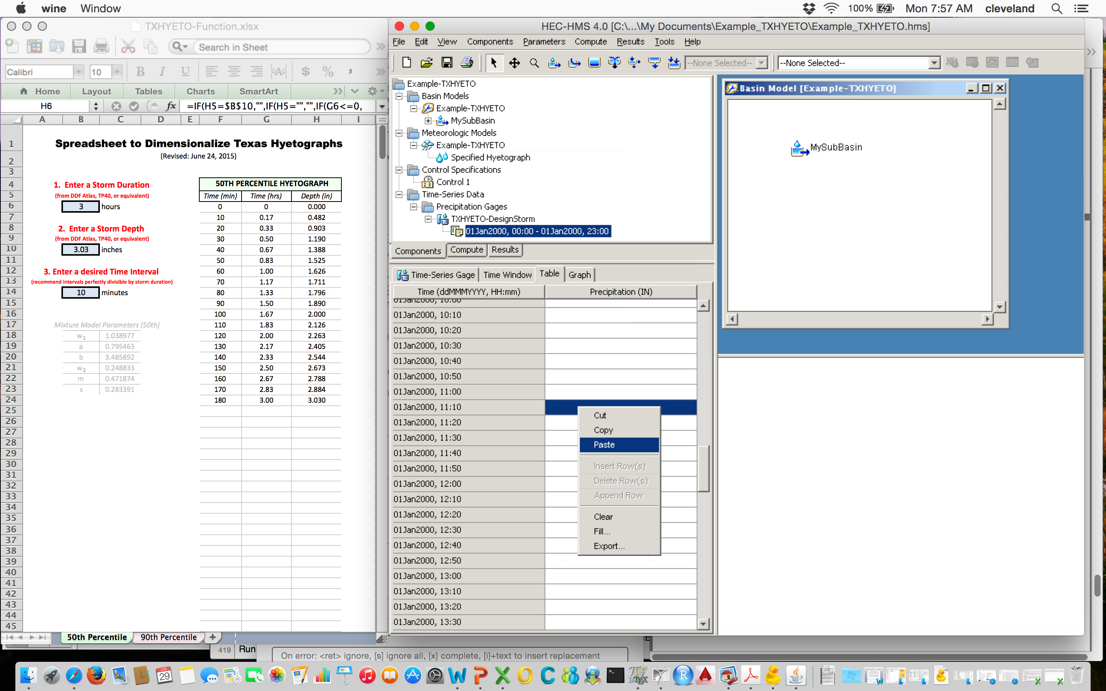
Integrated EBDLKUP, TXHYETO and HEC-HMS Example
Select destination (in time) for the storm in HMS

Slide 56
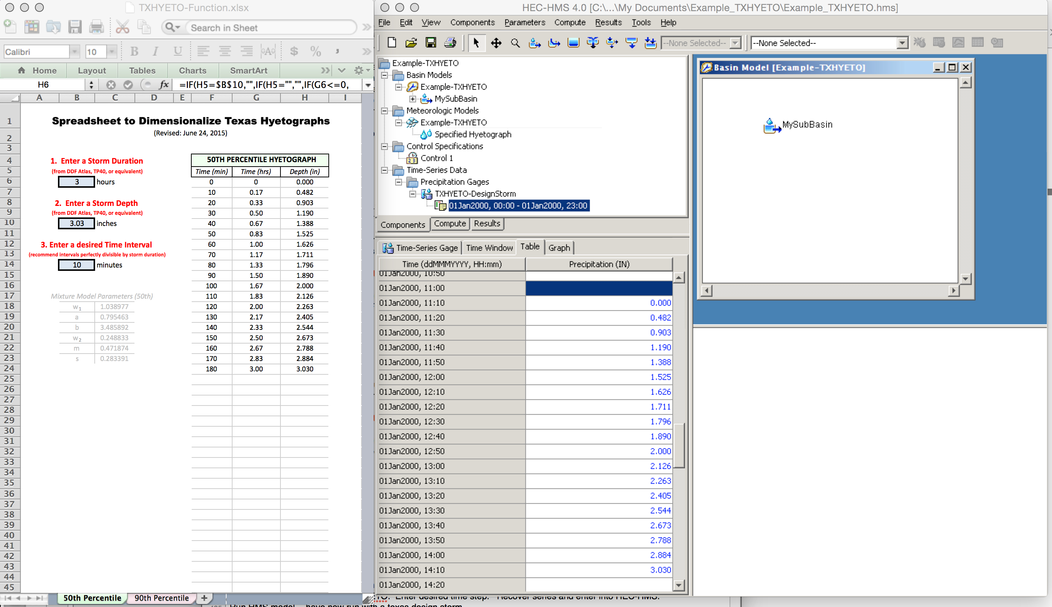
Integrated EBDLKUP, TXHYETO and HEC-HMS Example
Paste the the design storm into HMS

Slide 57
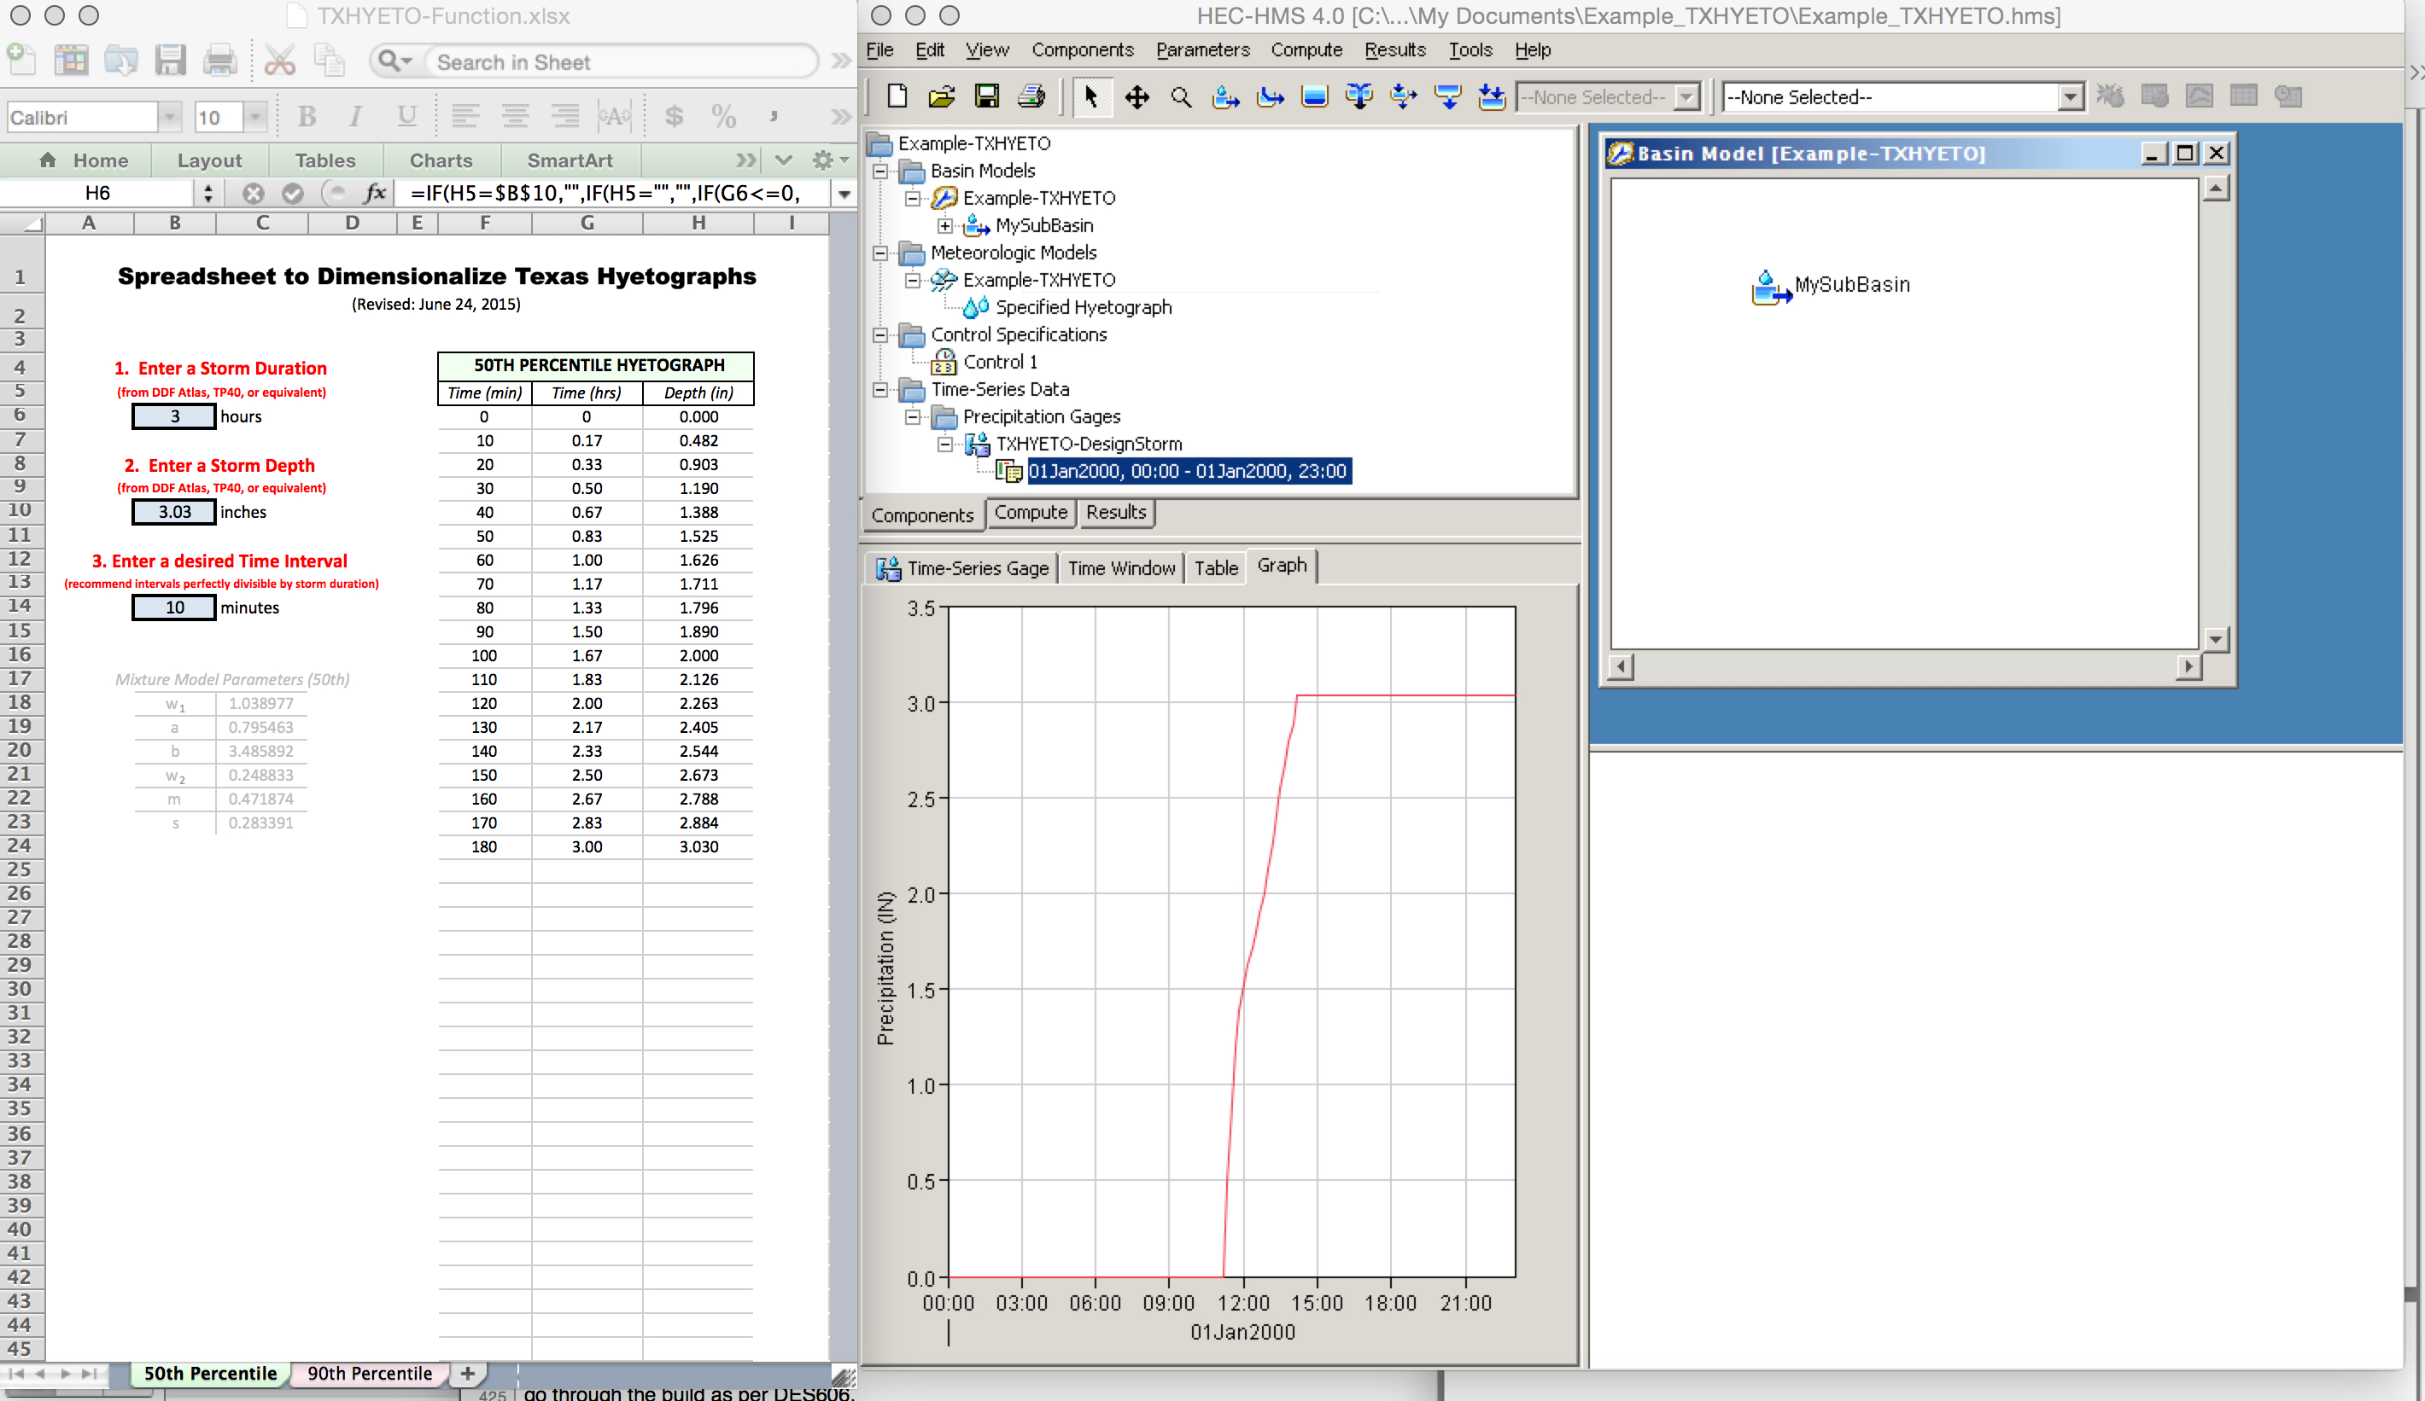
Integrated EBDLKUP, TXHYETO and HEC-HMS Example
Fill missing values (see the report) and plot the storm to verify successful paste.

Slide 58
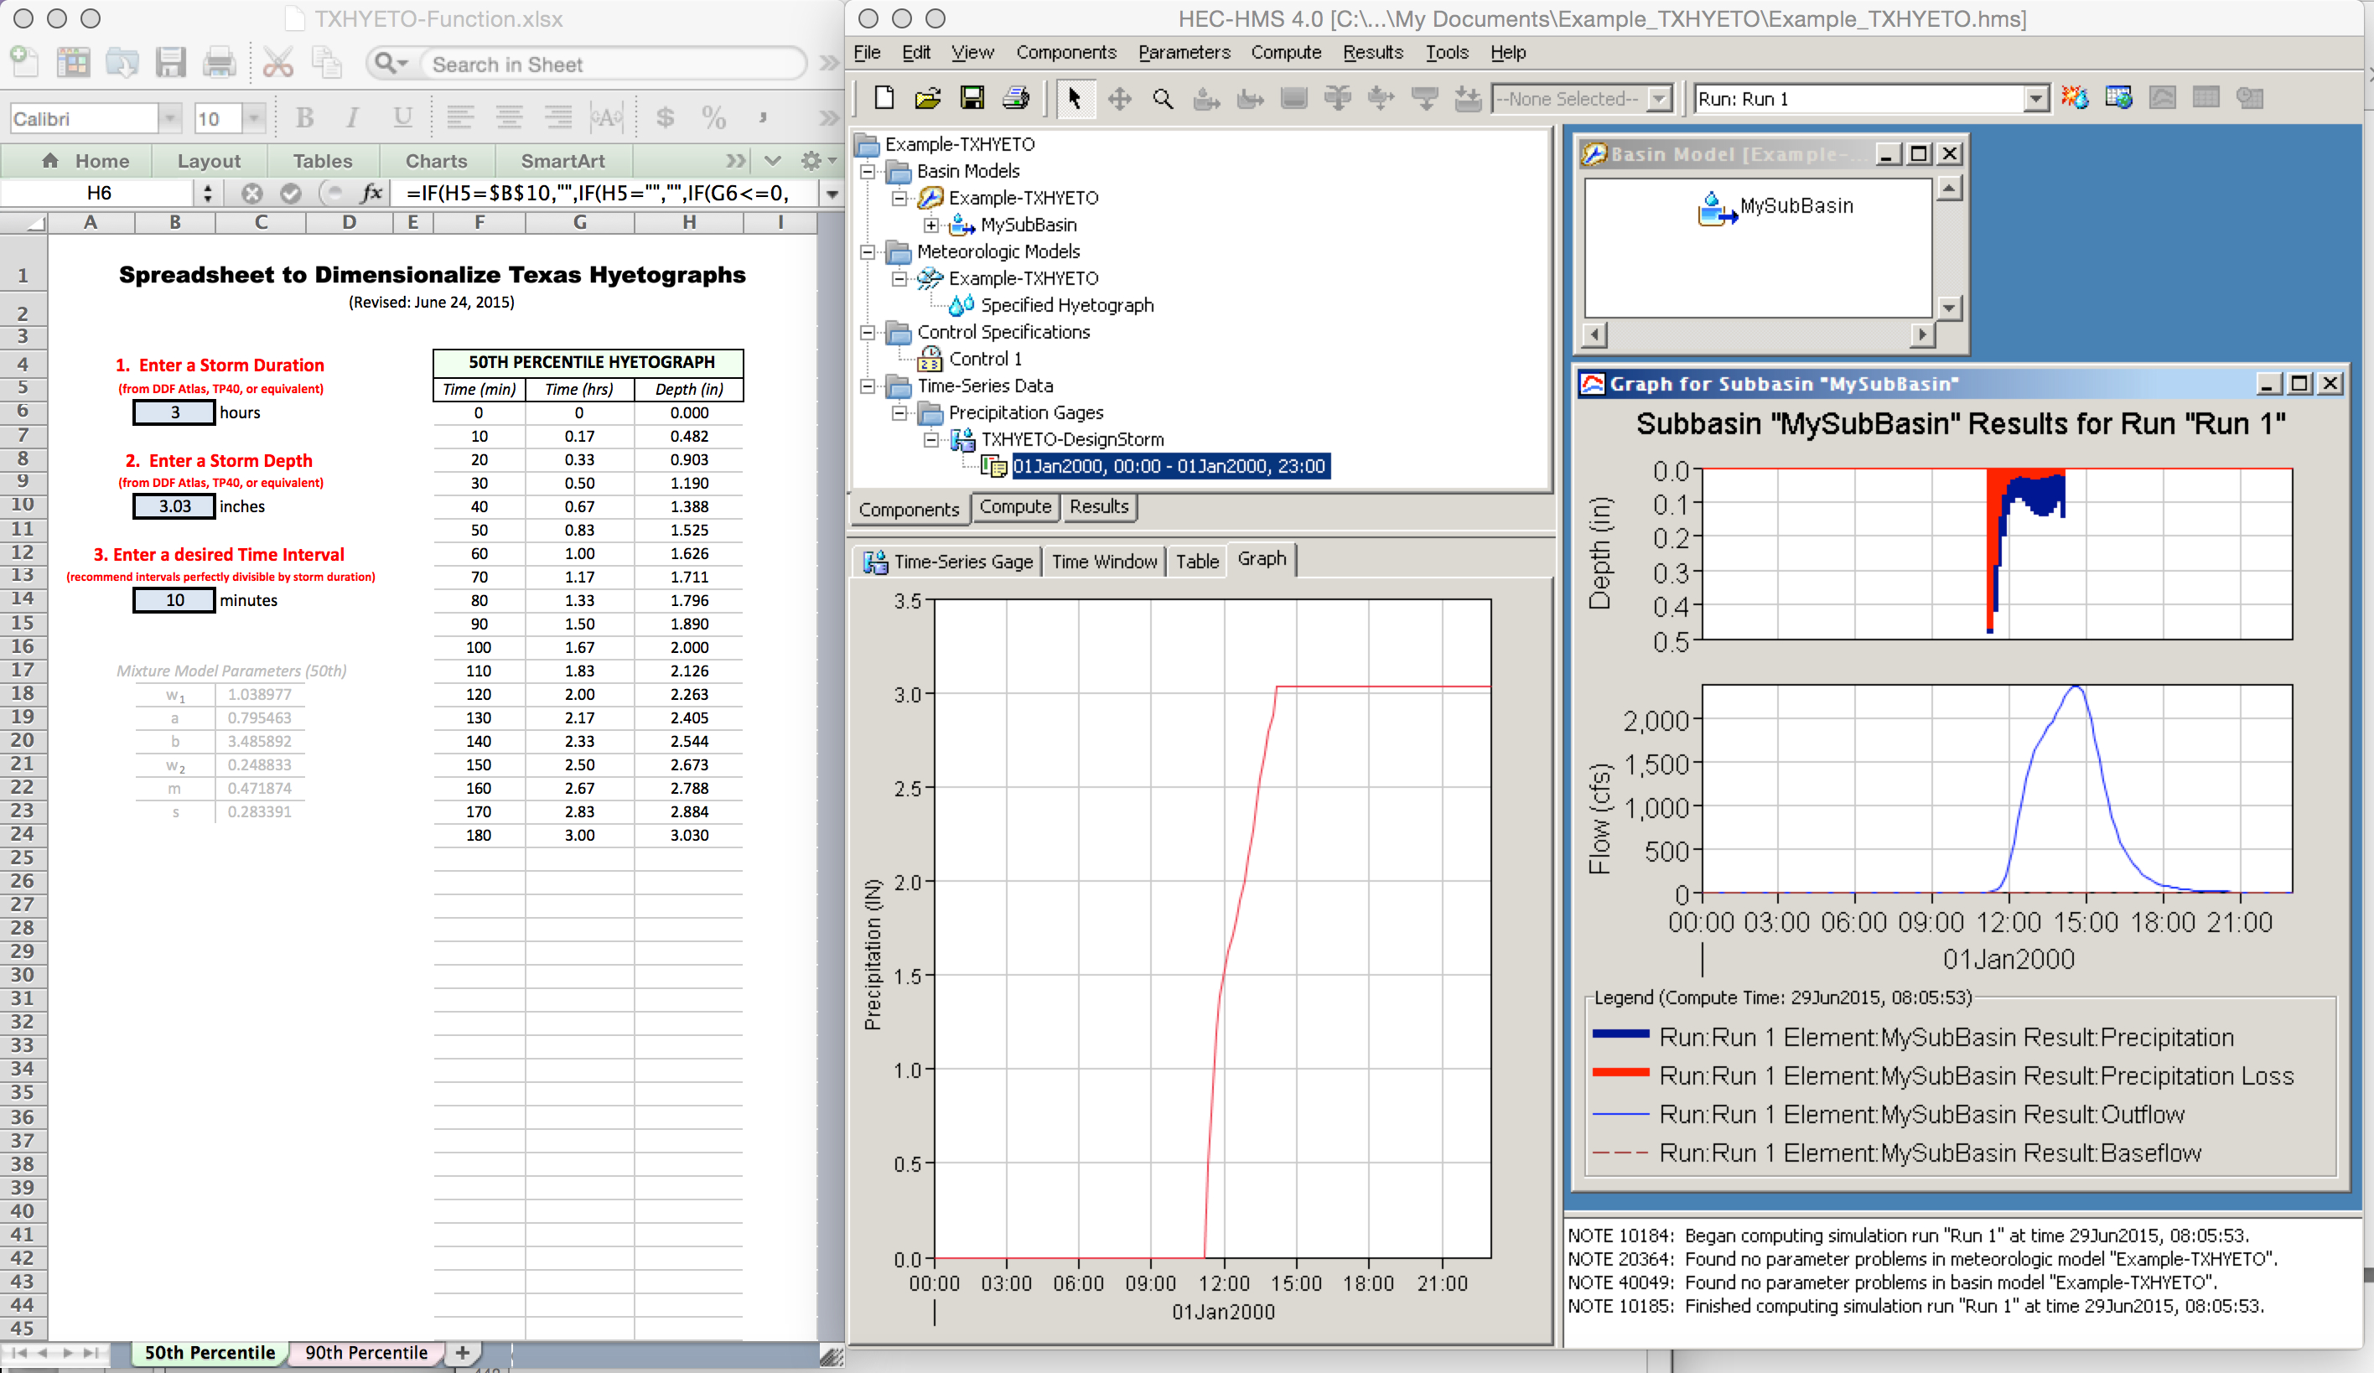
Integrated EBDLKUP, TXHYETO and HEC-HMS Example
Run HEC-HMS to estimate the discharge hydrograph at the watershed outlet

Slide 59
Summary
Rainfall is described by DDF or IDF curves
DDF values are obtained from NWS or similar sources – they are mapped to locations
EBDLKUP-NEW can be used to estimate rainfall intensity (for use with the rational equation) directly.
EBDLKUP-NEW can be used to estimate DDF values
  The duration does not need to match a mapped time value.

Slide 60
Summary
Design storms are used to estimate temporal behavior during a storm – required when need to estimate an entire hydrograph
Design storms based on the Texas Empirical Hyetographs can be built using TXHYETO
The result from TXHYETO can be directly pasted into HEC-HMS (or SWMM)

