Slide 1
FE Review
Construction Management
Min Deng, Ph.D.

Slide 2
Main Contents
Construction Project People, Acquisition and Contractual Methods
Project Estimation
Project Scheduling

Slide 3
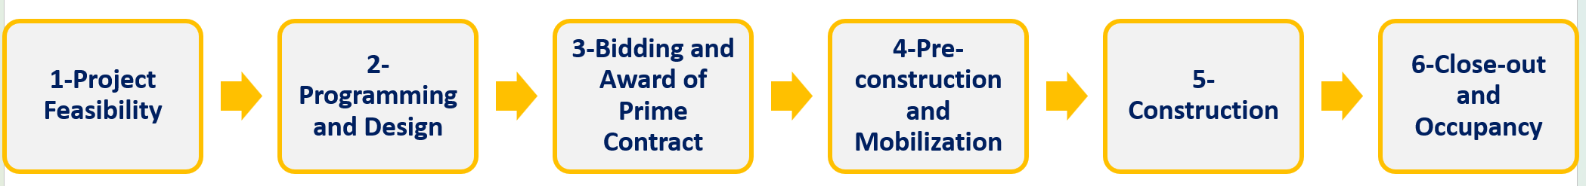
1. Which party is mainly responsible for the pre-construction and mobilization stage?
Owner
Construction manager
Architect engineer
Contractor
2. Off-site labor usually are associated with what type of construction:
Modular construction
Fast track construction
Highway construction
Building construction
3. If you want to defend your right as a construction worker, it will be easier if you are a ____?
Open shop worker
Union worker

Slide 4
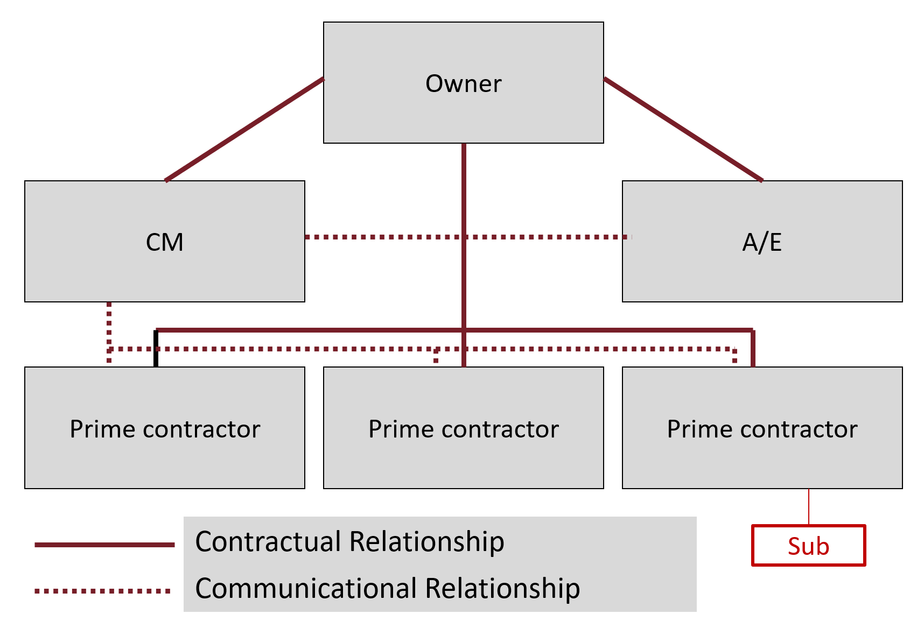
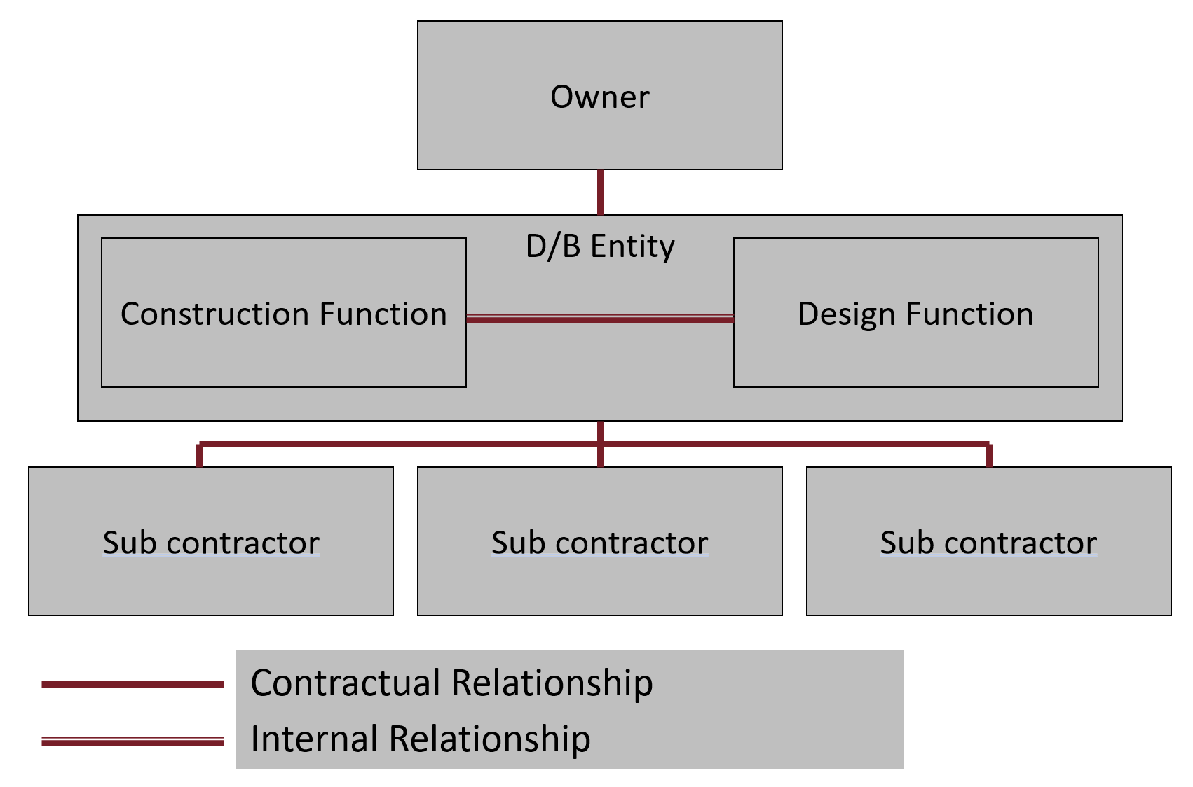
4. In a Pure Construction Management project delivery system, the construction manager has contracted with:
Only the owner
Only the contractor
Both the owner and the contractor
5. For the Design-Build project delivery method, what is the relationship between the construction entity and design entity within the design/build firm?
Contractual relationship
Communicational relationship
Internal relationship (we also refer to it as joint venture)

Slide 5
6. A contractor signed a $1,500,000 lump sum (fixed price) contract with an owner. This number included an estimated $100,000 profit for the contactor. At completion of the construction, the project final cost for the contractor was $1,600,000. How much did the contractor lose?
-$1,600,000
-$100,000
-$200,000
-$50,000
7. A project decided to use a unit price contract for its concrete placement. The owner estimated that the concrete quantity will be 15,000 CY. The contractor’s equipment cost is $8/CY, material cost is $4/CY, and the labor cost is $4/CY. The burden factor is 1.25. What will be the unit price (per CY)?
$8
$10
$16
$20

Slide 6
8. The owner and the general contractor have a cost plus 10% percentage fee contract. The final cost of the project was $140 million. What is the contractor’s fee on this project?
$14 million
$15 million
$10 million
$5 million
9. The owner and contractor signed a cost plus $5,000 fixed fee contract with a GMP of $100,000. The contractor ended up spending $90,000 on the project. How much will the owner pay to the contractor if no incentive clause is used in the contract?
90,000
95,000
100,000
105,000

Slide 7
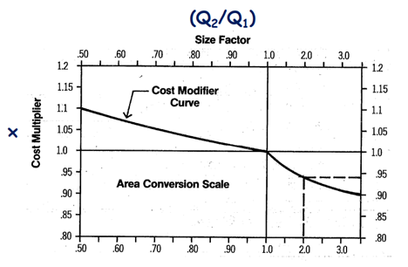
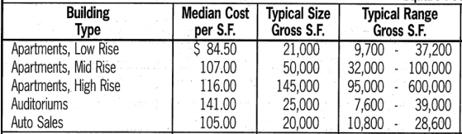
10. You want to estimate the cost of a 63,000 S.F. low-rise apartment using RS Means Project Size Modifier - Cost Capacity Factor using the data given below. What is the cost multiplier?
1.1
1.05
0.95
0.90
11. You want to estimate the cost of a 63,000 S.F. low-rise apartment using RS Means Project Size Modifier - Cost Capacity Factor using the data given below. What is the total project cost?
$1,597,050
$1,774,500
$4,791,150
$5,323,500
Notes:
3 – 0.9
84.5*63000*0.9

Slide 8
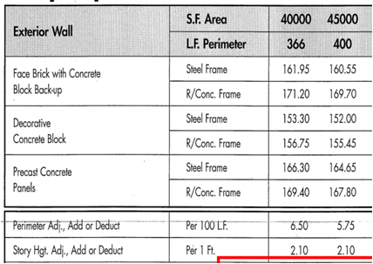
12. You want to build a 4-story 100 ft x 100 ft apartment building with a steel frame. The east and west walls will use Face Brick with Concrete Block Backup. The south and north wall will use Decorative Concrete Block. Considering the exterior wall variation, what is the cost per square foot? (Remember your answer for the next question)
$153.30
$156.28
$157.63
$160.55
13. You want to build a 4-story 100 ft x 100 ft apartment building with a steel frame. The east and west walls will use Face Brick with Concrete Block Backup. The south and north wall will use the Decorative Concrete Block. After considering the exterior wall variation, you need to do the perimeter adjustment. What is the cost per square foot after perimeter adjustment? (Remember your answer for the next question)
$155.42
$151.13
$159.84
$164.13
Notes:
($161.95 * 50% + $153.30 * 50% = $157.625)
($157.63 + $6.5 * 34 / 100 = $159.84)

Slide 9
14. A subcontractor needs to haul 450 CY of excavation material. Assume the hauler (Truck) bucket capacity is 20 CY. The total cycle time (Loading+Hauling+Dumping) is 10 minutes. There is 50 minutes of effective work per hour. The owning and operating cost for a hauler is $50 per hour. The fuel cost for a hauler is $5 per cycle. If the work needs to be completed in one hour and no standby hauler is needed, how many haulers are needed? You can round up your answer. (Remember your answer for the next question)
3
4
5
6
15. A subcontractor needs to haul 450 CY of excavation material. Assume the hauler bucket capacity is 20 CY. The total cycle time (Loading+Hauling+Dumping) is 10 minutes. There is 50 minutes of effective work per hour. No standby hauler is needed. The owning and operating cost for a hauler is $50 per hour. The fuel cost for a hauler is $5 per cycle. The work needs to be completed in one hour. What is the total owning and operating cost to the subcontractor?
$50
$200
$250
$300
Notes:
5 cycle * 20 = 100
450/100 = 4.5 = 5
5 * 50 = 250

Slide 10
Construct the AON Network
Activity | Duration | Predecessors | ES | EF | LS | LF | TF | FF
Start | 0 | -
A | 2 | -
B | 1 | -
C | 3 | -
D | 1 | A, B
E | 2 | B, C
End | 0 | D, E
fill in the table and determine the critical path.

Slide 11
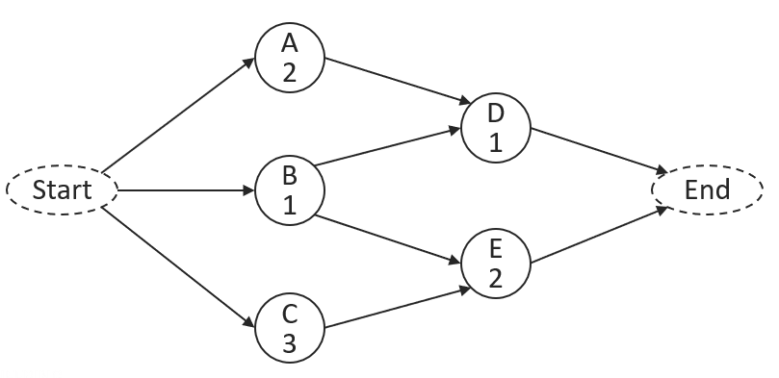
Practice: Construct the AON Network
ES
EF
TF
FF
FF<=TF
LS
LF
0
2
2
0
2
2
3
4
2
2
0
0
0
1
4
5
5
5
0
0
2
1
0
0
0
0
2
3
3
5
5
5
0
0
0
3
3
5
0
0
0
3
Notes:
successors

Slide 12
Critical Path
Definitions
A critical path is the sequence of critical activities that forms a continuous path between the start of a project and its completion. A delay in any activity on the critical path will delay the completion of the project.
Characteristics:
The critical path is a path of activities with zero floats spanning from the beginning to the end of the network.
Critical path has the longest duration in the project. It determines the shortest time possible to complete the project.
Some projects may have more than one critical paths.

Slide 13
Practice: Construct the AON Network
ES
EF
TF
FF
FF<=TF
LS
LF
0
2
2
0
2
2
3
4
2
2
0
0
0
1
4
5
5
5
0
0
2
1
0
0
0
0
2
3
3
5
5
5
0
0
0
3
3
5
0
0
0
3
Notes:
successors

