Slide 1
FE EXAM KNOWLEDGE QUIZ
William D. Lawson, P.E., Ph.D.
Texas Tech University
SPRING 2022

Slide 2
Why this Quiz?
Dispel certain myths about the FE Exam.
Increase your knowledge of the FE Exam
Introduce you to some helpful resources
Think of this quiz as a learning opportunity!
… as ALL tests are meant to be

Slide 3
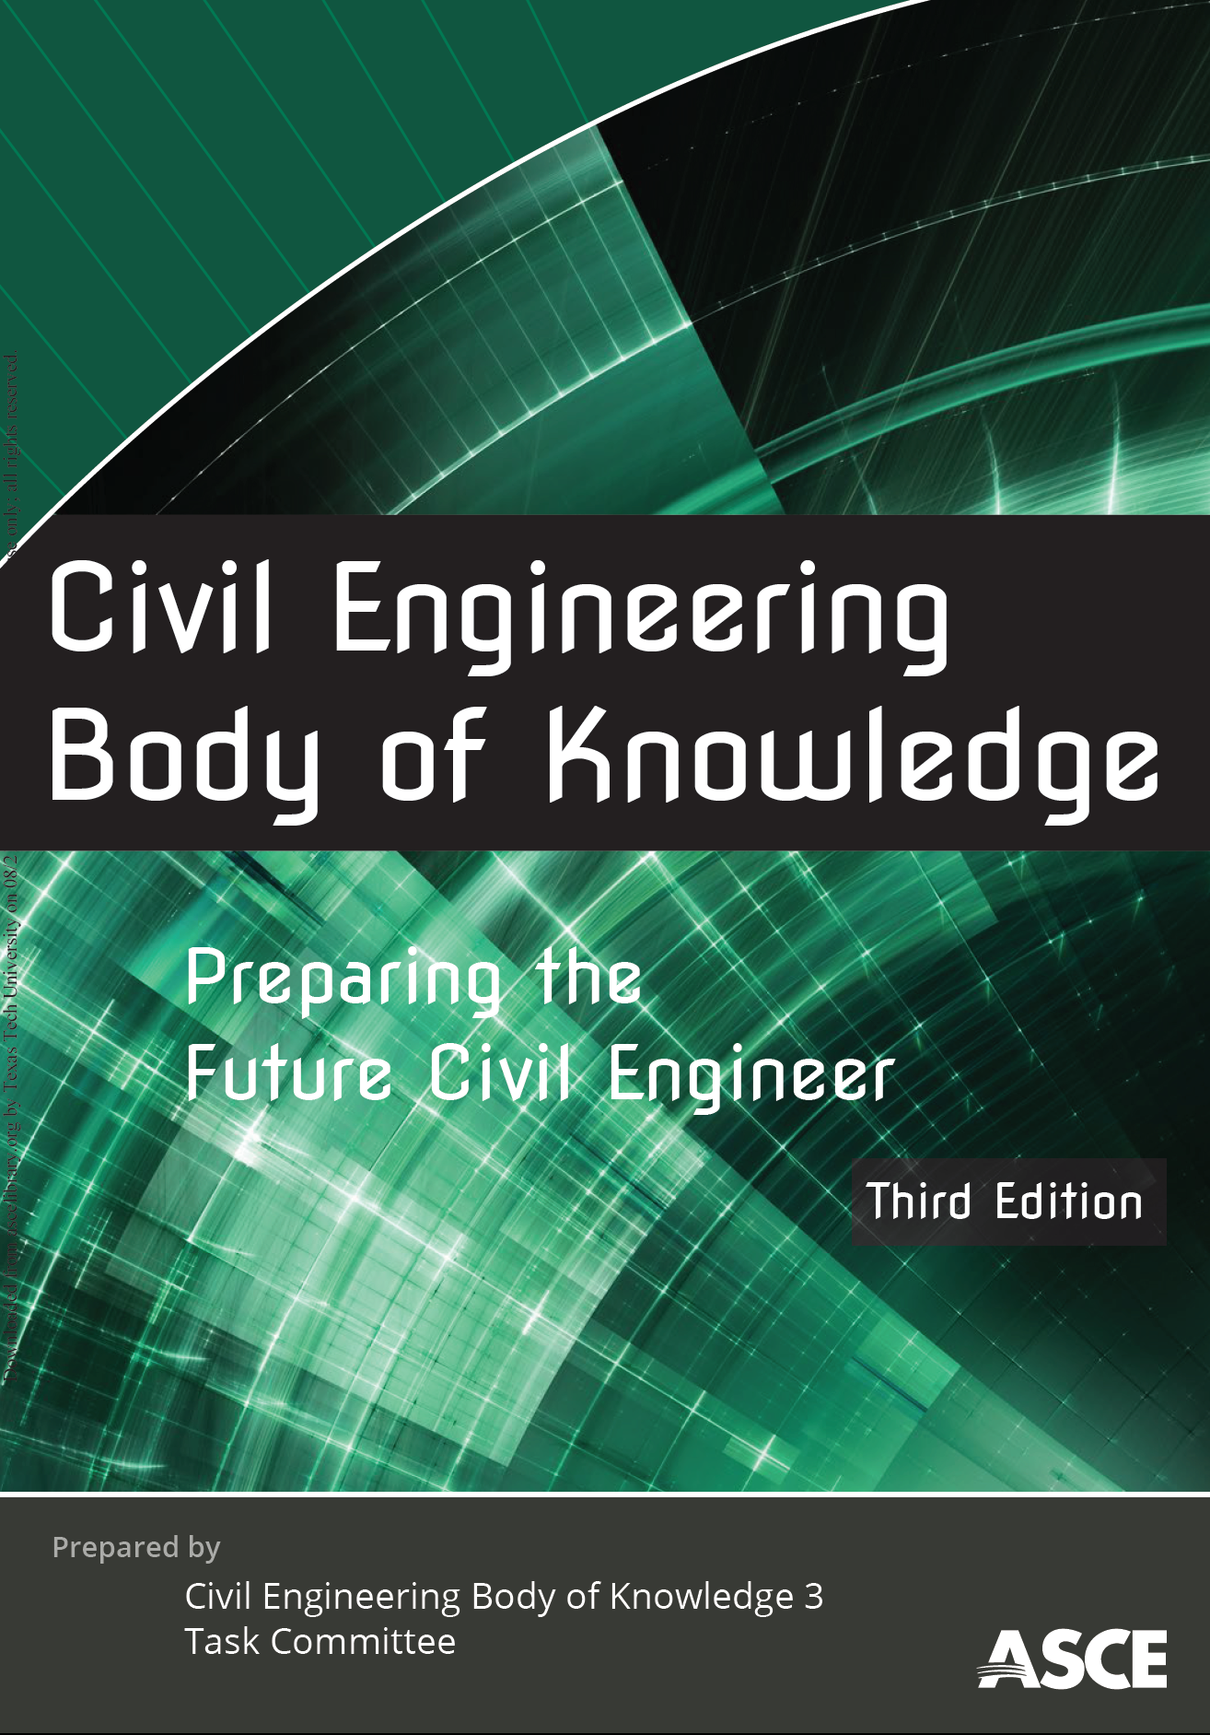
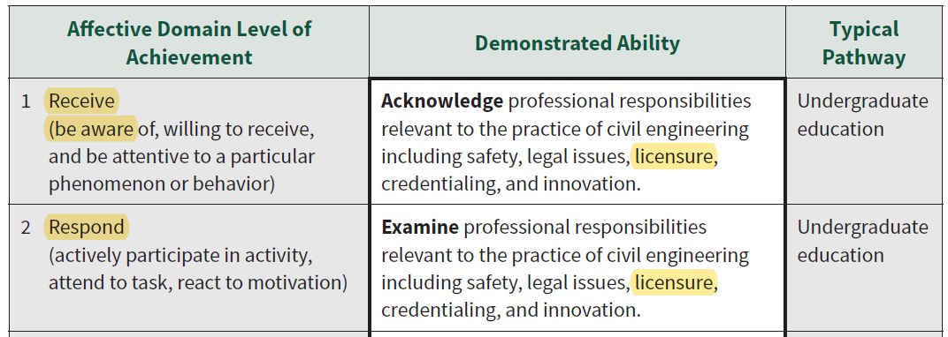

Slide 4
Q1
According to the NCEES Examinee Guide, for the FE Exam, the CIVIL CBT FE Exam has the following number of questions:
55
60
110
180

Slide 5
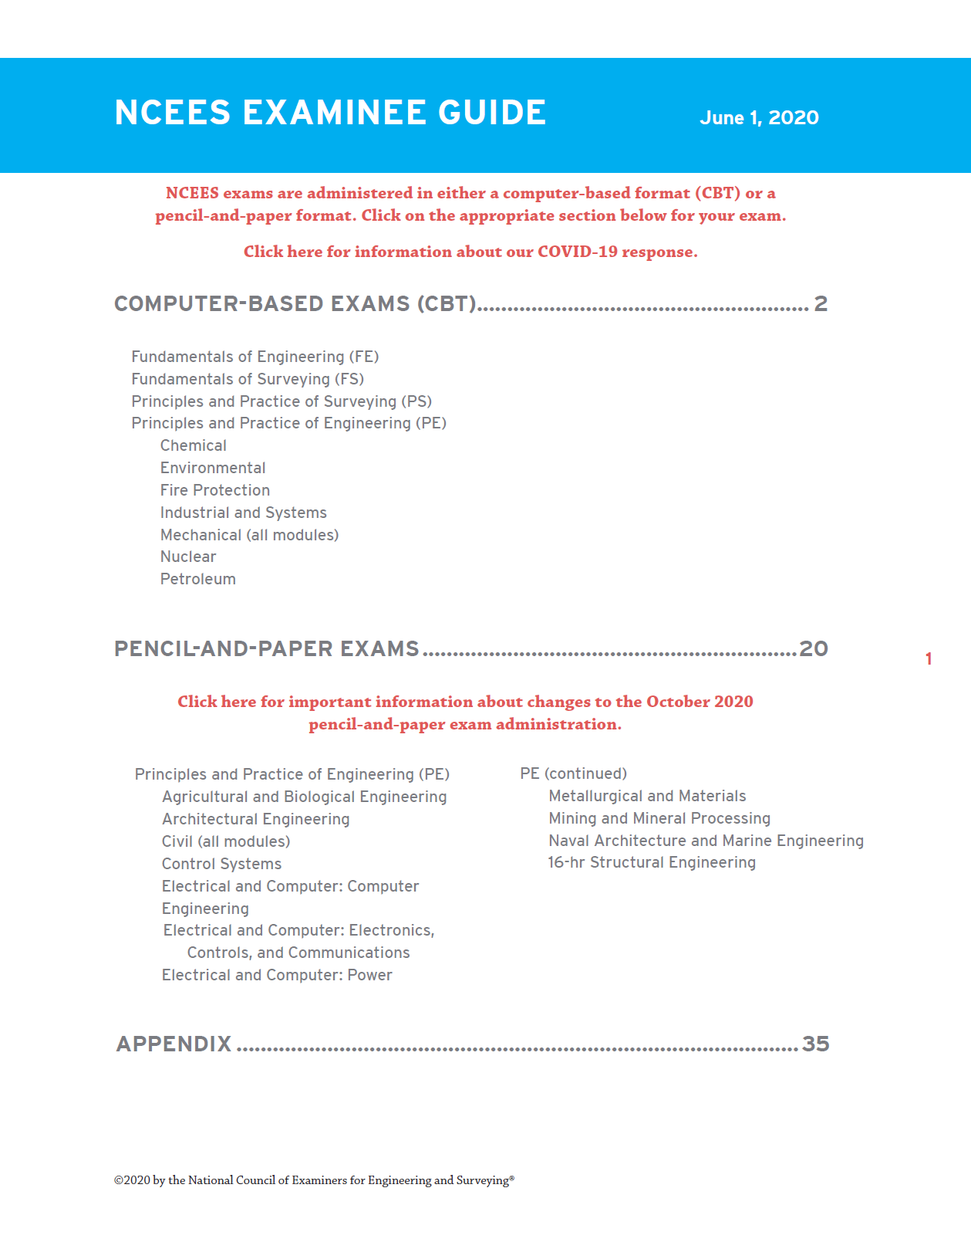
A1
C. 110

Slide 6
Q2
NCEES provides accommodations for individuals with documented disabilities:
TRUE
FALSE

Slide 7
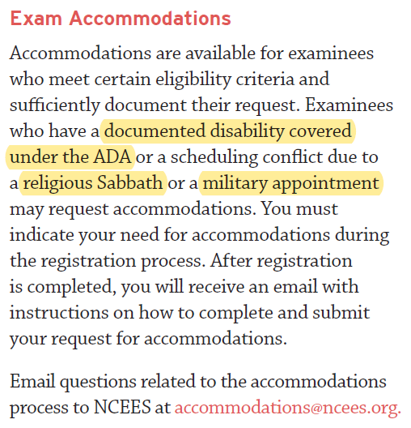
A2
A. TRUE

Slide 8
Q3
[TRUE/FALSE] NCEES policy allows the use of any scientific calculator as long as it does not have a QWERTY keyboard.
TRUE
FALSE

Slide 9
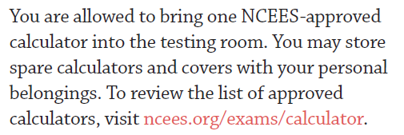
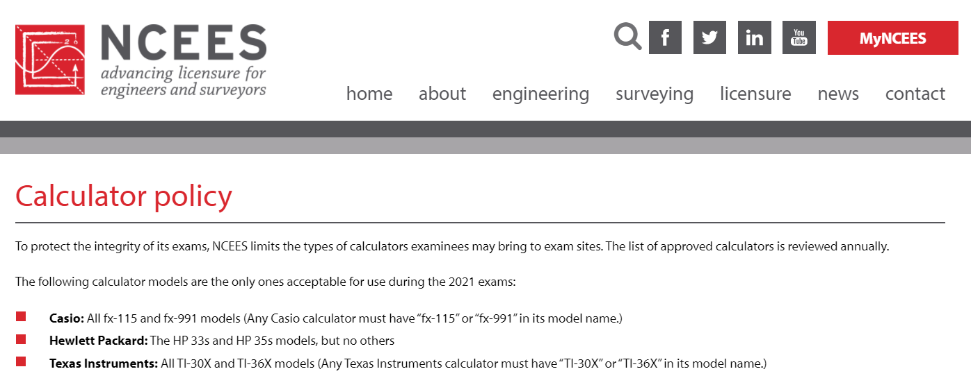
A3
B. FALSE

Slide 10
Q4
[TRUE/FALSE] Eligibility for taking the FE Exam is determined by whether the student is within two long semesters of graduation.
TRUE
FALSE

Slide 11
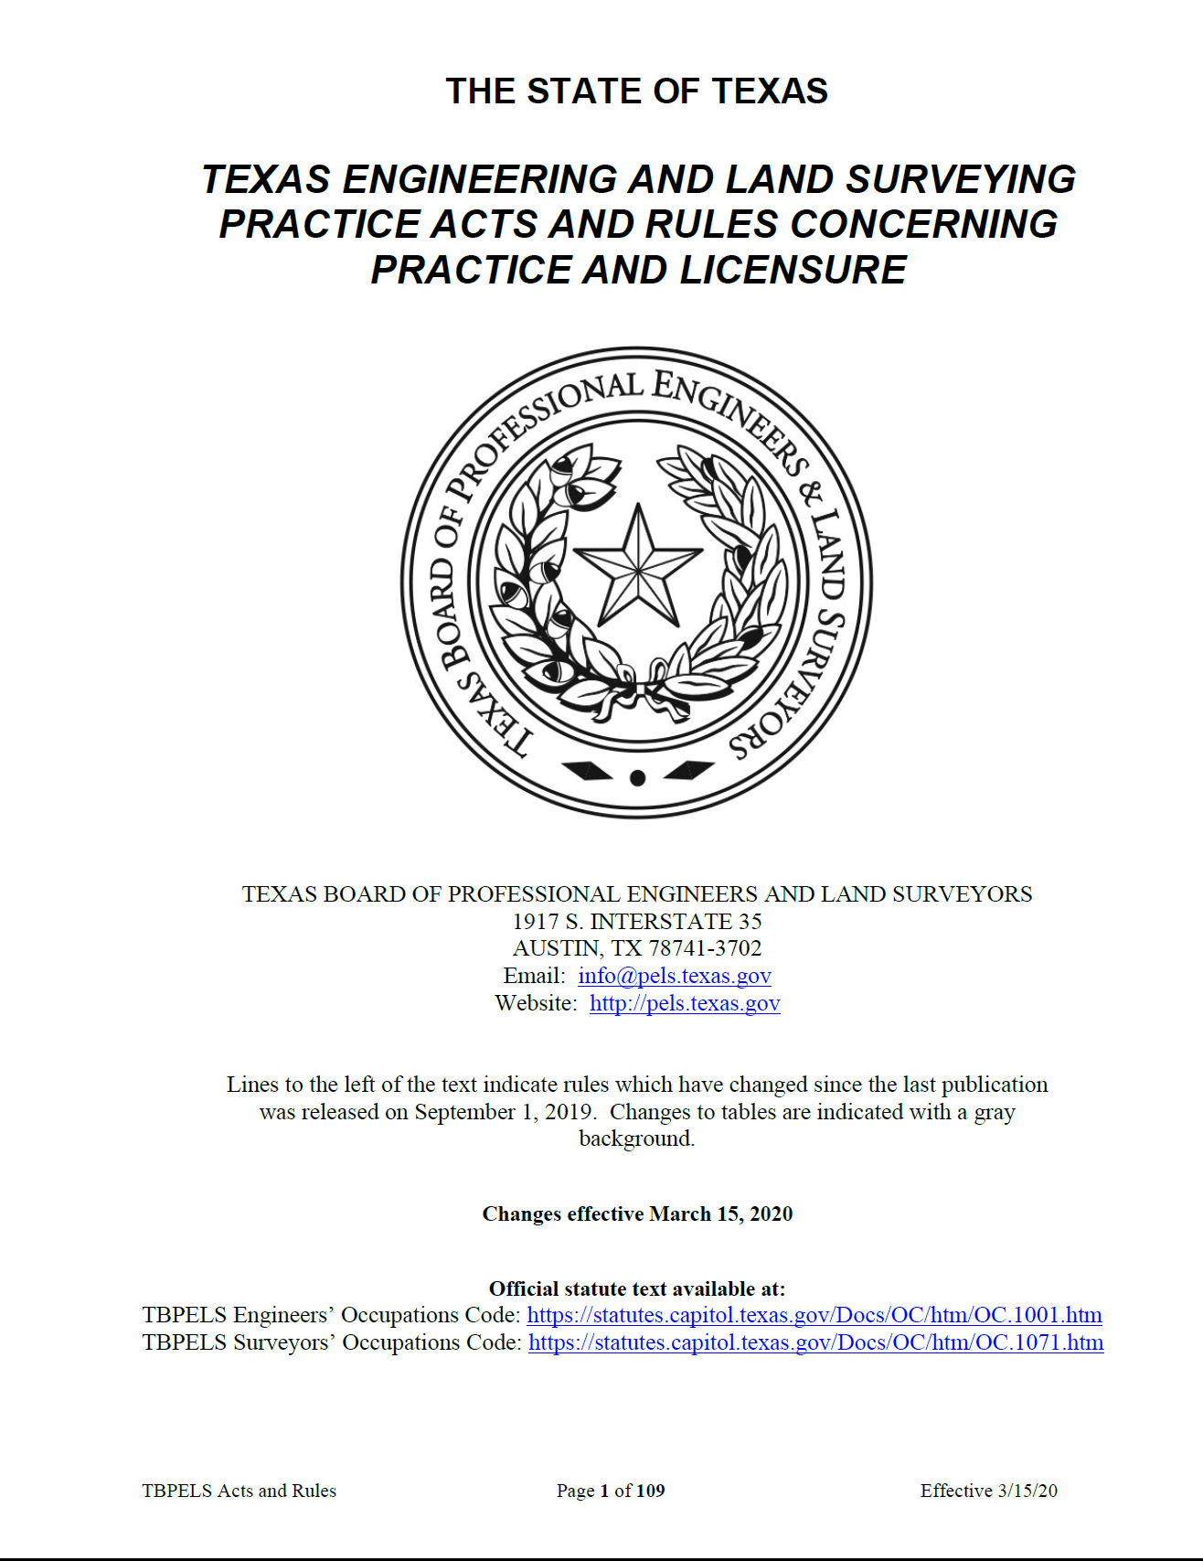
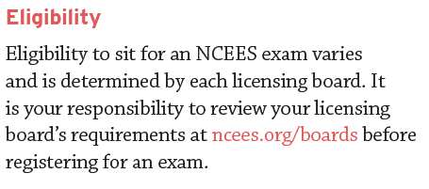
A4
A. TRUE

Slide 12
Q5
[TRUE/FALSE] The FE Exam uses both metric system (SI) and U.S. Customary System (USCS) units.
TRUE
FALSE

Slide 13
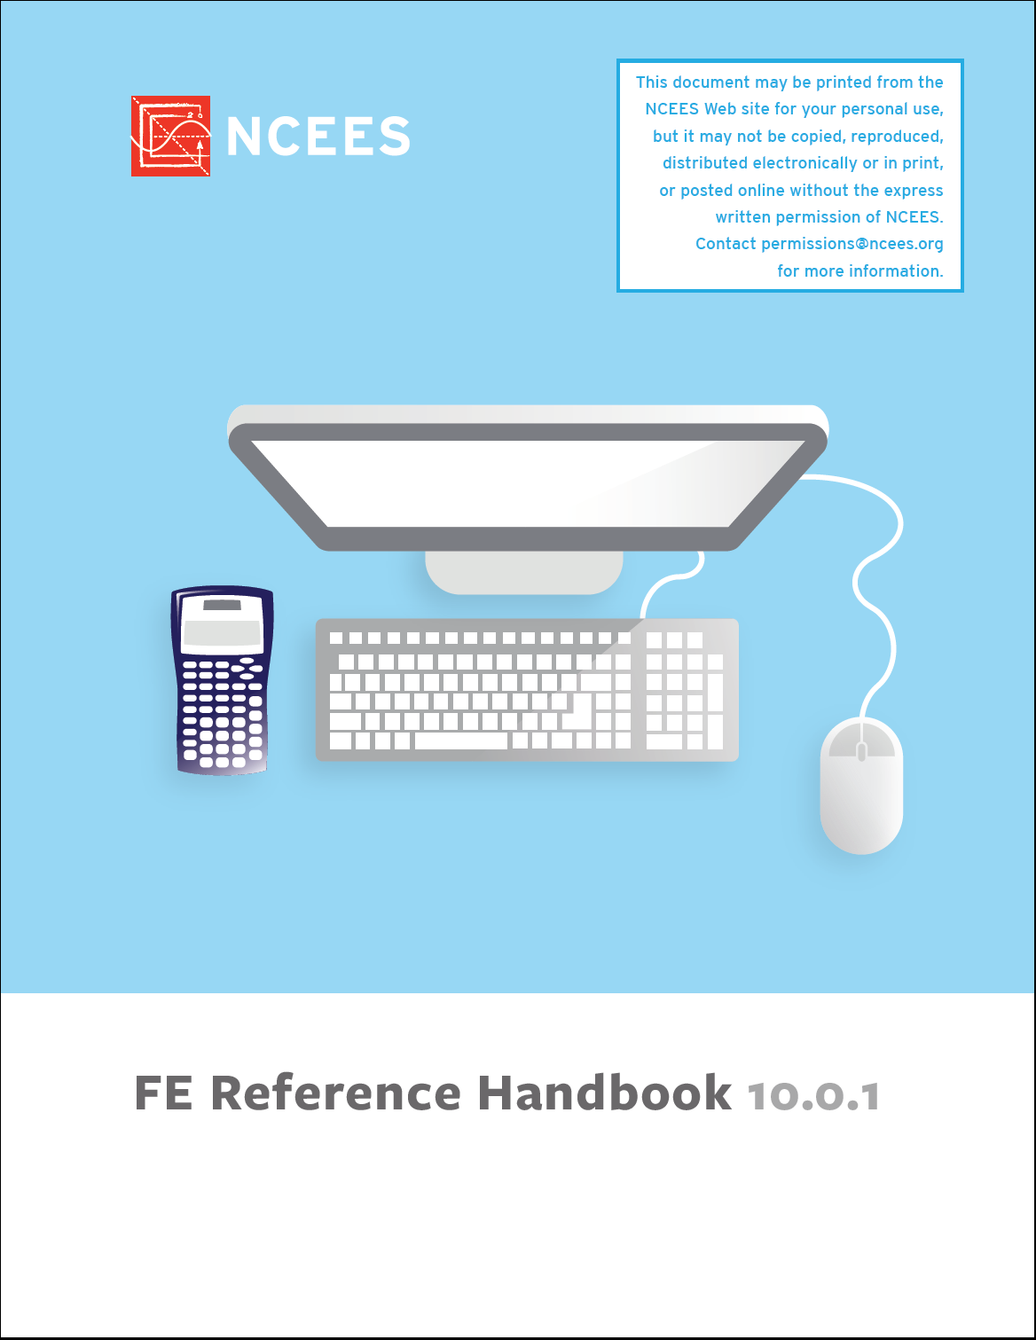
A5
A. TRUE
SEE UNITS
P 1

Slide 14
Q6
The topic that constitutes the largest percentage of questions on the CIVIL CBT FE Exam is:
Mathematics and Statistics
Mechanics of Materials
Structural Engineering
Transportation Engineering

Slide 15
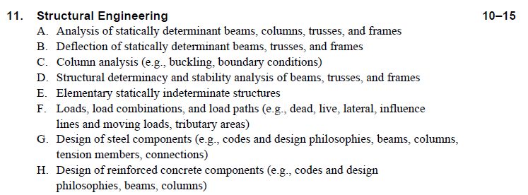
A6
C. Structural Engineering
SEE CBT EXAM SPEC
PP476-478
See also Water Resources/Environmental and Geotechnical

Slide 16
Q7
One of the CIVIL CBT FE Exam topics that Texas Tech CE students will **NOT** have had as a required course in their CE curriculum is:
Probability and Statistics
Materials
Thermodynamics
Construction Engineering

Slide 17
A7
D. Construction Engineering
SEE CBT EXAM SPEC
PP267-270

Slide 18
Q8
[TRUE/FALSE] The NCEES Reference Handbook conveniently groups all reference material for “general” engineering topics on the CIVIL CBT FE Exam to correspond directly to each of these exam topics.
TRUE
FALSE

Slide 19
A8
B. FALSE
COMPARE TABLE OF CONTENTS TO EXAM SPECIFICATION
BETTER THAN IN PREVIOUS VERSIONS
“GENERAL” TOPICS ARE COVERED
NOT IN ORDER

Slide 20
Q9
[TRUE/FALSE] The reference material needed for the CIVIL CBT FE Exam, presented on pages 259-309 of the Reference Handbook, contains all the information you need for CIVIL discipline-specific topics.
TRUE
FALSE

Slide 21
A9
B. FALSE
COMPARE CONTENTS TO EXAM SPECIFICATION
MOST “CE” TOPICS ARE COVERED (BUT NOT IN ORDER)
SURVEYING IS EMBEDDED WITHIN TRANSPORTATION
ENVIRONMENTAL ENGINEERING IS ITS OWN CHAPTER
YOU’LL HAVE TO DO SOME HUNTING AROUND

Slide 22
Q10
[TRUE/FALSE] The nomenclature and symbols presented in the FE Reference Handbook for all Civil Engineering topics of the FE Exam will always match the nomenclature and symbols presented in your coursework and textbooks at Texas Tech University.
TRUE
FALSE

Slide 23
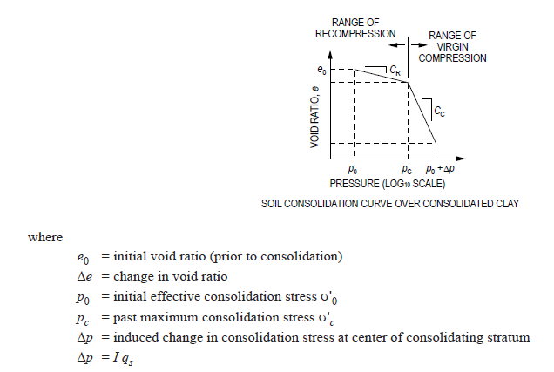
A10
B. FALSE
EXAMPLE FROM GEOTECH

Slide 24
Q11
[TRUE/FALSE] It is fair to say that the FE Reference Handbook for the FE Exam is like a 3x5 formula card that one of your professors might allow you to use on an exam in an engineering course.
TRUE
FALSE

Slide 25
A11
A. TRUE
CAREFULLY REVIEW THE REFERENCE HANDBOOK.
SEE WHAT YOU THINK…

Slide 26
Q12
[TRUE/FALSE] The recommended strategy for TTU students is to take the FE Exam as soon as you are eligible, and keep taking until you pass.
TRUE
FALSE

Slide 27
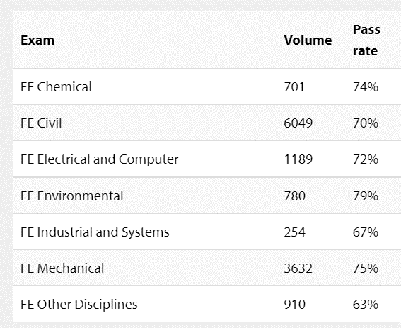
A12
B. FALSE
TAKING EARLY IS A BAD IDEA…
STUDENTS DO BETTER WHEN THEY TEST OVER TOPICS THEY KNOW
THE FE EXAM ONLY HAS 14 TOPICS NOW (NO FLUFF)
TAKING EARLY USUALLY MEANS YOU HAVEN’T HAD COURSES (TRANSPO, STR DESIGN, DYNAMICS, ETC.)
COMPARE PASS RATES FOR FIRST TIME TAKERS VS. 2ND, 3RD OR 4TH TIME TAKERS
JAN-JUN 2021 FE PASS RATES

Slide 28
Q13
[TRUE/FALSE] The PPI FE CIVIL Review Manual is conveniently organized such that the order of topics in is exactly the same as for the NCEES CIVIL CBT Exam Specification and the FE Supplied Reference Handbook.
TRUE
FALSE

Slide 29
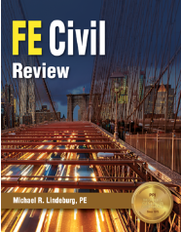
A13
B. FALSE
COMPARE TABLE OF CONTENTS
“CLOSE” TO FE SPECIFICATION,
BUT NOT EXACTLY
TOPIC COVERAGE IN MANUAL IS VARIABLE
ENVIRONMENTAL IS ITS OWN CHAPTER
SURVEYING COMBINED WITH TRANSPORTATION
NOT IN EXACT SAME ORDER

Slide 30
Q14
According to the “How You Can Use this Book” section of the FE Review Manual, the book is written such that you should be able to review a typical chapter in:
30 minutes or so
One hour or so
Two hours or so
Four hours or so

Slide 31
A14
B. ONE HOUR OR SO…

Slide 32
Q15
[TRUE/FALSE] According to the “About this Book” section of the FE Review Manual, the FE Review Manual is not intended as a reference book.
TRUE
FALSE

Slide 33
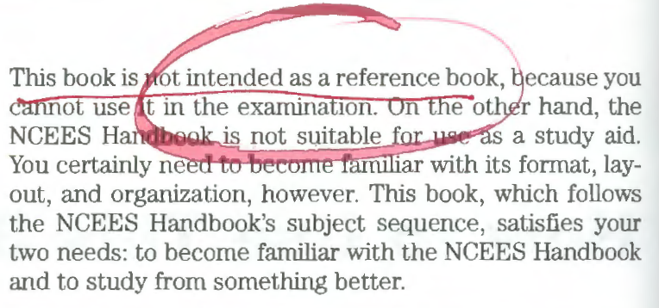
A15
A. TRUE

Slide 34
Q16
[TRUE/FALSE] According to the “How You Can Use this Book” section of the FE Review Manual, you should study every subject in the book.
TRUE
FALSE

Slide 35
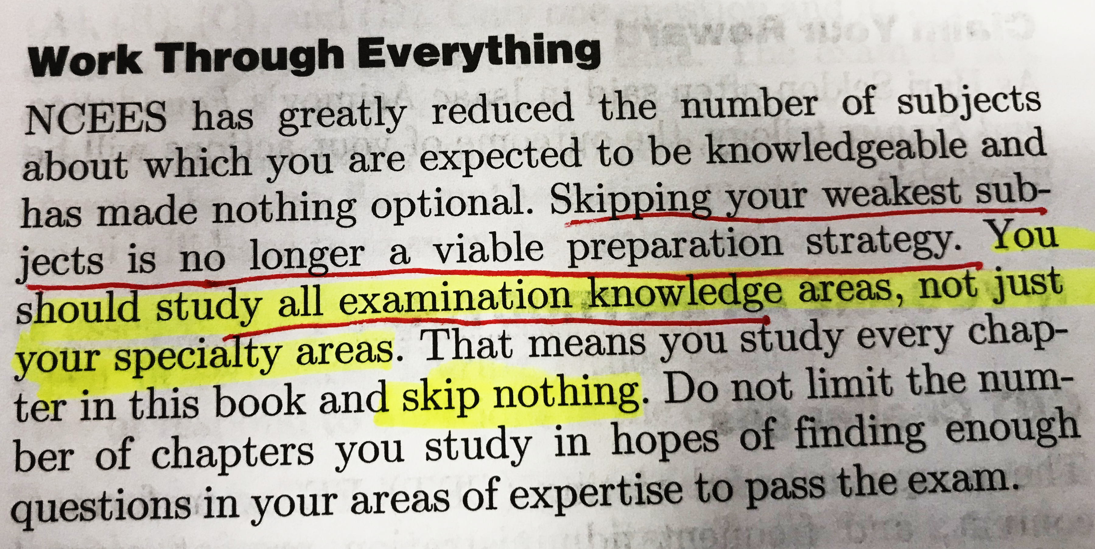
A16
A. TRUE

Slide 36
Q17
[TRUE/FALSE] According to the “About the Exam” section of the FE Review Manual, some of the exam question statements contain superfluous/ confusing information.
TRUE
FALSE

Slide 37
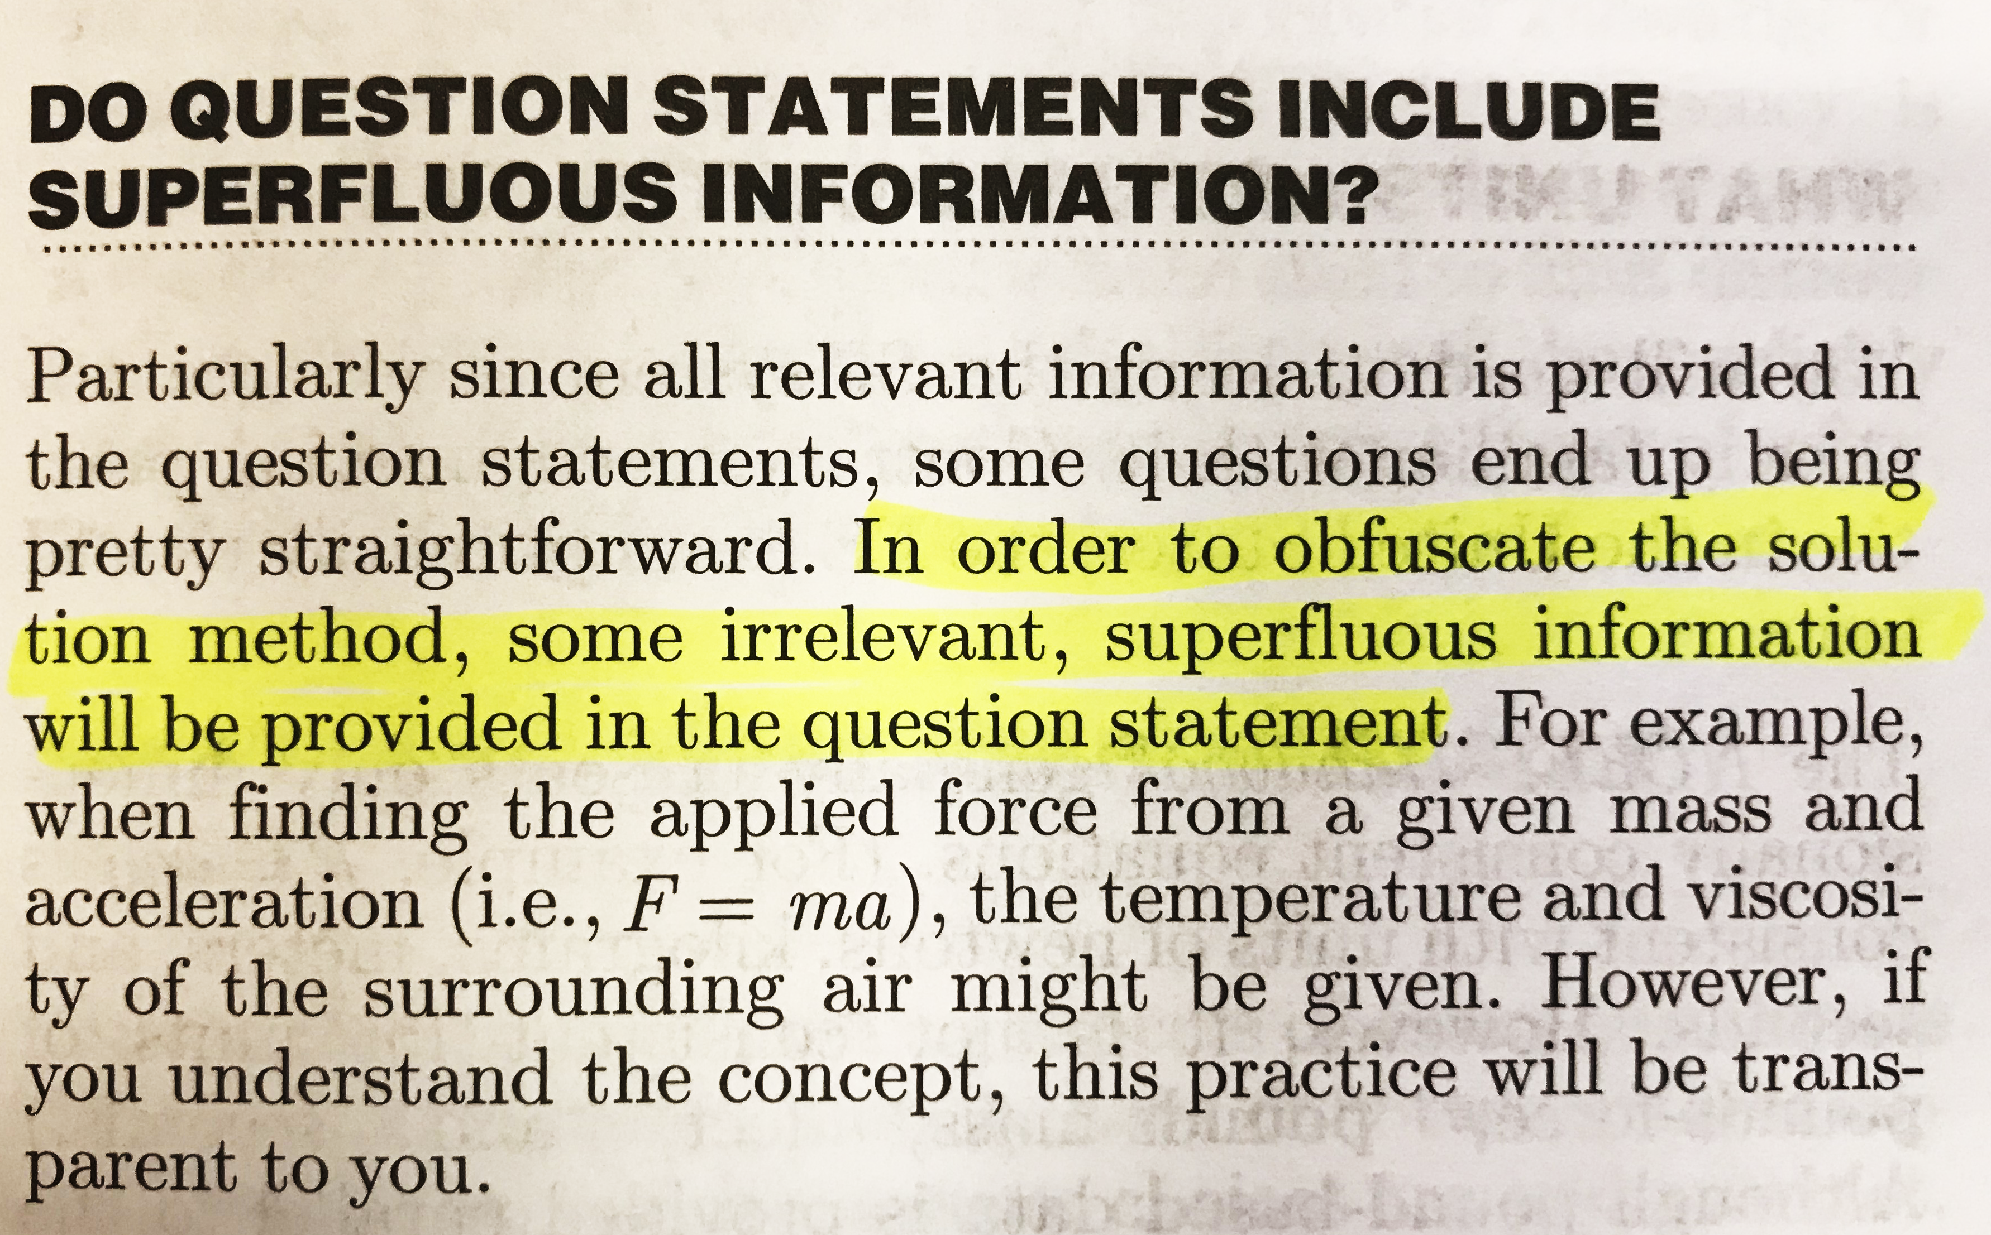
A17
A. TRUE

Slide 38
Q18
[TRUE/FALSE] According to the “About the Exam” section of the FE Review Manual, to facilitate score reliability, NCEES changes the FE Exam questions so that each exam contains a different yet specific “set” of equivalent exam questions.
TRUE
FALSE

Slide 39
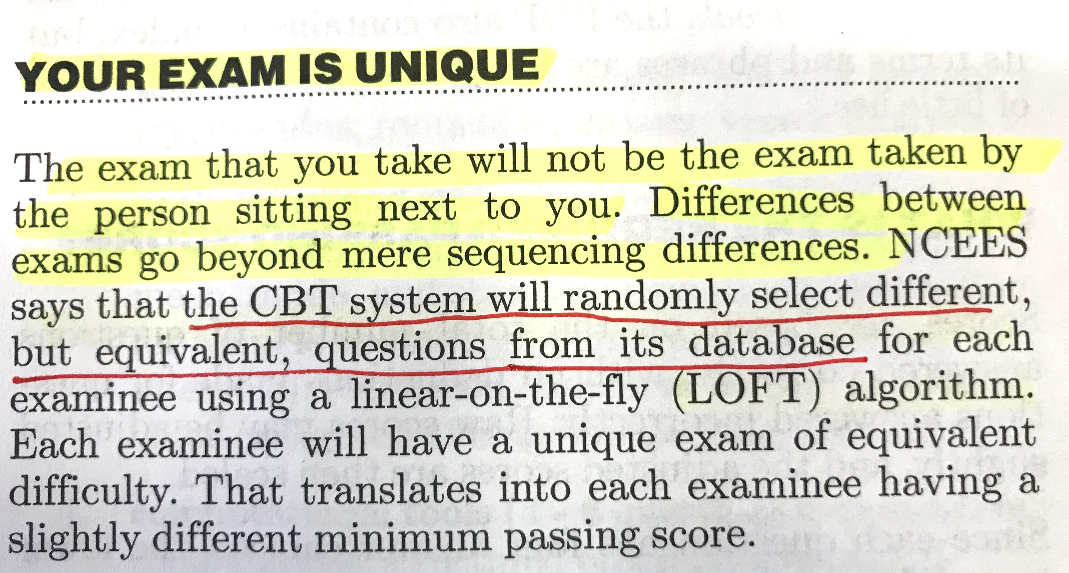
A18
A. TRUE

Slide 40
Q19
[TRUE/FALSE] According to the “Engineering Registration in the United States” section of the FE Review Manual, the FE Exam is not graded on a curve.
TRUE
FALSE

Slide 41
A19
A. TRUE

Slide 42
Q20
According to the “About the Exam” section of the FE Review Manual, a passing score on the FE Exam equates to working the following “raw” percentage of problems correctly:
Somewhat less than 30 percent
Somewhat less than 40 percent
Somewhat less than 50 percent
Somewhat less than 60 percent

Slide 43
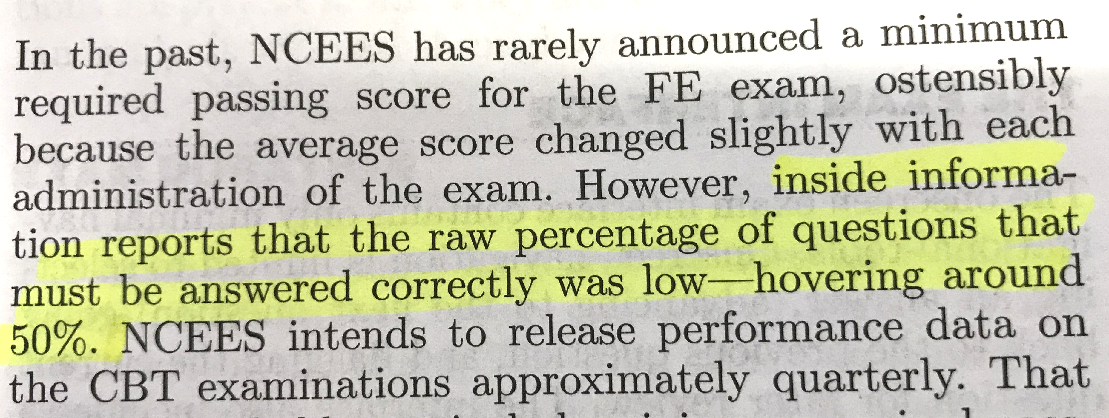
A20
C. Hovering around 50 percent

Slide 44
Q21
[TRUE/FALSE] According to the “About the Exam” section of the FE Review Manual, your “raw” percent correct FE Exam score will probably be scaled such that 70 is identified as a passing score.
TRUE
FALSE

Slide 45
A21
A. TRUE

Slide 46
Q22
[TRUE/FALSE] According to the “About the Exam” section of the FE Review Manual, you should always take the phrase “most nearly” to mean the answer option that is most nearly what you calculated, regardless of whether it is more or less than your calculated value.
TRUE
FALSE

Slide 47
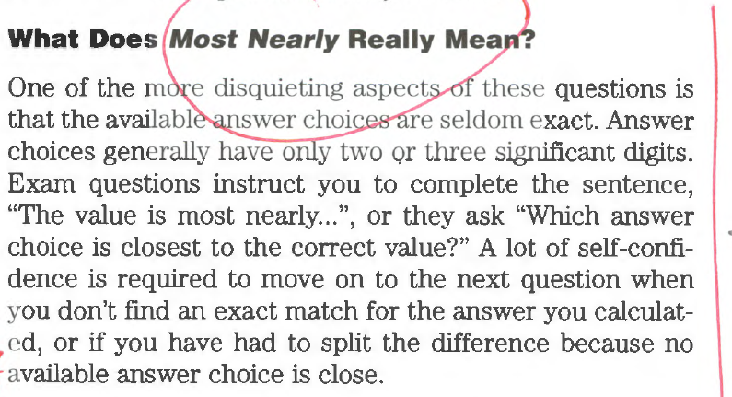
A22
B. FALSE

Slide 48
Q23
[TRUE/FALSE] According to the “How You Can Use this Book” section of the FE Review Manual, the most successful strategy to pass the FE Exam is to prepare in all the examination subjects. Do not limit the number of subjects you study.
TRUE
FALSE

Slide 49
A23
A. TRUE

Slide 50
Q24
[TRUE/FALSE] According to the “Strategies for Passing the Exam” section of the FE Review Manual, “a good prior night’s sleep” is the best way to start the examination.
TRUE
FALSE

Slide 51
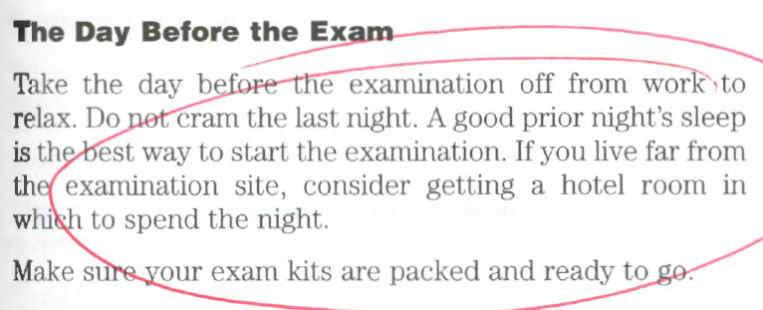
A24
A. TRUE

