Slide 1
NCEES FUNDAMENTALS OF ENGINEERING (FE) EXAM CECE DEPARTMENT TEXAS TECH UNIVERSITY
William D. Lawson, PE, PhD
Spring 2022 Semester

Slide 2
National Council of Examiners for Engineering and Surveying
http://ncees.org/engineering/fe/

Slide 3
OVERVIEW
FE Exam… What is it?
Eligibility
New vs. Old… FE Exam Comparison
The 2020 CBT FE Exam
FE Exam Study Materials
FE Exam Performance by CE [& ENVE] Students
Professional Philosophy toward the FE Exam
Educational Philosophy toward the FE Exam

Slide 4
1. FE Exam… what is it?
FE EXAM DISCUSSION CECE DEPARTMENT TEXAS TECH UNIVERSITY

Slide 5
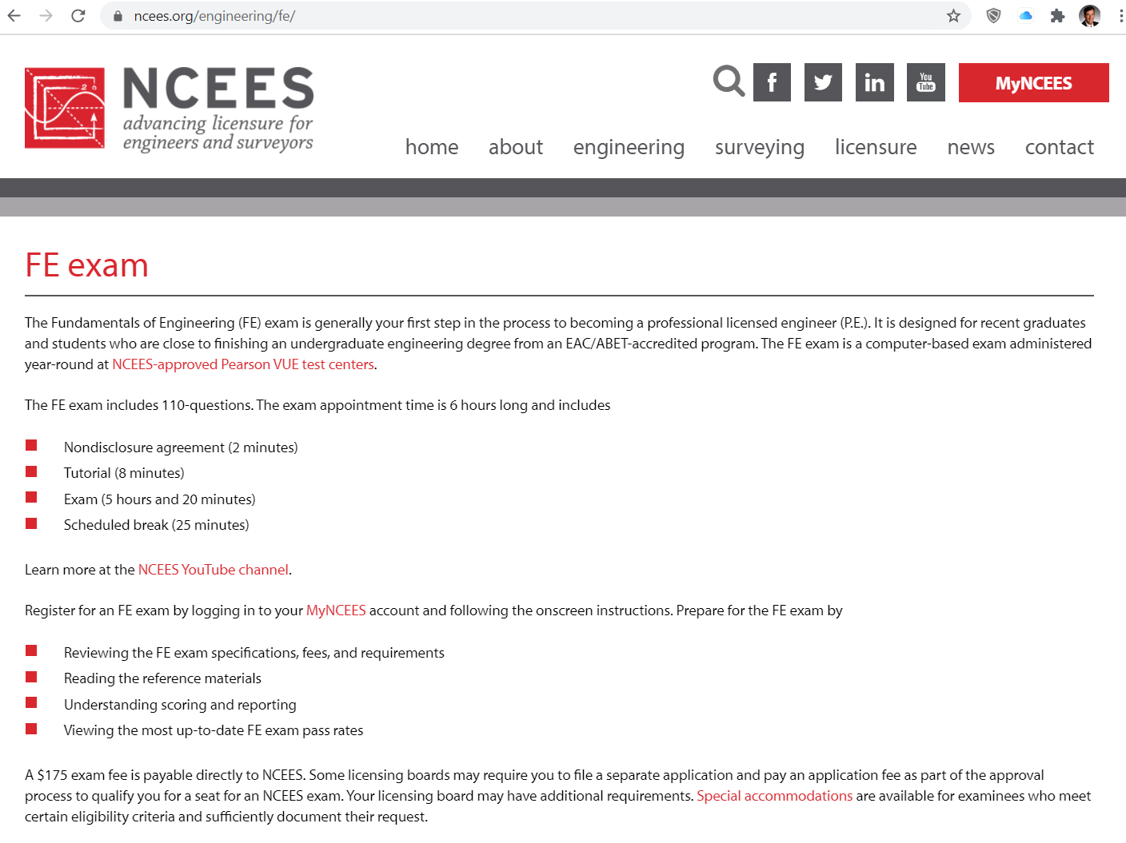

Slide 6
The FE Exam
The Fundamentals of Engineering (FE) exam is typically the first step in the process leading to the P.E. license.
It is designed for recent graduates and students who are close to finishing an undergraduate engineering degree.

Slide 7
What is the FE, really?
The FE Exam is designed to provide evidence of technical competency for the purpose of engineering licensure.

Slide 8
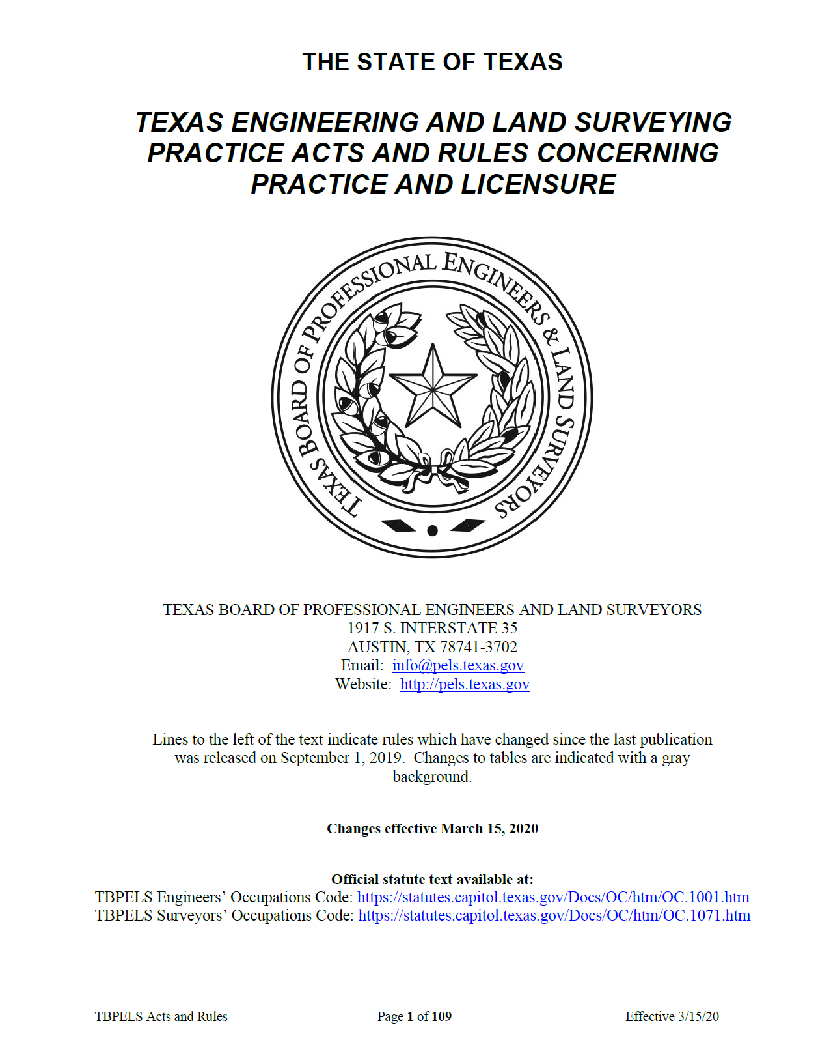

Slide 9
Idealized Engineering Licensure Model
Yes
ABET Accredited
Engineering Bachelor
of Science Degree
[or equivalent]
“Licensed
Professional
Engineer”
Mandatory
Continuing
Professional
Competency
Pass
No
Fail
4 Years
of
Acceptable
Experience
Inactive
Pass
FE Exam
Engineer-in
Training
PE Exam
Fail

Slide 10
FE Exam Overview
The FE contains 110 multiple-choice/ AIT (alternative item type) questions.
The exam appointment time is 6 hours long
Includes
a nondisclosure agreement (2 minutes)
tutorial (8 minutes)
the exam (5 hours and 20 minutes)
a scheduled break (25 minutes)
a brief survey

Slide 11
FE Exam Specifications
The FE is offered in seven disciplines:
FE Chemical
FE Civil
FE Electrical and Computer
FE Environmental
FE Industrial
FE Mechanical
FE Other Disciplines

Slide 12
2. ELIGIBILITY
FE EXAM DISCUSSION CECE DEPARTMENT TEXAS TECH UNIVERSITY

Slide 14
Register for the Exam
How do I register for an exam?
You must register for all FE and PE exams on-line at the NCEES exam registration system.
The exam registration system begins at: http://ncees.org/engineering/fe/
You must have a MyNCEES account to register for an exam: https://account.ncees.org/login

Slide 15
FE Exam Dates
When are the exam dates and what are the fees?
The FE exam is offered in testing windows throughout the year during the following months:
January-March
April-June
July-September
October-December.
The exams will be conducted at Pearson VUE testing centers.
NCEES policy allows an examinee to take the FE exam once during a testing window, and no more than three times during a twelve-month period.

Slide 16
FE Exam FEES

Slide 17
3. New vs. Old… FE Exam Comparison
FE EXAM DISCUSSION CECE DEPARTMENT TEXAS TECH UNIVERSITY

Slide 18
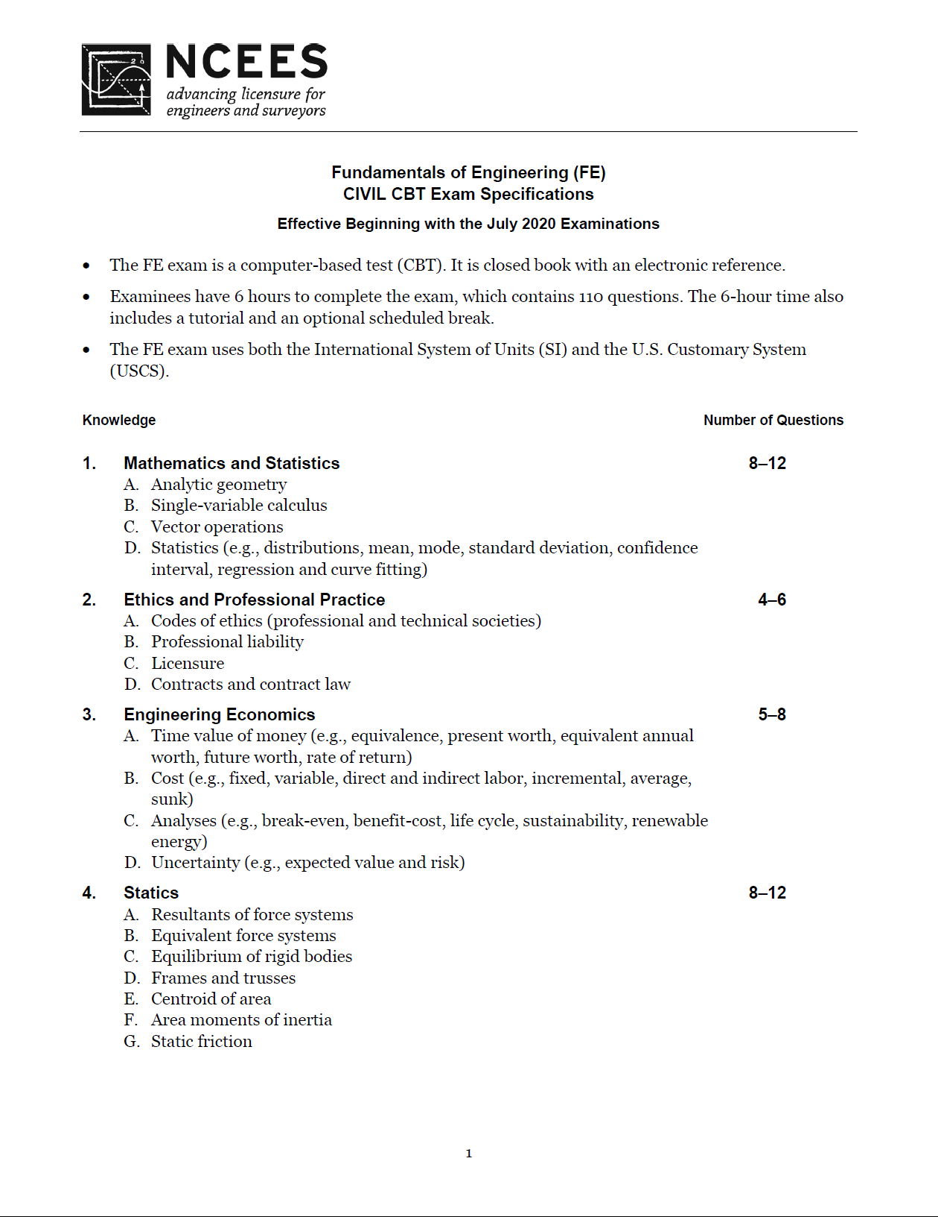
FE EXAM SPECIFICATION

Slide 19
Ongoing Evolution of the FE Exam
1940 | 1950 | 1960 | 1970 | 1980 | 1990 | 2000 | 2010 | 2020 | 2030
1956
Pencil & Paper, 8.0 hrs, General Engr Content, 180 Questions, Open Book
1993
Supplied Reference, Ed. 1
1996
4.0 hrs Gen. / 4.0 hrs Discipline-Spec.
2014
CBT, 5.3 hrs, 110 ques
2020
Topics…

Slide 20
2014“Morning” Session, FE Exam (CIVIL)
FORMER VERSION (120 questions) |  | 2014 CBT VERSION (CIVIL)
Mathematics | 18 | Mathematics | 7-11
Engineering Probability and Statistics | 8 | Engineering Probability and Statistics | 4-6
Chemistry | 11 | Chemistry | OUT
Computers | 8 | Computational Tools | 4-6
Ethics and Business Practices | 8 | Ethics and Professional Practice | 4-6
Engineering Economics | 10 | Engineering Economics | 4-6
Engineering Mechanics - Statics | 6 | Statics | 7-11
Engineering Mechanics - Dynamics | 6 | Dynamics | 4-6
Strength of Materials | 8 | Mechanics of Materials | 7-11
Material Properties | 8 | Material Properties | OUT
Fluid Mechanics | 8 | Fluid Mechanics | 4-6
Electricity and Magnetism | 11 | Electricity and Magnetism | OUT
Thermodynamics | 8 | Thermodynamics | OUT

Slide 21
2014 “Afternoon” Session, FE Exam (CIVIL)
FORMER VERSION (60 questions) |  | 2014 CBT VERSION (CIVIL)
Surveying | 7 | Surveying | 4-6
Hydraulics and Hydrologic Systems | 7 | Hydraulics and Hydrologic Systems | 8-12
Soil Mechanics and Foundations | 9 | Geotechnical Engineering | 9-14
Environmental Engineering | 7 | Environmental Engineering | 6-9
Transportation | 7 | Transportation Engineering | 8-12
Structural Analysis | 6 | Structural Analysis | 6-9
Structural Design | 6 | Structural Design | 6-9
Construction Management | 6 | Construction | 4-6
Materials | 5 | Materials | 4-6
CBT CIVIL EXAM
AM… 43 to 69, avg 56/110 questions
PM… 55 to 83, avg 69/110 questions

Slide 22
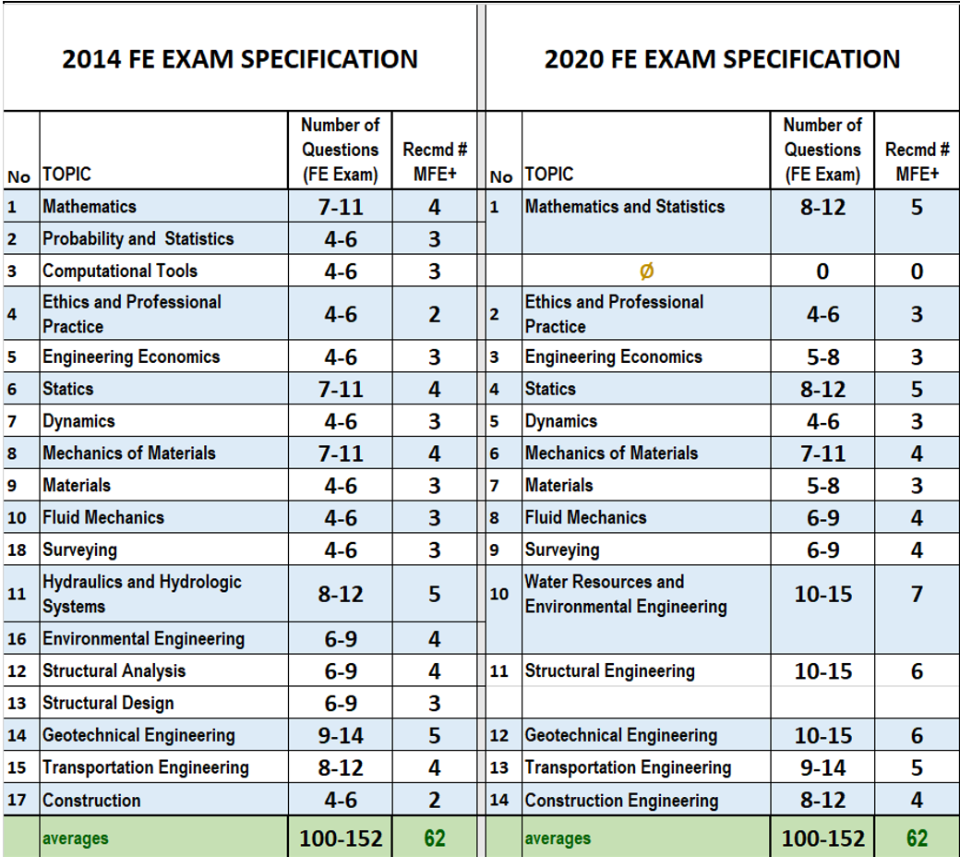
2020 FE Exam (CIVIL)

Slide 23
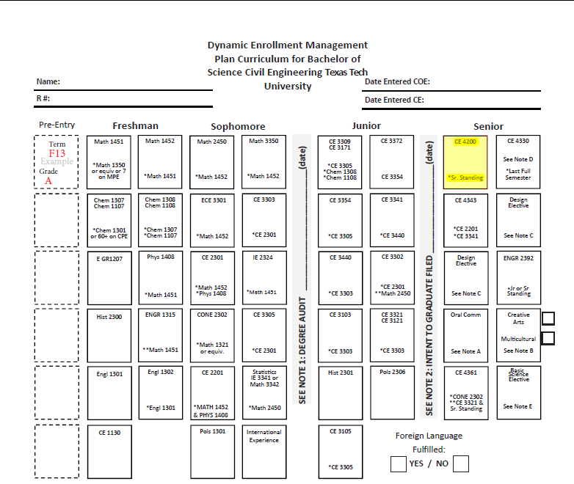
Civil Engineering Curriculum
10
10
10
11
11
xx
11
xx
9
11
12
13
10
14

Slide 24
FE EXAM SPECIFICATION

Slide 25
4. the 2020 cbt FE Exam
FE EXAM DISCUSSION CECE DEPARTMENT TEXAS TECH UNIVERSITY

Slide 26
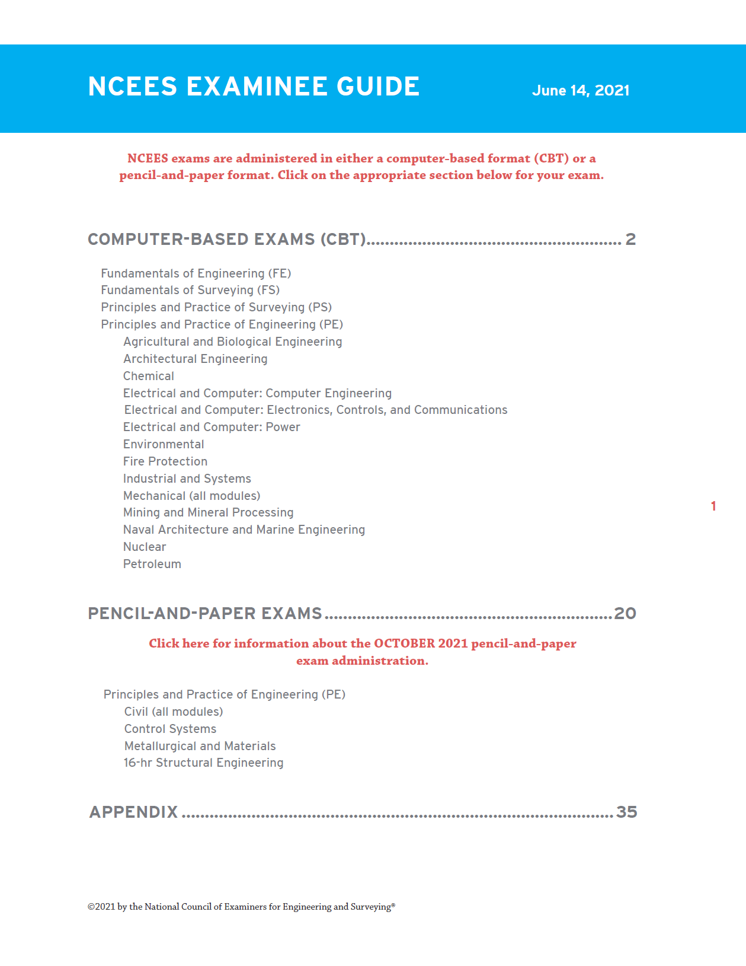

Slide 27
ABOUT the 2020 CBT Exam
110 questions
6 hours total
5 hours, 55 minutes appointment time
5 hours, 20 minutes exam time
Both SI & US customary units

Slide 28
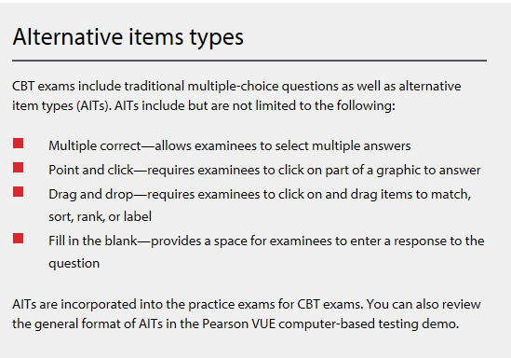
Alternative Item Types
Starting July 1, 2017, the computer-based FE introduced a new testing component: alternative item types (AITs). AITs are questions other than traditional multiple-choice questions.

Slide 29
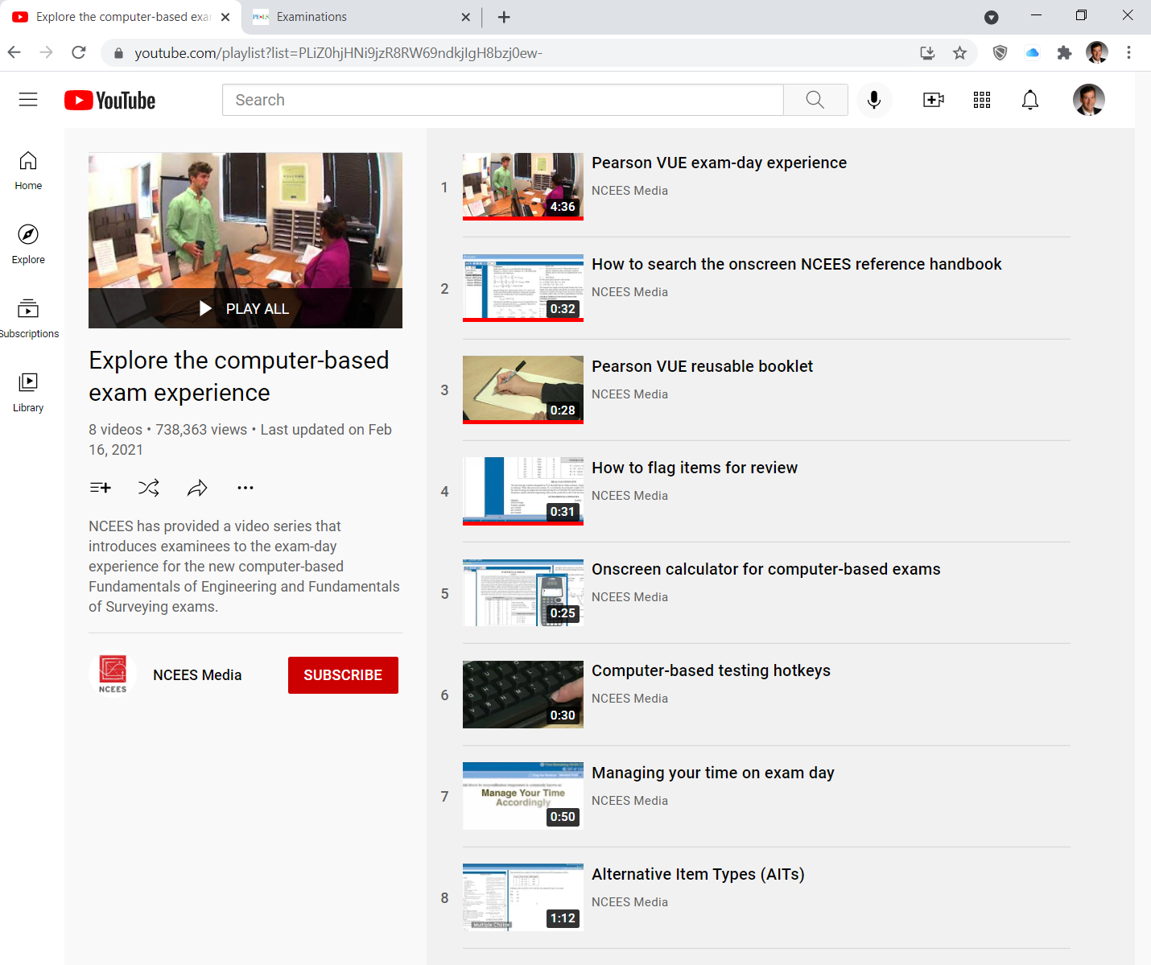
NCEES YouTube Channel
https://www.youtube.com/playlist?list=PLiZ0hjHNi9jzR8RW69ndkjIgH8bzj0ew-

Slide 30
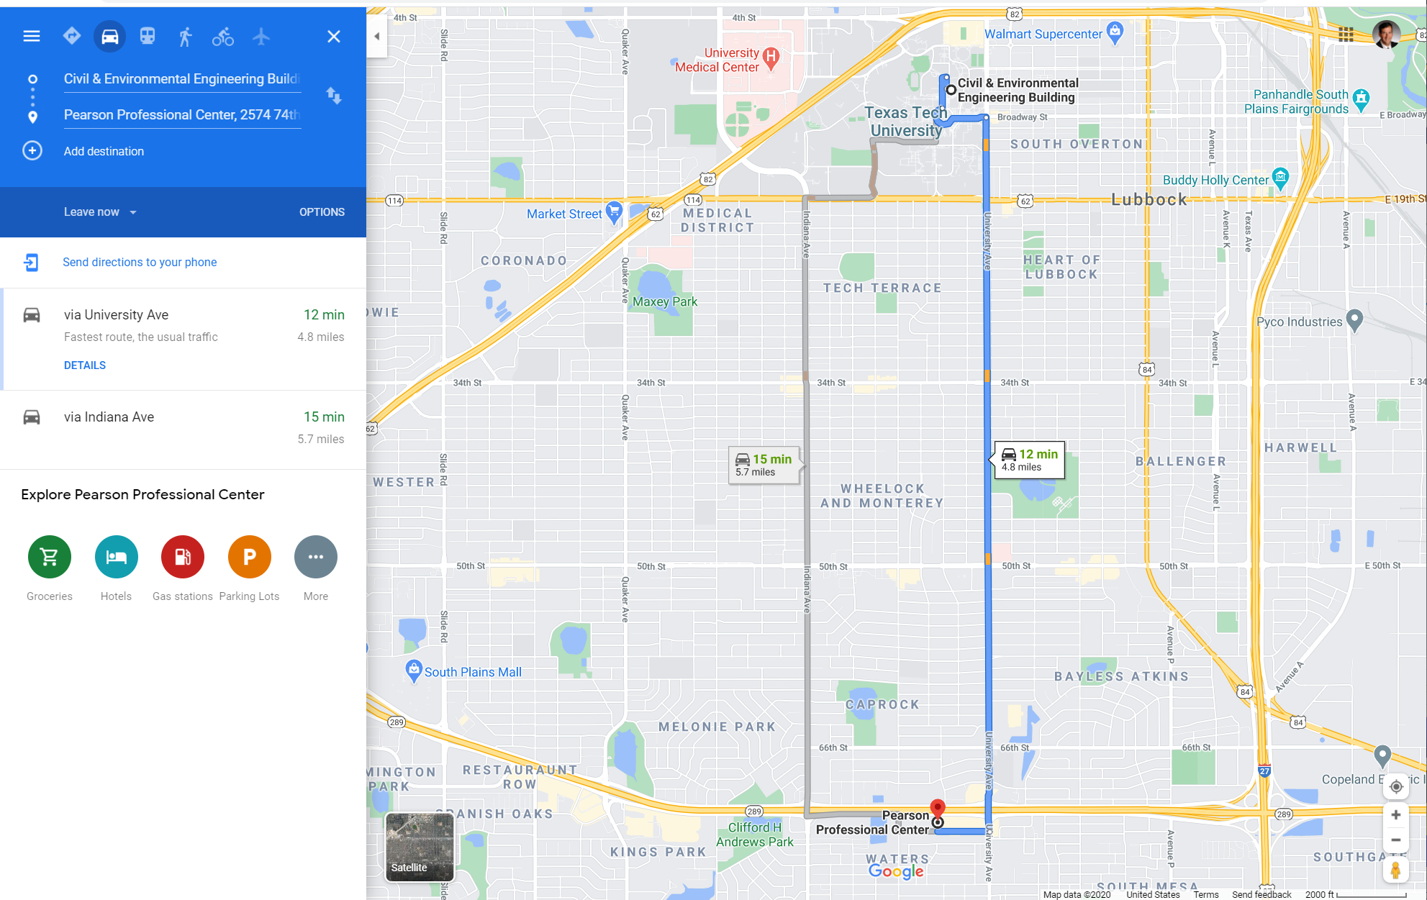
PEARSON PROFESSIONAL CENTER
PEARSON PROFESSIONAL CENTER
2574 74TH ST, Suite 201
LUBBOCK, TX 79423
806.445.0239

Slide 31
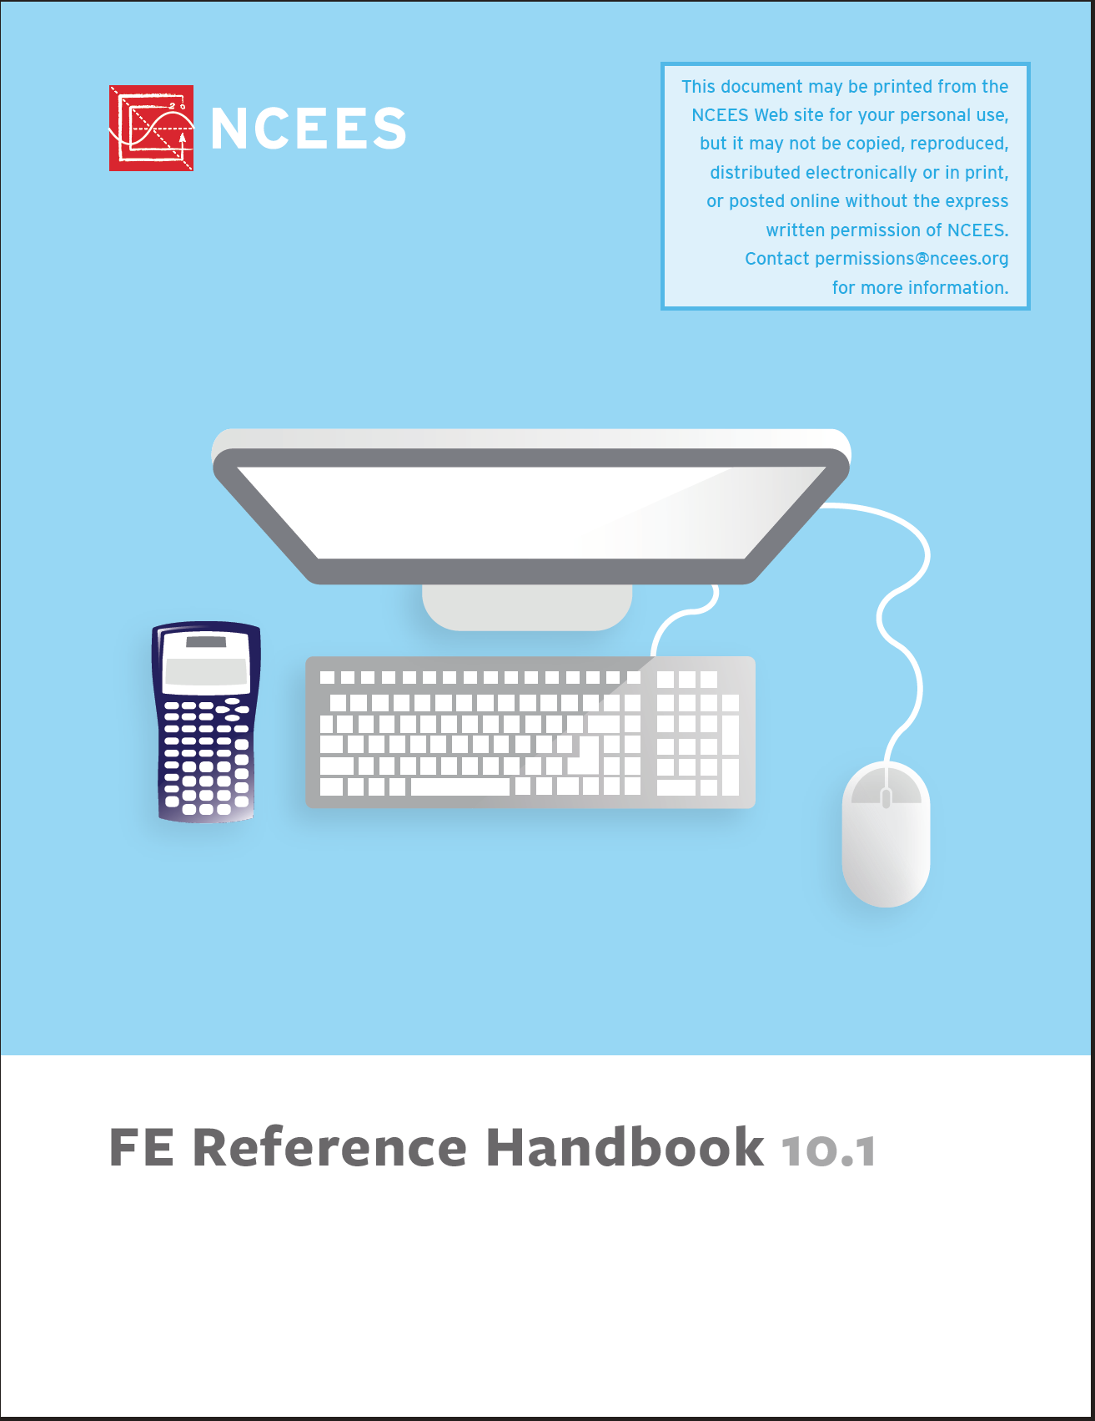
A New FE Reference Handbook

Slide 32
5. FE Exam STUDY MATERIALS
FE EXAM DISCUSSION CECE DEPARTMENT TEXAS TECH UNIVERSITY

Slide 33
1. FE REFERENCE HANDBOOK
This is the official reference material for the computer-based FE exam beginning in July 2020.
Review the handbook prior to exam day and familiarize yourself with the charts, formulas, tables, and other reference information provided.
An electronic version will be available onscreen during the actual exam.
Printed copies will not be allowed in the exam room.
10.1 edition ©2021

Slide 34
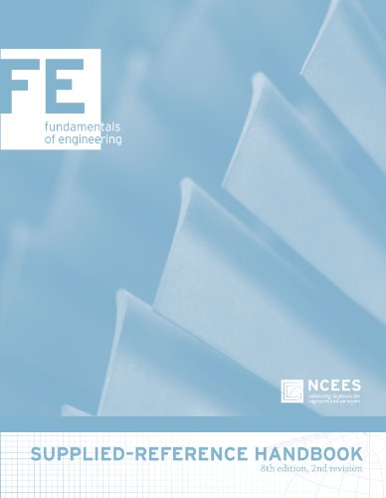
OLD BOOKS FE REFERENCE HANDBOOK
DO NOT USE!!!

Slide 35
2. THE “CURRENT” FE REVIEW MANUAL PROFESSIONAL PUBLICATIONS, INC. (PPI)
$149 (2017)
The Most Comprehensive Book for the Computer-Based FE Civil Exam FE Civil Review (FECER1P) features include:
equations, figures, and tables for version 9.4 of the NCEES FE Reference Handbook to familiarize you with the reference you’ll have on exam day
16 diagnostic exams to assess your grasp of knowledge areas covered in each chapter
concise explanations supported by exam-like example problems, with step-by-step solutions to reinforce the theory and application of fundamental concepts
… and more

Slide 36
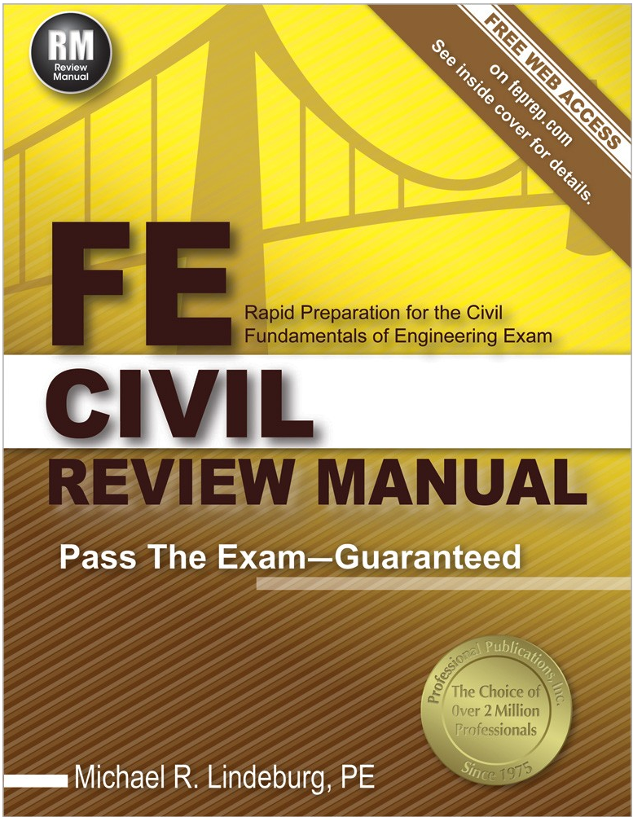
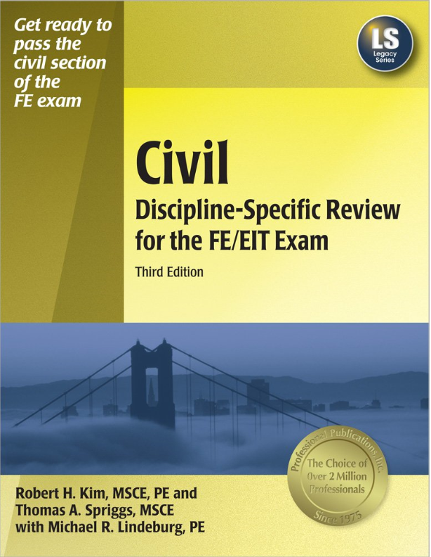
OLD BOOKS PROFESSIONAL PUBLICATIONS, INC. (PPI)
$160.00 (2014)
$65.00 (2009)

Slide 37
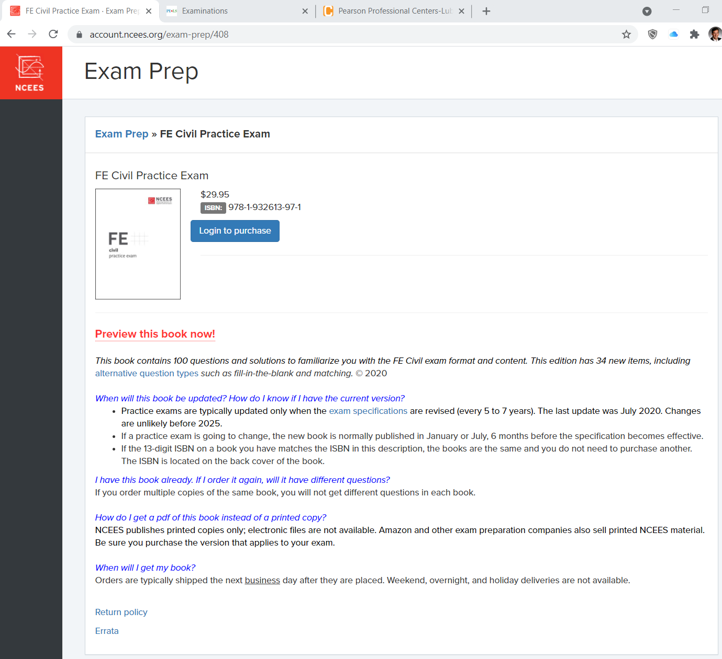
3. NCEES FE PRACTICE EXAM

Slide 38
Other Exam Prep Materials
Other materials available from PPI
Other materials from other publishers
Lots of old (pre-2020) stuff
FE review courses

Slide 39
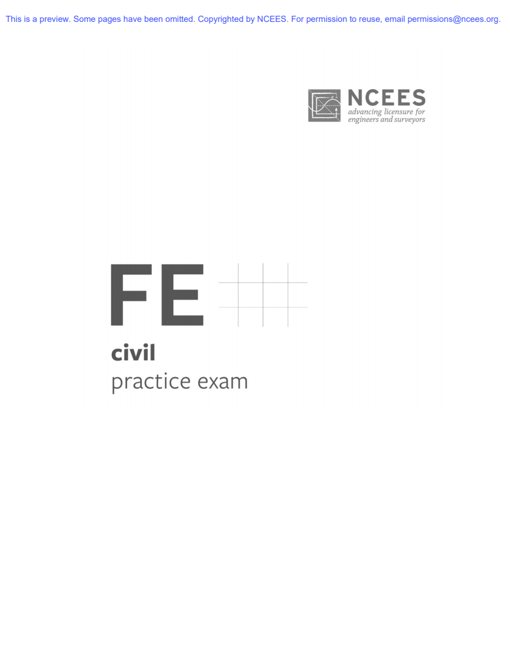
The FE Books You NEED

Slide 40
Mr. Miyagi’s rules to pass FE Exam
Rule No. 1- Study…

Slide 41
6. FE Exam Performance by CE Students
FE EXAM DISCUSSION CECE DEPARTMENT TEXAS TECH UNIVERSITY

Slide 42
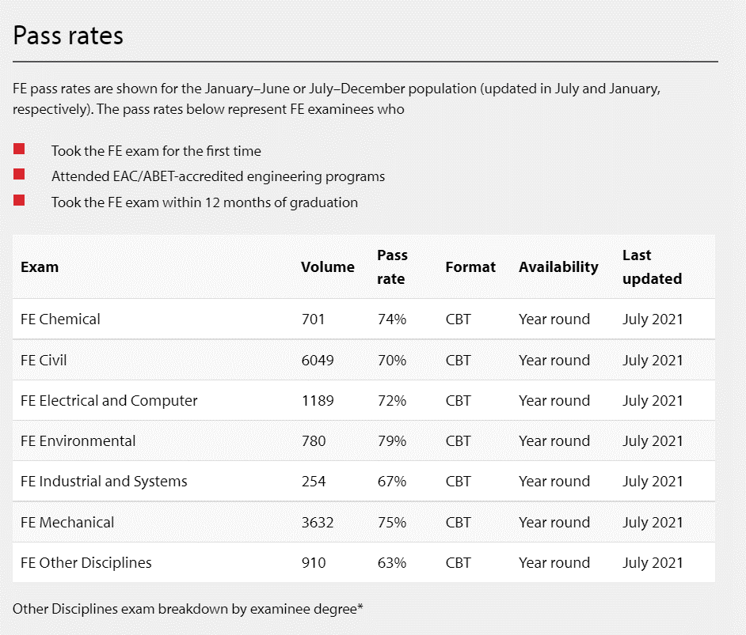
Current FE Pass Rates, per NCEES

Slide 43
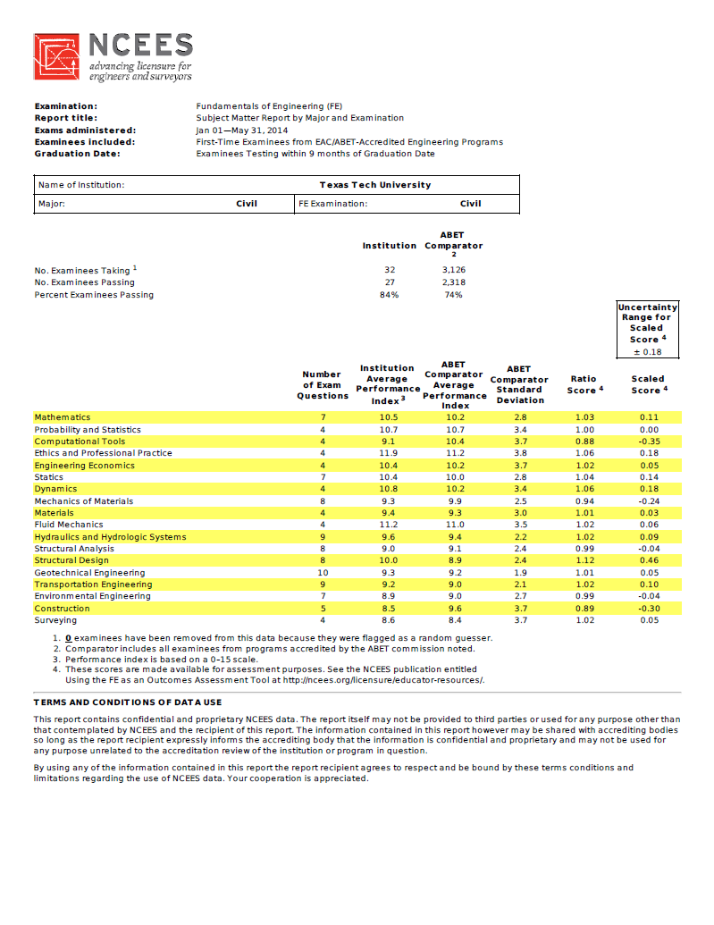

Slide 44
TTU Carnegie Comparators Carnegie Classification: Prof+A&S/HGC Professions plus arts & sciences, high graduate coexistence “60–79 percent of bachelor’s degree majors were in professional fields, and graduate degrees were observed in at least half of the fields corresponding to undergraduate majors.”
Institution | Location | Control
Auburn University Main Campus | Auburn University, Alabama | Public
Boricua College | New York, New York | Private not-for-profit
California State University-Los Angeles | Los Angeles, California | Public
Capella University | Minneapolis, Minnesota | Private for-profit
Clemson University | Clemson, South Carolina | Public
Cooper Union for the Advancement of Science and Art | New York, New York | Private not-for-profit
Drexel University | Philadelphia, Pennsylvania | Private not-for-profit
Duquesne University | Pittsburgh, Pennsylvania | Private not-for-profit
East Carolina University | Greenville, North Carolina | Public
Eastern Michigan University | Ypsilanti, Michigan | Public
Emerson College | Boston, Massachusetts | Private not-for-profit
Florida Atlantic University | Boca Raton, Florida | Public
Florida Institute of Technology | Melbourne, Florida | Private not-for-profit
Florida International University | Miami, Florida | Public
Georgia Institute of Technology-Main Campus | Atlanta, Georgia | Public
Howard University | Washington, District of Columbia | Private not-for-profit
Illinois Institute of Technology | Chicago, Illinois | Private not-for-profit
Illinois State University | Normal, Illinois | Public
Indiana University-Purdue University-Indianapolis | Indianapolis, Indiana | Public
Inter American University of Puerto Rico-Metro | San Juan, Puerto Rico | Private not-for-profit
Iowa State University | Ames, Iowa | Public
Kansas State University | Manhattan, Kansas | Public
Kent State University Kent Campus | Kent, Ohio | Public
Institution | Location | Control
Lehigh University | Bethlehem, Pennsylvania | Private not-for-profit
Long Island University-Brooklyn Campus | Brooklyn, New York | Private not-for-profit
Long Island University-C W Post Campus | Brookville, New York | Private not-for-profit
Marywood University | Scranton, Pennsylvania | Private not-for-profit
Mississippi College | Clinton, Mississippi | Private not-for-profit
Mississippi State University | Mississippi State, Mississippi | Public
Montana State University | Bozeman, Montana | Public
New Jersey Institute of Technology | Newark, New Jersey | Public
New Mexico State University-Main Campus | Las Cruces, New Mexico | Public
Northcentral University | Prescott Valley, Arizona | Private for-profit
Ohio University-Main Campus | Athens, Ohio | Public
Oklahoma State University-Main Campus | Stillwater, Oklahoma | Public
Oregon State University | Corvallis, Oregon | Public
Pennsylvania State University-Main Campus | University Park, Pennsylvania | Public
Polytechnic Institute of New York University | Brooklyn, New York | Private not-for-profit
Pratt Institute-Main | Brooklyn, New York | Private not-for-profit
Purdue University-Main Campus | West Lafayette, Indiana | Public
Rensselaer Polytechnic Institute | Troy, New York | Private not-for-profit
Rochester Institute of Technology | Rochester, New York | Private not-for-profit
Saint Louis University-Main Campus | Saint Louis, Missouri | Private not-for-profit
San Jose State University | San Jose, California | Public
Silicon Valley University | San Jose, California | Private not-for-profit
Southern Illinois University Carbondale | Carbondale, Illinois | Public
Carnegie Foundation identifies 72 universities, 47 public and 25 private, for the Prof+A&S/HGC classification. Comparators such as Texas A&M University, The University of Texas at Austin, are “Bal/HGC”, “Balanced arts & sciences/professions, high graduate coexistence.” Classification is based on data from 2008 and 2010. Note: this differs from the previous NCECES comparator classification, “Carnegie Research/Doctoral Extensive”.

Slide 45
TTU Carnegie Comparators, cont’d Carnegie Classification: Prof+A&S/HGC Professions plus arts & sciences, high graduate coexistence “60–79 percent of bachelor’s degree majors were in professional fields, and graduate degrees were observed in at least half of the fields corresponding to undergraduate majors.”
Institution | Location | Control
Temple University | Philadelphia, Pennsylvania | Public
Texas A & M International University | Laredo, Texas | Public
Texas Tech University | Lubbock, Texas | Public
The University of Alabama | Tuscaloosa, Alabama | Public
The University of Texas at El Paso | El Paso, Texas | Public
University of Akron Main Campus | Akron, Ohio | Public
University of Alabama in Huntsville | Huntsville, Alabama | Public
University of Arkansas | Fayetteville, Arkansas | Public
University of Central Florida | Orlando, Florida | Public
University of Cincinnati-Main Campus | Cincinnati, Ohio | Public
University of Idaho | Moscow, Idaho | Public
University of Maine | Orono, Maine | Public
University of Nebraska-Lincoln | Lincoln, Nebraska | Public
Institution | Location | Control
University of Nevada-Las Vegas | Las Vegas, Nevada | Public
University of North Dakota | Grand Forks, North Dakota | Public
University of South Carolina-Columbia | Columbia, South Carolina | Public
University of Southern Mississippi | Hattiesburg, Mississippi | Public
University of the West | Rosemead, California | Private not-for-profit
University of Toledo | Toledo, Ohio | Public
University of Wyoming | Laramie, Wyoming | Public
Utah State University | Logan, Utah | Public
Western Illinois University | Macomb, Illinois | Public
Western Michigan University | Kalamazoo, Michigan | Public
Wheelock College | Boston, Massachusetts | Private not-for-profit
Wichita State University | Wichita, Kansas | Public
Worcester Polytechnic Institute | Worcester, Massachusetts | Private not-for-profit
Carnegie Foundation identifies 72 universities, 47 public and 25 private, for the Prof+A&S/HGC classification. Comparators such as Texas A&M University, The University of Texas at Austin, are “Bal/HGC”, “Balanced arts & sciences/professions, high graduate coexistence.” Classification is based on data from 2008 and 2010. Note: this differs from the previous NCECES comparator classification, “Carnegie Research/Doctoral Extensive”.

Slide 46
20+ YEARS FE PASS RATE DATA TTU Civil Engineering Program Performance
2014
CBT
EXAM
FORMAT
2020 CBT
EXAM
FORMAT

Slide 47
7. Professional Philosophy toward the FE Exam
FE EXAM DISCUSSION CECE DEPARTMENT TEXAS TECH UNIVERSITY

Slide 48
FE Exam Initiative (1999)
The College of Engineering encourages our engineering students to graduate with their engineering degrees and become licensed professional engineers. We strongly encourage those students who intend to take the exam to prepare for it and take it successfully. We do not encourage students to approach the FE Exam in cavalier fashion, to make “trial runs” at the exam, or to take the exam without adequately preparing for it.

Slide 49
College Performance Comparison with Peer Universities Percentage of Engr. Students Taking FE Exam
Avg=72%
Percentage of Students
Avg=34%
Academic Year
Percentage = (Exam Takers/ BS Engineering Degrees Awarded) *100
No. of students taking the FE… based on NCECES data
No. of students receiving BS degrees in engineering… based onTHECB data (does not include engineering technology).

Slide 50
Civil Engineering Program TTU Engineering Students Taking FE Exam CE Students Taking CIVIL PM Discipline-Specific Exam
Avg=62
Avg=61
Number of TTU…
Academic Year

Slide 51
BEST IN CLASS PERFORMANCE…

Slide 52
8. educational Philosophy toward the FE Exam
FE EXAM DISCUSSION CECE DEPARTMENT TEXAS TECH UNIVERSITY

Slide 53
CECE Curriculum attention to the FE Exam
Share the FE Exam Specification with all CECE instructors, esp. for CECE Discipline-Specific topics to promote awareness of the topics relative to the FE Exam
CE 4200… students enroll 1 semester prior to graduation; focus on FE awareness and relearning/reviewing problem subjects
CE 4000… students enroll graduating semester; focus on FE preparation and reviewing problem subjects
FE Exam data are part of our ABET accreditation report

Slide 54
Civil Engineering Curriculum
CE 4000
FE Exam Review

Slide 55
CE 4200 Professional Engineering Practice Issues
About 10 percent of the content focuses on FE Exam topics
Includes a half-length (Mock) FE Exam
Provides diagnostic information as a pathway to student preparation for the real FE Exam

Slide 56
CE 4000 (formerly, CE 4101) “The FE Review Course”
Going toward “Elective” Online Course
Curriculum Design:
Review
Re-Learn
Learn
All Topics Covered
Mock FE (differs from CE 4200)
DELETED

Slide 57
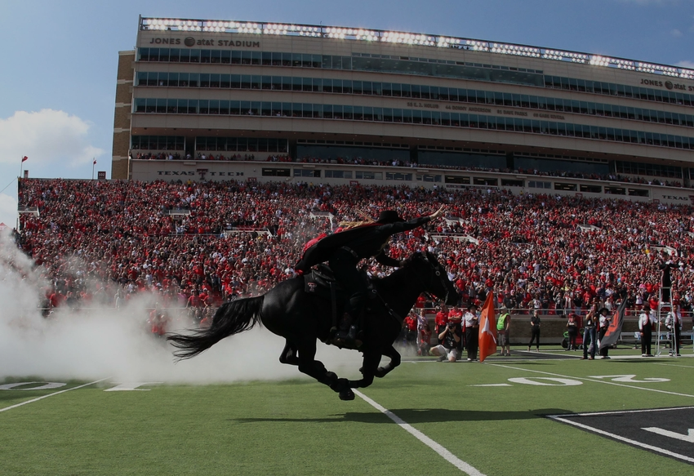
HOW IT’S DONE…
Plan to take the FE Exam while you are still a student
ONE SEMESTER BEFORE GRADUATION
Learn about the FE Exam as per the introduction in CE 4200
Use CE 4200 Mock FE as a diagnostic exercise, to guide your FE Exam preparation and study
YOUR GRADUATING SEMESTER
Take the FE Review Course
Focus your study on key topics, review & relearn
Use the CE 4000 Mock FE as confirmation you are ready to take the real FE
When you know the material, take the FE Exam

Slide 58
An FE Preparation Continuum Civil Engineering Curriculum, Texas Tech University
LESS MORE
SELF PREPARE: ON YOUR OWN
SELF- PREPARE: SOME FACULTY GUIDANCE
SELF- PREPARE: REVIEW MATERIALS PROVIDED
SELF- PREPARE: ONLINE LECTURES PROVIDED
SELF- PREPARE: GUEST LECTURES PROVIDED
CE 4200 REC’M (SOME TOPICS)
CE 4200 REQ’D (SOME TOPICS)
CE 4101 REC’M (ALL TOPICS)
CE 4101 REQ’D (ALL TOPICS)
CE 4200, CE 4101 REC’M
CE 4200, CE 4101 REQ’D
FE REQ’D TO GRADUATE

Slide 59
end
FE EXAM DISCUSSION CECE DEPARTMENT TEXAS TECH UNIVERSITY

