Slide 1
CE 3372 Water Systems Design
Lecture 19: SWMM hydrology

Slide 2
SWMM as Hydrologic Model
Sub-catchments
Infiltration model (runoff generation)
Raingages
Time-series of rainfall (hyetograph)

Slide 3
SWMM as Hydrologic Model
Size pipes so that velocity is 3-7 ft/sec
Slope no greater than 0.01
2.5 acres
40% Impervious
250 ft
S₀=0.01
4.0 acres
500 ft
475 ft
15% impervious
S₀=0.01
700 ft
30 ft

Slide 4
SWMM as Hydrologic Model
Load the picture into SWMM

Slide 5
SWMM as Hydrologic Model
3 Nodes + Outfall

Slide 6
SWMM as Hydrologic Model
Invert elevations
(example, these would be design values, except for outfall, adjust to get velocity)
Outfall = 0
Node 3 = 700*(0.01)=7 ft
Offset of 2 ft
Node 2 = 7+2+0.01(30) = 9.3
Node 1 = 7+2+0.01(500) = 14

Slide 7
SWMM as Hydrologic Model
3 Pipes, 24” diameter, concrete (n=0.013)

Slide 8
SWMM as Hydrologic Model
2 sub-catchments

Slide 9
SWMM as Hydrologic Model
Choose a Runoff Generation Mechanism!
For this scale Rational is logical, but not part of SWMM – need a hack!

Slide 10
Hacking Rational Method in SWMM
Runoff Generation
No explicit rational method for runoff generation
Horton, Green-Ampt, and CN.

Slide 11
Hacking Rational Method in SWMM
Suppose we want to simulate a 10.9 acre drainage area, with Tc =49 minutes, and C=0.32 and applied rain depth is 0.87 inches.
I = 0.87inches/49min X 60 min/hr = 1.06 in/hr
Qp = (0.32)(1.06)(10.9) = 3.7 cfs
Notes:
No need for SWMM to compute Qp, unless we need to study hydraulics later!
Here’s how. Build an equibvalent SWMM model

Slide 12
Hacking Rational Method in SWMM
Equivalent SWMM model:
Raingage
Catchment
Outlet
Notes:
No need for SWMM to compute Qp, unless we need to study hydraulics later!
Here’s how. Build an equibvalent SWMM model

Slide 13
Hacking a Rational Method in SWMM
Equivalent SWMM model:
Raingage ➔ Constant intensity of 1.06 in.hr
Catchment ➔ Area = 10.9 acres
Outlet
Notes:
No need for SWMM to compute Qp, unless we need to study hydraulics later!
Here’s how. Build an equibvalent SWMM model

Slide 14
Hacking a Rational Method in SWMM
Raingage ➔ Constant intensity of 1.06 in/hr
Notes:
No need for SWMM to compute Qp, unless we need to study hydraulics later!
Here’s how. Build an equibvalent SWMM model

Slide 15
Hacking Rational Method in SWMM
Catchment ➔ Set size, set to 100% impervious
Run to adjust width & slope
Arrival time of Qp at 50 minutes
Qp = 11.65 cfs (C=1)
Notes:
No need for SWMM to compute Qp, unless we need to study hydraulics later!
Here’s how. Build an equibvalent SWMM model

Slide 16
Hacking a Rational Method in SWMM
Catchment ➔ Set size, set to 100% impervious
Width = 1500
Arrival time of Qp at 50 minutes
Qp = 11.65 cfs (C=1)
Notes:
No need for SWMM to compute Qp, unless we need to study hydraulics later!
Here’s how. Build an equibvalent SWMM model

Slide 17
Hacking a Rational Method in SWMM
Catchment ➔ Adjust
Infiltration rates to be large
Set %impervious = runoff coefficient, C
Max and Min > 1.06 in/hr
Ensures all rain on pervious will infiltrate
Correct Qp
May want to adjust width once more to get timing about right – Just hacked Q=CiA into SWMM!
Notes:
No need for SWMM to compute Qp, unless we need to study hydraulics later!
Here’s how. Build an equibvalent SWMM model

Slide 18
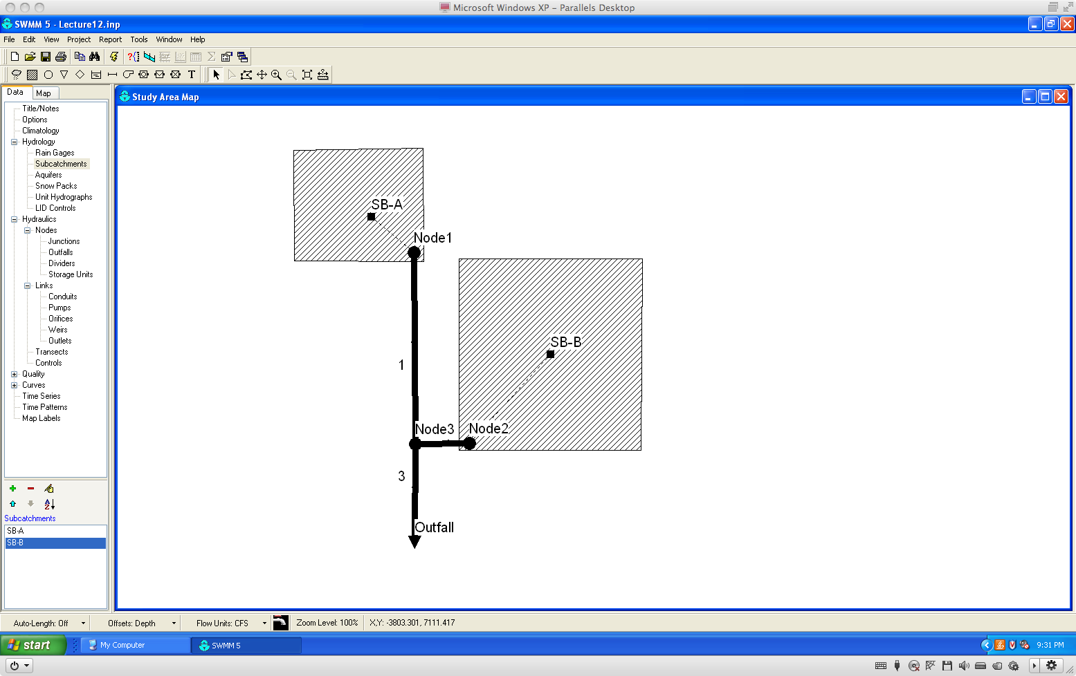
SWMM as Hydrologic Model
Suppress background, check layout

Slide 19
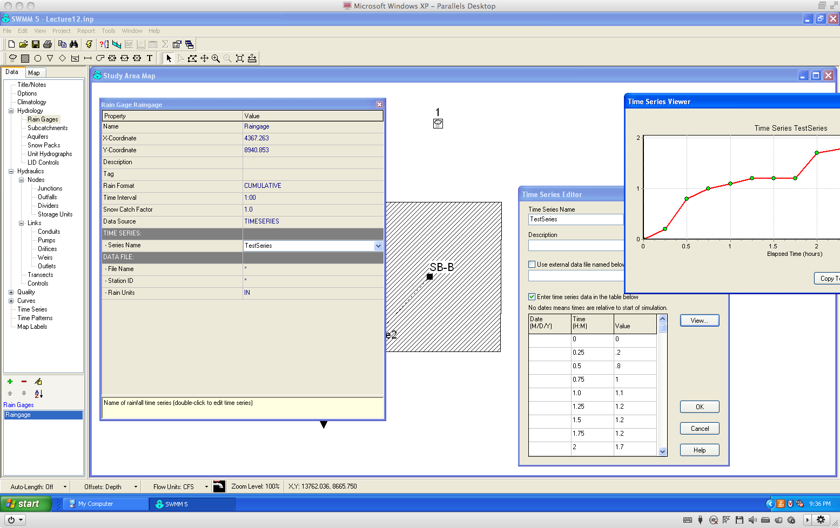
SWMM as Hydrologic Model
Insert a raingage

Slide 20
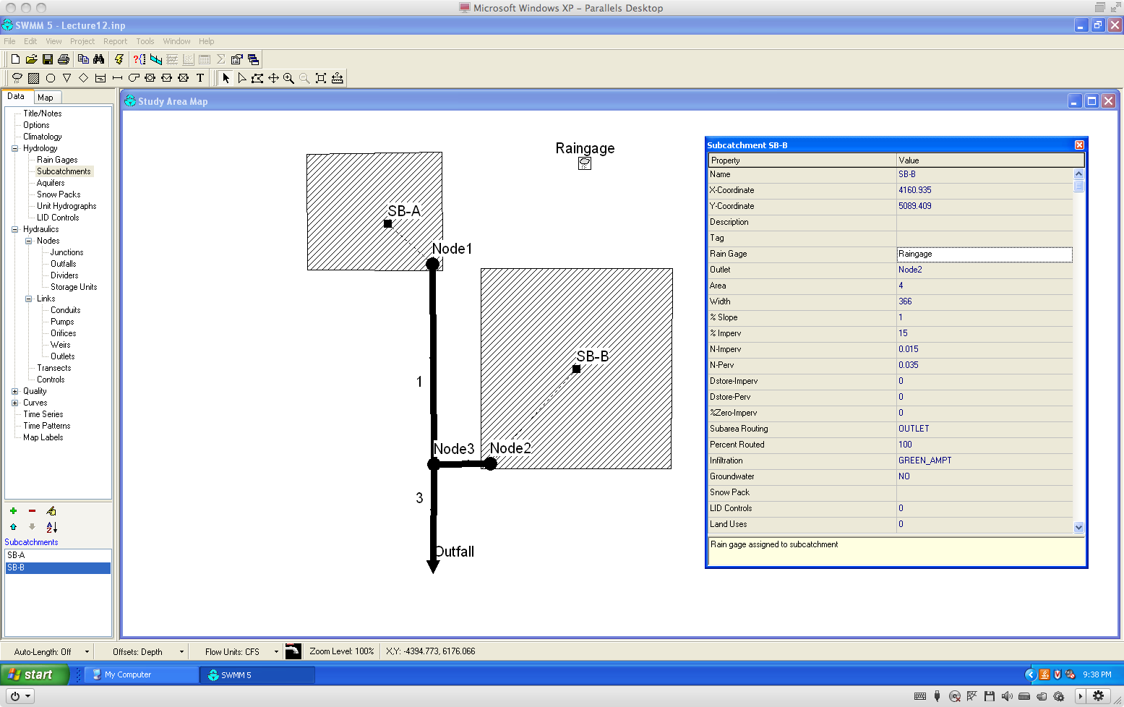
SWMM as Hydrologic Model
Apply the raingage to the sub-catcments

Slide 21
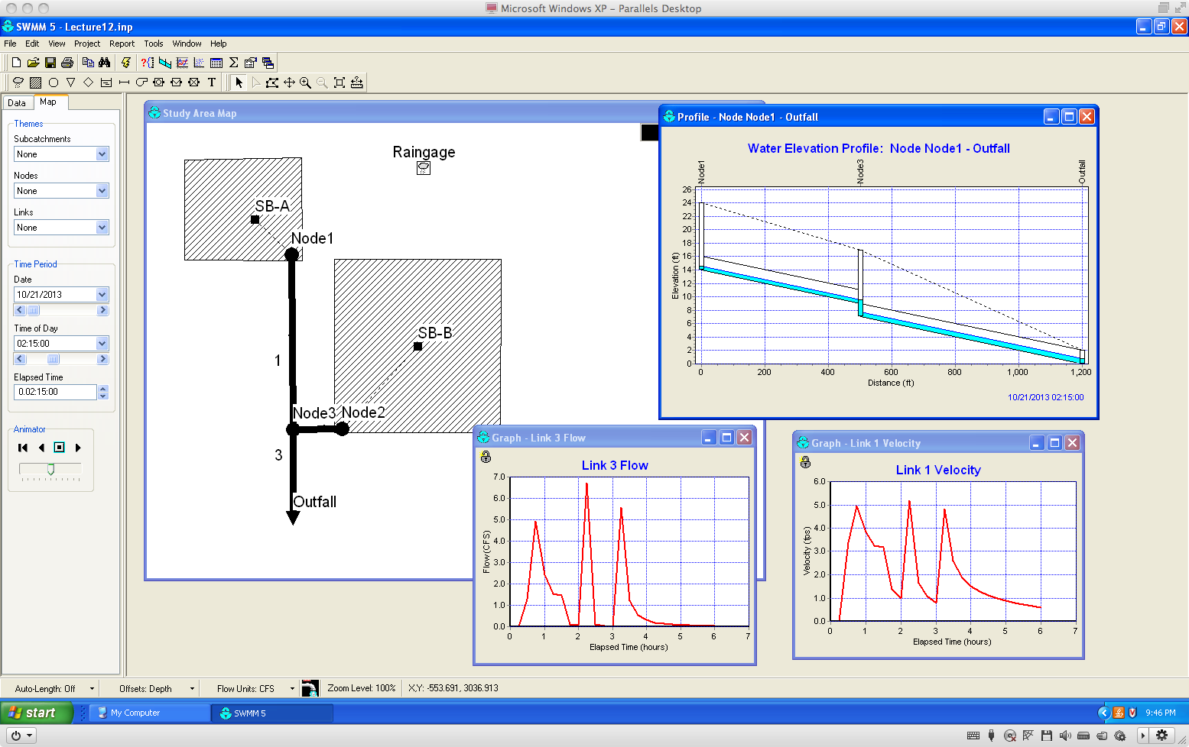
SWMM as Hydrologic Model
Set the time window, and run the model

Slide 22
SWMM as Hydrologic Model
For larger scale (lots of small catchments) there will be a desire to use SCS storms or even historical events to evaluate the design.
The next example illustrates how to use HEC-HMS as a tool to generate rainfall for use in SWMM.

Slide 23
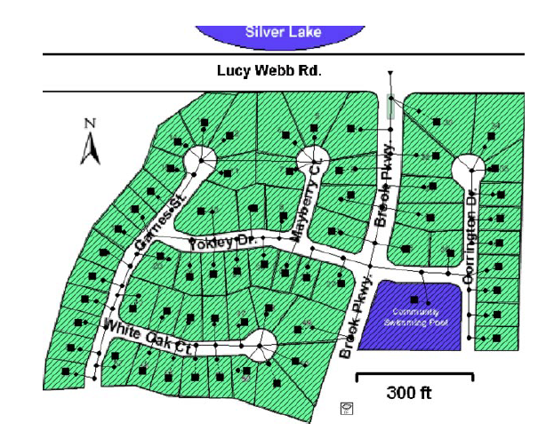
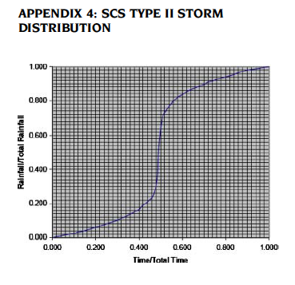
SWMM as Hydrologic Model

Slide 24
SWMM as Hydrologic Model
Assign a storm to a raingage
Suppose instructed to use SCS-Type II storm and parameterize for San Antonio, Texas
SCS Storms are built-in to HEC-HMS, so take advantage of that to generate a rainfall time series for SWMM

Slide 25
SWMM as Hydrologic Model
How to generate SCS Type storms
Select Annual Exceedance Probability (AEP) or Annual Recurrence Interval (ARI)
Look up 24 hour depth for the ARI and location
Generate 24 hour storm using SCS tabulations or HEC-HMS
Put the time series into SWMM and run the hydraulics

Slide 26
SWMM as Hydrologic Model
How to generate SCS Type storms
Select Annual Exceedance Probability (AEP) or Annual Recurrence Interval (ARI)
Given in the project statement, a 10% chance AEP or 10-year ARI (same probability) is specified.

Slide 27
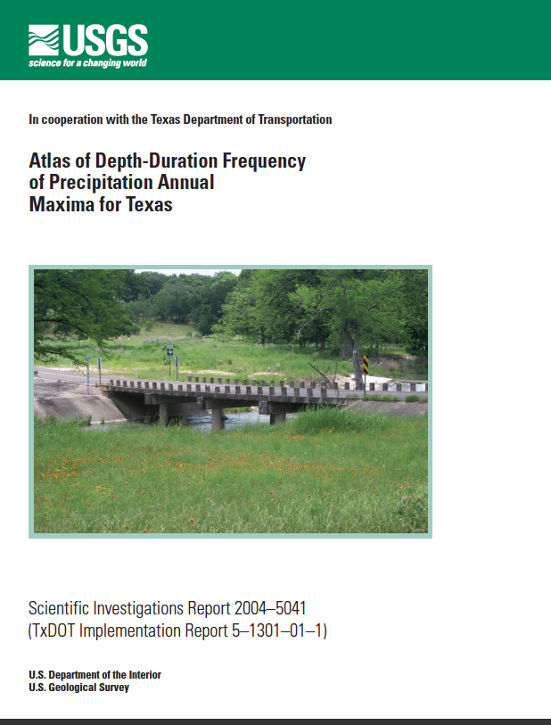
SWMM as Hydrologic Model
How to generate SCS Type storms
Look up 24 hour storm depth for the AEP/ARI and location

Slide 28
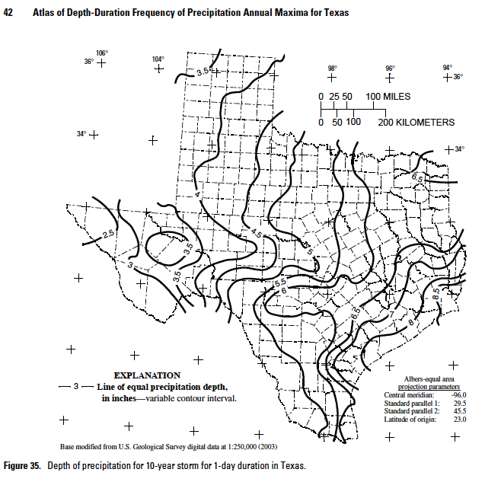

Slide 29
SWMM as Hydrologic Model
How to generate SCS Type storms
Select Annual Exceedance Probability (AEP) or Annual Recurrence Interval (ARI)
Look up 24 hour depth for the ARI and location
6 inches for Bexar County, TX

Slide 30
SWMM as Hydrologic Model
How to generate SCS Type storms
Generate 24 hour storm using SCS tabulations or HEC-HMS
Get the SWMM model built
Open HMS and generate a SCS storm from the meterological model

Slide 31
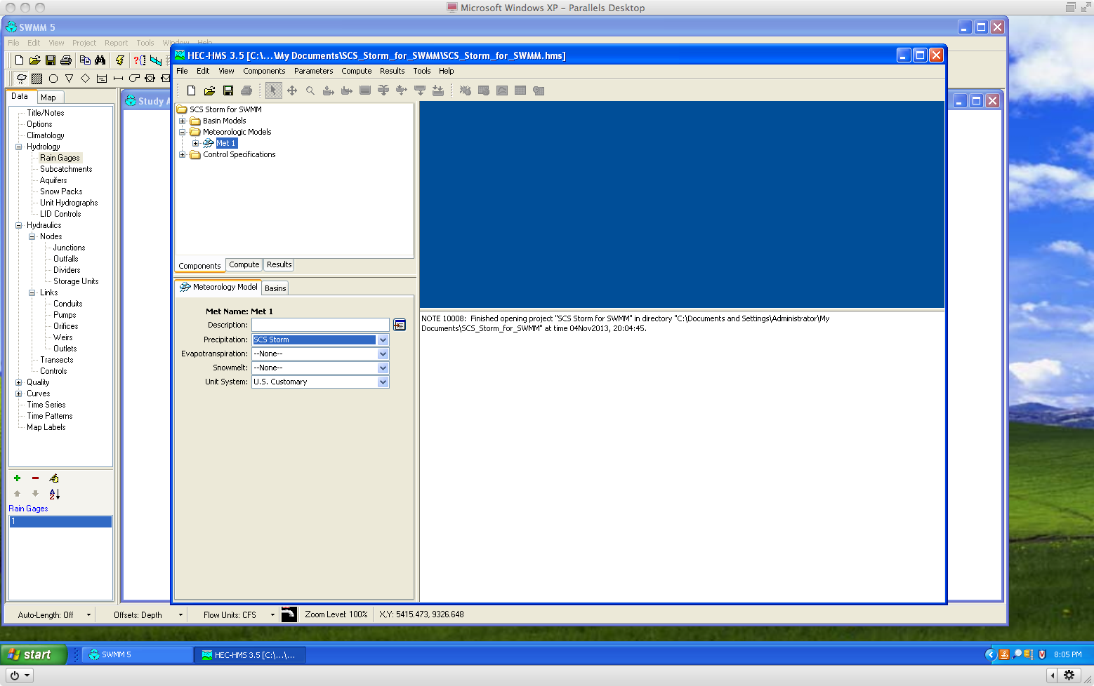
Build a Minimal HEC Model

Slide 32
Build a Minimal HEC Model

Slide 33
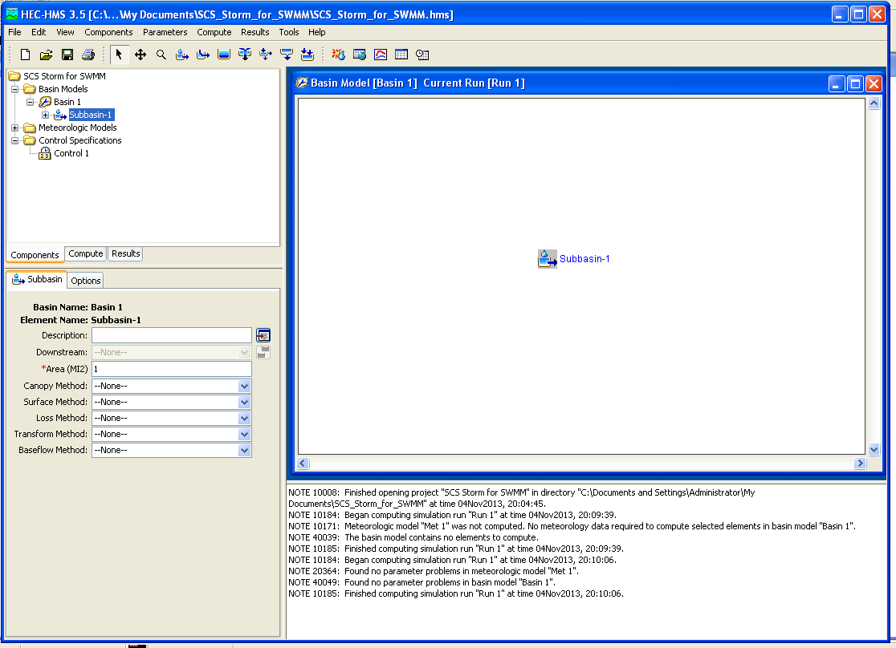
Build a Minimal HEC Model

Slide 34
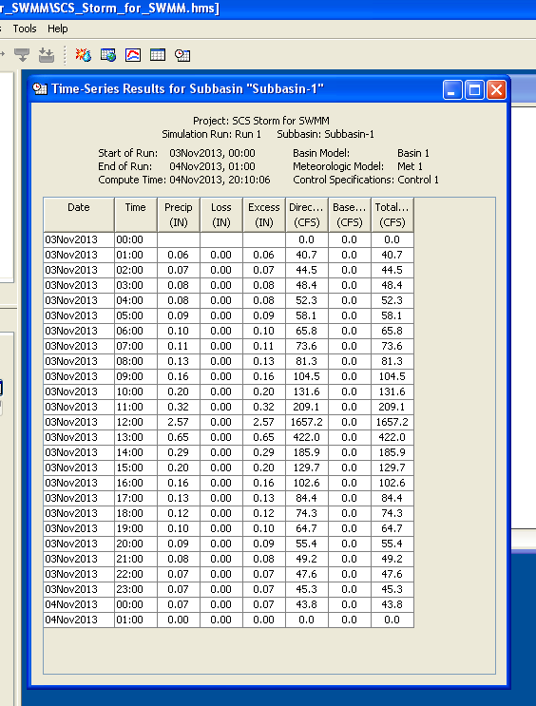
Run the HEC Model

Slide 35
SWMM as Hydrologic Model
Now have SCS Type II in HEC-HMS, only after the two columns in the time series
Now go to the SWMM model and build a raingage to accept the time series

Slide 36
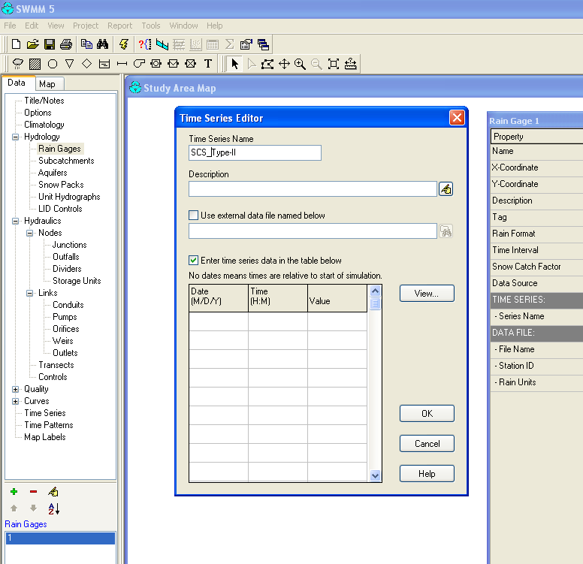
SWMM Raingage

Slide 37
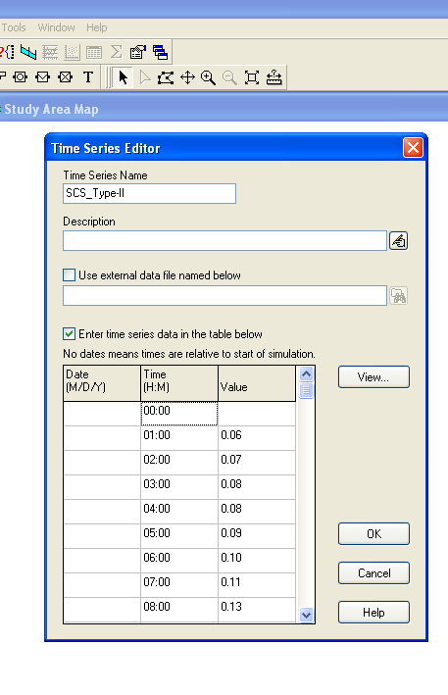
SWMM as Hydrologic Model
Now copy-paste from HMS to SWMM the two columns
Edit to fix the first value
Edit to fix the 24th and 25th hours
Set the time window
Run SWMM

Slide 38
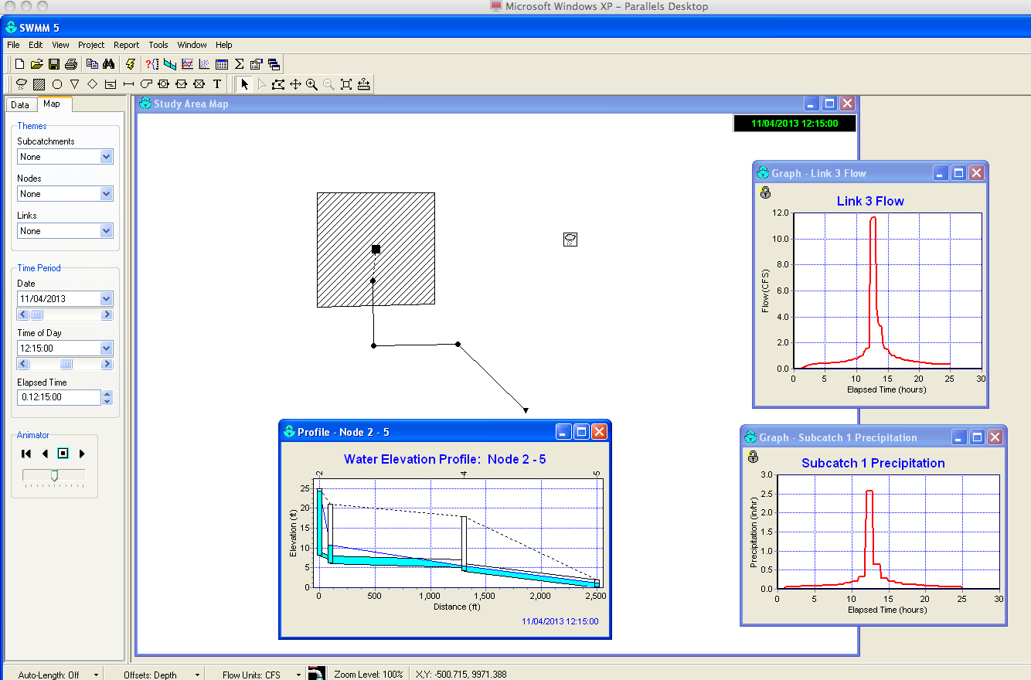
SWMM as Hydrologic Model
Done! Interpret results

Slide 39
SWMM as Hydrologic Model
Showed how to use HMS to generate SWMM input.
SWMM is also handy for generating HMS input
the time arithmetic is more demanding!

Slide 40
Next Time
Conduits in swmm
Invert elevations and offsets
Dual drainage systems

