Slide 1
CE 3372 Water Systems Design
Lesson 18: STORM SEWER DESIGN EXAMPLE (GOODWIN STREET STORM SEWER)

Slide 2
Design storm sewer for Goodwin street
“Rational Method Storm Sewer Design” in Mays, L. W. (2008) Water Resources Engineering. Pearson-Prentice Hall (pp. 613-635)
Method: Rational Equation Design Method to make initial design for subsequent hydraulics analysis

Slide 3
Preparation steps
Identify the individual drainage areas.
Determine the area of each contributing area, in acres. (ENGAUGE, PLANIMETER, etc)
Determine the rational runoff coefficient for each area (TABLE LOOKUP)

Slide 4
DRAINAGE AREA 1.1
Identify the individual drainage areas.

Slide 5
DRAINAGE AREA 1.2
Identify the individual drainage areas.

Slide 6
DRAINAGE AREA 2.1
Identify the individual drainage areas.

Slide 7
DRAINAGE AREA 2.2
Identify the individual drainage areas.

Slide 8
DRAINAGE AREA 3.1
Identify the individual drainage areas.

Slide 9
DRAINAGE AREA 3.2
Identify the individual drainage areas.

Slide 10
DRAINAGE AREA 3.3
Identify the individual drainage areas.

Slide 11
DRAINAGE AREA 4.1
Identify the individual drainage areas.

Slide 12
DRAINAGE AREA 4.2
Identify the individual drainage areas.

Slide 13
DRAINAGE AREA 5.1
Identify the individual drainage areas.

Slide 14
DRAINAGE AREA 5.2
Identify the individual drainage areas.

Slide 15
DRAINAGE AREA 5.3
Identify the individual drainage areas.

Slide 16
DRAINAGE AREA 6.1
Identify the individual drainage areas.

Slide 17
DRAINAGE AREA 7.1
Identify the individual drainage areas.

Slide 18
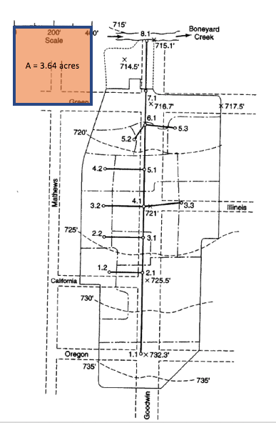
Calibrate area measurement tool
Area =400X400/43560 = 3.67 acres
Measure areas using Acrobat Pro
Need to measure a known area
Save the conversion factor
A = 3.67 acres

Slide 19
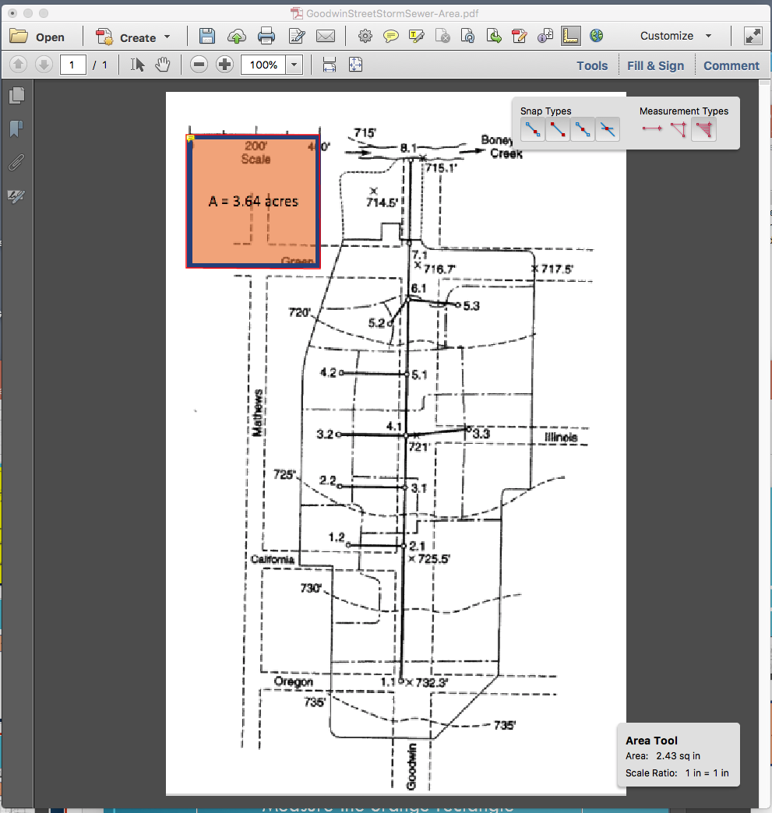
Calibrate area measurement tool
Measure areas using Acrobat Pro
Activate the measurement toolkit
Select Area
Measure the orange rectangle
Save the conversion factor: 2.43 sq.in. == 3.67 acres
A = 3.67 acres

Slide 20
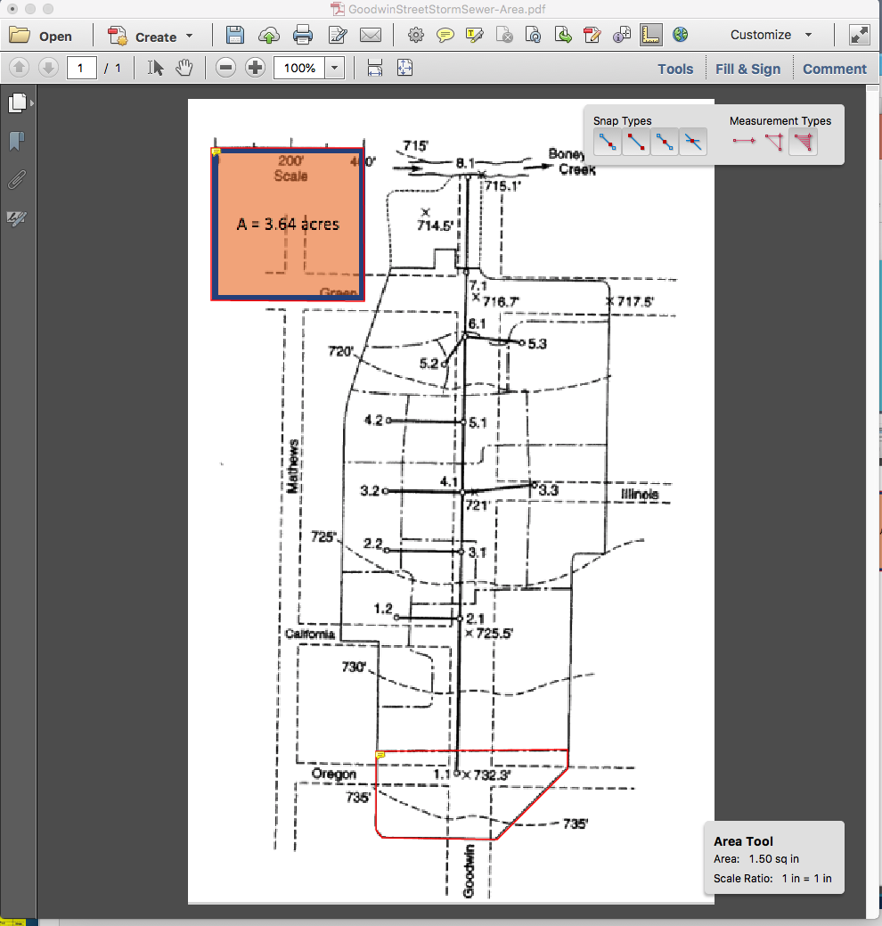
DRAINAGE AREA 1.1
Identify the individual drainage areas.
Determine the area of each contributing area, in acres. (ENGAUGE, PLANIMETER, etc)
Area = 1.50*3.67/2.43 = 2.26 acres
A = 3.67 acres

Slide 21
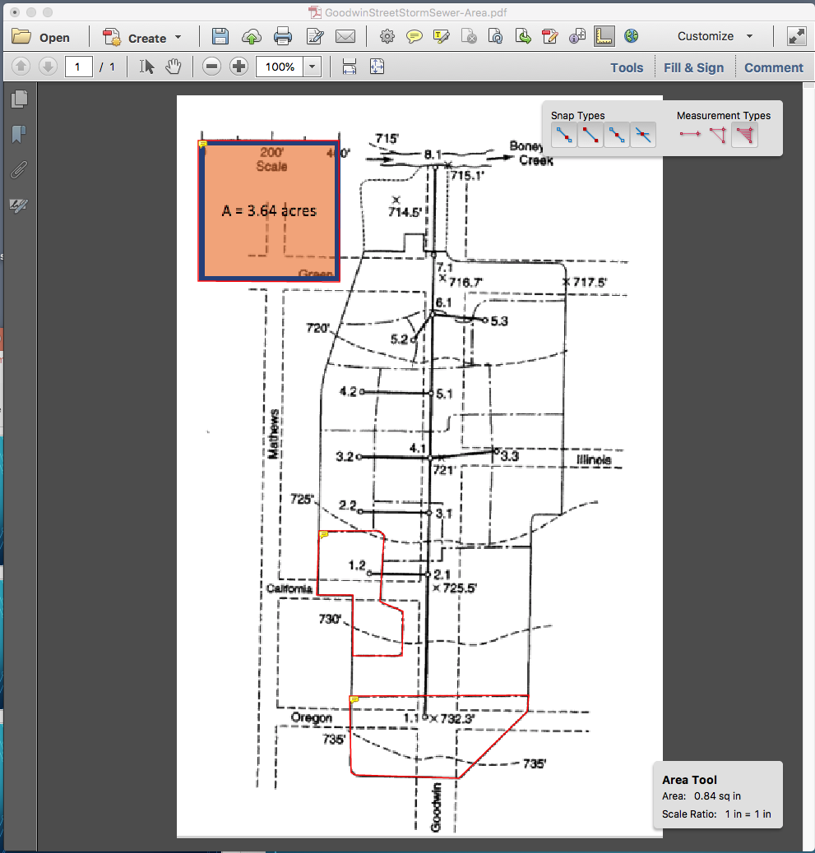
DRAINAGE AREA 1.2
Identify the individual drainage areas.
Determine the area of each contributing area, in acres. (ENGAUGE, PLANIMETER, etc)
Area = 0.84*3.67/2.43 = 1.26 acres
A = 3.67 acres

Slide 22
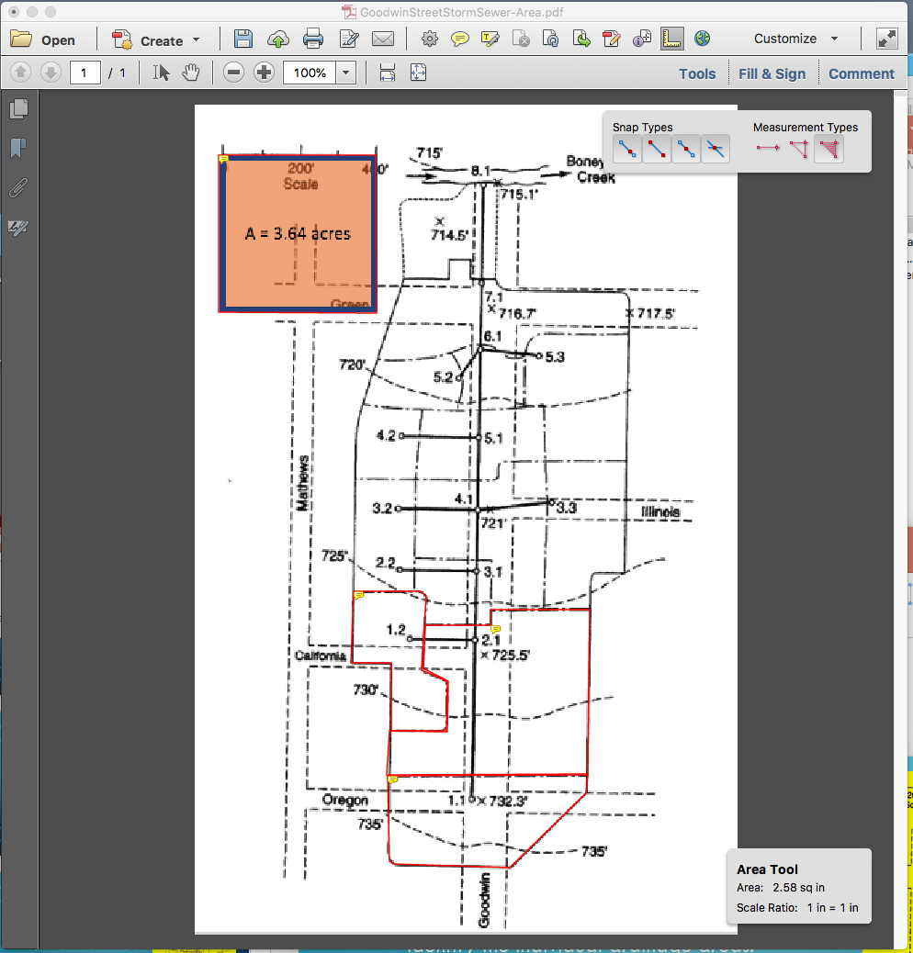
DRAINAGE AREA 2.1
Identify the individual drainage areas.
Determine the area of each contributing area, in acres.
Area = 2.58*3.67/2.43 = 3.89 acres
A = 3.67 acres

Slide 23
DRAINAGE AREA 2.2
Identify the individual drainage areas.
Determine the area of each contributing area, in acres.
Area = 0.35*3.67/2.43 = 0.53 acres
A = 3.67 acres

Slide 24
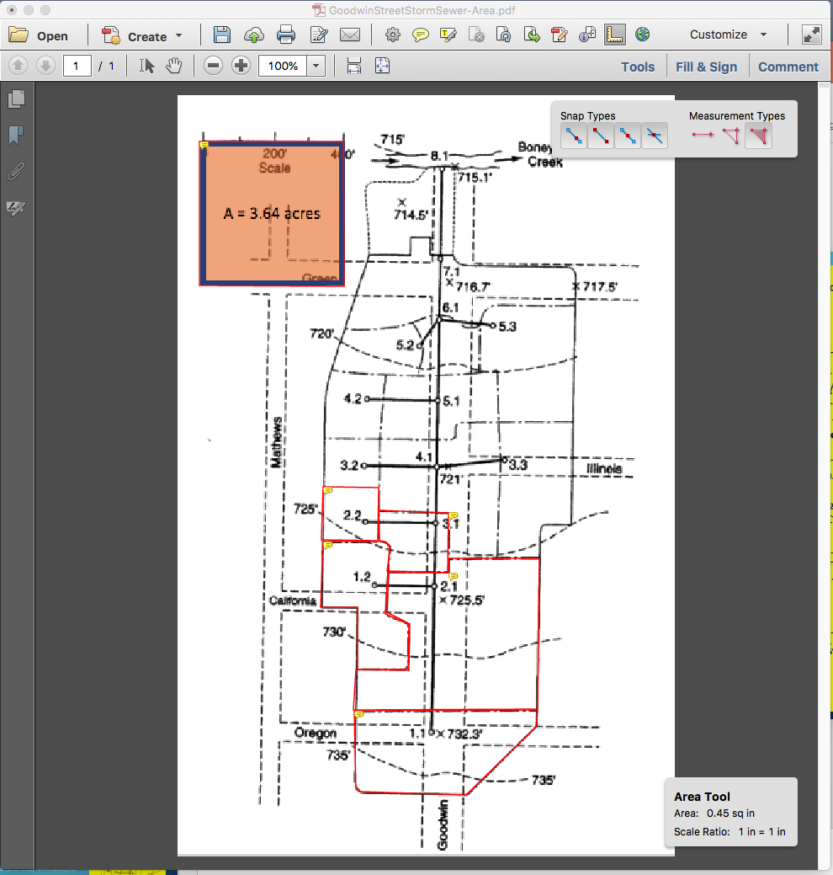
DRAINAGE AREA 3.1
A = 3.67 acres
Identify the individual drainage areas.
Determine the area of each contributing area, in acres.
Area = 0.45*3.67/2.43 = 0.68 acres

Slide 25
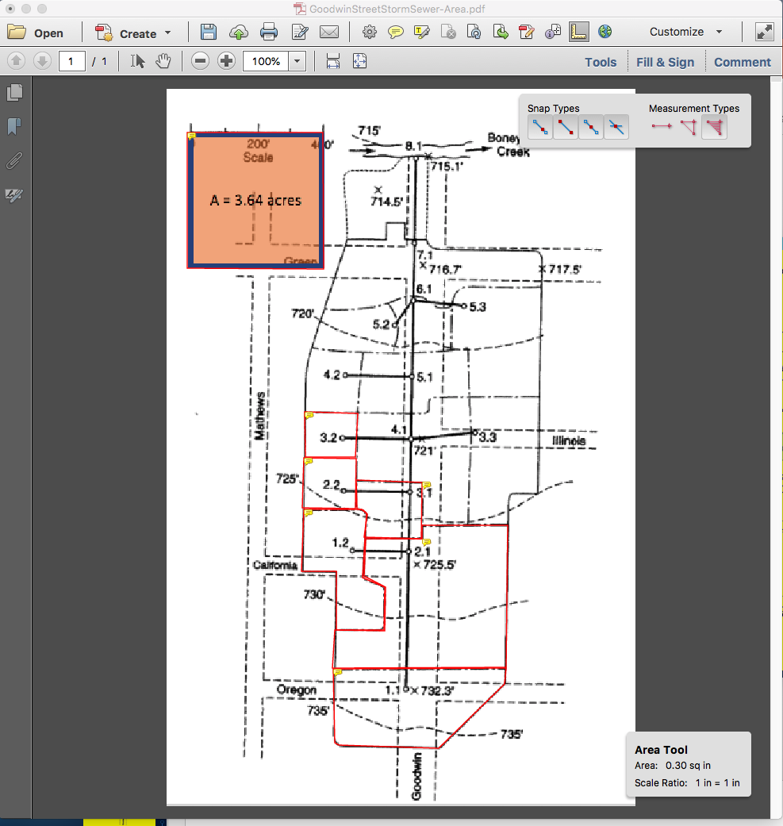
DRAINAGE AREA 3.2
A = 3.67 acres
Identify the individual drainage areas.
Determine the area of each contributing area, in acres.
Area = 0.30*3.67/2.43 = 0.45 acres

Slide 26
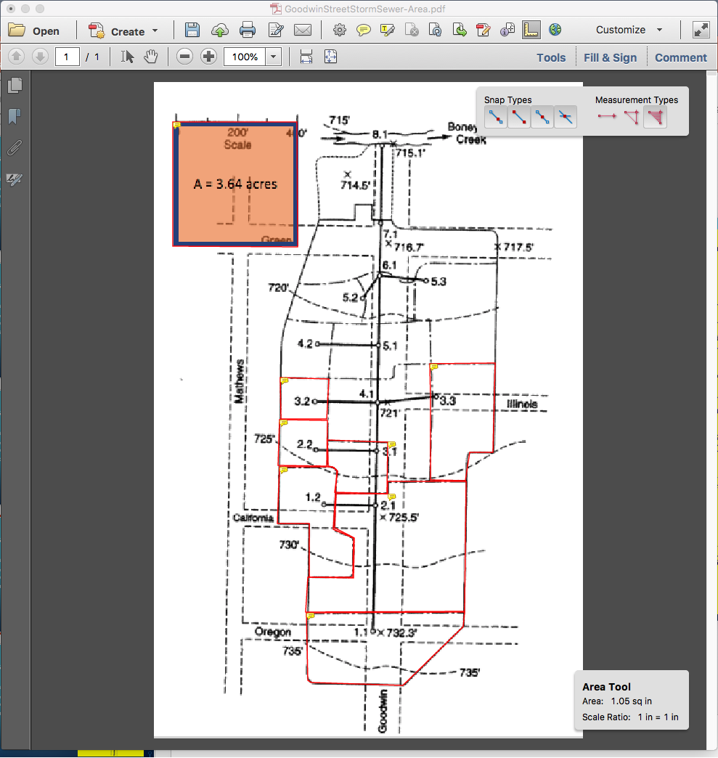
DRAINAGE AREA 3.3
Identify the individual drainage areas.
Determine the area of each contributing area, in acres.
Area = 1.05*3.67/2.43 = 1.58 acres
A = 3.67 acres

Slide 27
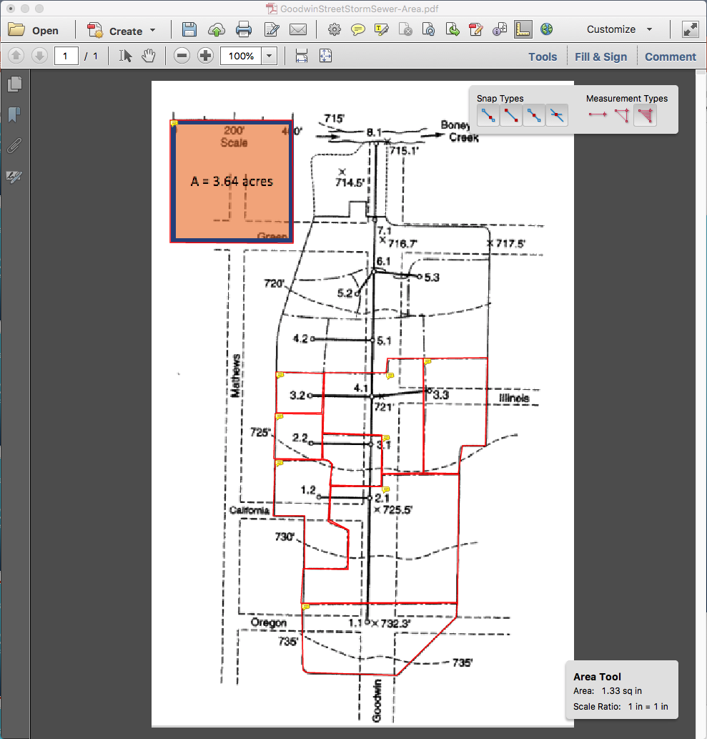
DRAINAGE AREA 4.1
Identify the individual drainage areas.
Determine the area of each contributing area, in acres.
Area = 1.33*3.67/2.43 = 2.01 acres
A = 3.67 acres

Slide 28
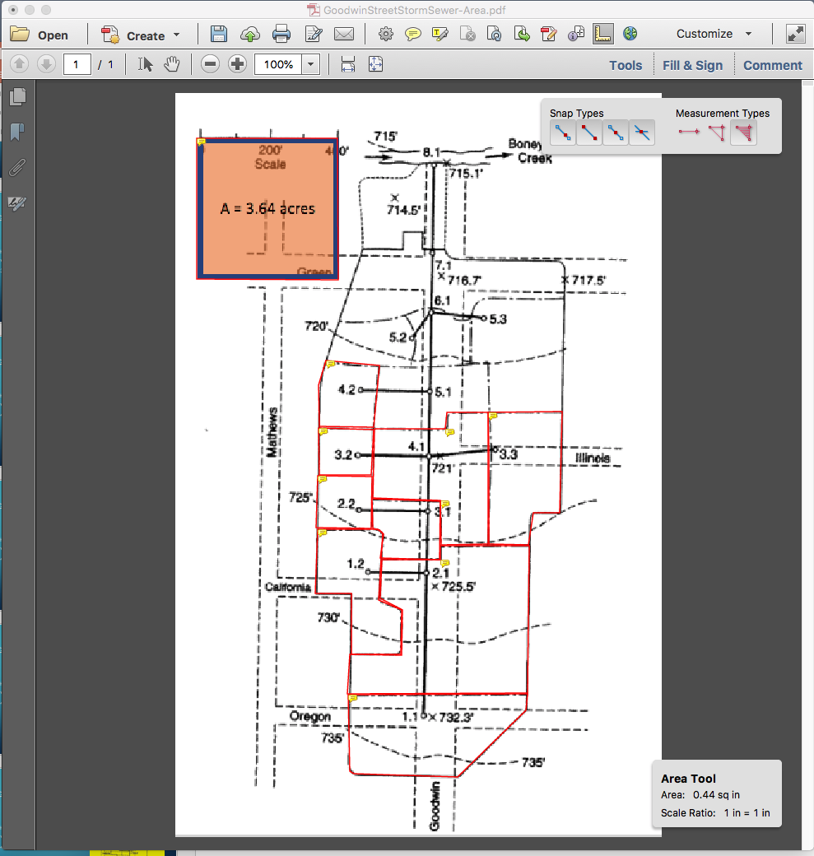
DRAINAGE AREA 4.2
Identify the individual drainage areas.
Determine the area of each contributing area, in acres.
Area = 0.44*3.67/2.43 = 0.66 acres
A = 3.67 acres

Slide 29
DRAINAGE AREA 5.1
Identify the individual drainage areas.
Determine the area of each contributing area, in acres.
Area = 0.78*3.67/2.43 = 1.17 acres
A = 3.67 acres

Slide 30
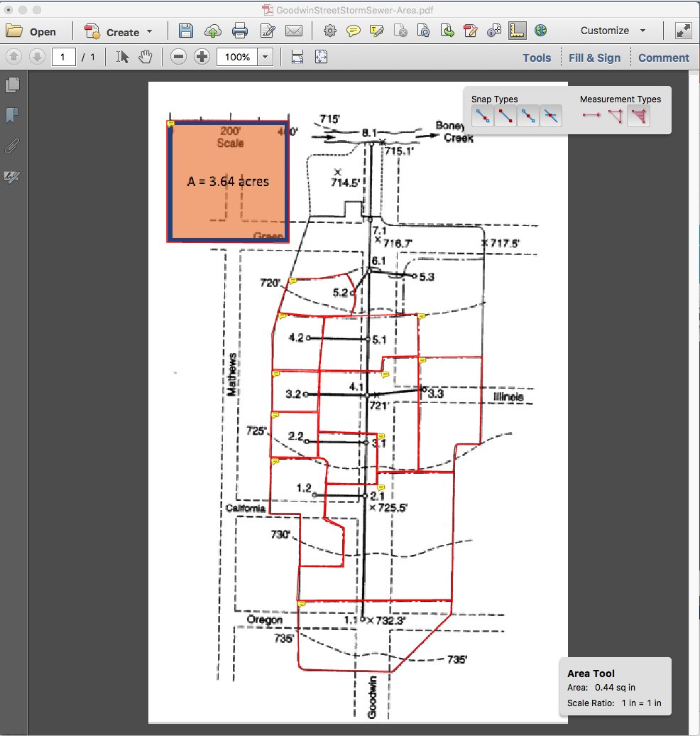
DRAINAGE AREA 5.2
Identify the individual drainage areas.
Determine the area of each contributing area, in acres.
Area = 0.44*3.67/2.43 = 0.66 acres
A = 3.67 acres

Slide 31
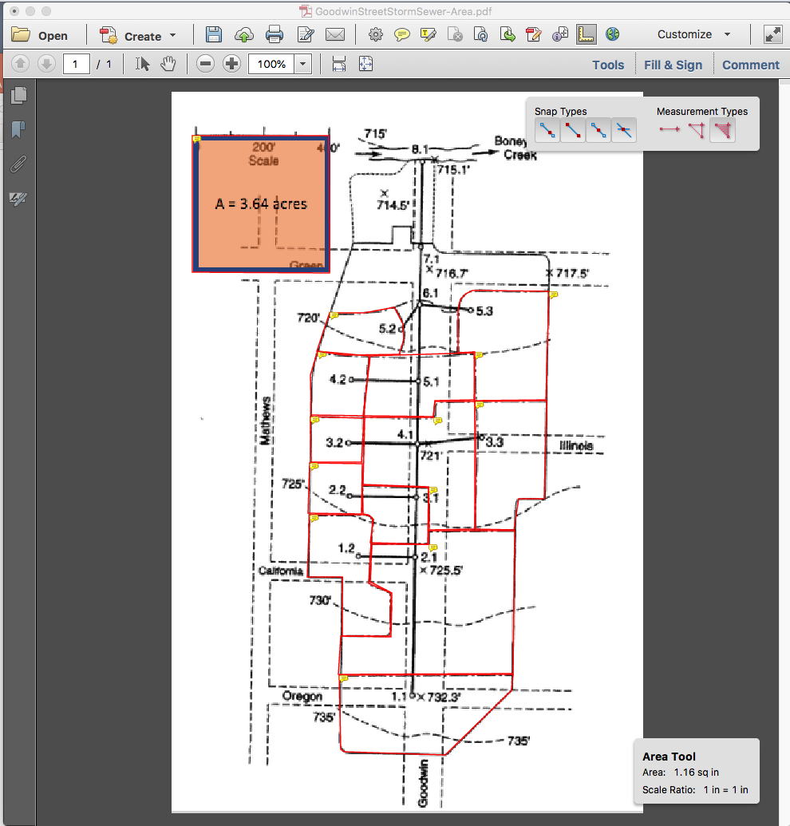
DRAINAGE AREA 5.3
Identify the individual drainage areas.
Determine the area of each contributing area, in acres.
Area = 1.16*3.67/2.43 = 1.75 acres
A = 3.67 acres

Slide 32
DRAINAGE AREA 6.1
A = 3.67 acres
Identify the individual drainage areas.
Determine the area of each contributing area, in acres.
Area = 0.36*3.67/2.43 = 0.54 acres

Slide 33
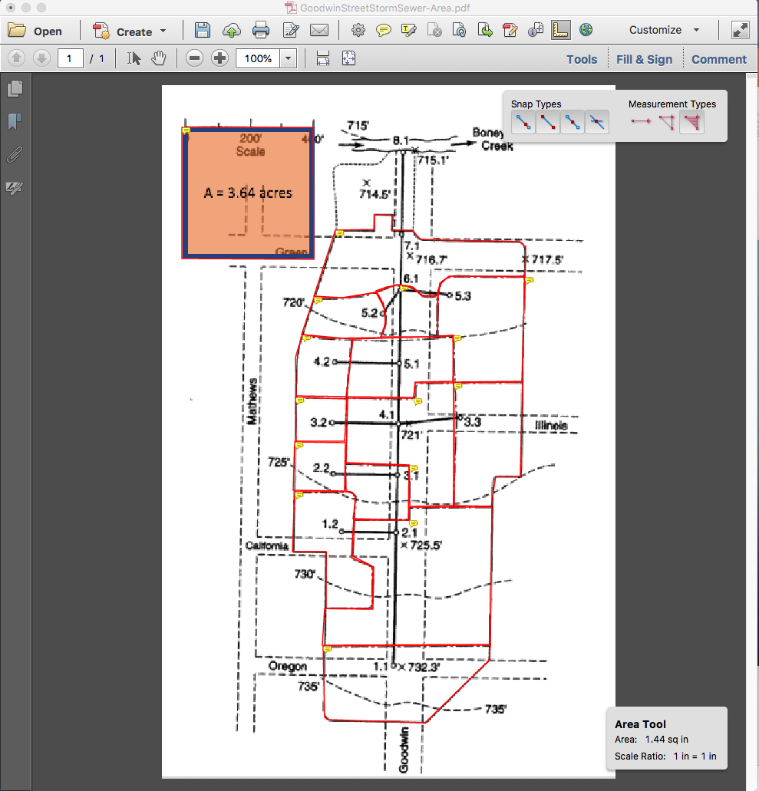
DRAINAGE AREA 7.1
Identify the individual drainage areas.
Determine the area of each contributing area, in acres.
Area = 1.44*3.67/2.43 = 2.17 acres
A = 3.67 acres

Slide 34
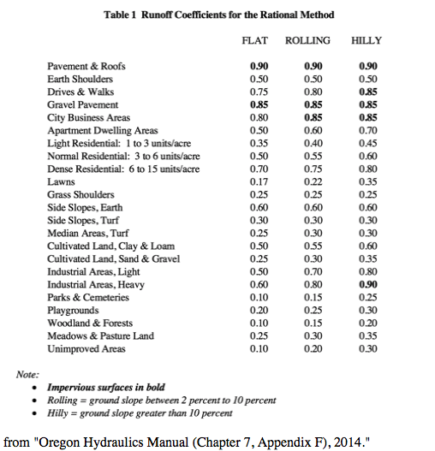
Estimate runoff coefficients
For each area estimate a runoff coefficient
Usually based on a table lookup and surface description

Slide 35
DRAINAGE AREA 1.1
Identify the individual drainage areas.
Determine the area of each contributing area, in acres. (ENGAUGE, PLANIMETER, etc)
Area = 1.50*3.67/2.43 = 2.26 acres
C = 0.65
A = 3.67 acres

Slide 36
DRAINAGE AREA 1.2
Identify the individual drainage areas.
Determine the area of each contributing area, in acres. (ENGAUGE, PLANIMETER, etc)
Area = 0.84*3.67/2.43 = 1.26 acres
C = 0.80
A = 3.67 acres

Slide 37
DRAINAGE AREA 2.1
Identify the individual drainage areas.
Determine the area of each contributing area, in acres.
Area = 2.58*3.67/2.43 = 3.89 acres
C= 0.70
A = 3.67 acres

Slide 38
DRAINAGE AREA 2.2
Identify the individual drainage areas.
Determine the area of each contributing area, in acres.
Area = 0.35*3.67/2.43 = 0.53 acres
C = 0.80
A = 3.67 acres

Slide 39
DRAINAGE AREA 3.1
A = 3.67 acres
Identify the individual drainage areas.
Determine the area of each contributing area, in acres.
Area = 0.45*3.67/2.43 = 0.68 acres
C = 0.70

Slide 40
DRAINAGE AREA 3.2
A = 3.67 acres
Identify the individual drainage areas.
Determine the area of each contributing area, in acres.
Area = 0.30*3.67/2.43 = 0.45 acres
C = 0.85

Slide 41
DRAINAGE AREA 3.3
Identify the individual drainage areas.
Determine the area of each contributing area, in acres.
Area = 1.05*3.67/2.43 = 1.58 acres
C = 0.65
A = 3.67 acres

Slide 42
DRAINAGE AREA 4.1
Identify the individual drainage areas.
Determine the area of each contributing area, in acres.
Area = 1.33*3.67/2.43 = 2.01 acres
C = 0.75
A = 3.67 acres

Slide 43
DRAINAGE AREA 4.2
Identify the individual drainage areas.
Determine the area of each contributing area, in acres.
Area = 0.44*3.67/2.43 = 0.66 acres
C = 0.85
A = 3.67 acres

Slide 44
DRAINAGE AREA 5.1
Identify the individual drainage areas.
Determine the area of each contributing area, in acres.
Area = 0.78*3.67/2.43 = 1.17 acres
C = 0.70
A = 3.67 acres

Slide 45
DRAINAGE AREA 5.2
Identify the individual drainage areas.
Determine the area of each contributing area, in acres.
Area = 0.44*3.67/2.43 = 0.66 acres
C = 0.65
A = 3.67 acres

Slide 46
DRAINAGE AREA 5.3
Identify the individual drainage areas.
Determine the area of each contributing area, in acres.
Area = 1.16*3.67/2.43 = 1.75 acres
C = 0.55
A = 3.67 acres

Slide 47
DRAINAGE AREA 6.1
A = 3.67 acres
Identify the individual drainage areas.
Determine the area of each contributing area, in acres.
Area = 0.36*3.67/2.43 = 0.54 acres
C = 0.75

Slide 48
DRAINAGE AREA 7.1
Identify the individual drainage areas.
Determine the area of each contributing area, in acres.
Area = 1.44*3.67/2.43 = 2.17 acres
C = 0.70
A = 3.67 acres

Slide 49
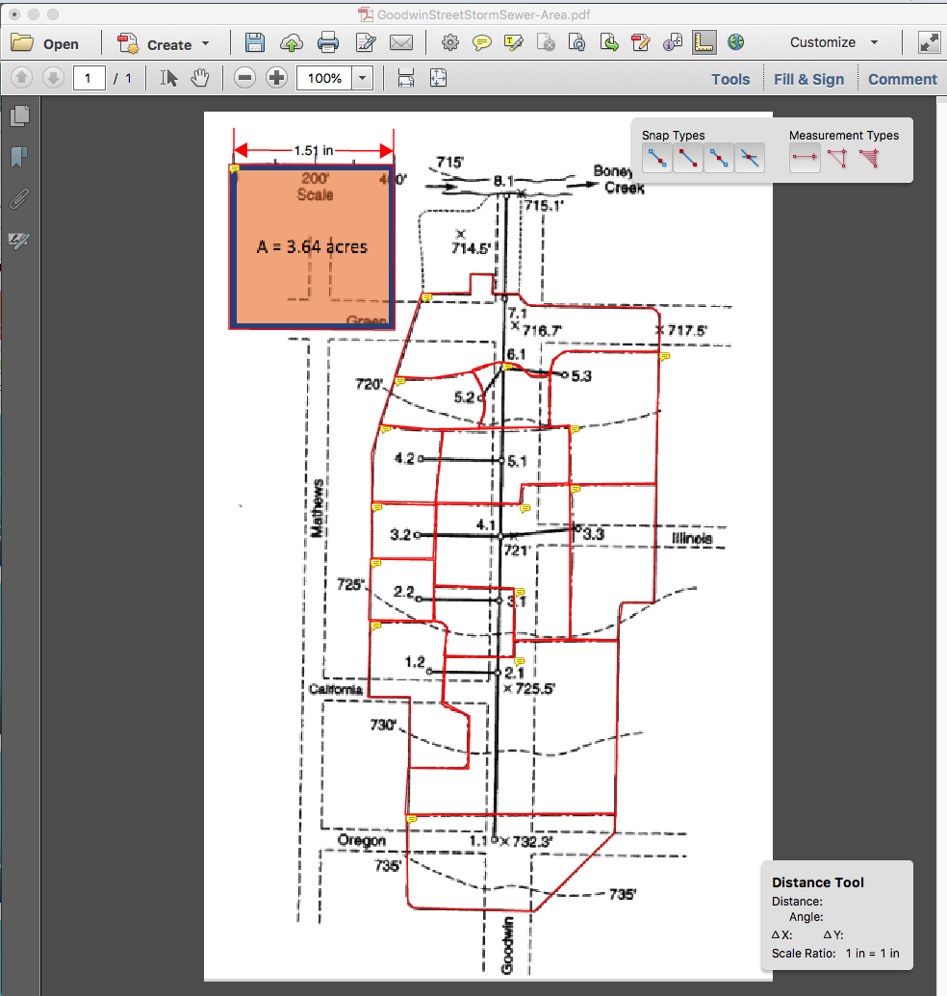
IDENTIFY AND MEASURE CONDUIT LENGTHS
Use ACROBAT to measure distances between Node ID
Select distance tool
Measure the 400 foot scale
Save scale factor 1.51 in == 400 feet

Slide 50
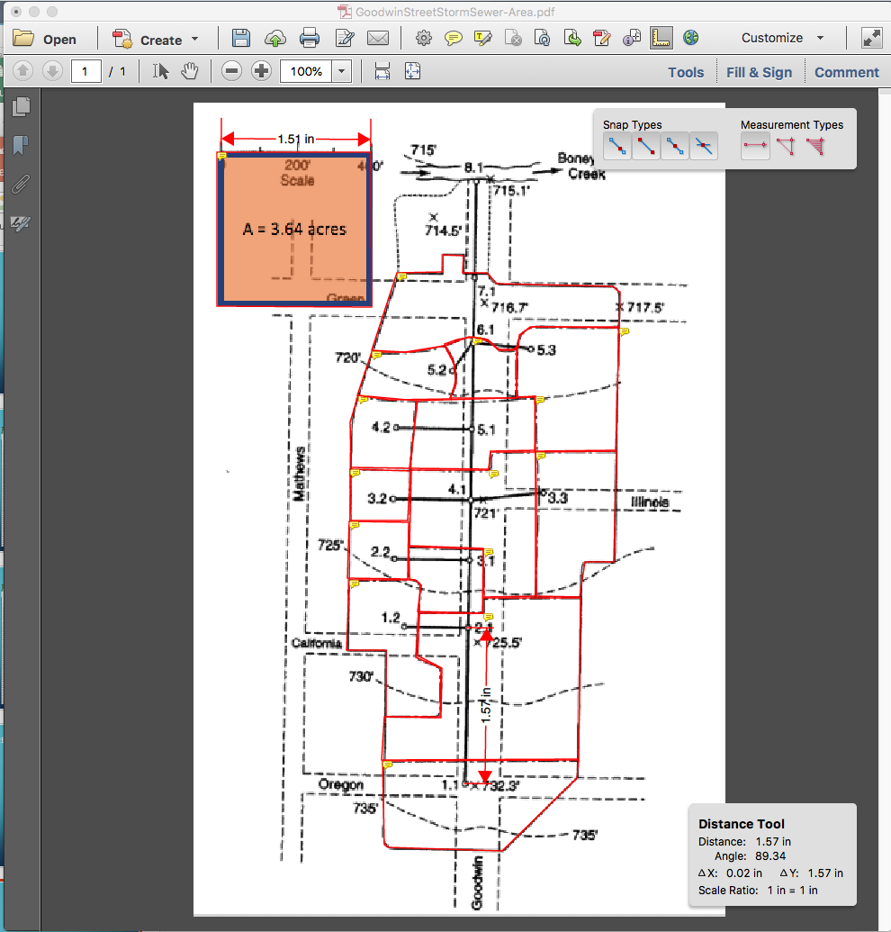
PIPE 1.1
Connects 1.1 to 2.1
Length = 1.57*400/1.51 = 415 ft
Repeat for all the other pipes

Slide 51
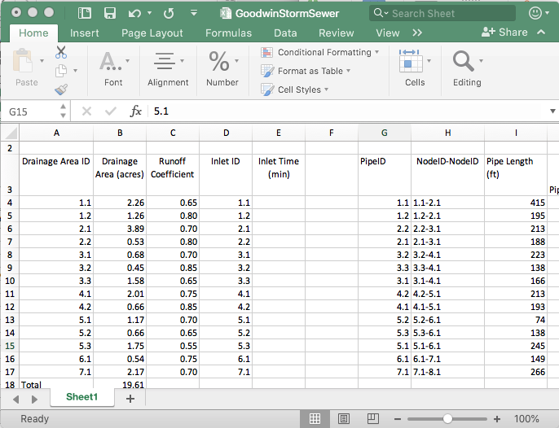
Gather the information into a spreadsheet
Build a sheet with the information
Note the naming convention (a bit awkward, but faithful to the original example)

Slide 52
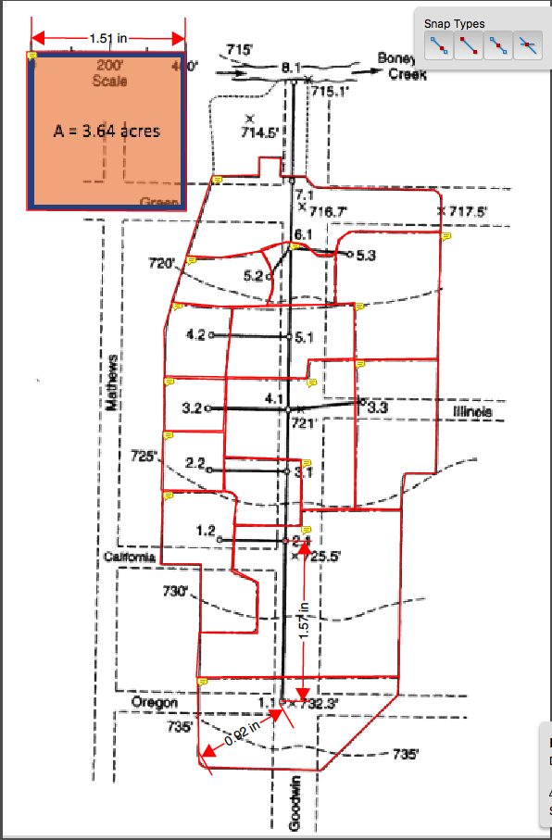
Determine inlet times for each drainage area
Measure actual best-guess flow path
Find Slope (737.5 – 732.3)/(0.92*400/1.51) = 5.2ft/243.7 ft = 0.021 (2.1%)
Determine some kind of cover
Apply NRCS Velocity, NRCS Upland, or Kerby-Kirpich
Use method that makes most sense

Slide 53
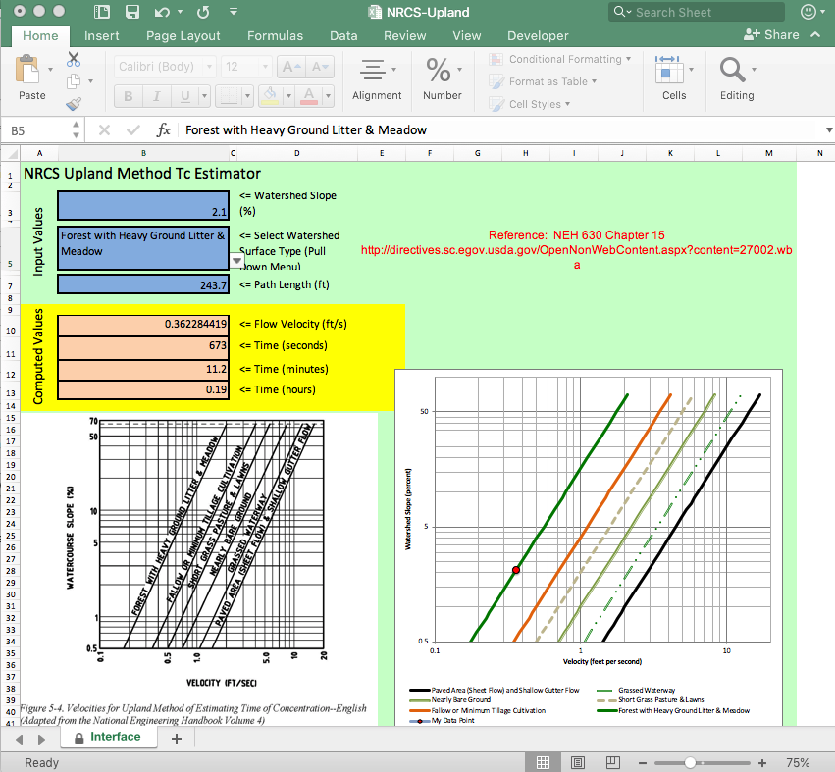
Determine inlet times for each drainage area
NRCS Upland Method
Measure actual best-guess flow path
Path = 243.7 ft
Slope = 0.021 (2.1%)
Inlet Time ~ 11 minutes
Repeat for each drainage area, populate spreadsheet

Slide 54
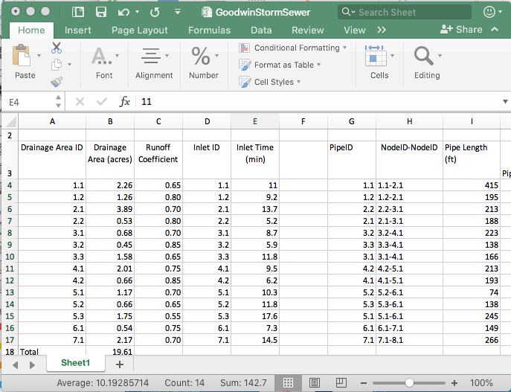
Determine inlet times for each drainage area
Repeat for each drainage area, populate spreadsheet

Slide 55
Estimate pipe slopes
Use the node elevations and topographic map to estimate pipe slopes
Contour lines
Elevation Markers

Slide 56
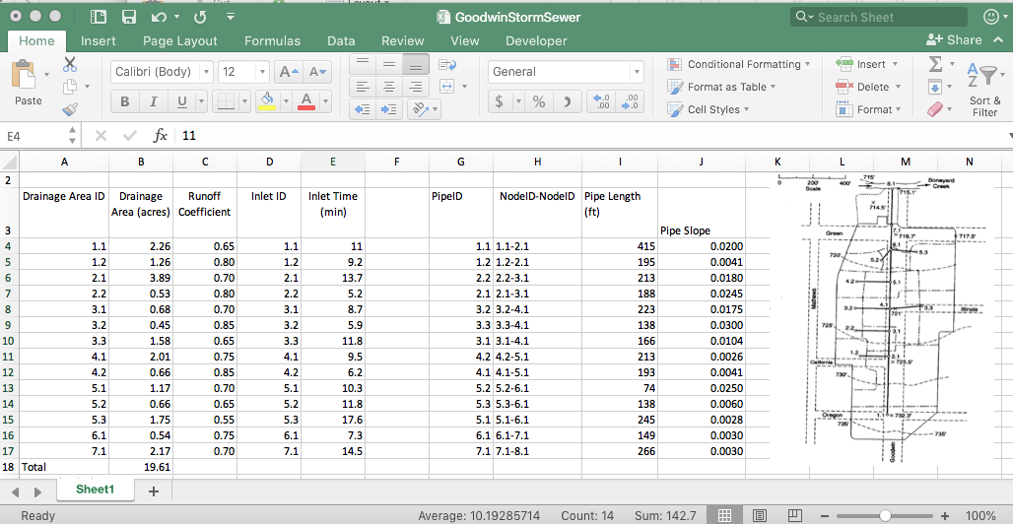
Estimate pipe slopes
Use the node elevations and topographic map to estimate pipe slopes
Populate the spreadsheet

Slide 57
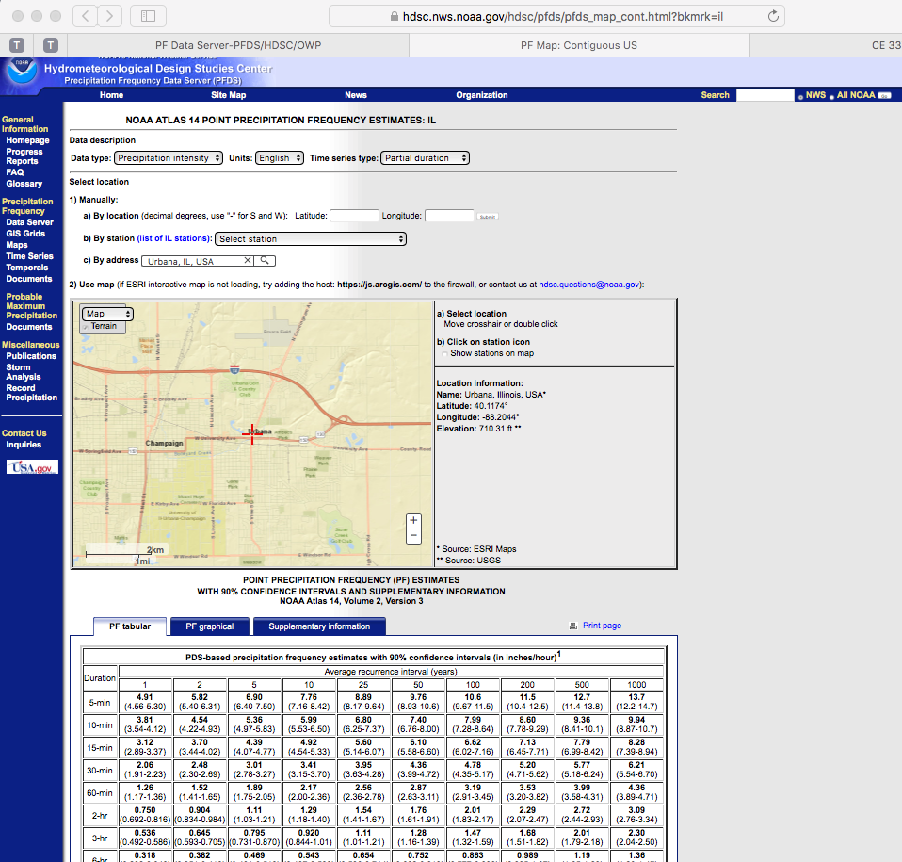
Intensity equation
Next we will need to precipitation information for the design.
Easiest for this example is to build an IDF curve for the location.
The basin in the example is in Urbana, Illinois – Use NOAA Atlas 14
For the example use a 2-yr ARI

Slide 58
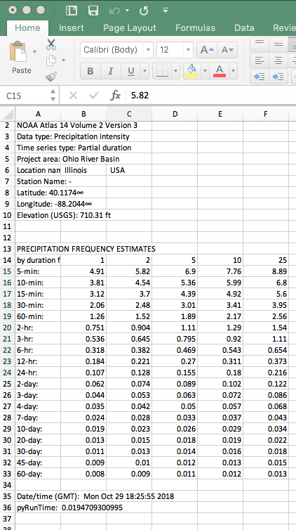
Intensity equation
Download the table
Use the 2-nd column

Slide 59
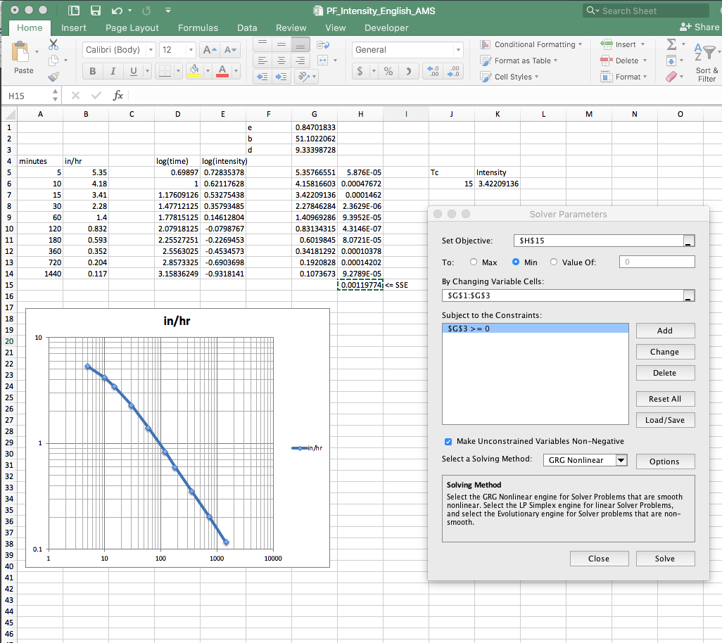
Intensity equation
Download the table
Use the 2-nd column
Use solver to fit $I=\frac{B}{{(T_{c}+D)}^{E}}$
Use this equation for estimating intensity and runoff

Slide 60
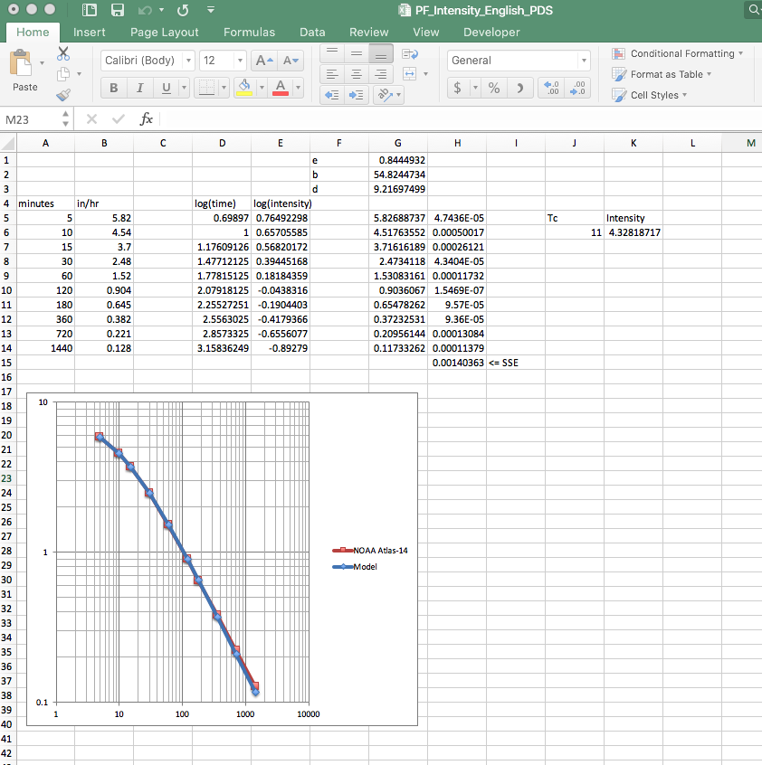
Intensity equation
Intensity function for the example: $I=\frac{54.82}{{(T_{c}+9.21)}^{0.844}}$
This can be coded into an analysis spreadsheet directly

Slide 61
Begin with most upstream node
Intensity Equation
Rational Method
Discharge to Inlet

