Slide 1
CE 3372 Water Systems Design
Lesson 17: Storm sewers Conduit design (size selection) by rational equation method Fall 2020

Slide 2
Purposes
Conduits convey Flow from one location to another
Pipes
Culverts
Open channels

Slide 3
Conduit design
Select size, material, and slope
Storm sewer – usually desire to operate with free surface (as an open channel)
Sanitary sewer – similar usually want a free surface
Size (diameter) is dictated by
Flow required
Burial depth relative to drop available

Slide 4
methods
A good preliminary design can be obtained using a combination of the rational equation and manning’s equation
Done without regard to downstream boundary conditions
Needs to be checked using a hydraulic model (like SWMM)

Slide 5
Preliminary design
Determine discharge in each pipe.
Size using manning’s equation (… in us customary)
Assumes full, but pipes will have free surface

Slide 6
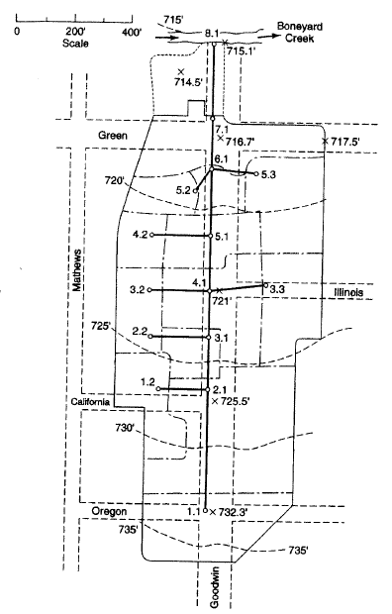
Preliminary design
Layout of system
Drainage area and Inlets
Pipes
Outfall
elevations

Slide 7
Preliminary design
Drainage areas and inlets
Determine inlet time of concentration
Determine drainage area runoff coefficient

Slide 8
Preliminary design
Pipes (Start upstream)
Select pipe size
Design guidelines
Discharge criteria
Velocity criteria
Determine pipe travel time
$$D=1.333{\left(\frac{Qn}{\sqrt{S}}\right)}^{3/8}$$
Adjust
$$V=\frac{1.49}{n}{\left(\frac{D}{4}\right)}^{2/3}\sqrt{S}$$
From criterion
$$t=\frac{distance}{V}$$
Notes:
$$V=\frac{1.49}{n}{(\frac{D}{4})}^{2/3}\sqrt{S}$$

Slide 9
Preliminary design
At most upstream inlet
Compute Q_{P}=CiA to the inlet from inlet time
Size pipe from this inlet to hold Q_{P}
ADD pipe travel time to inlet time
Move to next node
Notes:
$$V=\frac{1.49}{n}{(\frac{D}{4})}^{2/3}\sqrt{S}$$

Slide 10
Preliminary design
At NEXT upstream inlet
Compute Q_{P}=CiA to the inlet from inlet time
Size pipe from this inlet to hold Q_{P}
ADD pipe travel time to inlet time
Move to next node
Notes:
$$V=\frac{1.49}{n}{(\frac{D}{4})}^{2/3}\sqrt{S}$$

Slide 11
Preliminary design
AT JUNCTION AND INLET
Choose largest of:
Local inlet time
Upstream node+travel time
Compute Q_{p} LEAVING THE JUNCTION FROM:
SIZE next pipe from this q_{p}
$$Q_{p}=\left({CA}_{local}+\sum{{CA}_{upstream}}\right)i_{T_{c}}$$
local
Notes:
$$V=\frac{1.49}{n}{(\frac{D}{4})}^{2/3}\sqrt{S}$$

Slide 12
Preliminary design
Continue downstream in same fashion (from upstream to junction) until reach outlet
Accumulate CA values and Tc as move downstream
Checks include that all areas add up to total area
T_{c} should be increasing in value as move downstream
local
Notes:
$$V=\frac{1.49}{n}{(\frac{D}{4})}^{2/3}\sqrt{S}$$

Slide 13
Preliminary design
At outlet should have:
Pipe sizes
Pipe discharges
Next check hydraulics
SWMM – enter Q_{INLET} directly and check pipe hydraulics
SWMM – Approximate rational in SWMM to check a design hyetograph
Use SWMM results to adjust design and produce a HGL drawing
local
Notes:
$$V=\frac{1.49}{n}{(\frac{D}{4})}^{2/3}\sqrt{S}$$

Slide 14
Design storm sewer for Goodwin street
“Rational Method Storm Sewer Design” in Mays, L. W. (2008) Water Resources Engineering. Pearson-Prentice Hall (pp. 613-635)
Method: Rational Equation Design Method to make initial design for subsequent hydraulics analysis

Slide 15
Preparation steps
Identify the individual drainage areas.
Determine the area of each contributing area, in acres. (ENGAUGE, PLANIMETER, etc)
Determine the rational runoff coefficient for each area (TABLE LOOKUP)

Slide 16
DRAINAGE AREA 1.1
Identify the individual drainage areas.

Slide 17
DRAINAGE AREA 1.2
Identify the individual drainage areas.

Slide 18
DRAINAGE AREA 2.1
Identify the individual drainage areas.

Slide 19
DRAINAGE AREA 2.2
Identify the individual drainage areas.

Slide 20
DRAINAGE AREA 3.1
Identify the individual drainage areas.

Slide 21
DRAINAGE AREA 3.2
Identify the individual drainage areas.

Slide 22
DRAINAGE AREA 3.3
Identify the individual drainage areas.

Slide 23
DRAINAGE AREA 4.1
Identify the individual drainage areas.

Slide 24
DRAINAGE AREA 4.2
Identify the individual drainage areas.

Slide 25
DRAINAGE AREA 5.1
Identify the individual drainage areas.

Slide 26
DRAINAGE AREA 5.2
Identify the individual drainage areas.

Slide 27
DRAINAGE AREA 5.3
Identify the individual drainage areas.

Slide 28
DRAINAGE AREA 6.1
Identify the individual drainage areas.

Slide 29
DRAINAGE AREA 7.1
Identify the individual drainage areas.

Slide 30
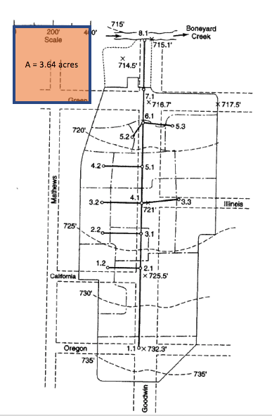
Calibrate area measurement tool
Area =400X400/43560 = 3.67 acres
Measure areas using appropriate tools
E.g. Acrobat Pro
Need to measure a known area
Save the conversion factor
A = 3.67 acres

Slide 31
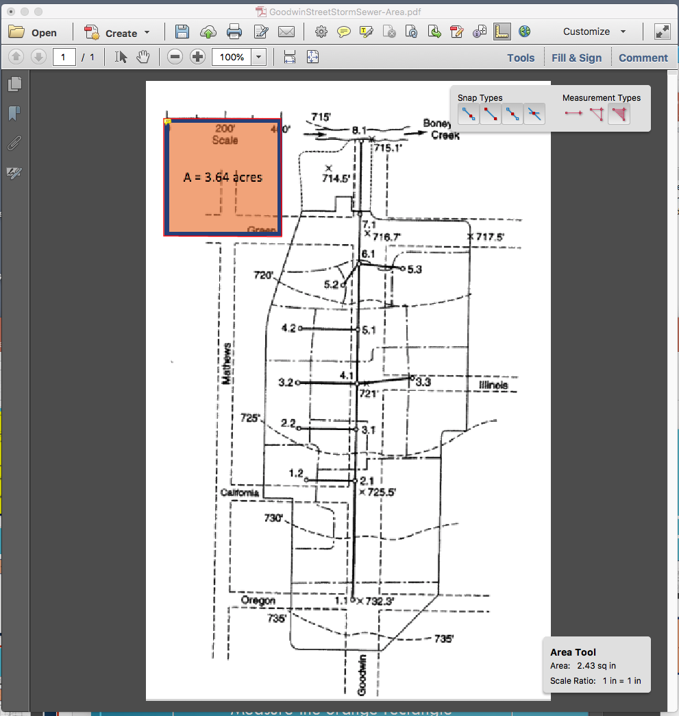
Calibrate area measurement tool
Measure areas using Acrobat Pro
Activate the measurement toolkit
Select Area
Measure the orange rectangle
Save the conversion factor: 2.43 sq.in. == 3.67 acres
A = 3.67 acres

Slide 32
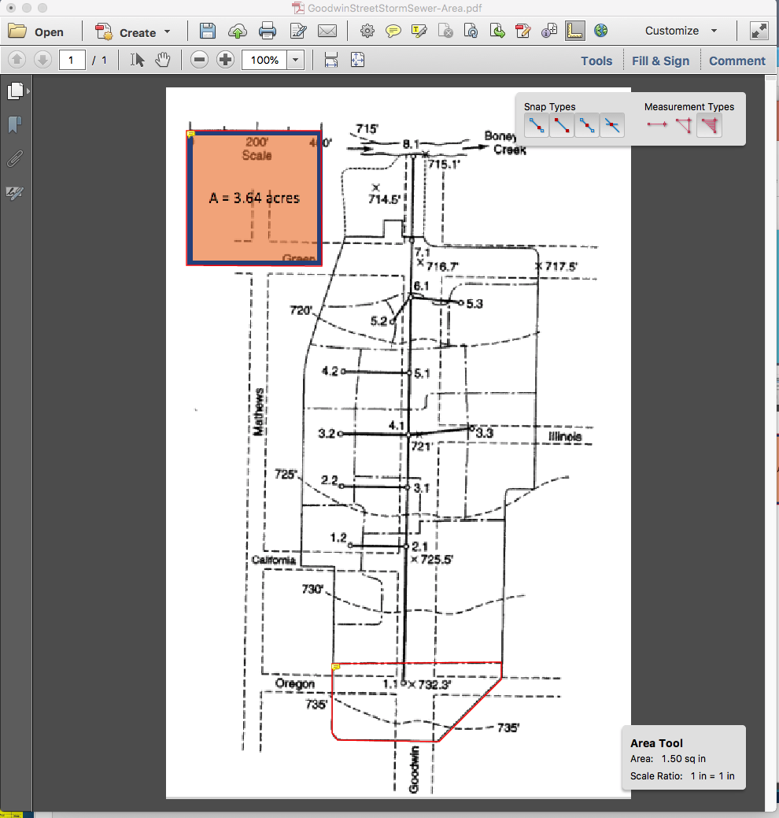
DRAINAGE AREA 1.1
Identify the individual drainage areas.
Determine the area of each contributing area, in acres. (G3DATA; PLANIMETER, etc)
Area = 1.50*3.67/2.43 = 2.26 acres
A = 3.67 acres

Slide 33
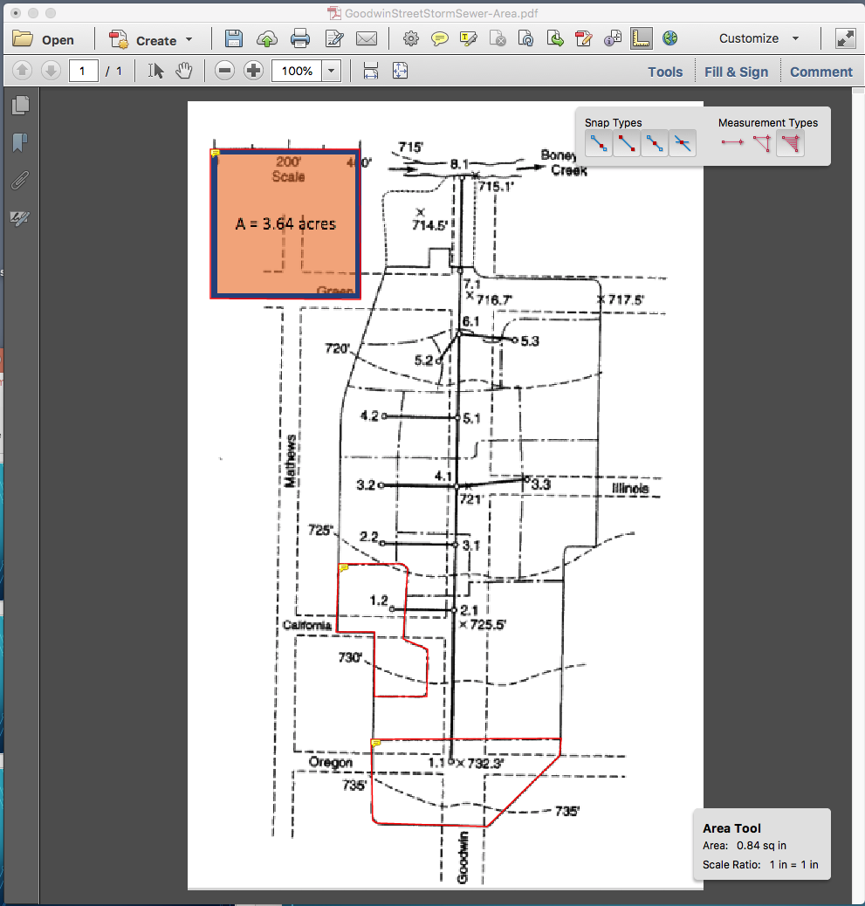
DRAINAGE AREA 1.2
Identify the individual drainage areas.
Determine the area of each contributing area, in acres. (ENGAUGE, PLANIMETER, etc)
Area = 0.84*3.67/2.43 = 1.26 acres
A = 3.67 acres

Slide 34
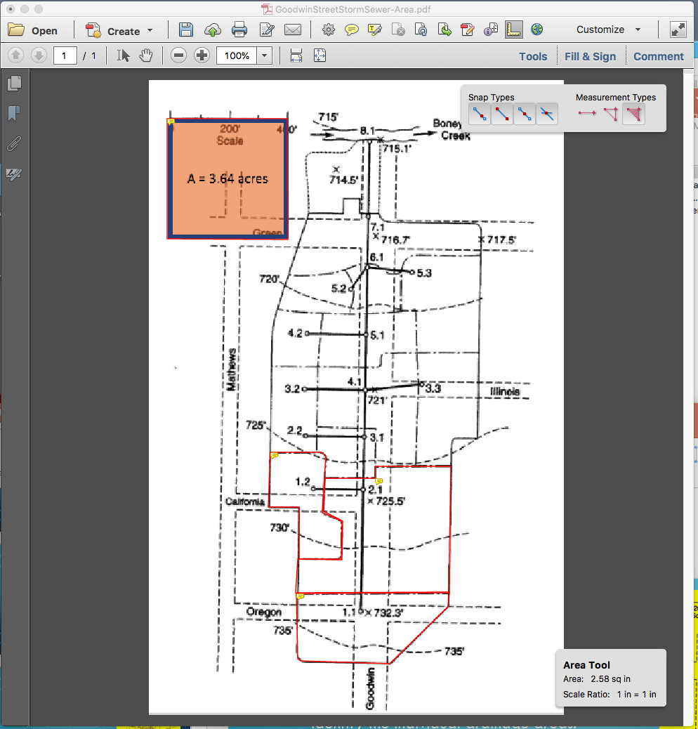
DRAINAGE AREA 2.1
Identify the individual drainage areas.
Determine the area of each contributing area, in acres.
Area = 2.58*3.67/2.43 = 3.89 acres
A = 3.67 acres

Slide 35
DRAINAGE AREA 2.2
Identify the individual drainage areas.
Determine the area of each contributing area, in acres.
Area = 0.35*3.67/2.43 = 0.53 acres
A = 3.67 acres

Slide 36
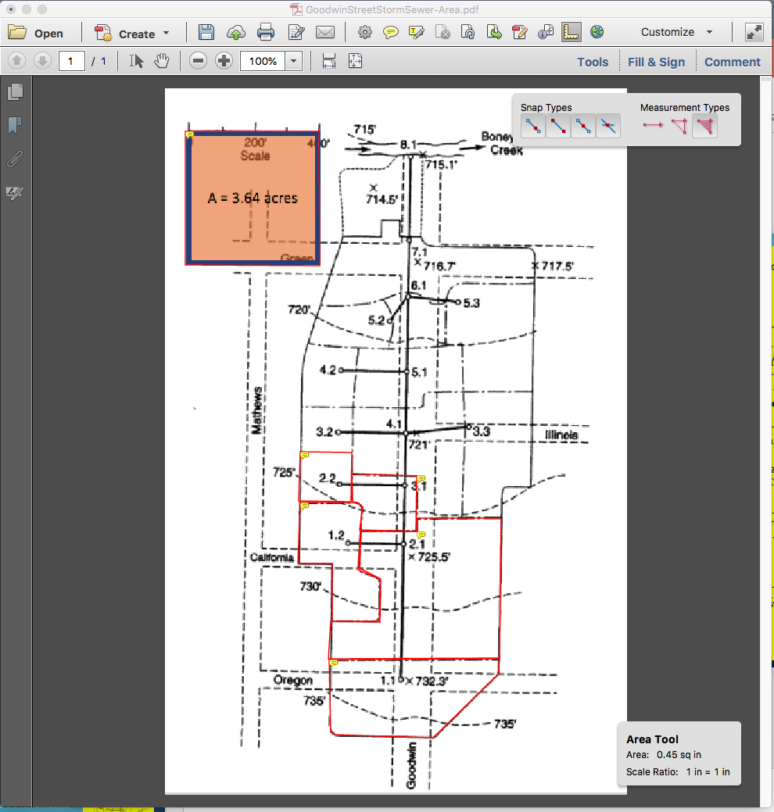
DRAINAGE AREA 3.1
A = 3.67 acres
Identify the individual drainage areas.
Determine the area of each contributing area, in acres.
Area = 0.45*3.67/2.43 = 0.68 acres

Slide 37
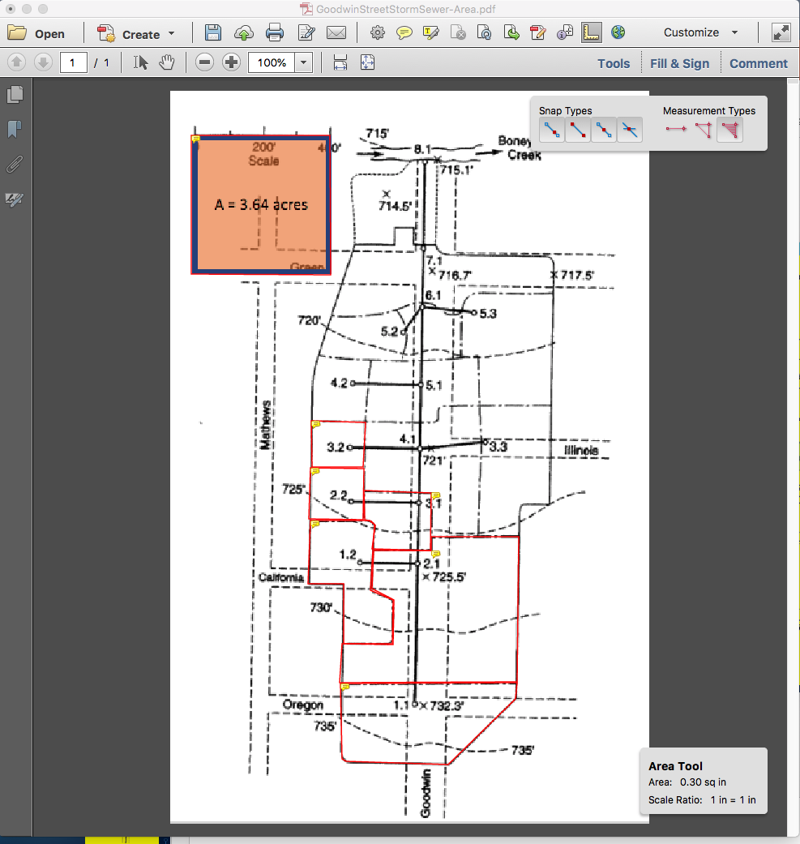
DRAINAGE AREA 3.2
A = 3.67 acres
Identify the individual drainage areas.
Determine the area of each contributing area, in acres.
Area = 0.30*3.67/2.43 = 0.45 acres

Slide 38
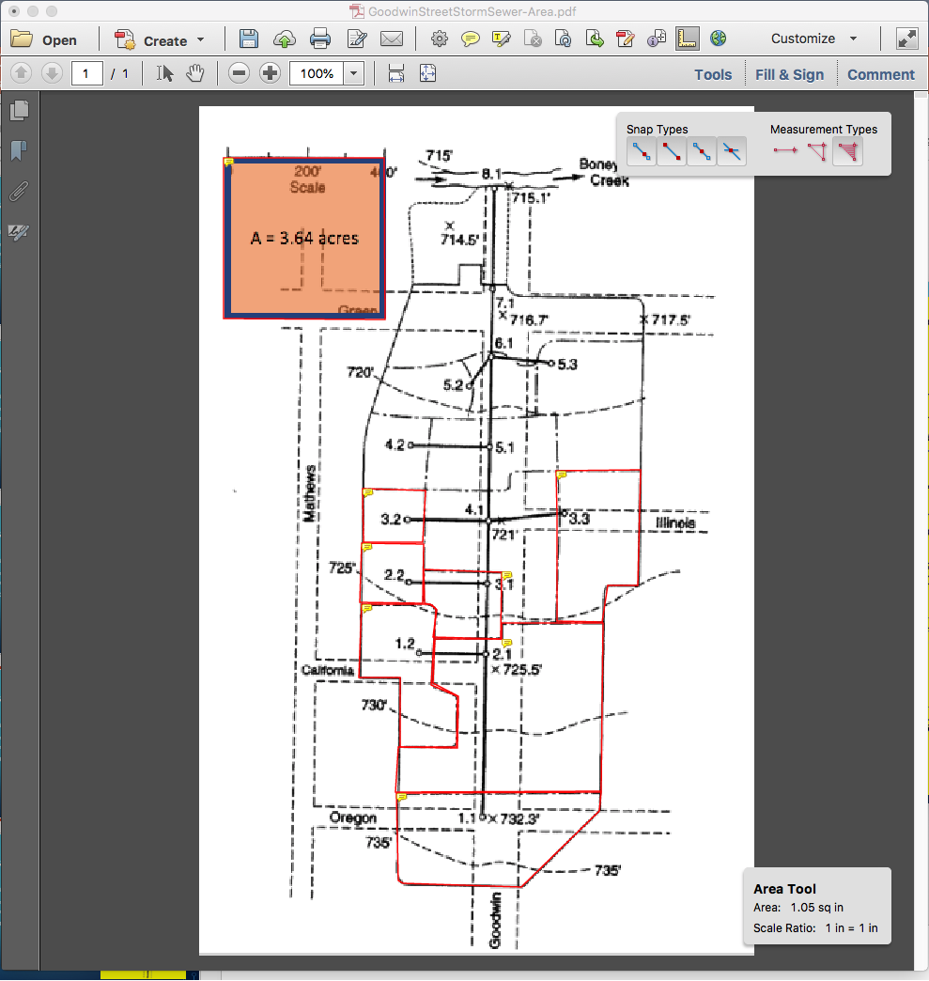
DRAINAGE AREA 3.3
Identify the individual drainage areas.
Determine the area of each contributing area, in acres.
Area = 1.05*3.67/2.43 = 1.58 acres
A = 3.67 acres

Slide 39
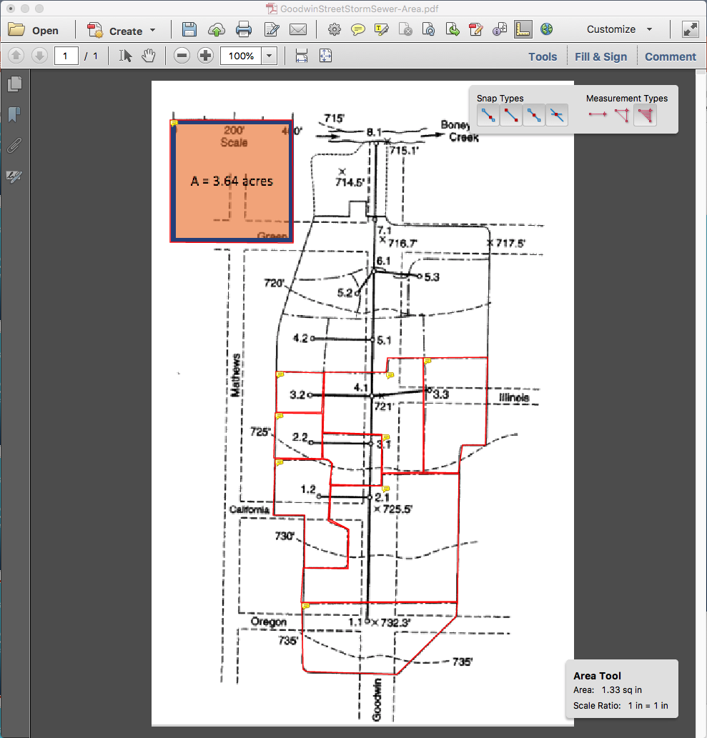
DRAINAGE AREA 4.1
Identify the individual drainage areas.
Determine the area of each contributing area, in acres.
Area = 1.33*3.67/2.43 = 2.01 acres
A = 3.67 acres

Slide 40
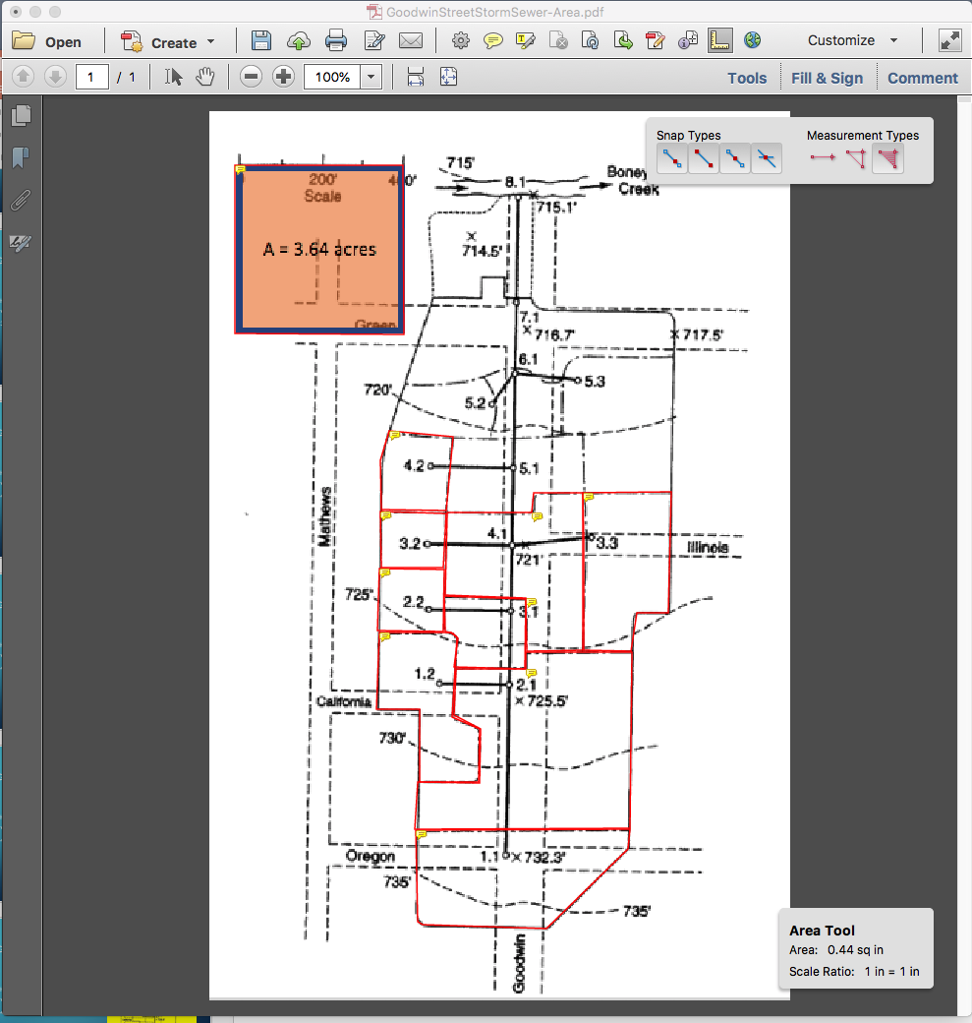
DRAINAGE AREA 4.2
Identify the individual drainage areas.
Determine the area of each contributing area, in acres.
Area = 0.44*3.67/2.43 = 0.66 acres
A = 3.67 acres

Slide 41
DRAINAGE AREA 5.1
Identify the individual drainage areas.
Determine the area of each contributing area, in acres.
Area = 0.78*3.67/2.43 = 1.17 acres
A = 3.67 acres

Slide 42
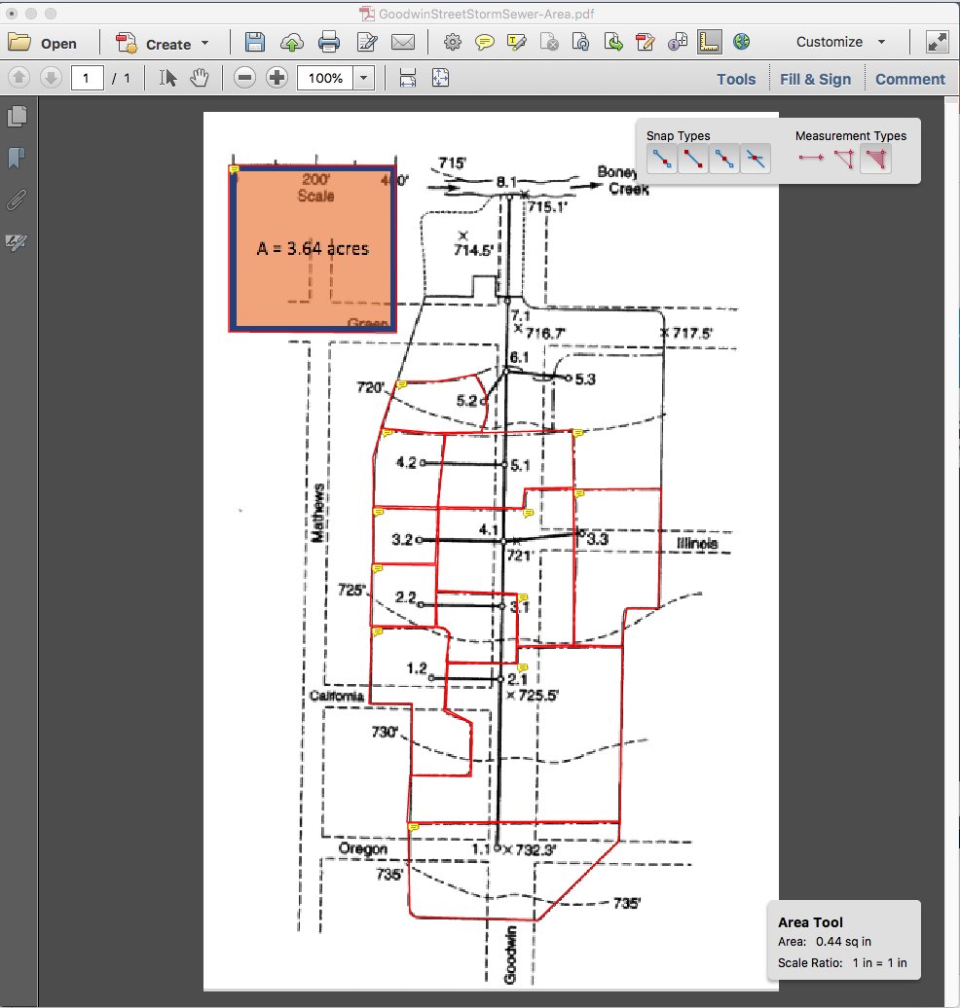
DRAINAGE AREA 5.2
Identify the individual drainage areas.
Determine the area of each contributing area, in acres.
Area = 0.44*3.67/2.43 = 0.66 acres
A = 3.67 acres

Slide 43
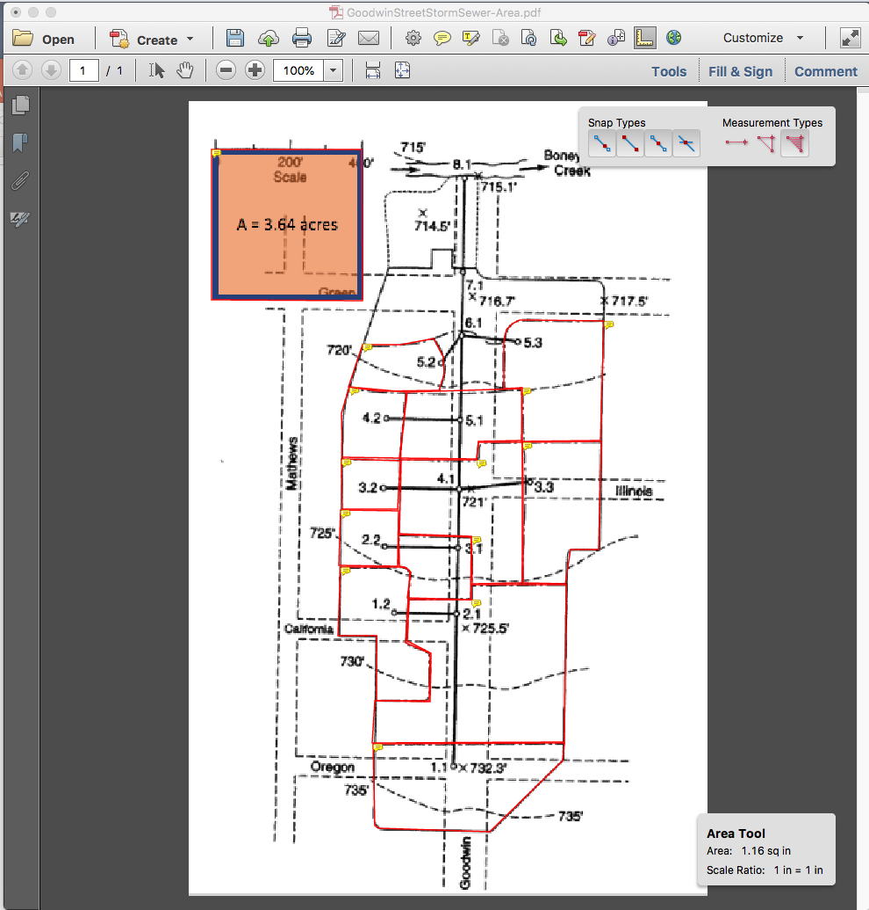
DRAINAGE AREA 5.3
Identify the individual drainage areas.
Determine the area of each contributing area, in acres.
Area = 1.16*3.67/2.43 = 1.75 acres
A = 3.67 acres

Slide 44
DRAINAGE AREA 6.1
A = 3.67 acres
Identify the individual drainage areas.
Determine the area of each contributing area, in acres.
Area = 0.36*3.67/2.43 = 0.54 acres

Slide 45
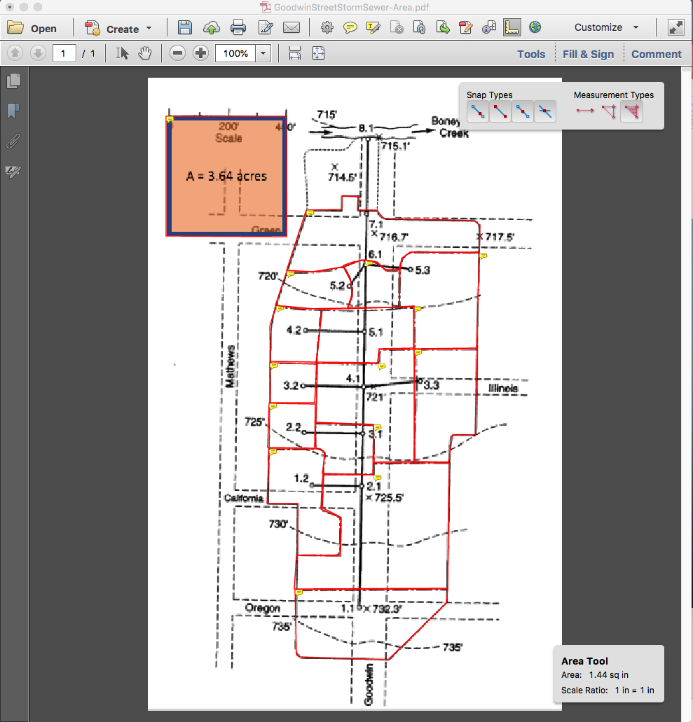
DRAINAGE AREA 7.1
Identify the individual drainage areas.
Determine the area of each contributing area, in acres.
Area = 1.44*3.67/2.43 = 2.17 acres
A = 3.67 acres

Slide 46
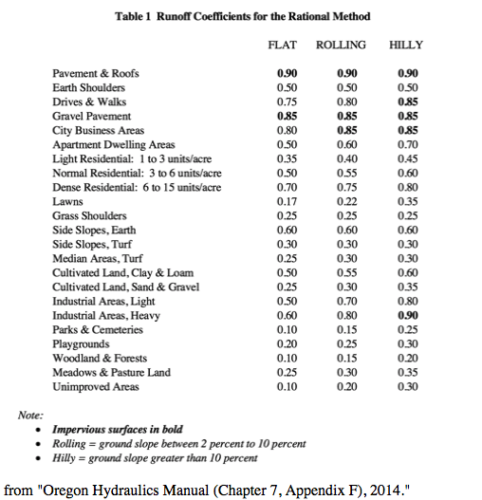
Estimate runoff coefficients
For each area estimate a runoff coefficient
Usually based on a table lookup and surface description

Slide 47
DRAINAGE AREA 1.1
Identify the individual drainage areas.
Determine the area of each contributing area, in acres. (ENGAUGE, PLANIMETER, etc)
Area = 1.50*3.67/2.43 = 2.26 acres
C = 0.65
A = 3.67 acres

Slide 48
DRAINAGE AREA 1.2
Identify the individual drainage areas.
Determine the area of each contributing area, in acres. (ENGAUGE, PLANIMETER, etc)
Area = 0.84*3.67/2.43 = 1.26 acres
C = 0.80
A = 3.67 acres

Slide 49
DRAINAGE AREA 2.1
Identify the individual drainage areas.
Determine the area of each contributing area, in acres.
Area = 2.58*3.67/2.43 = 3.89 acres
C= 0.70
A = 3.67 acres

Slide 50
DRAINAGE AREA 2.2
Identify the individual drainage areas.
Determine the area of each contributing area, in acres.
Area = 0.35*3.67/2.43 = 0.53 acres
C = 0.80
A = 3.67 acres

Slide 51
DRAINAGE AREA 3.1
A = 3.67 acres
Identify the individual drainage areas.
Determine the area of each contributing area, in acres.
Area = 0.45*3.67/2.43 = 0.68 acres
C = 0.70

Slide 52
DRAINAGE AREA 3.2
A = 3.67 acres
Identify the individual drainage areas.
Determine the area of each contributing area, in acres.
Area = 0.30*3.67/2.43 = 0.45 acres
C = 0.85

Slide 53
DRAINAGE AREA 3.3
Identify the individual drainage areas.
Determine the area of each contributing area, in acres.
Area = 1.05*3.67/2.43 = 1.58 acres
C = 0.65
A = 3.67 acres

Slide 54
DRAINAGE AREA 4.1
Identify the individual drainage areas.
Determine the area of each contributing area, in acres.
Area = 1.33*3.67/2.43 = 2.01 acres
C = 0.75
A = 3.67 acres

Slide 55
DRAINAGE AREA 4.2
Identify the individual drainage areas.
Determine the area of each contributing area, in acres.
Area = 0.44*3.67/2.43 = 0.66 acres
C = 0.85
A = 3.67 acres

Slide 56
DRAINAGE AREA 5.1
Identify the individual drainage areas.
Determine the area of each contributing area, in acres.
Area = 0.78*3.67/2.43 = 1.17 acres
C = 0.70
A = 3.67 acres

Slide 57
DRAINAGE AREA 5.2
Identify the individual drainage areas.
Determine the area of each contributing area, in acres.
Area = 0.44*3.67/2.43 = 0.66 acres
C = 0.65
A = 3.67 acres

Slide 58
DRAINAGE AREA 5.3
Identify the individual drainage areas.
Determine the area of each contributing area, in acres.
Area = 1.16*3.67/2.43 = 1.75 acres
C = 0.55
A = 3.67 acres

Slide 59
DRAINAGE AREA 6.1
A = 3.67 acres
Identify the individual drainage areas.
Determine the area of each contributing area, in acres.
Area = 0.36*3.67/2.43 = 0.54 acres
C = 0.75

Slide 60
DRAINAGE AREA 7.1
Identify the individual drainage areas.
Determine the area of each contributing area, in acres.
Area = 1.44*3.67/2.43 = 2.17 acres
C = 0.70
A = 3.67 acres

Slide 61
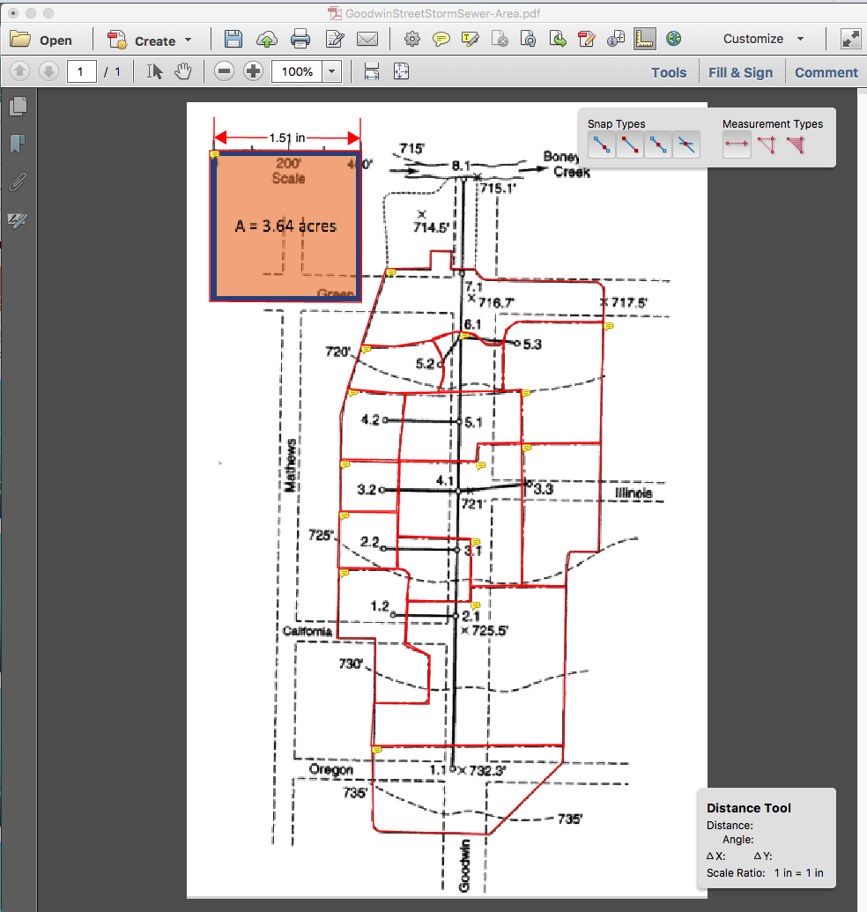
IDENTIFY AND MEASURE CONDUIT LENGTHS
Use ACROBAT to measure distances between Node ID
Select distance tool
Measure the 400 foot scale
Save scale factor 1.51 in == 400 feet

Slide 62
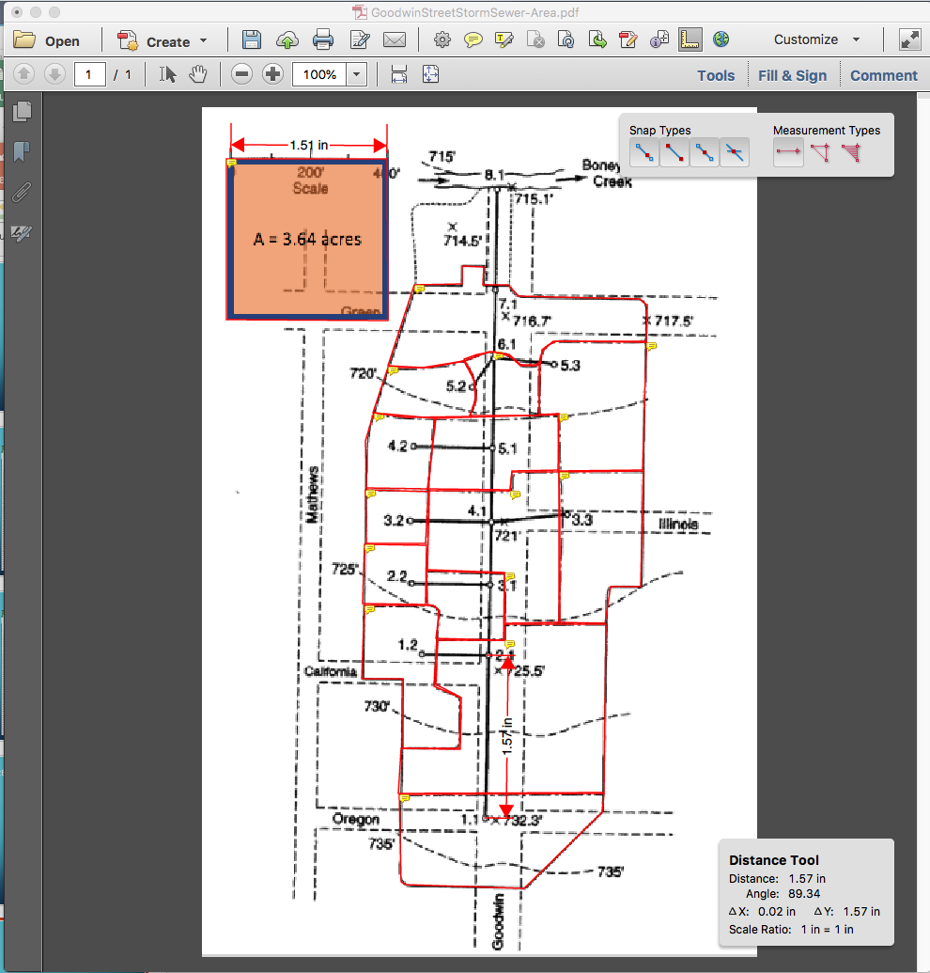
PIPE 1.1
Connects 1.1 to 2.1
Length = 1.57*400/1.51 = 415 ft
Repeat for all the other pipes

Slide 63
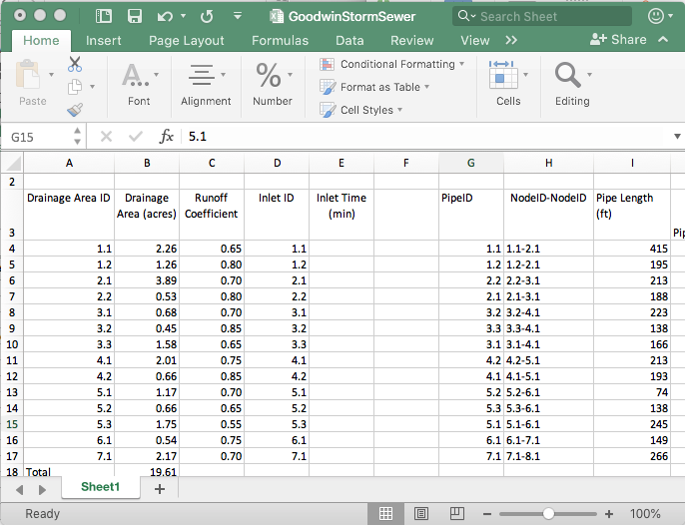
Gather the information into a spreadsheet
Build a sheet with the information
Note the naming convention (a bit awkward, but faithful to the original example)

Slide 64
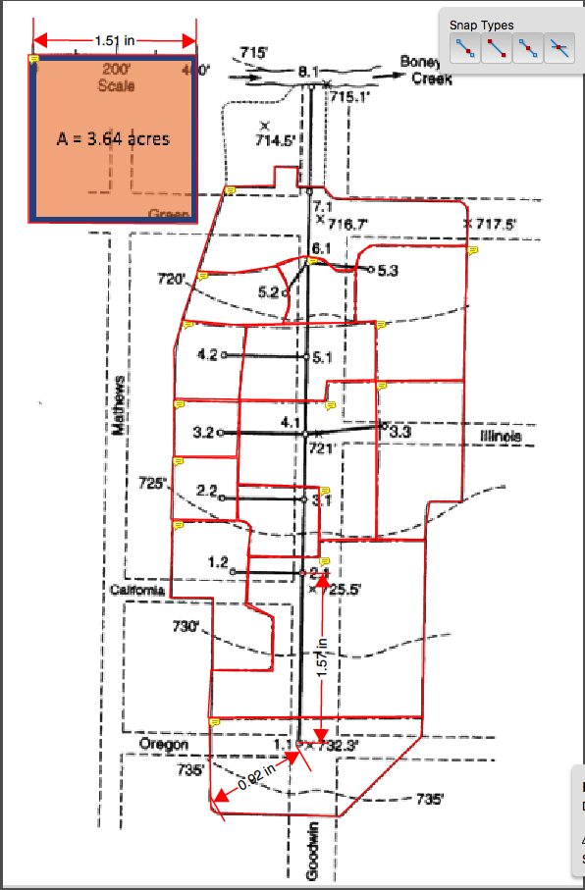
Determine inlet times for each drainage area
Measure actual best-guess flow path
Find Slope (737.5 – 732.3)/(0.92*400/1.51) = 5.2ft/243.7 ft = 0.021 (2.1%)
Determine some kind of cover
Apply NRCS Velocity, NRCS Upland, or Kerby-Kirpich
Use method that makes most sense

Slide 65
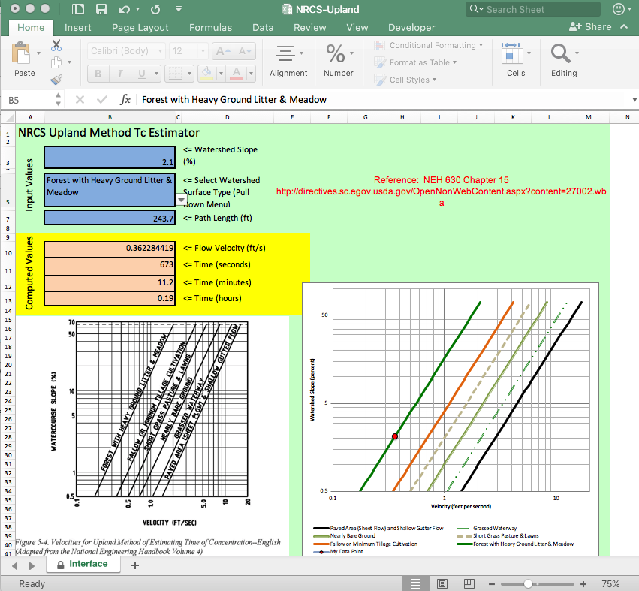
Determine inlet times for each drainage area
NRCS Upland Method
Measure actual best-guess flow path
Path = 243.7 ft
Slope = 0.021 (2.1%)
Inlet Time ~ 11 minutes
Repeat for each drainage area, populate spreadsheet

Slide 66
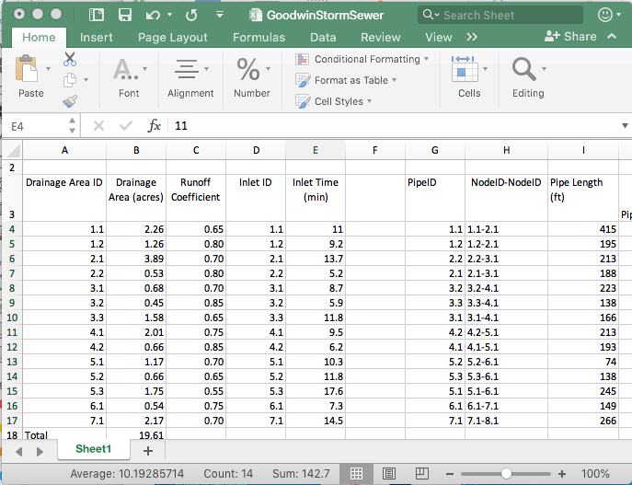
Determine inlet times for each drainage area
Repeat for each drainage area, populate spreadsheet

Slide 67
Estimate pipe slopes
Use the node elevations and topographic map to estimate pipe slopes
Contour lines
Elevation Markers

Slide 68
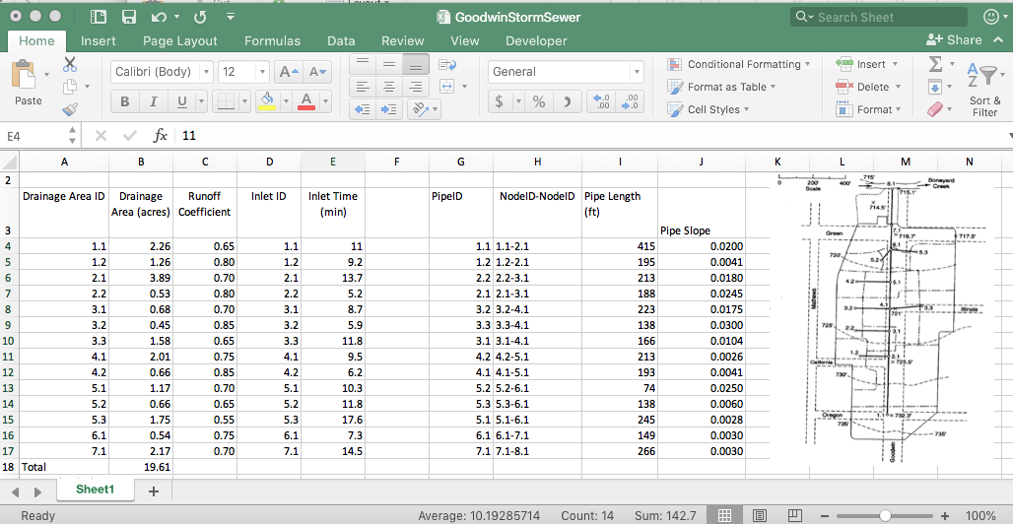
Estimate pipe slopes
Use the node elevations and topographic map to estimate pipe slopes
Populate the spreadsheet

Slide 69
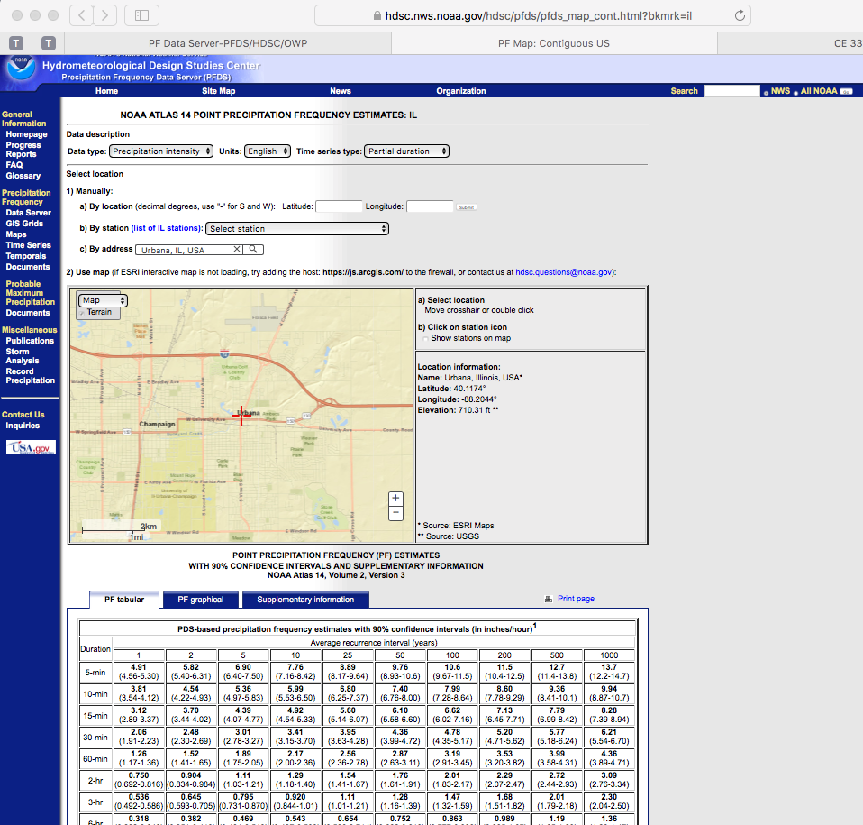
Intensity equation
Next we will need to precipitation information for the design.
Easiest for this example is to build an IDF curve for the location.
The basin in the example is in Urbana, Illinois – Use NOAA Atlas 14
For the example use a 2-yr ARI

Slide 70
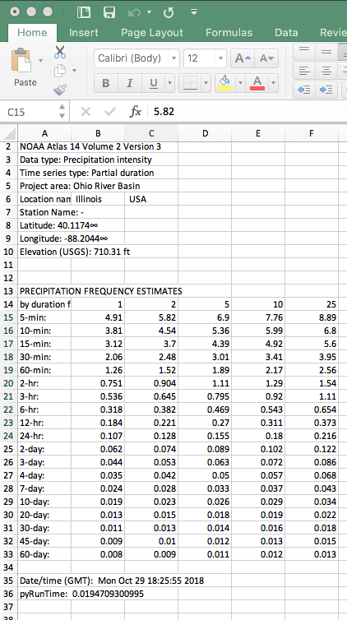
Intensity equation
Download the table
Use the 2-nd column

Slide 71
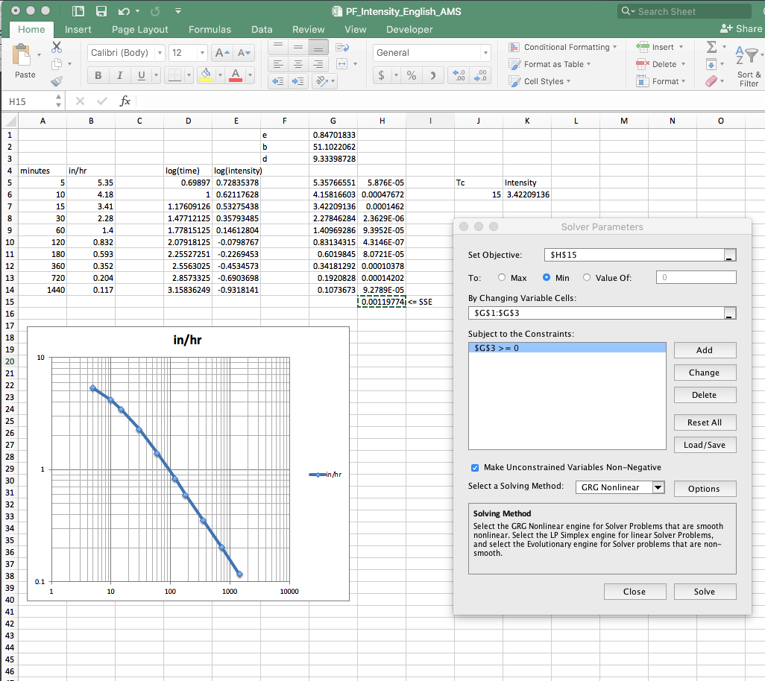
Intensity equation
Download the table
Use the 2-nd column
Use solver to fit $I=\frac{B}{{(T_{c}+D)}^{E}}$
Use this equation for estimating intensity and runoff

Slide 72
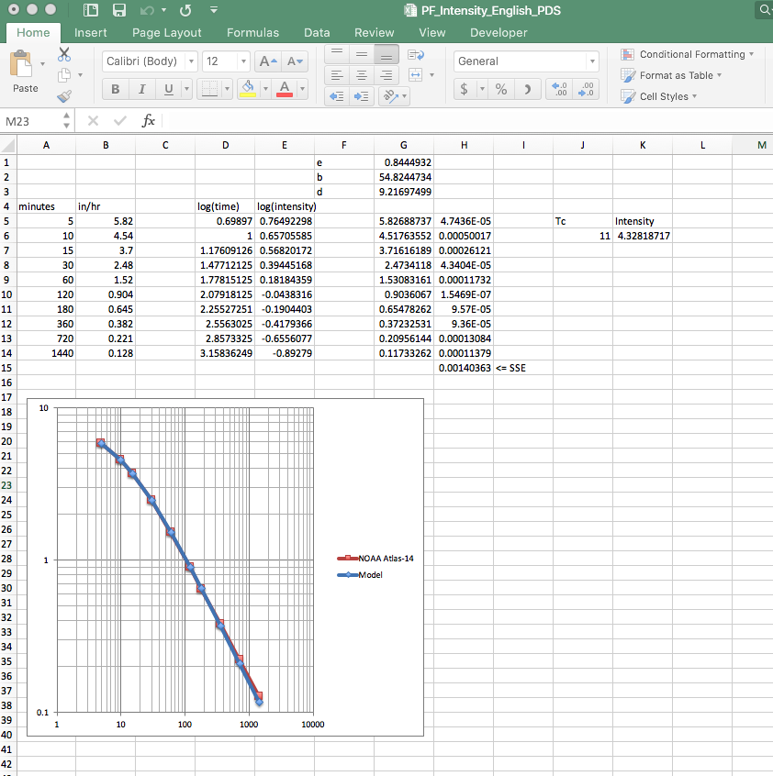
Intensity equation
Intensity function for the example: $I=\frac{54.82}{{(T_{c}+9.21)}^{0.844}}$
This can be coded into an analysis spreadsheet directly

Slide 73
Begin with most upstream node
Intensity Equation
Rational Method
Discharge to Inlet

