Slide 1
CE 3372 Water Systems Design
Lesson 16: Storm sewers, inlets, and conduits

Slide 2
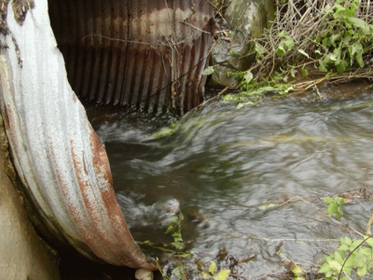
Review
Supercritical, Critical, or Subcritical
Location A ?
Location B ?
Location C ?

Slide 3
Outline
Storm sewer overview
Inlets
Design using FHWA methods (as specified in TxDOT Hydraulic Design Manual)
Representative of typical design computations involved, change to fit your jurisdiction

Slide 4
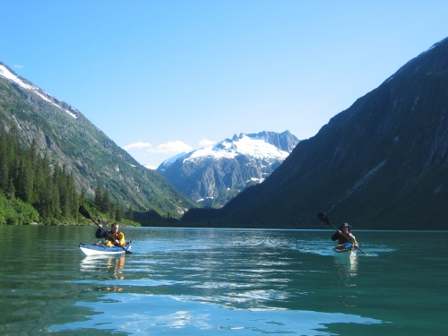
Storm Sewers
Inlets to capture runoff
Conduits to convey to outfall
Lift Stations if cannot gravity flow to outfall
Detention and diversions
Outfall release back into environment

Slide 5
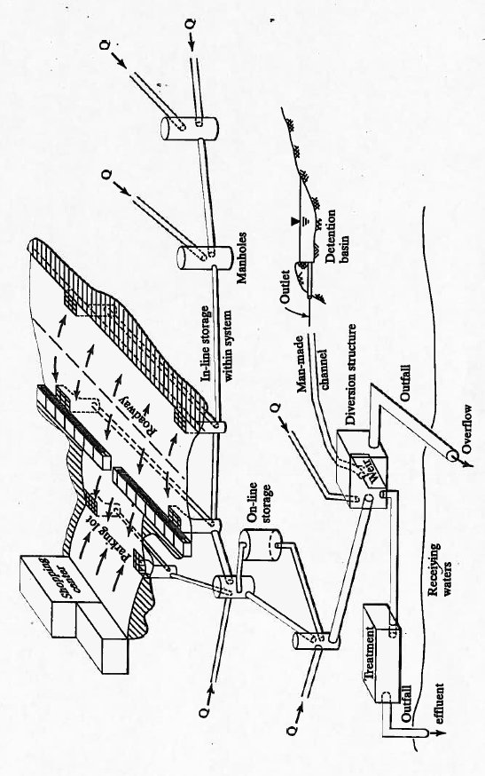
Storm Sewer Systems
Inlets
Lift Station
Lift Station
Conduits

Slide 6
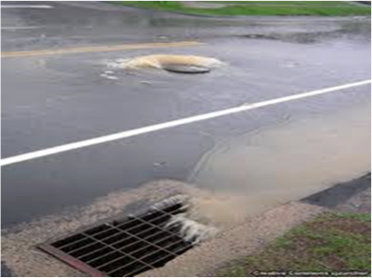
Storm Sewer Inlets
Spread width
Combination Inlet
Curb+Grate
Carryover
Flow that passes beyond the inlet (none in this picture – complete capture)

Slide 7
Storm Drains
A storm drain is a system of curbs and gutters, inlets, and pipe networks that receives runoff and conveys it to some point where it is discharged into a pond, channel, stream, or another pipe system.
A storm drain may be comprised of a closed-conduit, an open conduit, or some combination of the two

Slide 8
Design Challenges
Drainage in urban areas is challenging because of:
Heavy traffic and subsequent higher risks
Wide roadway sections
Relatively flat grades, both longitudinal and transverse
Shallow water courses
Absence of side ditches
Concentrated flow

Slide 9
Design Challenges
Drainage in urban areas is challenging because of:
Potential for costly property damage from water ponding or flow through built-up areas
Roadway section must carry traffic and serve as a channel to carry water to a discharge point
Limited ROW to place drainage infrastructure
Outfalls not convenient
Infrastructure impacts multiple jurisdictions
Water quality

Slide 10
Storm Drain Design
Establish design parameters and criteria
Decide layout, component location, and orientation
Use appropriate design tools
Comprehensive documentation
The process is iterative

Slide 11
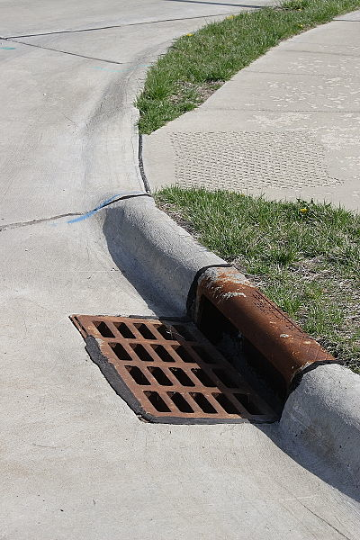
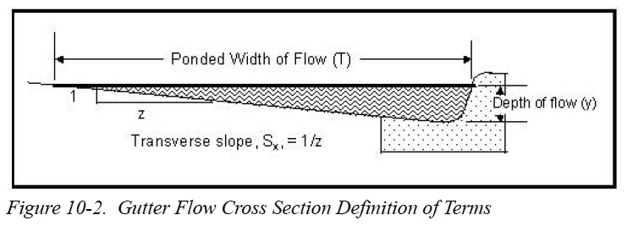
Streets and flow in streets
Curb-and-gutter sections
Curb
Inlet (Curb Opening + Grate)
Gutter
Transverse (cross) slope
Longitudinal Slope, S₀

Slide 12
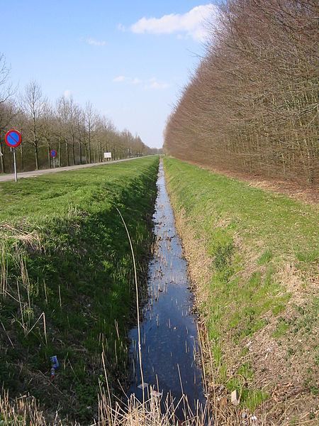
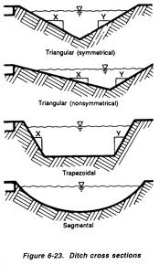
Streets and flow in streets
Ditch sections

Slide 13
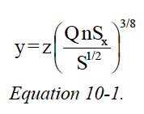
Streets and flow in streets
Flow in curb-and-gutter sections
Equation 10-4

Slide 14
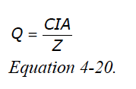
Rational & Modified Rational
The “Rational Equation” is an equation that is used in the vast majority of urban storm drain designs.
The basic equation (HDM) is:
Z is a dimensions correction coefficient
C is a “runoff coefficient”
I is rainfall intensity for an appropriate duration and frequency
A is contributing area, in acres.
Notes:
The area contributing to a point of interest contributes in a simple, linear way (essentially as a regular rectangle and as a kinematic wave)
The area contributing to a point is small (the usual upper bound is 200 acres)
The area contributing to a point is reasonably homogeneous (or composite runoff coefficients make sense)

Slide 15
Intensity-Duration-Frequency
Intensity is the ratio of an accumulated depth to some averaging time usually the time of concentration.
Called “inlet time” for inlet design.

Slide 16
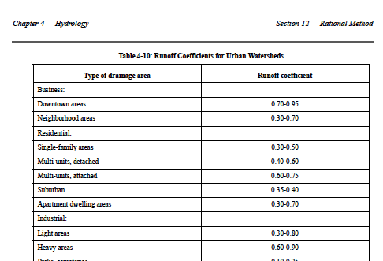
Runoff coefficients
Runoff coefficients are tabulated, and selected from a land use description.

Slide 17
Tc applies where?
2.5 acres
Use NRCS or Kerby-Kirpich;
channel flow only if appropriate
40% Impervious
250 ft
S₀=0.01
4.0 acres
500 ft
475 ft
15% impervious
S₀=0.01
700 ft
30 ft
Travel time based on conduit hydraulics

Slide 18
Curbs
Curbs are the usual roadway bounding feature in urban areas.
Vary in height from negligible to as much as 8 inches
Curbs serve multiple purposes
Minor redirection for errant vehicles
Bounding feature for water running in the roadway as an open channel
Curbs provide constraint that allows them to become a part of inlets.

Slide 19
Roadway ponding width
The primary design criterion for urban storm drainage systems is usually “ponded width” in the roadway
Ponded width is the width of the roadway covered by ponded water
What remains is considered usable roadway
The portion with water ponded is considered to be a traffic hazard
In the design process, each side of the roadway must is considered separately with respect to ponding.

Slide 20
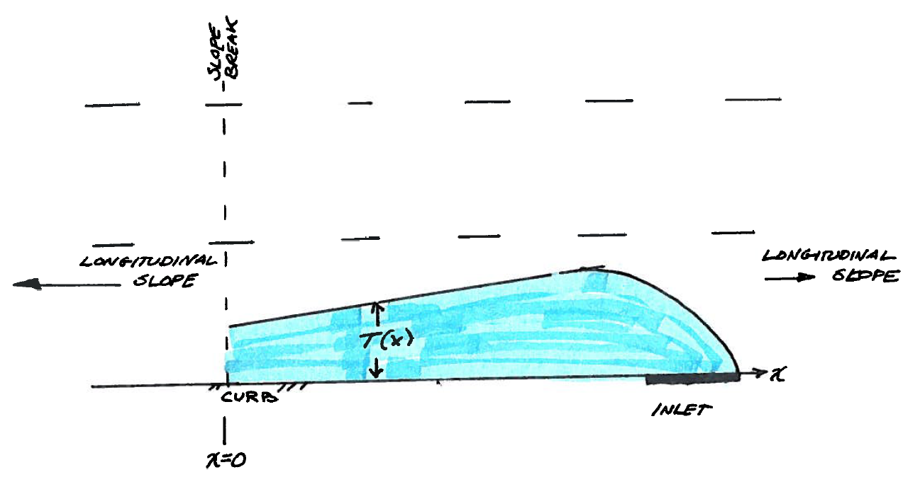
Increase in ponded width
Flow accumulation

Slide 21
Velocity and travel time
As average velocity of contribution increases, travel time for a given distance decreases
All other things being equal, as travel time decreases, critical duration decreases, and the intensity associated with it increases
Notes:
While it may appear that getting water conducted away from features of interest as quickly as possible is desirable, decreasing travel time typically is counter to reducing peak flow rates (because of the relationship between intensity and time).

Slide 22
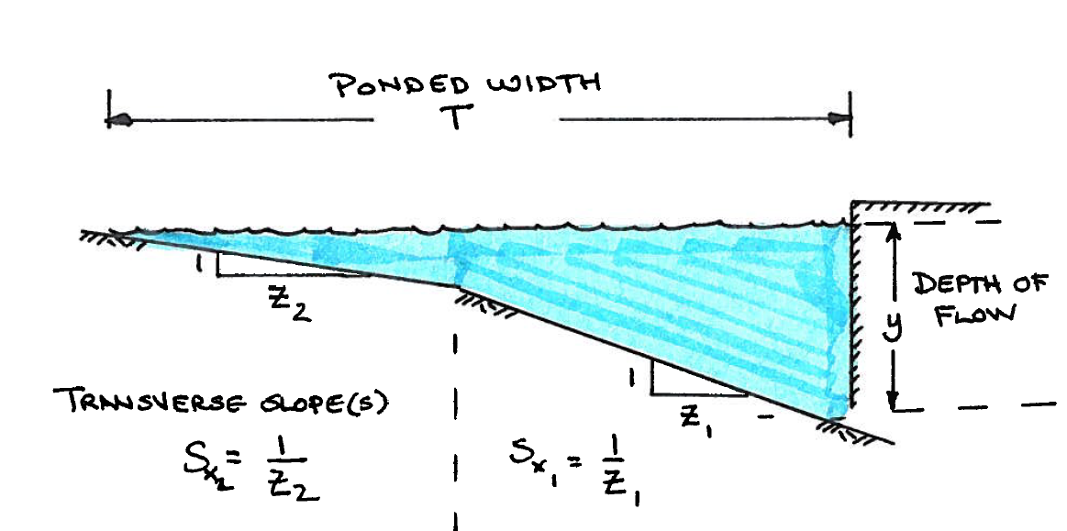
Ponded width
Ponded width computations will usually involve all “Z” values in the typical section.
Z₁ is usually the slope closest to the curb and gutter.

Slide 23
Ponded depth
Ponded depth is the depth at the curb (or edge).
If at an inlet, the depth would be measured from the lip of the inlet.

Slide 24
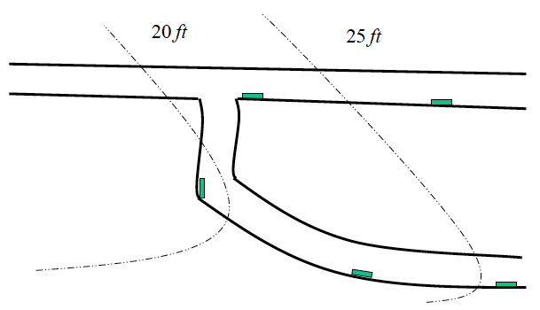
Inlet placement to reduce width
Inlets are placed in low points
Consider intersections
Acceptable ponding widths

Slide 25
Inlet placement to reduce width
Ponding width

Slide 26
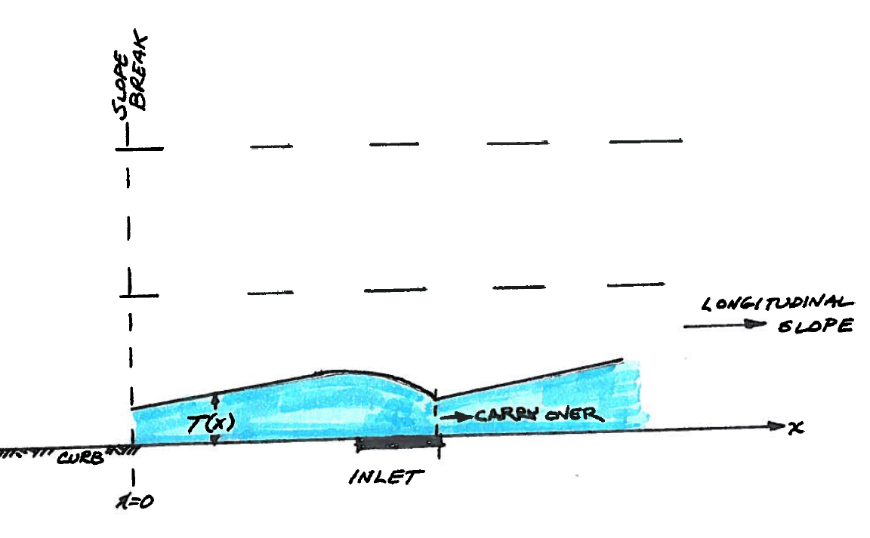
Inlet placement to reduce width
Partial capture with carryover

Slide 27
Inlet Placement
Locations dictated by physical demands, hydraulics, or both
Logical locations include:
Sag configurations
Near intersections
At gore islands
Super-elevation transitions
Allowable ponded width guides location selection

Slide 28
Allowable Ponded Width
Typical Transportation Guidelines
Limit ponding to one-half the width of the outer lane for the main lanes of interstate and controlled access highways
Limit ponding to the width of the outer lane for major highways, which are highways with two or more lanes in each direction, and frontage roads
Limit ponding to a width and depth that will allow the safe passage of one lane of traffic for minor highways

Slide 29
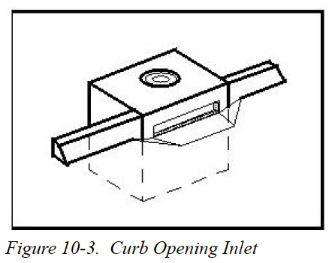
Curb Inlet on Grade
Compute length of inlet for total interception
Subjective decision of actual length
Estimate carryover
L_{R}

Slide 30
Curb Inlet on Grade
Design guidance in HDM pp. 10-30 – 10-35.
Formula for estimating required length
Need geometry
Need desired flow (to capture)
Calculate equivalent cross slope
Inlet height used here
Apply formula for required inlet length

Slide 31
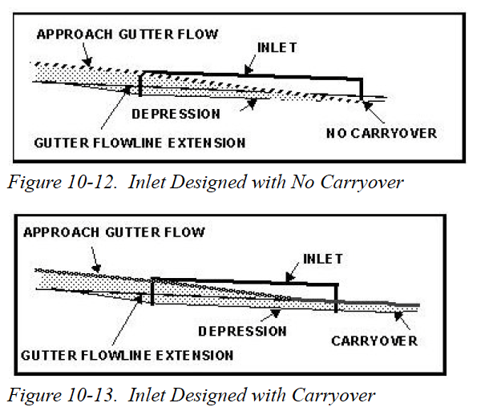
Curb Inlet on Grade
Value of carryover
Uses more of inlet open area – hence may be able to use shorter inlet (if there is compelling need)

Slide 32
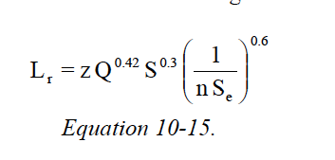
Profile grade vs. inlet length
Inlet length is proportional to longitudinal slope
As slope increases, required length increases
Length for complete capture
Longitudinal slope

Slide 33
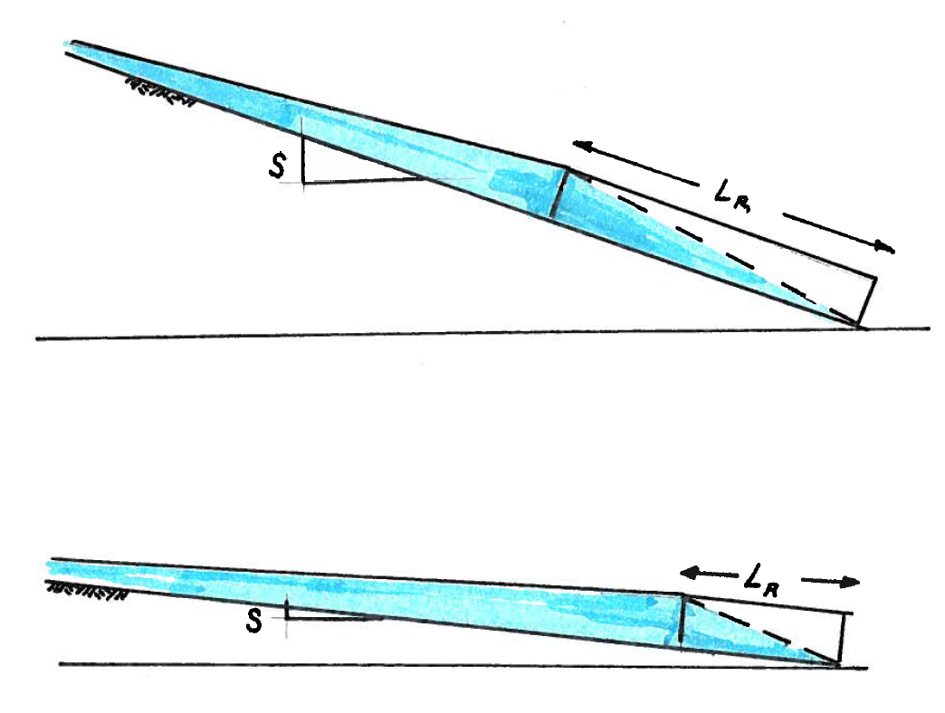
Profile grade vs. inlet length
Inlet length is proportional to longitudinal slope
As slope increases, required length increases

Slide 34
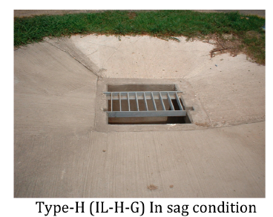
Sag Inlets
Inlets placed at low point of a vertical curve.
Various actual geometries, lowest point is the key feature.

Slide 35
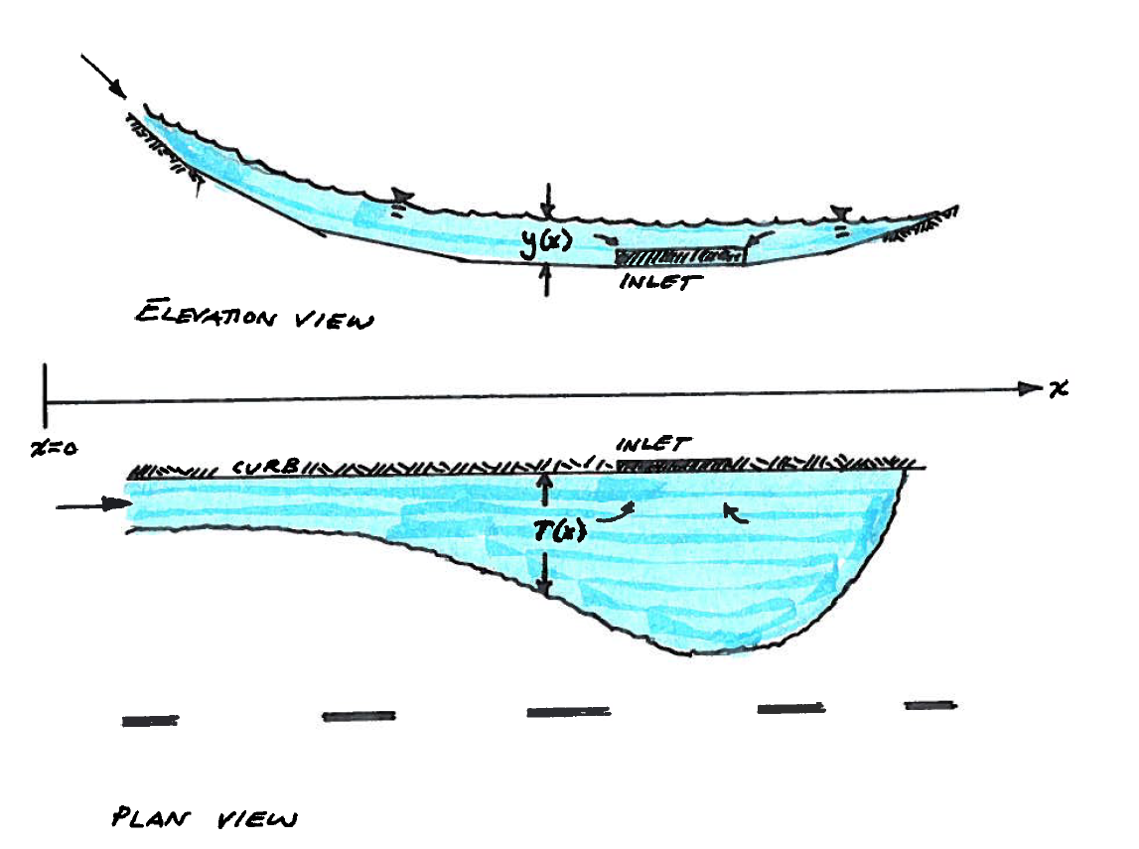
Ponded width vs. vertical curvature
As slope of vertical curve decreases, spread width increases

Slide 36
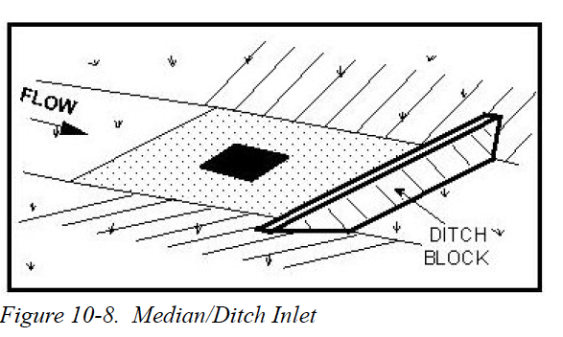
Ponded width vs. vertical curvature
Median inlet configuration

Slide 37
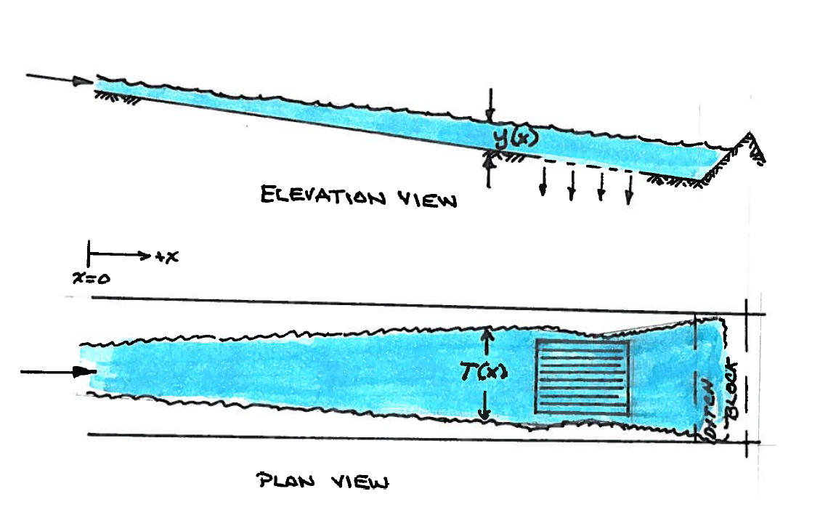
Ponded width vs. vertical curvature
Median inlet configuration

Slide 38
Inlets and inlet performance (Videos)
Grate On-Grade

Slide 39
Inlets and inlet performance (Videos)
Grate with Ditch Block (Sag Condition)

Slide 40
Inlets and inlet performance (Videos)
Tandem Grate Inlets On Grade

Slide 41
Tandem Grate Inlets with Ditch Block (Sag Condition)

Slide 42
Design discharge
The design discharge to the inlet is based on the desired risk (AEP), the surface area that drains to the inlet, and the time of concentration
The time of concentration in this context is also called the inlet time

Slide 43
Design discharge (1 of 2)
The “steps” for the inlet are:
State the desired risk (typically 10-50% AEP)
Determine the area that drains to the inlet
Determine the T_{c} appropriate for the area
If T_{c}<10 min., then use 10 min as the averaging time.

Slide 44
Design discharge (2 of 2)
The “steps” for the inlet are:
Compute intensity from T_{c}.
EBDLKUP.xls, or equation in HDM – be sure to check time units with either tool!
Estimate a reasonable runoff coefficient, C.
Apply rational equation to estimate design discharge, Q

Slide 45
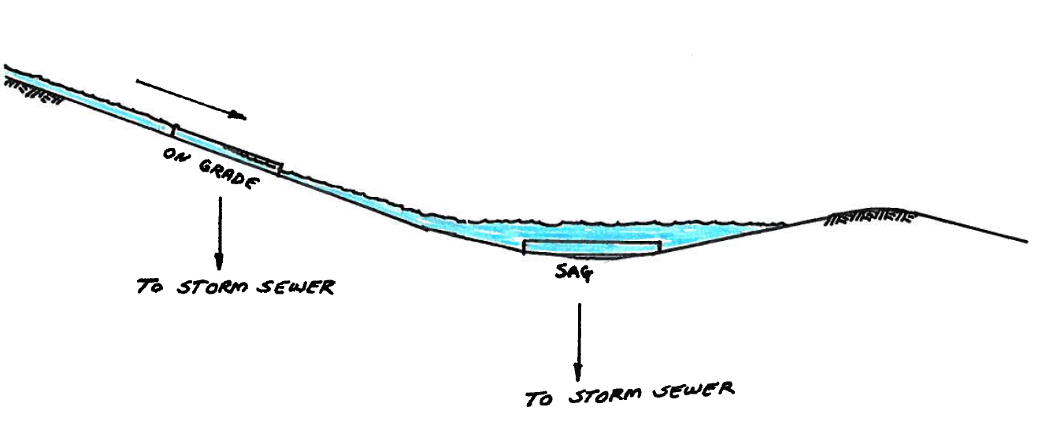
Capacity computations
Based on the design flow, gutter geometry, longitudinal and cross slope, and inlet length and height.
Computations for Inlet On-grade
Computations for Inlet in Sag

Slide 46
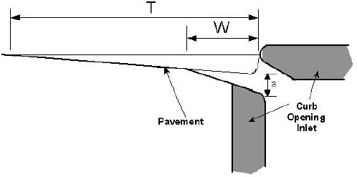
Curb opening inlet design variables
Ponding width = T
Gutter depression = a
Gutter depression width = W

Slide 47
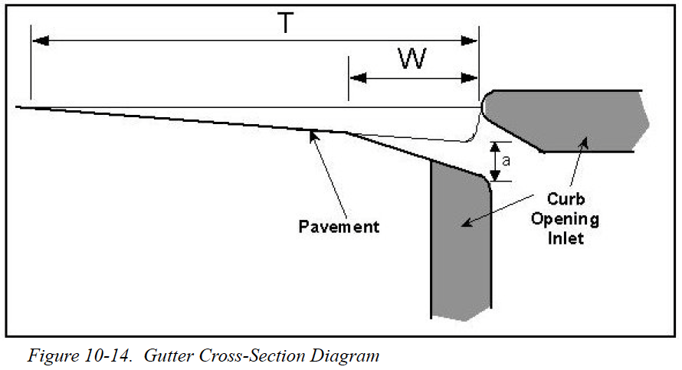
Determining Inlet Length
Use HDM Equations 10-8 through 10-16
Depressed section
Beyond depressed section

Slide 48
Normal depth
TxDOT HDM Eq 10-1
where Q = design flow (cfs); n = Manning’s roughness coefficient; Sx = pavement cross slope; S = friction slope; d = ponded depth (ft).

Slide 49
Ponded width
TxDOT HDM Eq 10-2 where d = ponded depth (ft); Sx = pavement cross slope.

Slide 50
Ratio of depressed section flow to total flow
TxDOT HDM Eq 10-8 where K_{w} = conveyance in depressed section (cfs); K_{o} = conveyance beyond depressed section (cfs); E_{o} = ratio of depressed section flow to total flow.

Slide 51
Conveyance
TxDOT HDM Eq 10-9 where A = cross section area (sq ft); n = Manning roughness coefficient; P = wetted perimeter (ft); K = conveyance.

Slide 52
Area of the depressed gutter section
TxDOT HDM Eq 10-10 where W = depression width (ft); Sx = pavement cross slope; T = ponded width (ft); a = curb opening depression (ft); A_{w} = area of depressed gutter section(sq.ft.).

Slide 53
Wetted perimeter of the depressed gutter section
TxDOT HDM Eq 10-11 where W = depression width (ft); Sx = pavement cross slope; a = curb opening depression (ft); Pw = wetted perimeter of depressed gutter section (ft).

Slide 54
Area of cross section beyond the depression
TxDOT HDM Eq 10-12 where S_{x} = pavement cross slope; T = ponded width (ft); W = depression width (ft); Ao = area of cross section beyond depression.

Slide 55
Wetted perimeter of cross section beyond the depression
TxDOT HDM Eq 10-13 where T = ponded width (ft); W = depression width (ft); Po = wetted perimeter of cross section beyond depression (ft).

Slide 56
Equivalent cross slope
TxDOT HDM Eq 10-14 where Sx = pavement cross slope; a = curb opening depression (ft); W = depression width (ft); Eo = ratio of depression flow to total flow; Se = equivalent cross slope.

Slide 57
Length of curb inlet required
TxDOT HDM Eq 10-15 where Q = flow (cfs); S = longitudinal slope; n = Manning’s roughness coefficient; Se = equivalent cross slope; Lr = length of curb inlet required.

Slide 58
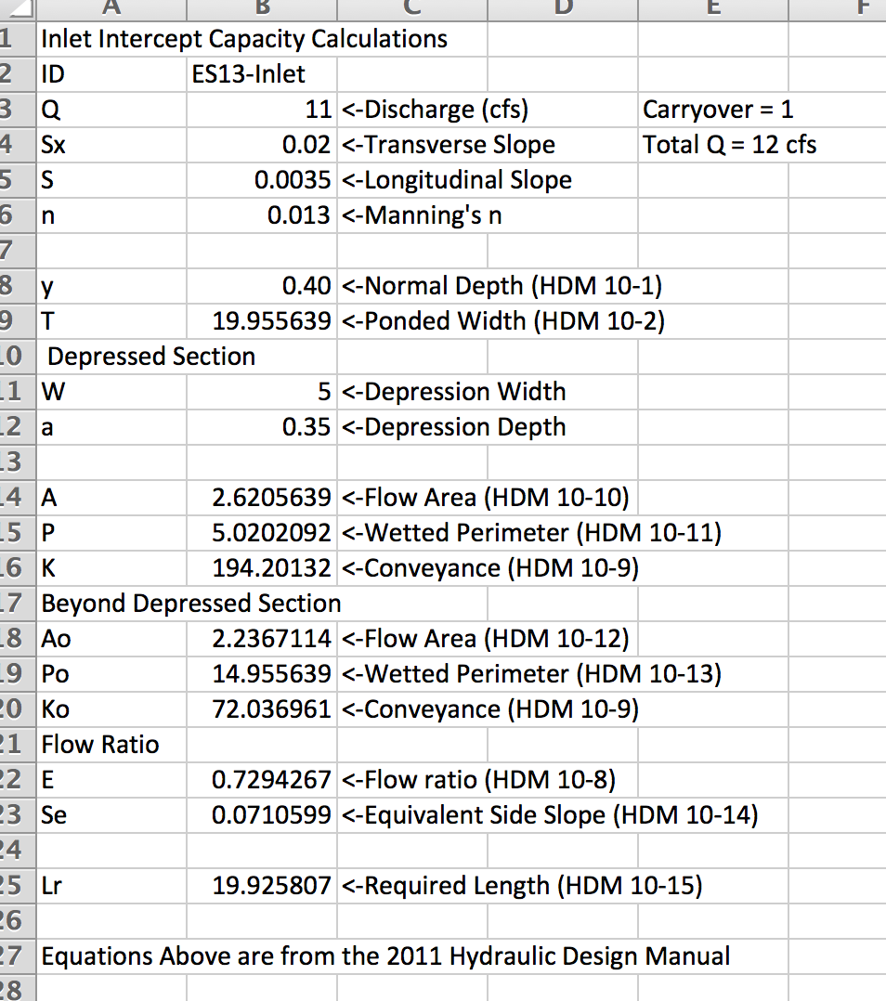
Use spreadsheet tool
Implements inlet computations
Need to think about what trying to accomplish; the tool is not yet nbr ena

Slide 59
Capacity in Sag Placement
Depends on water depth at opening and opening height
Determine if orifice-only flow (d>1.4h)
If d<1.4h compute using a weir flow equation and orifice flow equation for the depth condition, then choose the larger length
d
h
L

Slide 60
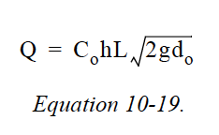
Orifice Flow
d>1.4h
Use equation 10-19

Slide 61
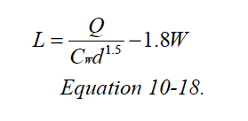
Weir Flow
d<1.4h
Use equation 10-18

Slide 62
Drop Inlets on Grade and Sag

Slide 63
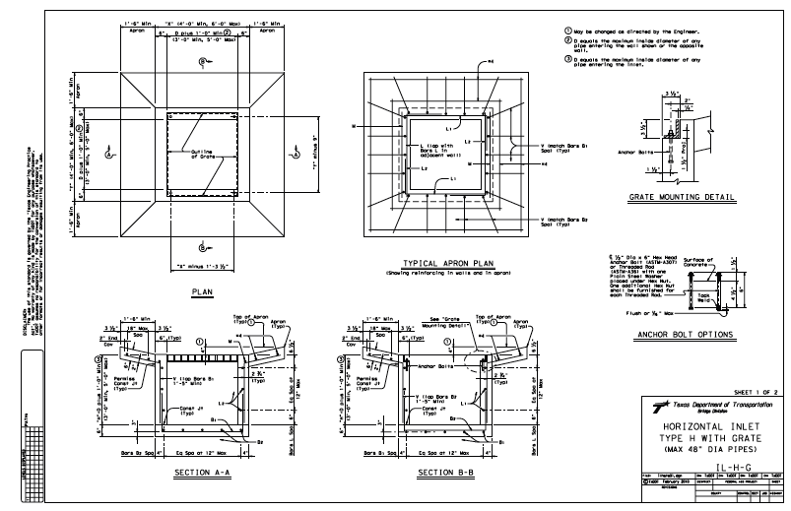
Inlets and inlet performance
Choose grate of standard dimension (e.g. Type-H, etc. from standards and specifications server)

Slide 64
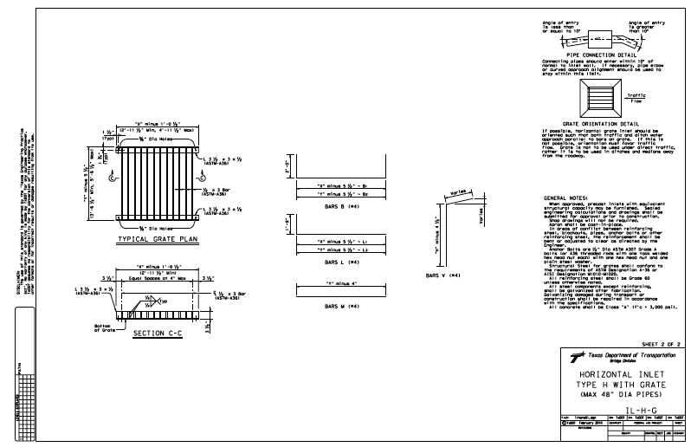
Inlets and inlet performance
Choose grate of standard dimension (e.g. Type-H, etc. from standards and specifications server)

Slide 65
Inlets and inlet performance
Determine allowable head (depth) for the inlet location. Lower of the curb height and depth associated with allowable pond width

Slide 66
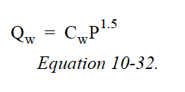
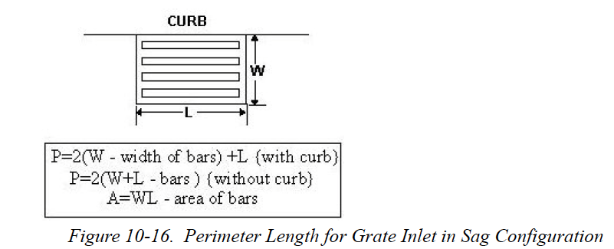
Inlets and inlet performance
Determine the capacity of the grate inlet opening as a weir.
Perimeter controls the capacity.

Slide 67
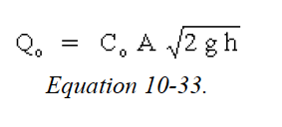
Inlets and inlet performance
Determine the capacity of the grate inlet opening as an orifice.
Area controls the capacity.

Slide 68
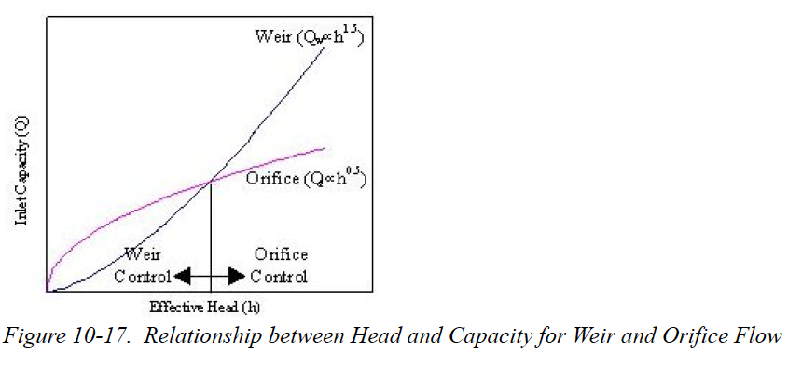
Inlets and inlet performance
Compare the weir and orifice capacities, choose the lower value as the inlet design capacity.

Slide 69
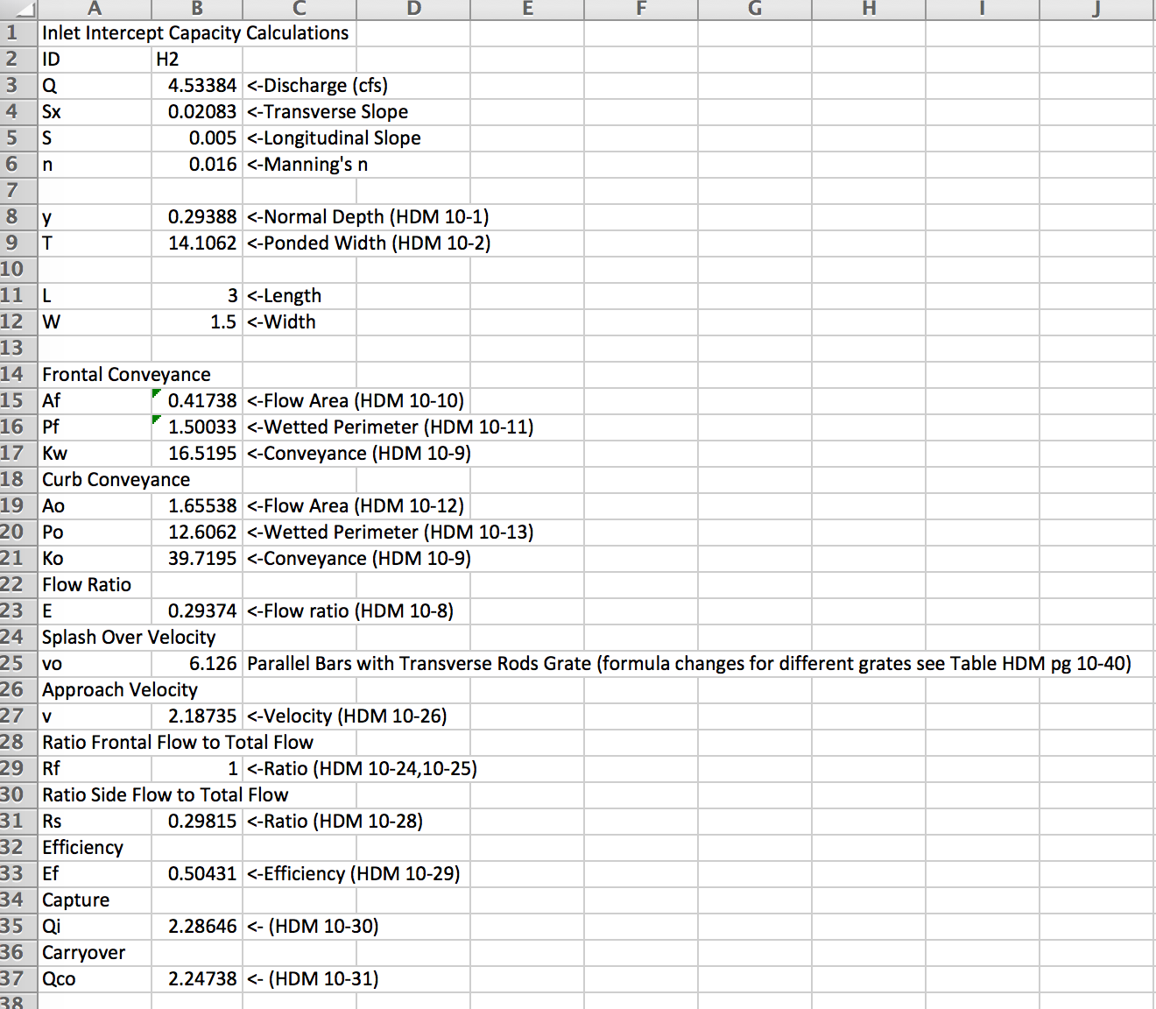
Spreadsheet tools
Grate Inlet On Grade

Slide 70
NEXT TIME
Conduit design
Rational method for storm sewer conduit sizing (by-hand)
Used to obtain initial estimates of required diameters, flowlines, and hydraulic grade lines.
Notes:
So how do we calc peak flow and volumes?
A comparison of the various methodologies shows a wide variation in computed peak discharges for similar watershed and channel conditions. On occasion, these variations lead to confusion and inconsistency among the engineering community
So diff people have diff standards. Which to pick!? It’s like a checklist
Methodology depends primarily on the drainage area of the project. In some cases, the complexity of the design or level of accuracy may influence the method selected.

