Slide 1
CE 3372 Water Systems Design
Lecture 12: storage and extended period simulation

Slide 2
Overview
Storage Concepts
Flow equalization
EPANET Tank Model(s)
Single period simulation
But multiple period simulation -- interesting
Multiple Period Simulation
Reasons
Multiplier Table

Slide 3
Storage
Storage is used in water supply, storm water management, and wastewater systems for a variety of reasons.
One primary reason is flow equalization — generally things are designed for a particular steady flow rate and storage can be used to accommodate variable flow rates in a system.
Storage is either elevated (above grade), at grade (reservoir, tanks, ponds, etc.) or below grade (subsurface vaults — NOT AQUIFERS).

Slide 4
Storage Compartments
Fire storage
Flow-equalization storage
Emergency storage
Fire
Flow Equalization
Emergency

Slide 5
Fire storage
Fire storage is sufficient storage to allow the system to meet routine uses plus substantial fire flow.
The desirable volume is based on expected fire flow rates multiplied by the required fire flow duration.

Slide 6
Flow-equalization
Flow-equalization storage is sufficient storage to account for peak demands in the system without having to exceed supply capacity.
A desirable volume is 1-2 days of average daily demand.

Slide 7
emergency storage
Emergency storage to allow the system to operate without external supply sources for a period of time to allow for repairs or other unusual circumstances.
Without emergency storage, every upset will lead to a ”boil-water” order or substantial interruption of service — these kinds of interruptions should be rare if the system is well engineered.
A desirable volume is 1-2 days of average daily demand.

Slide 8
How much?
Engineering would tend to choose for the larger volumes
Economics will argue for the smaller volumes
The engineer will have to balance these competing choices in a design.

Slide 9
Residence time
Additionally, residence times in any storage reservoir for TREATED water should not exceed a reasonable amount disinfection residual contact time.
For chlorine/chloramine disinfection time is on the order of 6-10 days
An hydraulic retention time of any such reservoir should be no longer than 8 days (as a reasonable rule of thumb).

Slide 10
Hydraulic Retention Time
Hydraulic retention time is the ratio of storage volume to average discharge through the reservoir

Slide 11
How much? Flow Equalization
Operating (flow-equalization) storage is determined as follows:
Determine the hourly demand for a typical design day.
Compute the cumulative draft (cumulative volume as a function of time)
Compute the average constant draft rate (flow rate that if applied over the day end at the same accumulated value)
The equalization storage is the sum of the two largest deviations from the average flow line to the cumulative draft line.

Slide 12
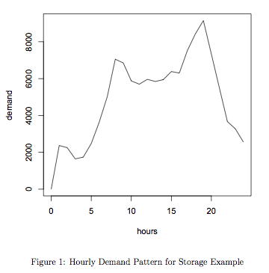
Flow Equalization Storage
Demand pattern from historical data appropriate to the service area.

Slide 13
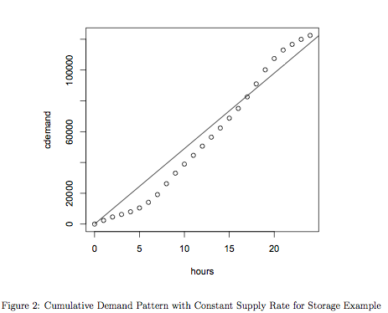
Flow Equalization Storage
Accumulate the demand

Slide 14
Flow Equalization Storage
Average constant draft

Slide 15
Flow Equalization Storage
Sum the 2 largest deviations
Storage required V1+V2
In this chart, about 25000 volume units.
V2
V1

Slide 16
Flow Equalization
The engineer needs to decide which demand to use:
Daily
Peak
These volumes are added to that needed for emergency and fire flow.
Determines the tank volume required
Tank type (elevated, at-grade, buried) determines shape – elevation, diameter, min-level, max-level.
Elevated tanks have substantial structural considerations

Slide 17
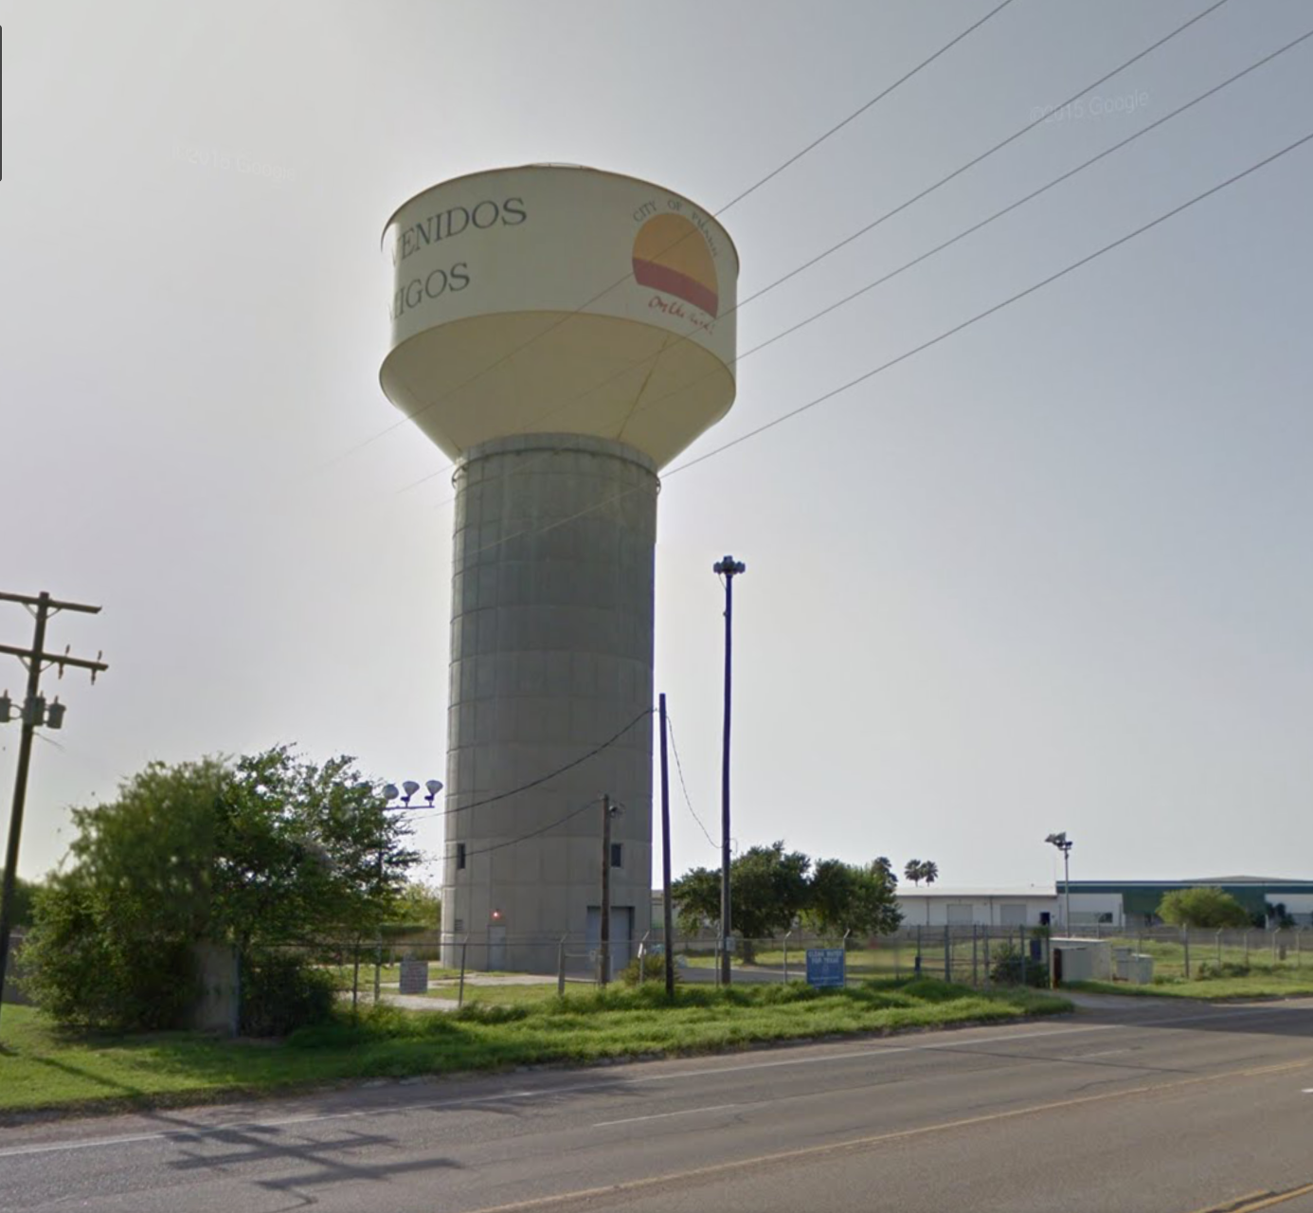
Typical installation

Slide 18
Storm Water Storage
Used to mitigate peak flows from development.
Provide water quality benefit.
Develop a water resource (rainwater harvesting)

Slide 19
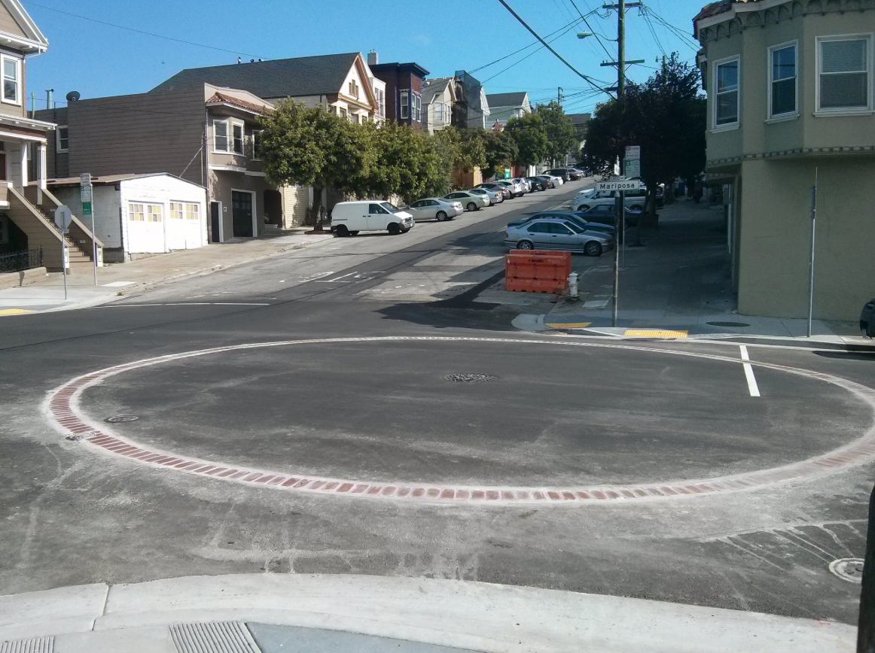
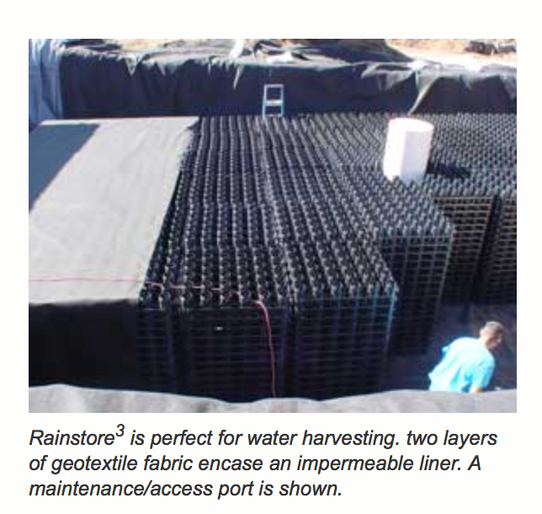
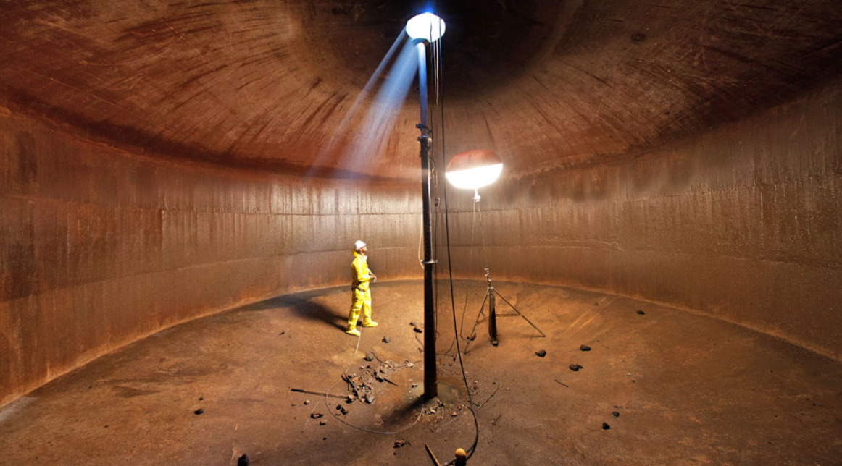
Underground “tank”
More than a hole in the ground
Needs structure to support surface loads
Needs a way to drain completely (usually a pump)

Slide 20
Readings
EPA NET User Manual – how to model storage tanks in a water distribution system.
Interesting web-resources
http://www.invisiblestructures.com/rainstore3.html
http://www.upout.com/blog/san-francisco-3/heres-what-it-looks-like-under-those-brick-circles-in-the-street

Slide 21
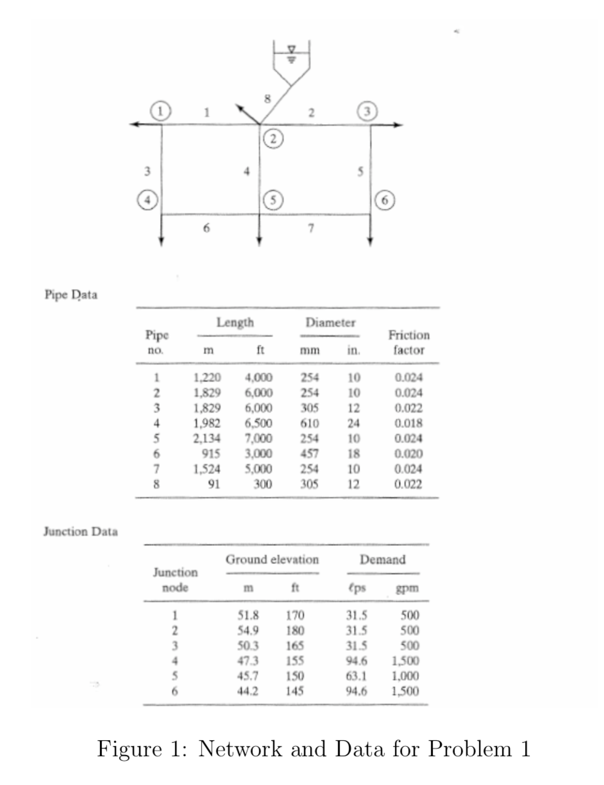
Recall earlier example

Slide 22
Modeling Protocol
Sketch a layout on paper
Identify pipe diameters; length; roughness values
Identify node elevations; demands
Supply reservoir (or tank); identify reservoir pool elevation
Identify pumps; pump curve in problem units
Notes:
Globe is most used.

Slide 23
Tank
Supply reservoir (or tank); identify reservoir pool elevation
May need assumptions
Tank dimensions should be sensible
Pipe length is given
Diameter
Z=315 ft
Max Level
Z=300 ft
Min Level
L₂=120 ft
Node 2
Pipe 8: L₁ + L₂ = 300 ft
Z=180 ft
Elevation
L₁=180 ft
Notes:
Globe is most used.

Slide 24
Extended period simulation
EPANET and similar programs find steady-flow solutions
Extended period simulation produces a sequence of steady states with approximations for:
Tanks drain and fill
Pressures can change at beginning and end of a time interval
Pump operating points moving along a pump curve

Slide 25
Uses
Extended period simulation used for:
Modeling pressure in systems during changing demand –usually at hourly time scale
Storage tank operation and sizing
Water quality simulation
EPANET can approximate water quality from multiple sources – has uses in
Water age in system
Detection of intrusions into a system
Severity of contamination (impact assessment)

Slide 26
How implemented?
In EPANET assign a demand pattern to a node
Set simulation times
Program then follows the pattern

Slide 27
Modeling Protocol
Sketch a layout on paper
Identify pipe diameters; length; roughness values
Identify node elevations; demands
Supply reservoir (or tank); identify reservoir pool elevation
Identify pumps; pump curve in problem units
Identify demand pattern(s) and tank operating considerations
Notes:
Globe is most used.

Slide 28
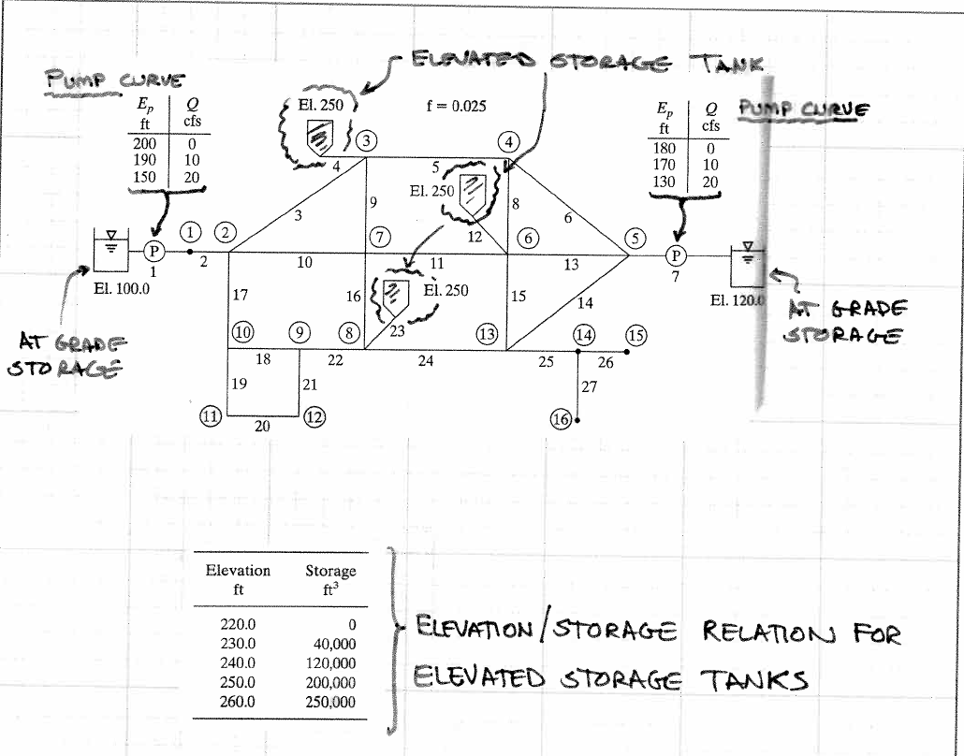
example

Slide 29
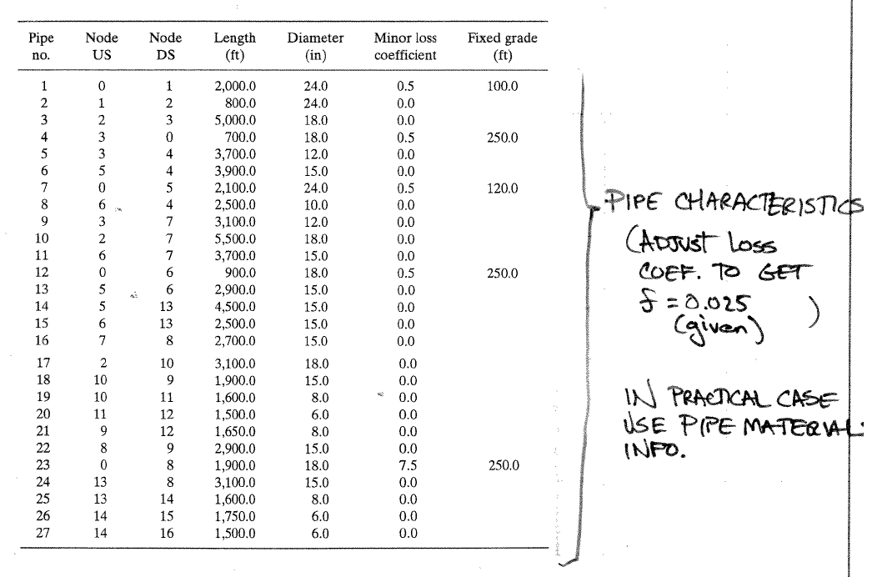
Illustrate by example

Slide 30
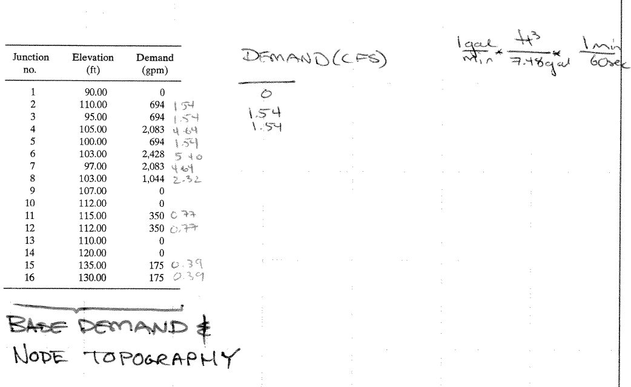
Illustrate by example

Slide 31
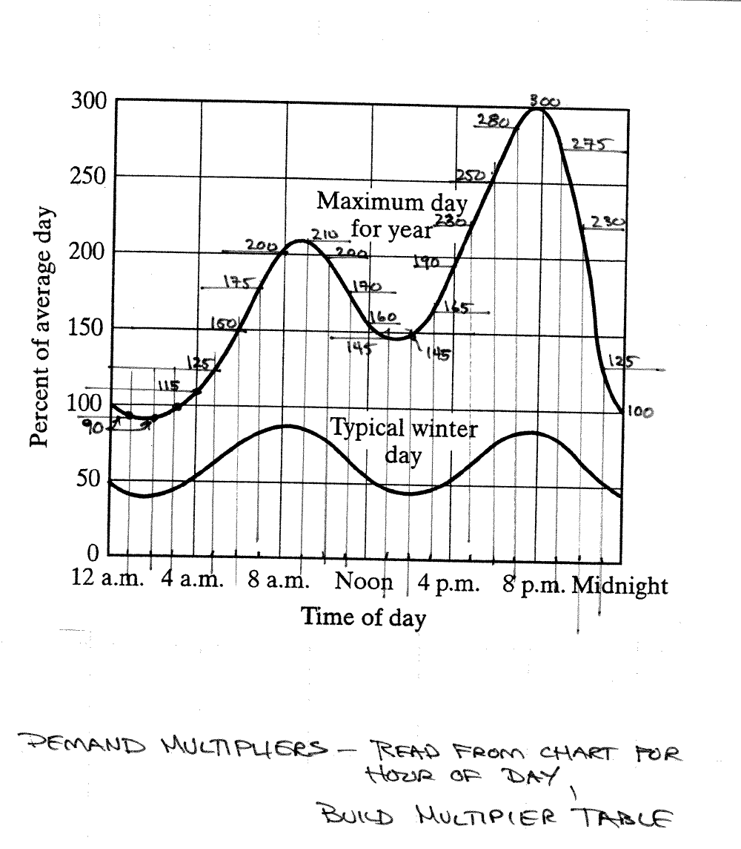
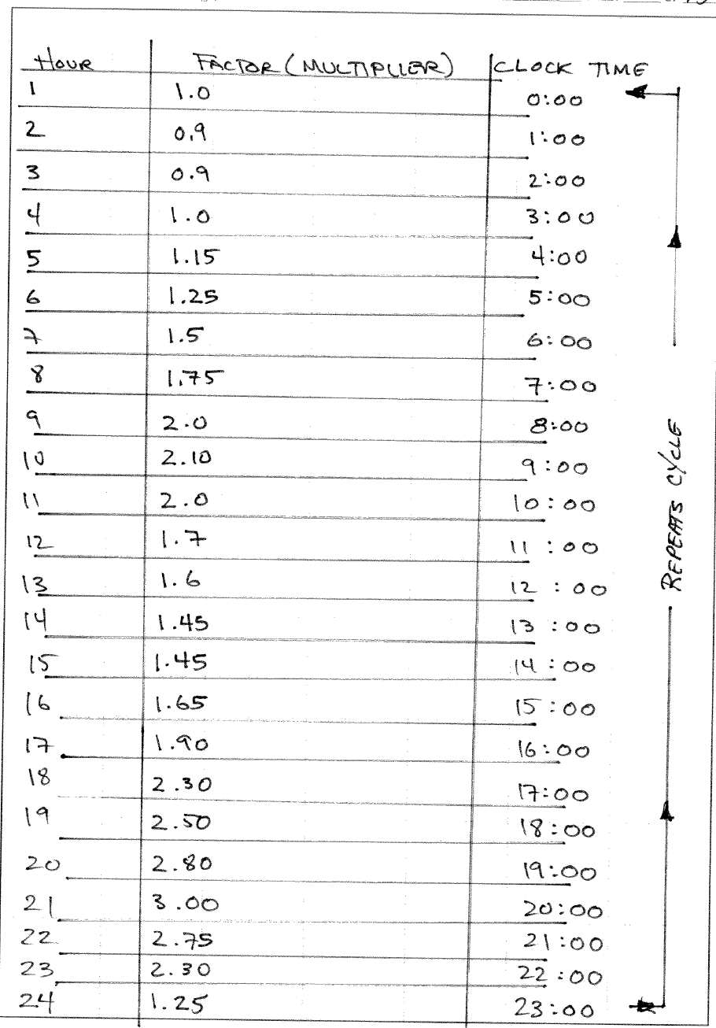
Illustrate by example

Slide 32
Illustrate by example
Build network layout
Nodes (junctions, tanks, reservoirs)
Links (pipes, pumps, valves)
Add pump curves
BROWSER/DATA/CURVES/ADD (TYPE=PUMP)
Add storage curves
BROWSER/DATA/CURVES/ADD (TYPE=STORAGE)
Add demand pattern(s)
BROWSER/PATTERNS/ADD

Slide 33
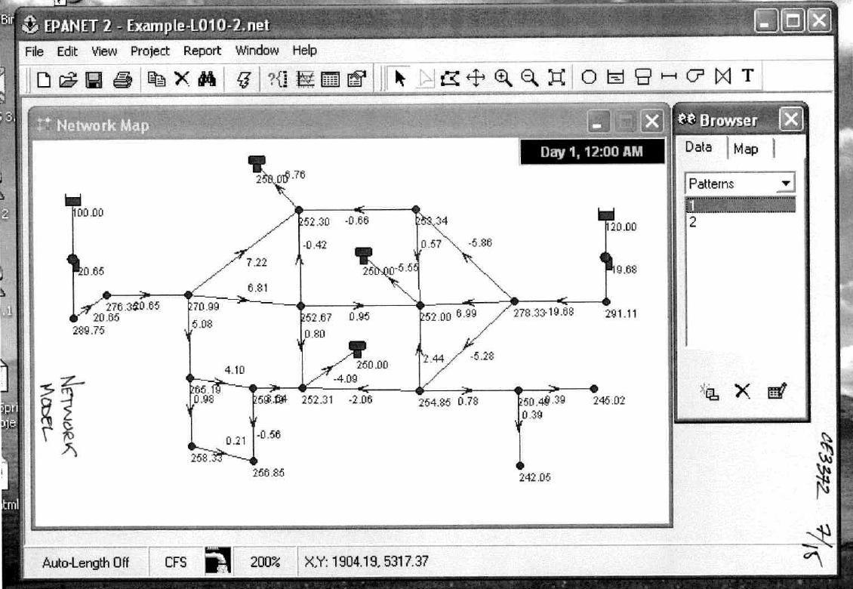
Illustrate by example

Slide 34
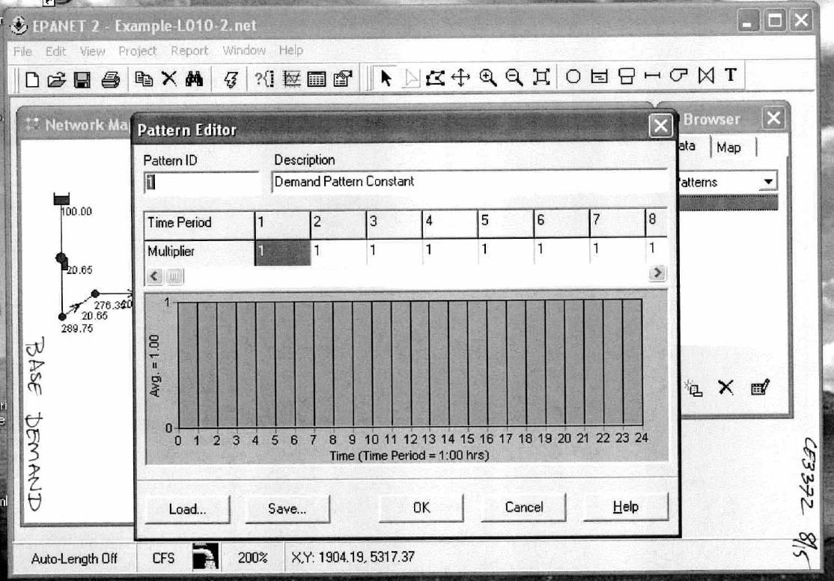
Illustrate by example

Slide 35
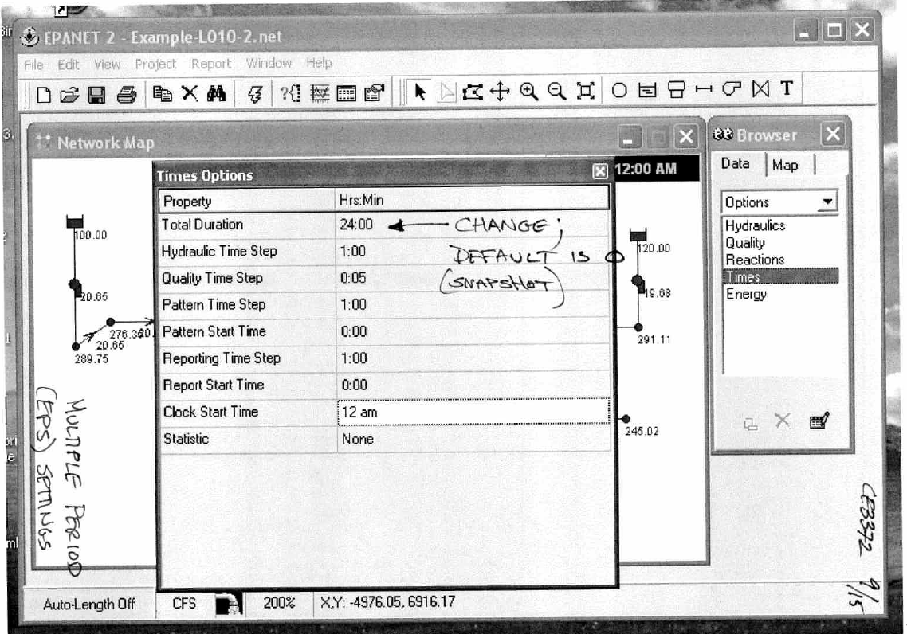
Illustrate by example

Slide 36
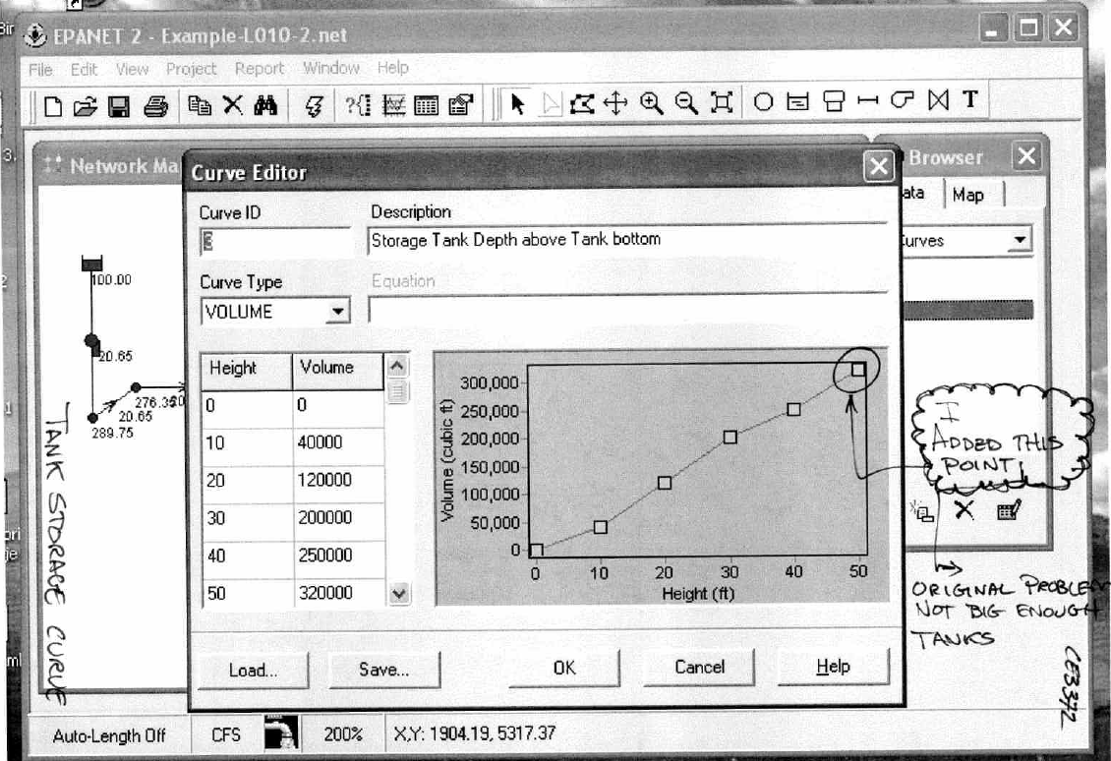
Illustrate by example

Slide 37
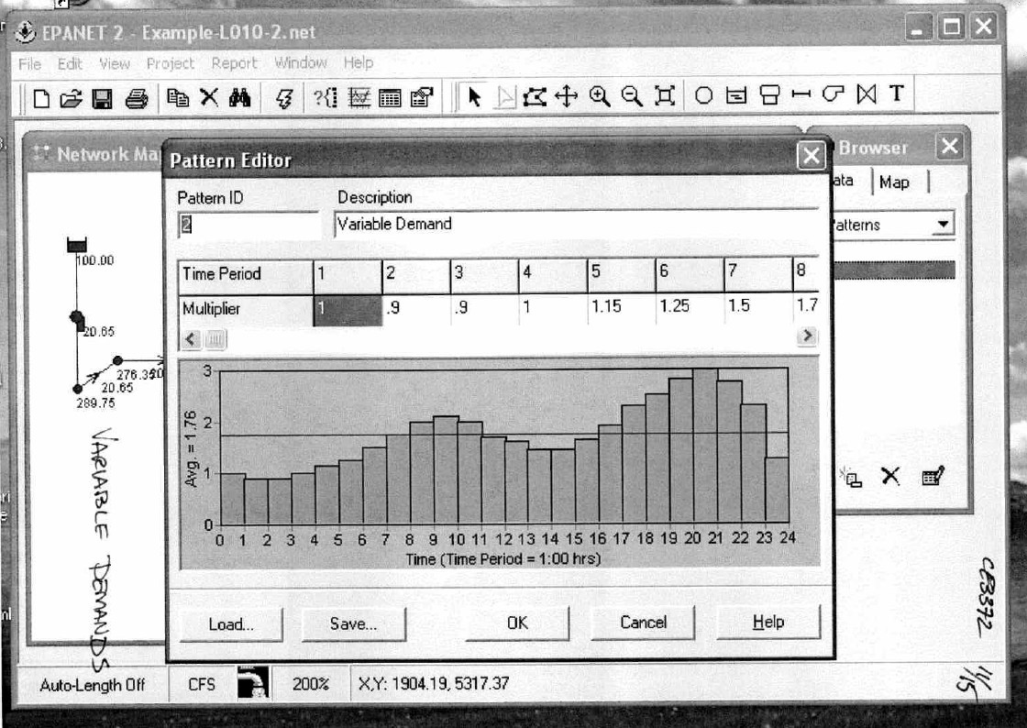
Illustrate by example

Slide 38
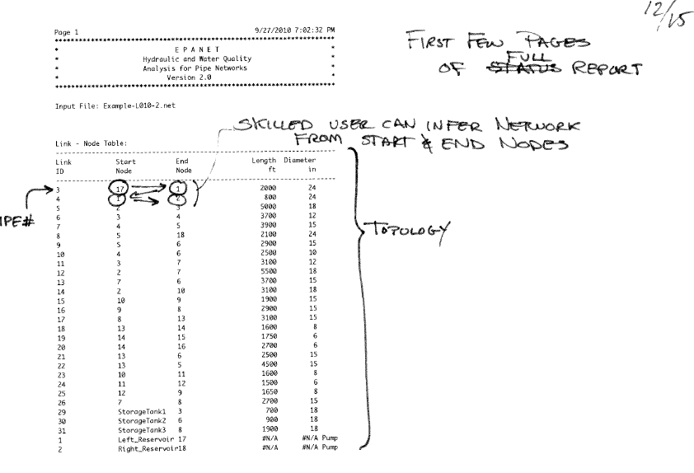
Report output

Slide 39
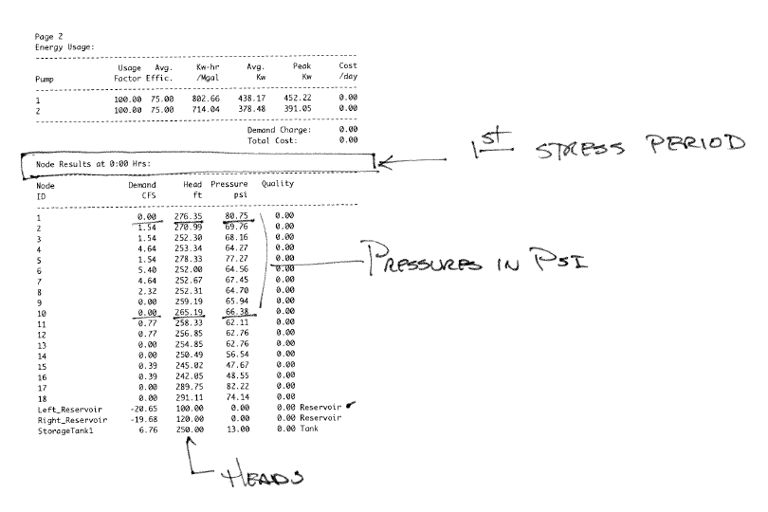
Report output

Slide 40
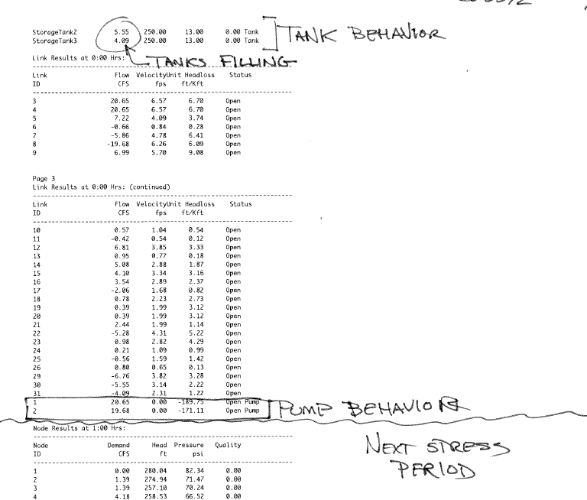
Report output

Slide 41
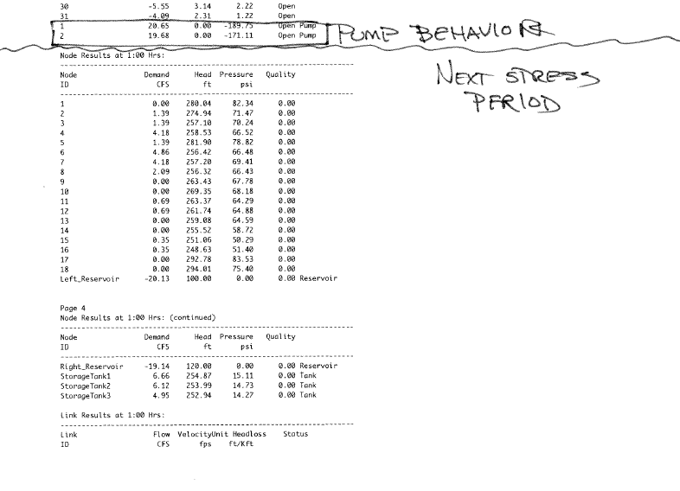
Report output

Slide 42
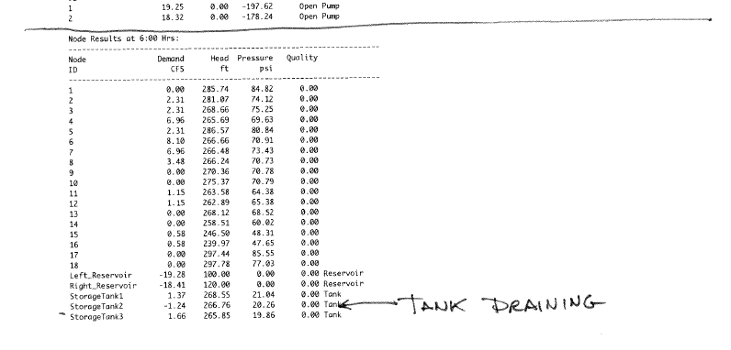
Report output

Slide 43
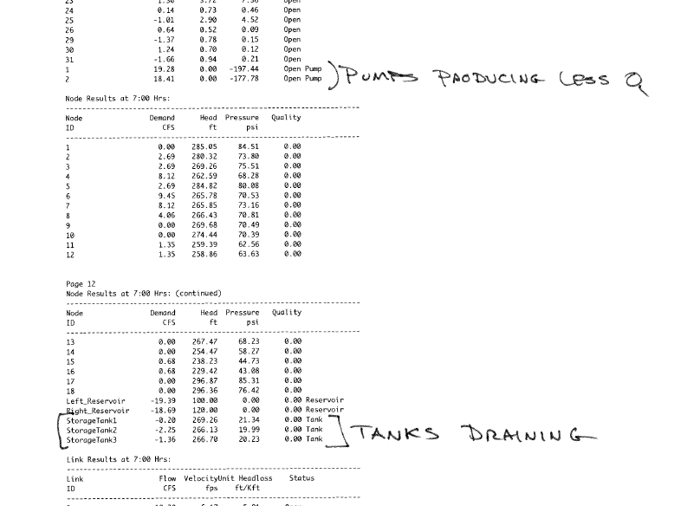
Report output

Slide 44
Next time
Water Quality in EPANET

