Slide 1
CE 3372 Water Systems Design
pipeline HYDRAULICS examples : Part 1

Slide 2
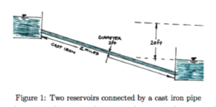
Example 1: Using on-line tools
Repeat the flow between two reserviors, but change materials, include entrance and exit losses
K_{in} = ?
K_{exit} = ?
concrete

Slide 3
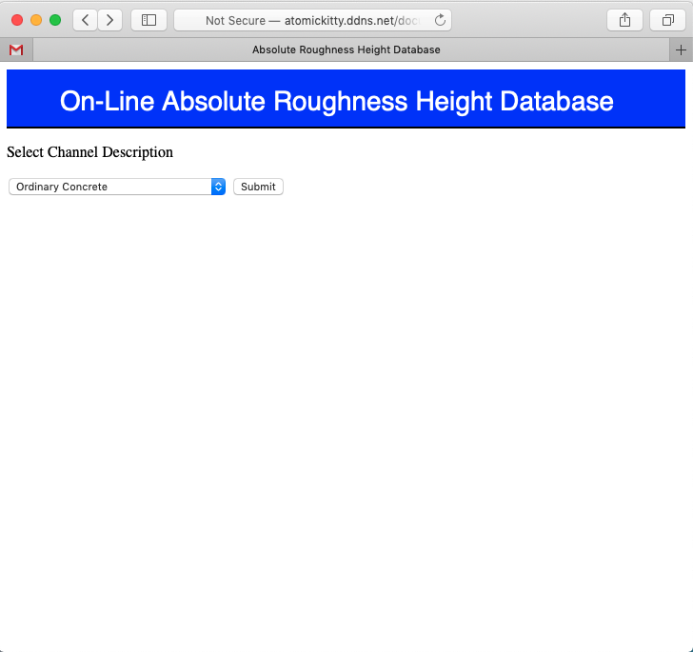
Example:
Determine roughness height for pipeline; k_{s} = 1.0mm

Slide 4
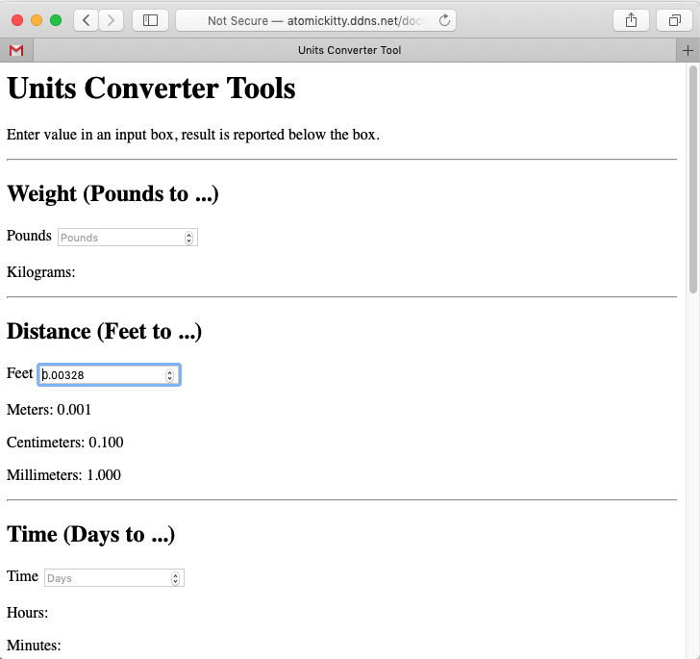
Example:
Convert millimeters to feet, k_{s} = 0.00328 ft

Slide 5
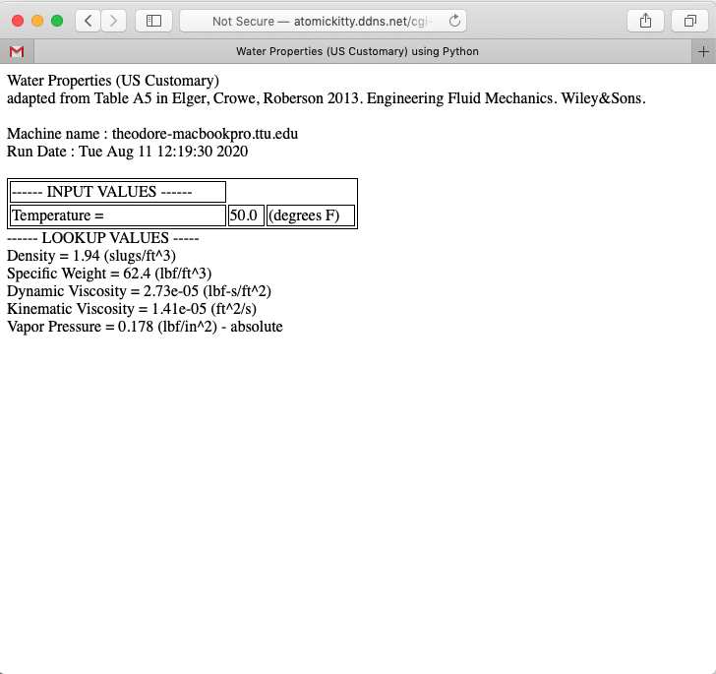
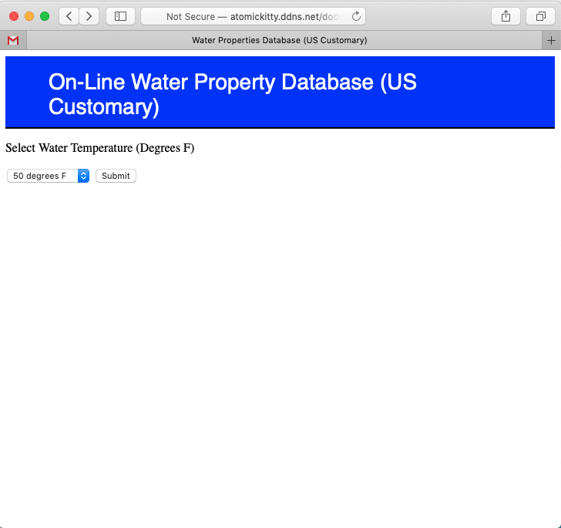
Example:
Water Properties

Slide 6
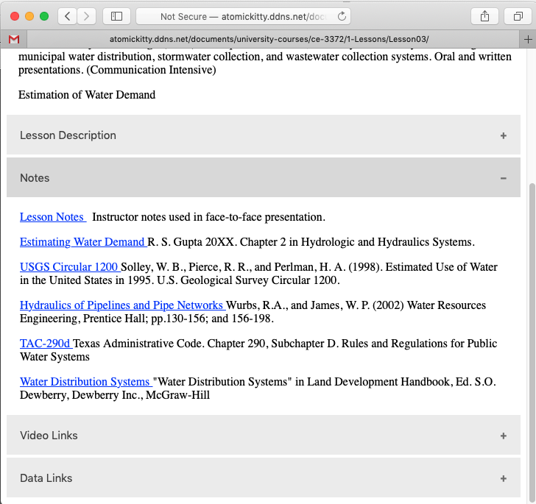
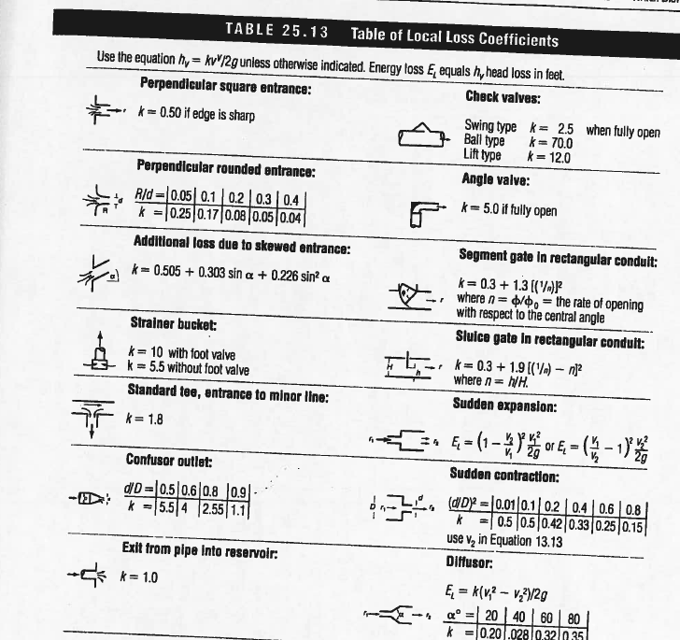
Example:
Minor Loss Coefficients
K_{in} = 0.5
K_{exit} = 1.0

Slide 7
Example:
Collect the various pieces of information:
Apply the JupyterLab tool, or online tool.
K_{in} = 0.5
K_{exit} = 1.0
Concrete:
k_{s} = 0.00328 ft
Kinematic Viscosity = 1.41e-05 (ft^2/s)

Slide 8
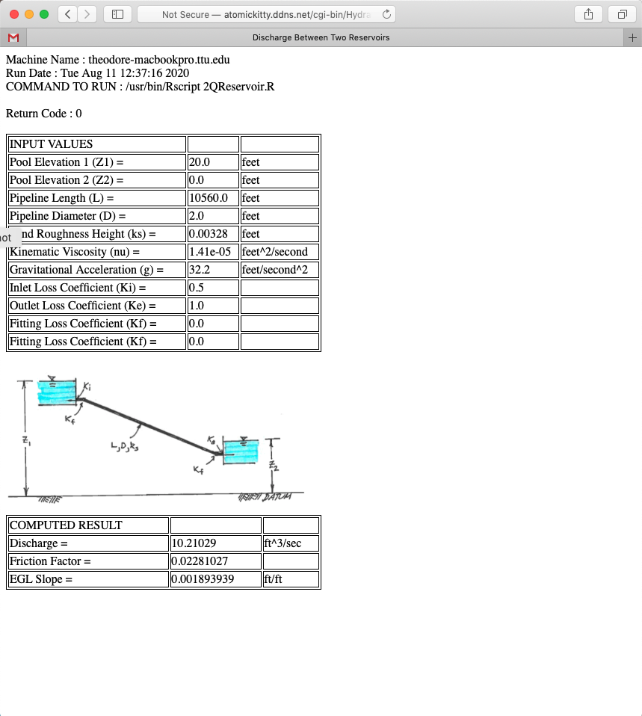
Example:
Online tool:

Slide 9
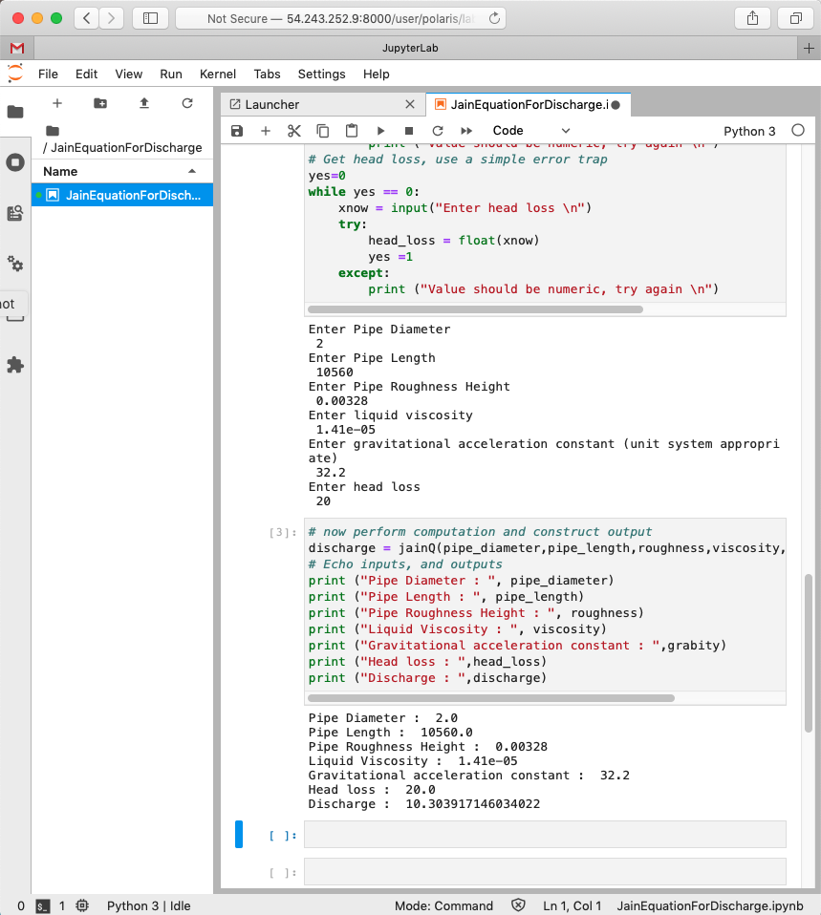
Example:
JupyterLab Notebook:
Nearly same result, Notebook did not account for entrance and exit losses

