Slide 1
Use of the Basin Development Factor to Urban Watershed Response
Theodore G. Cleveland
Shiva Sunder
David Thompson

Slide 2
Acknowledgements
W.H. Asquith, M.S. Roussel, USGS-Austin; S. Fitzgerald, HCFCD; D. Barrett, F. Liscum, D. Schwartz, S. Johnson (RGMiller, PBS&J, NWS, LJA)
Texas Department of Transportation, Harris County Flood Control District.

Slide 3
Background
Needed to explain hydrologic responses to answer:
How have responses changed with urbanization over time (in a coastal low-slope area)?
How will responses change as urbanization proceeds?
Want to use the answers to understand how to implement drainage policy, etc.

Slide 4
Background
Assumptions:
Response of a watershed is controlled in large part by its topography, storage properties, and loss (or runoff generation) properties.
Observe that topography is relatively unchanged in urban watersheds (we are not moving mountains in our study area) but hydrologic response certainly changes.
Response change is some proportion to changes in storage, runoff generation, and conveyance efficiency to the outlet.

Slide 5
Background
Prior Work:
Various work in Houston and in broader Texas area demonstrated that a large fraction of variability is explained by topography, but a distinction between undeveloped and developed was used (binary distinction).
A basin-development-factor extends the classification by more categories, possible that such further refinement could improve estimates.

Slide 6
Background
Basin Development Factor (BDF)
The BDF (Sauer et al., 1983) is a metric thought to be associated with runoff transport efficiency of the drainage systems in a watershed.
The BDF indirectly addresses the storage and transport components of a watershed’s runoff signal.
BDF is a categorical variable, whose value is assigned based on the prevalence of certain drainage conditions that result from urbanization of a watershed.

Slide 7
Basin Development Factor
Basin Development Factor (BDF)
Scoring based upon presence of
(1) Channel Improvements: straightening, deepening, clearing and enlarging.
(2) Channel linings
(3) Storm drains or storm sewers:
(4) Curbs and gutters:
Value from 0-12. Most analysts produce same scores (+/- 1) when using the same imagery.

Slide 8
What We Did
Determined present-day BDF for 133 watersheds in Texas with paired rainfall-runoff observations. (historical BDF for a subset was also available)
Prior analysis of the rainfall-runoff data produced peak discharge factors (Qp), and characteristic times (Tp) – these values were segregated by BDF to examine if a useful relationship exists.
Conjecture:
BDF -> small, Qp -> small, Tp -> large.
BDF -> large, Qp -> large, Tp ->small.

Slide 9
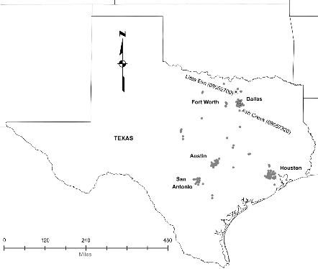
Study Area
130+ Texas watersheds.
3000+ storms.

Slide 10
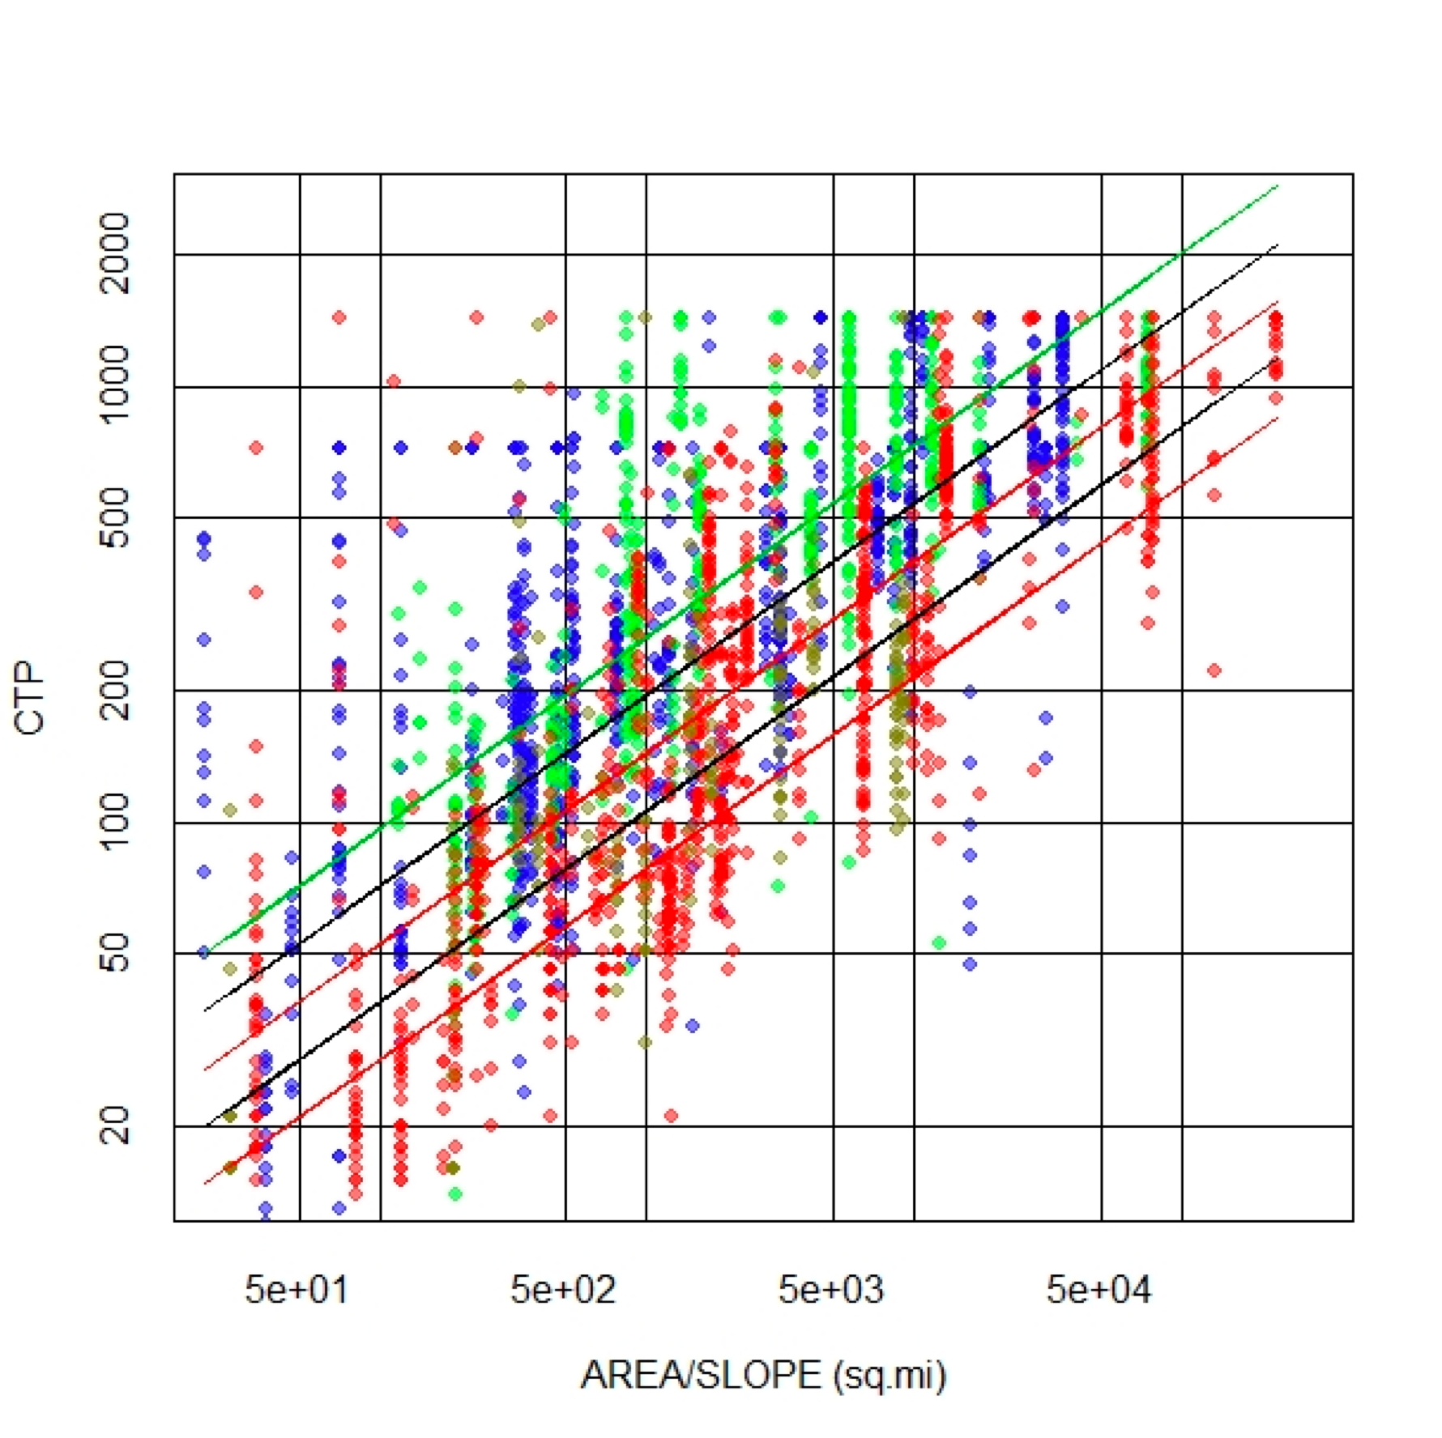
What We Learned
Considerable variability
Evidence in the plot supporting the conjecture.
More than binary distinction, but not huge demarcations.
Decreasing BDF
Increasing BDF

Slide 11
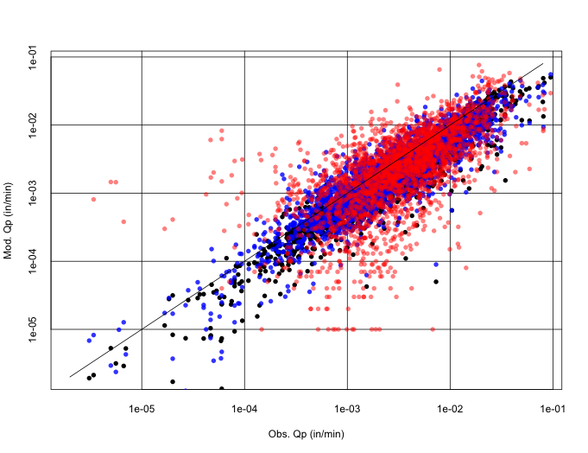
What We Learned
Model and observed responses.
Black= storm optimized.
Blue = terrain model (binary considerations of development)
Red = BDF result.
Increased variability.

Slide 12
What We Learned
Inclusion of BDF as an explanatory variable did not increase prediction performance as compared to binary classification of developed/undeveloped.
If zero-discharge cases are censored (not shown), there is support of the conjecture that BDF explains a portion of response.

Slide 13
Recent Efforts
Added ARS paired datasets from 30+ watersheds around the USA; re-analyzed entire database.
Have 4 “groups”:
ARS Not-Texas
Small Rural – Texas
Urban – Texas (not Houston)
Houston.

Slide 14
Study Area
130+ Texas watersheds.
ARS Research Watersheds from:
Arkansas
Georgia
Indiana
Iowa
Nebraska
Ohio
Virginia

Slide 15
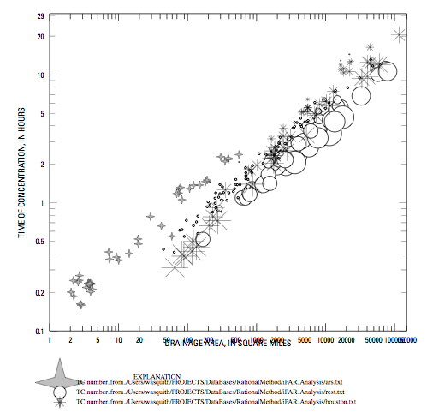
Small Rural-Texas
Decreasing Slope
Developed, Not Houston - Texas
ARS – Non-Texas
Increasing BDF
Houston-Texas
ACRES

Slide 16
Summary
BDF applied as part of broader study of response metrics. Exhibits some utility when zero-discharge cases are censored.
BDF increase correlated with characteristic time decrease (anticipated result).
Slope (as an explanatory variable) plays a confounding role.

Slide 17
Where we are heading
Continued to explore the concept --- seems to have value within a geographic region.
BDF 0-3 is associated with larger characteristic time, BDF 9-12 is associated with smaller characteristic time.
In the intermediate range of the categorical variable, there is ambiguity.

