Slide 1
Empirical Flow Parameters: A Tool for Hydraulic Model Screening Theodore G. Cleveland Caroline M. Neale Cristal C. Tay George R. Herrmann

Slide 2
Acknowledgements
Contributions by W.H. Asquith, Hatim Sharif, Xiaofeng Liu, and K.B. Strom
Funding and direction provided by the Texas Department of Transportation through research contract 0-6654 Empirical Flow Parameters - A Tool for Hydraulic Model Validity Assessment
Disclaimer: The contents of this presentation reflect the views of the author(s), who is (are) responsible for the facts and the accuracy of the data presented herein. The contents do not necessarily reflect the official view or policies of the Federal Highway Administration (FHWA) or the Texas Department of Transportation (TxDOT). This report does not constitute a standard, specification, or regulation. This presentation is not intended for construction, bidding, or permit purposes. The United States Government and the State of Texas do not endorse products or manufacturers.

Slide 3
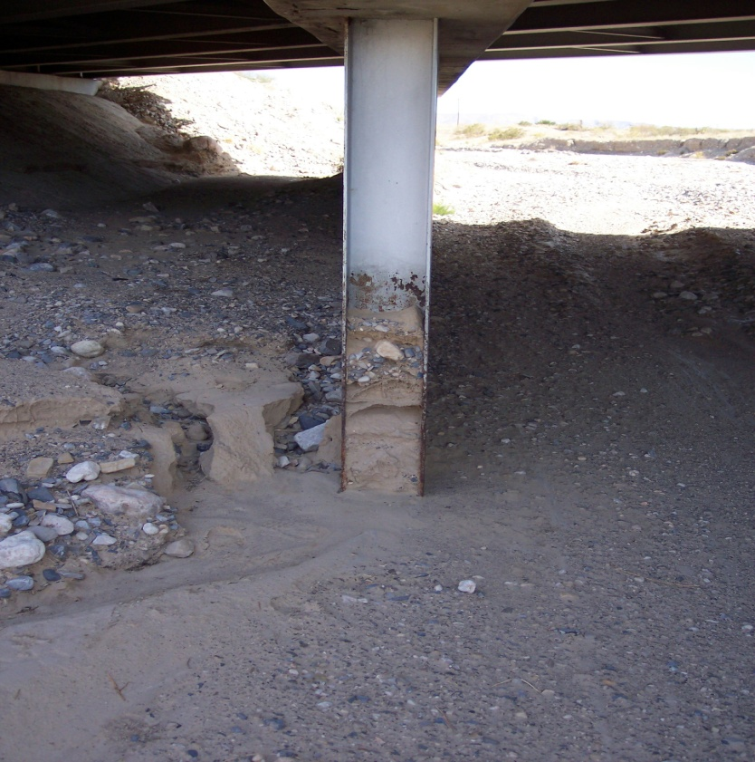
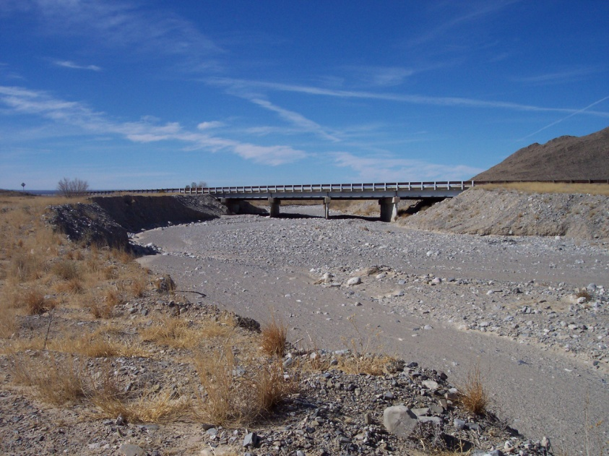
Background
Highway crossing in Texas (West of Guadalupe Mountain National Park)

Slide 4
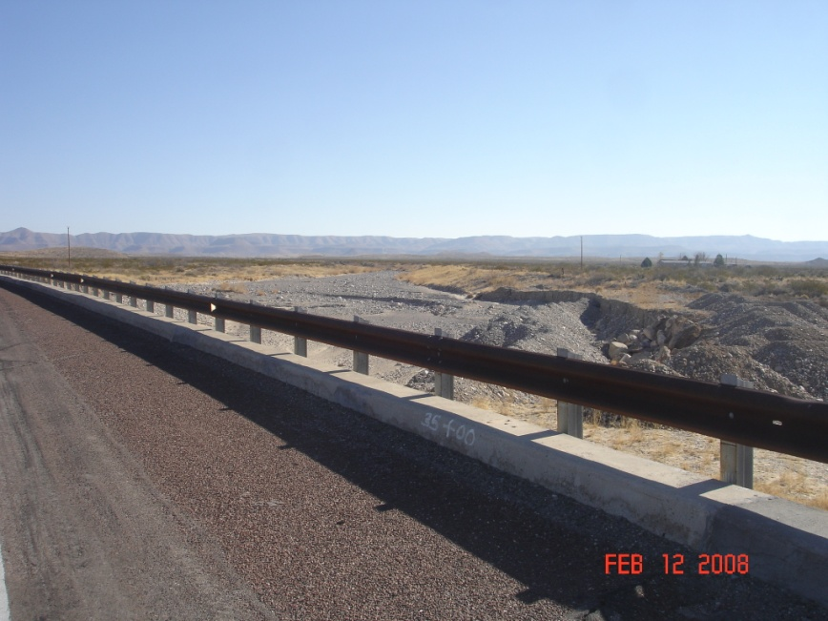
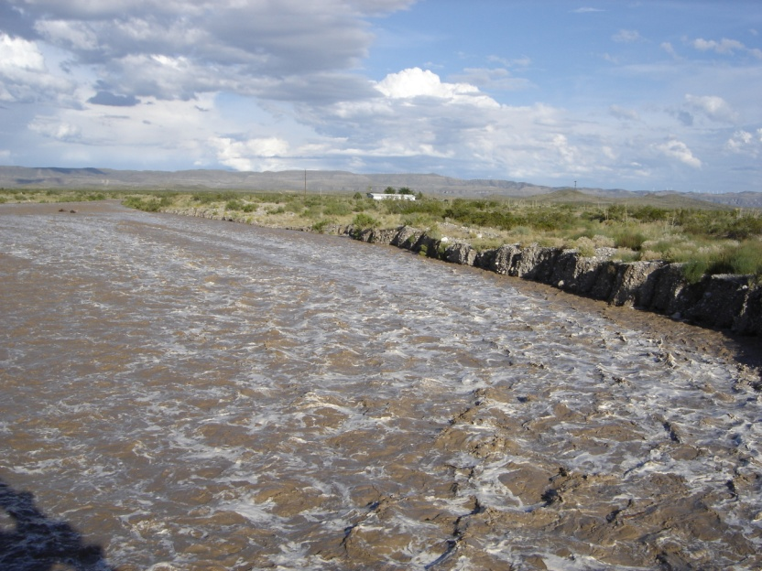
Background
Flow is uncommon – arid climate, but it does happen from time-to-time

Slide 5
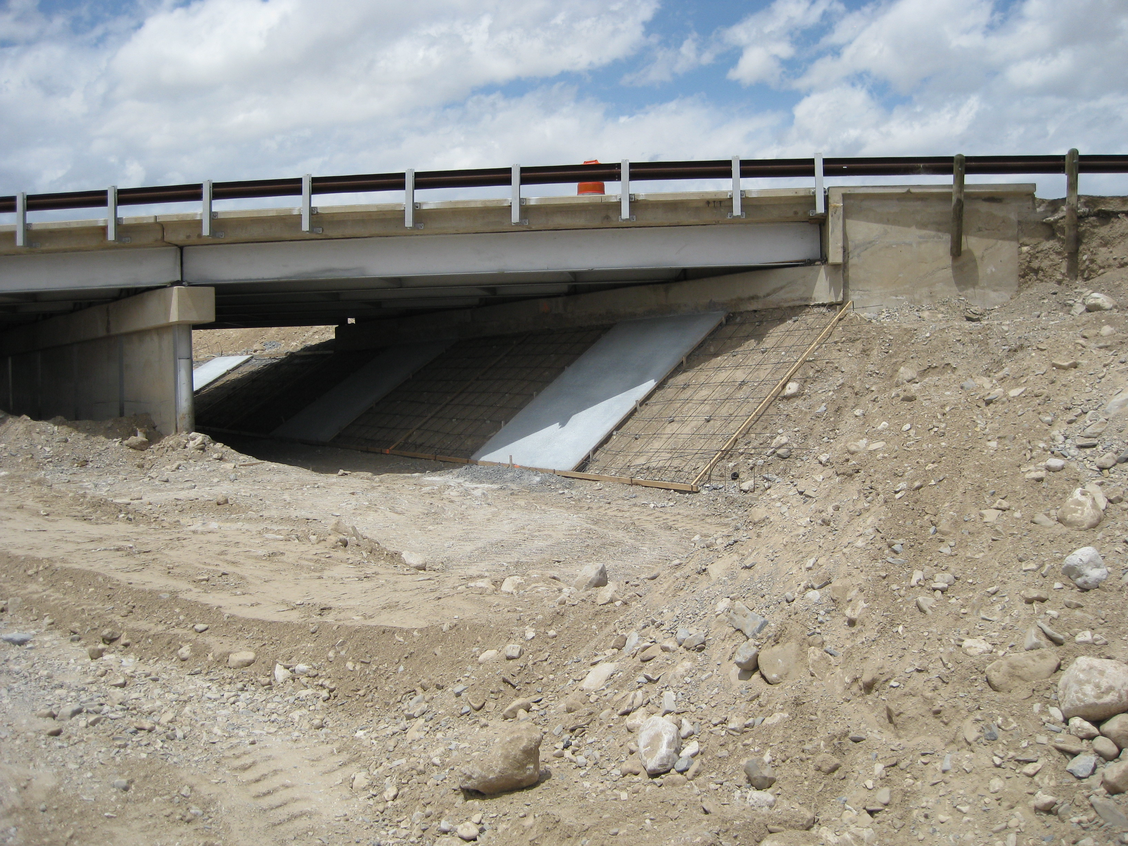
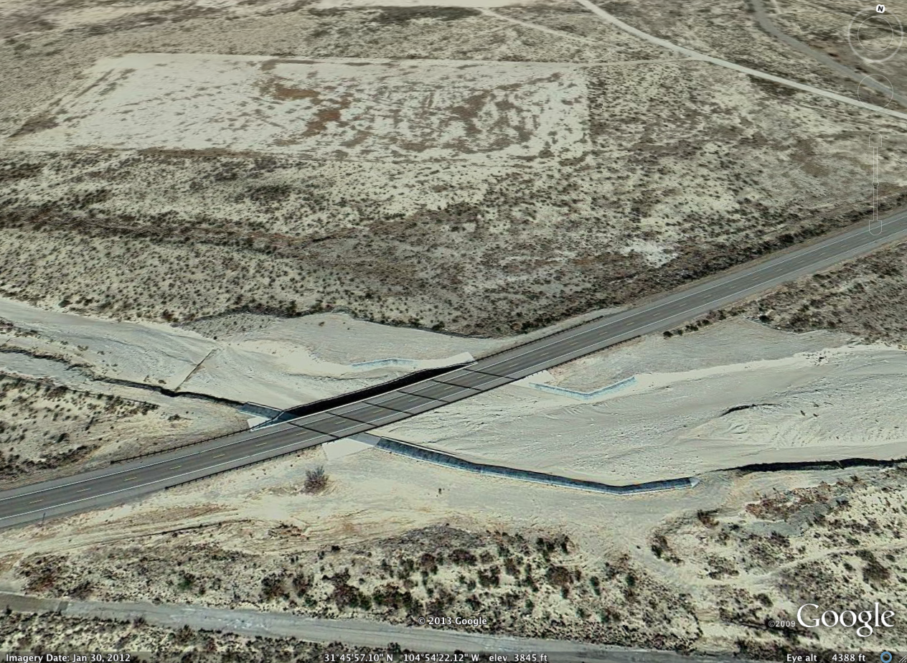
Background
Flow is uncommon – arid climate, but it does happen from time-to-time

Slide 6
Background
Good faith to reporting velocities (needed for assessing forces on bridge piers, and assessing erosion and scour potential) that are unusually large and in some instances absurd.
What is unusually large (or small)?
Are there independent ways to assess computed velocities based on prior observational experience?
Notes:
Water-surface prfiole modeling assembles models based on generalizations of parameter
values from textbooks, professional literature, computer program documentation, and from
engineering experience. Stage-discharge relations or measurements of stream
flow at or adjacent to the modeling locale are seldom available for use in screening model parameters.
In stream flow measurement at least three components are important; depth, width, and
velocity. At field scale depth and width are straightforward but the velocity measurement is
a significant contributor to overall uncertainty, complicated because a mean section velocity
(as reported in a model) requires a spatial integration of the measured velocity field. As a
result, modeling efforts by even experienced engineers are assembled and often judged to
be valid based entirely on experiences from earlier modeling efforts for hydraulically similar
settings.
This situation often leads engineers in good faith to report velocities (needed for assessing
forces on bridge piers, and assessing erosion and scour potential) that are unusually large
and in some instances absurd.
This research developed independent ways to assess computed
velocities based on prior, authoritative, observational experience.

Slide 7
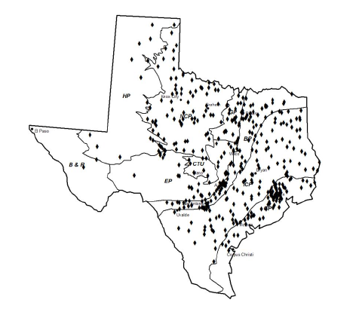
Background
NWIS database for Texas, and just plotted Q and V

Slide 8
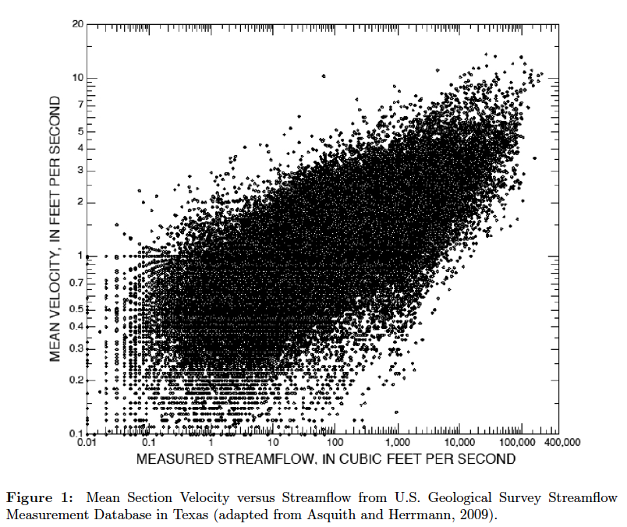
Background
NWIS database for Texas, and just plotted Q and V
Notes:
So for the flow in the Guadelupe Arroyo case (22 ft/sec) is a really unusual value (at least in the stream as it approaches the bridge).

Slide 9
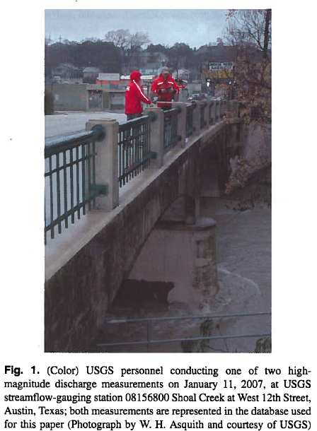
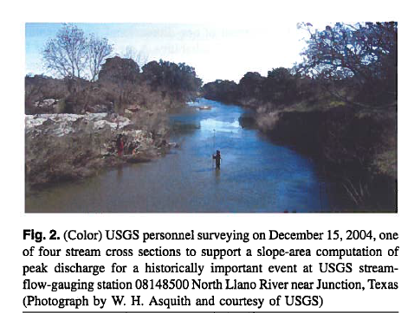
Measurements
Low and high magnitude
Notes:
The column headings in the figure correspond to the following descriptions:
1. STATION is 8-digit USGS station identification code. These codes can be entered into the NWIS web interface to recover textural description of the particular station and other locational information.
2. LATDEG is the latitude in degrees and decimal degrees (dd.ddddd).
3. LONDEG is the longitude in degrees and decimal degrees (ddd.ddddd).
4. CDA is the contributing drainage area to the station in square miles (mi2).
5. MCS is the main channel slope (Asquith and Slade, 1997).
6. PCS is the proximal channel slope.
7. MCS1085 is the 10-85 main channel slope (Gordon and others, 2004).
8. OMEGAEM is the OmegaEM parameter (Asquith, and Roussel , 2009).
9. Q is the observed discharge in cubic feet per second ( ft³/s ).
10. A is the cross sectional flow area (at the above observed discharge) in square feet (ft²).
11. V is the mean section velocity (ratio of discharge to flow area) in feet per second (ft/s).
12. B is the topwidth (at the observed discharge) in feet (ft).
13. FDC is the flow duration curve for the associated station. There are hundreds of stations represented in the database, and a flow duration curve was computed for each station. The exceedance probabilities of flow for that station were maintained to provide a useful conditioning capability.

Slide 10
Database Description
17,000 records
424 locations
Notes:
The column headings in the figure correspond to the following descriptions:
1. STATION is 8-digit USGS station identification code. These codes can be entered into the NWIS web interface to recover textural description of the particular station and other locational information.
2. LATDEG is the latitude in degrees and decimal degrees (dd.ddddd).
3. LONDEG is the longitude in degrees and decimal degrees (ddd.ddddd).
4. CDA is the contributing drainage area to the station in square miles (mi2).
5. MCS is the main channel slope (Asquith and Slade, 1997).
6. PCS is the proximal channel slope.
7. MCS1085 is the 10-85 main channel slope (Gordon and others, 2004).
8. OMEGAEM is the OmegaEM parameter (Asquith, and Roussel , 2009).
9. Q is the observed discharge in cubic feet per second ( ft³/s ).
10. A is the cross sectional flow area (at the above observed discharge) in square feet (ft²).
11. V is the mean section velocity (ratio of discharge to flow area) in feet per second (ft/s).
12. B is the topwidth (at the observed discharge) in feet (ft).
13. FDC is the flow duration curve for the associated station. There are hundreds of stations represented in the database, and a flow duration curve was computed for each station. The exceedance probabilities of flow for that station were maintained to provide a useful conditioning capability.

Slide 11
Regression Analysis
Created a Generalized Additive Model for Q
Created a Generalized Additive Model for V
Asquith, W.H., Herrmann, G.R., and Cleveland, T.G., 2013, “Generalized Additive Regression Models of Discharge and Mean Velocity generally associated with Direct-Runoff Conditions in Texas: The Utility of the U.S. Geological Survey Discharge Measurement Database” American Society of Civil Engineers, Journal of Hydrologic Engineering, Vol. 18, No. 10, pp 1331-1348
Notes:
One approach was an elaborate regression analysis of the database.
The analysis resulted in two extimation equations, one for discharge and the other for velocity.
The result is elaborate because a designer needs to use supporting tools to use the equations – in particular an omega-EM map, and a lat-lon adjustment map.

Slide 12
Regression Analysis
Created a Generalized Additive Model for Q
Notes:
One approach was an elaborate regression analysis of the database.
The analysis resulted in two extimation equations, one for discharge and the other for velocity.
The result is elaborate because a designer needs to use supporting tools to use the equations – in particular an omega-EM map, and a lat-lon adjustment map.

Slide 13
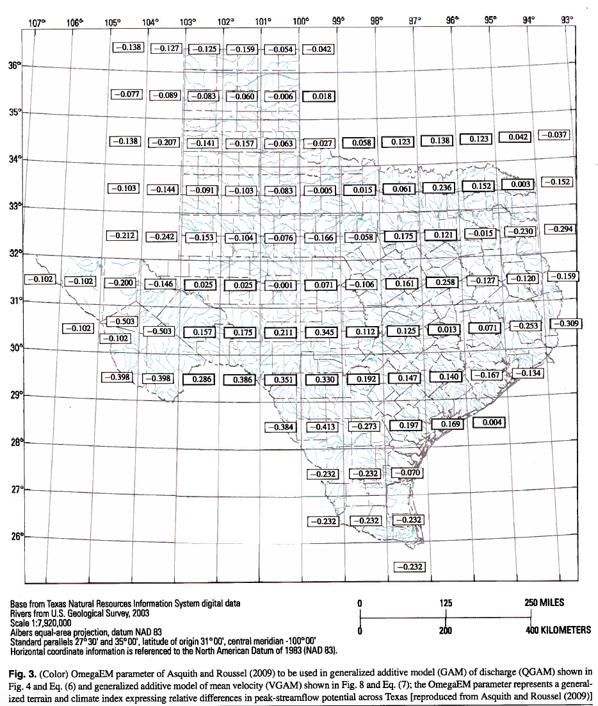
Regression Analysis
“Omega-EM” function
Notes:
One approach was an elaborate regression analysis of the database.
The analysis resulted in two extimation equations, one for discharge and the other for velocity.
The result is elaborate because a designer needs to use supporting tools to use the equations – in particular an omega-EM map, and a lat-lon adjustment map.

Slide 14
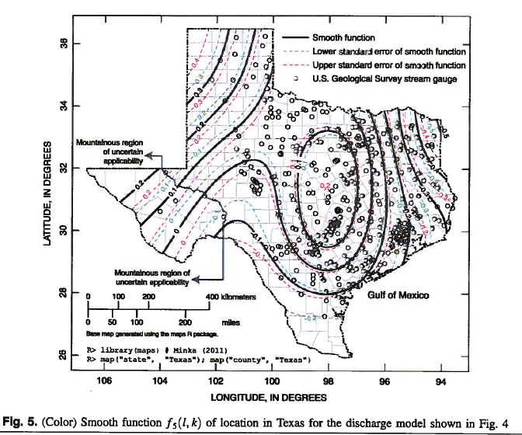
Regression Analysis
Location adjustment function
Notes:
One approach was an elaborate regression analysis of the database.
The analysis resulted in two extimation equations, one for discharge and the other for velocity.
The result is elaborate because a designer needs to use supporting tools to use the equations – in particular an omega-EM map, and a lat-lon adjustment map.

Slide 15
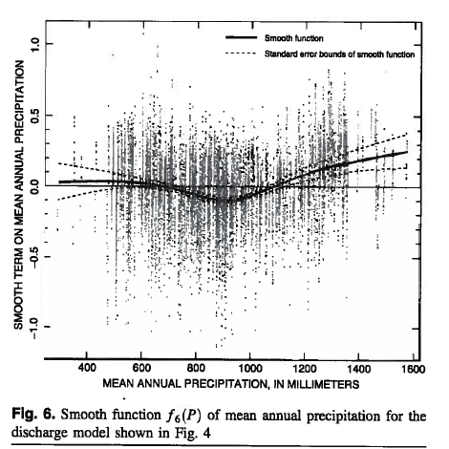
Regression Analysis
Precipitation adjustment function
Notes:
One approach was an elaborate regression analysis of the database.
The analysis resulted in two extimation equations, one for discharge and the other for velocity.
The result is elaborate because a designer needs to use supporting tools to use the equations – in particular an omega-EM map, and a lat-lon adjustment map, and a precipitation adjustment function.

Slide 16
Idea
Why not just directly access the database?
Use conditioning to restrict the range of explanatory variables (i.e. all values for topwidth between 10 and 50 feet)
From the conditioned results, the empirical distributions should be a decent estimator tool.
Notes:
Water-surface prfiole modeling assembles models based on generalizations of parameter
values from textbooks, professional literature, computer program documentation, and from
engineering experience. Stage-discharge relations or measurements of stream
flow at or adjacent to the modeling locale are seldom available for use in screening model parameters.
In stream flow measurement at least three components are important; depth, width, and
velocity. At field scale depth and width are straightforward but the velocity measurement is
a significant contributor to overall uncertainty, complicated because a mean section velocity
(as reported in a model) requires a spatial integration of the measured velocity field. As a
result, modeling efforts by even experienced engineers are assembled and often judged to
be valid based entirely on experiences from earlier modeling efforts for hydraulically similar
settings.
This situation often leads engineers in good faith to report velocities (needed for assessing
forces on bridge piers, and assessing erosion and scour potential) that are unusually large
and in some instances absurd.
This research developed independent ways to assess computed
velocities based on prior, authoritative, observational experience.

Slide 17
Script to Access the Database
Database access is pretty straightforward – we used R, but could use MatLab, SAS, S or even Excel (17000 records is kind of a nuisance in Excel)
Notes:
Water-surface prfiole modeling assembles models based on generalizations of parameter
values from textbooks, professional literature, computer program documentation, and from
engineering experience. Stage-discharge relations or measurements of stream
flow at or adjacent to the modeling locale are seldom available for use in screening model parameters.
In stream flow measurement at least three components are important; depth, width, and
velocity. At field scale depth and width are straightforward but the velocity measurement is
a significant contributor to overall uncertainty, complicated because a mean section velocity
(as reported in a model) requires a spatial integration of the measured velocity field. As a
result, modeling efforts by even experienced engineers are assembled and often judged to
be valid based entirely on experiences from earlier modeling efforts for hydraulically similar
settings.
This situation often leads engineers in good faith to report velocities (needed for assessing
forces on bridge piers, and assessing erosion and scour potential) that are unusually large
and in some instances absurd.
This research developed independent ways to assess computed
velocities based on prior, authoritative, observational experience.

Slide 18
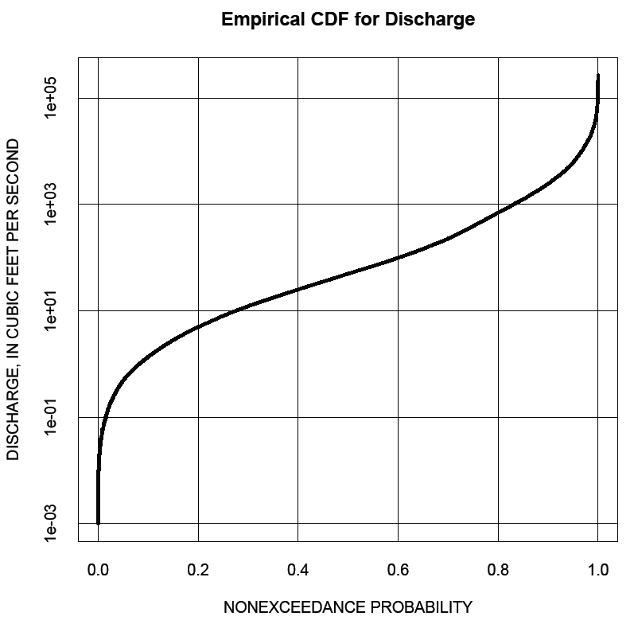
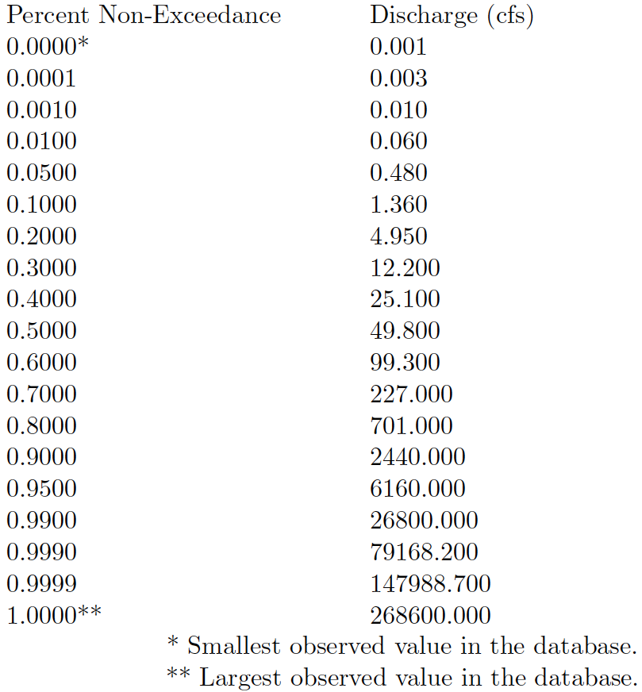
Empirical Distributions
Cumulative distribution – all values

Slide 19
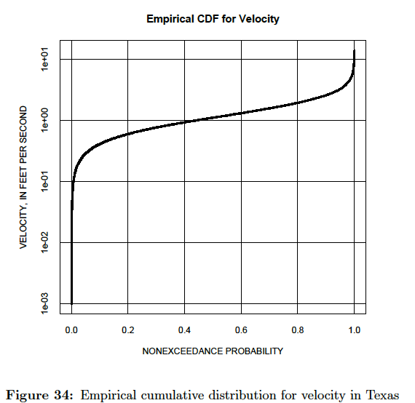
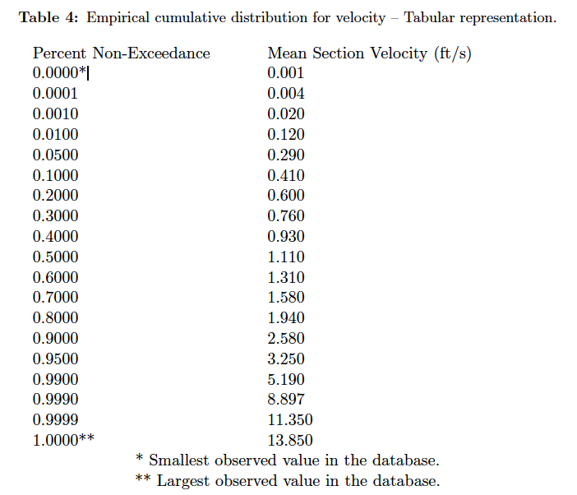
Empirical Distributions
Cumulative distribution – all values

Slide 20
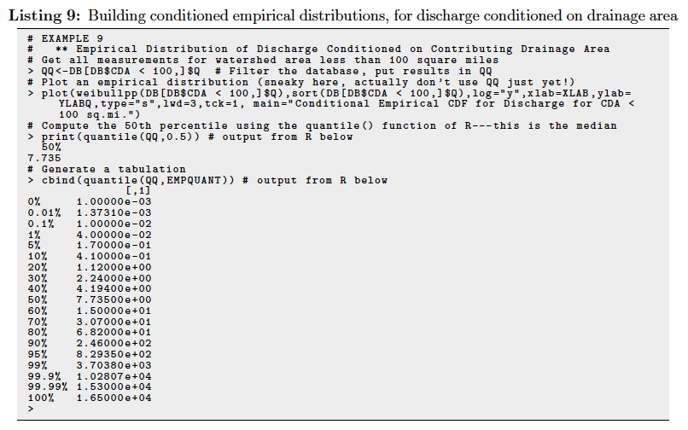
Conditional Distributions
Condition to use what we know about a location

Slide 21
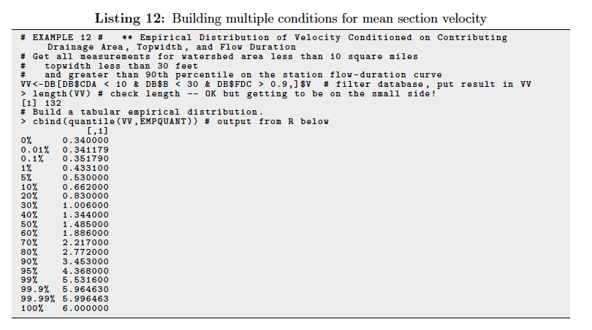
Multiple Conditioning
Condition to use what we know about a location

Slide 22
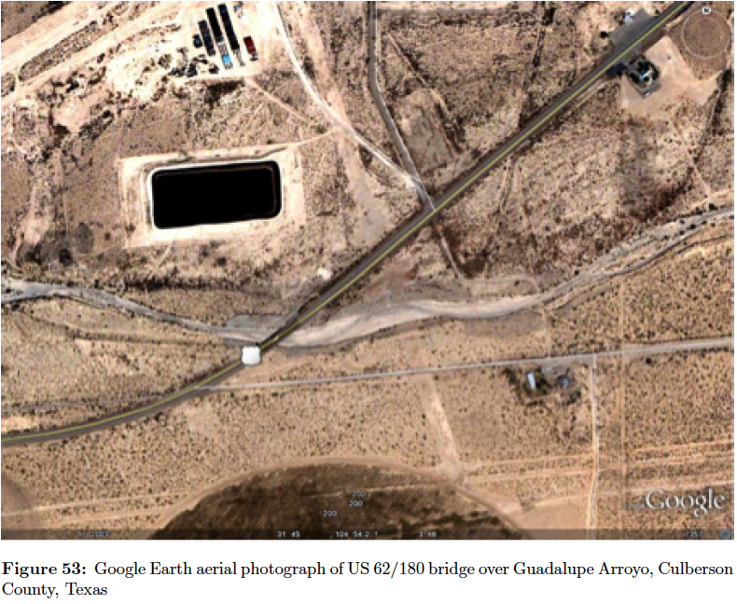
Application for Guadelupe Arroyo Example
HEC-RAS Model (reconstructed)

Slide 23
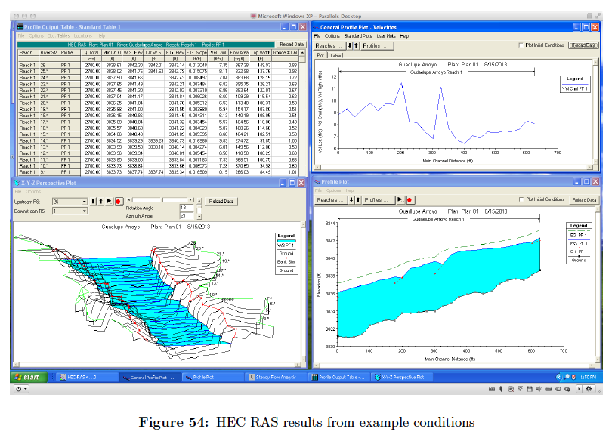
HEC-RAS Model

Slide 24
HEC-RAS Model
Two excursions into supercritical flow at sections 14 and 9.
Velocity being in excess of 6 ft/second everywhere
Two velocity spikes of about 11 feet per second.

Slide 25
HEC-RAS Model
For drainage areas up to the 40 square mile range, with individual low duration curve values greater than the 90-th percentile:
Is 2700 cfs an accessible discharge?
What is the anticipated water velocity?
What is a typical topwidth?

Slide 26
HEC-RAS Model

Slide 27
HEC-RAS Model

Slide 28
HEC-RAS Model
1. Is 2700 cfs an accessible discharge?
Yes, the value has been observed for drainage areas about the same as the area at the point of interest, however the value is comparatively rare and not anticipated for a “median" event.
2. What is the anticipated water velocity?
Somewhere in the 2-8 feet per second range. The HEC-RAS values are high, suggesting either too much discharge (hydrology) or model boundary conditions are inappropriate.
3. What is a typical topwidth?
For the location of interest, based on contributing drainage area, 58 feet is the anticipated value. The HEC-RAS values are larger, but not by too much.

Slide 29
Conclusions
An approach for assessing modeling validity from observational experience is presented.
Empirical distributions are an alternative to regression-like approach -- the authors think these are simpler to actually use
Prediction limits are analogous to empirical distributions presented herein.

Slide 30
Going Forward
The R script is reasonably simple, but for practical use an interface is needed
Perhaps RExcel (an Excel add-in that allows direct access to R scripts)
Need to build a compendium of examples to illustrate various uses rather than a single case study in an admittedly remote part of Texas
Attractiveness is that because the conditioning is really a database look-up, as new data is available can simply add it to the database, whereas the Regression Models are unable to incorporate new data (without reanalysis)

