Slide 1
TXHYETO.XLS: A Tool To Facilitate Use of Texas-Specific Hyetographs for Design Storm Modeling Caroline M. Neale Texas Tech University

Slide 2
Acknowledgements
Funding and direction provided by the Texas Department of Transportation through research contract 0-6824, “New Rainfall Coefficients”
Disclaimer: The contents of this presentation reflect the views of the author(s), who is (are) responsible for the facts and the accuracy of the data presented herein. The contents do not necessarily reflect the official view or policies of the Federal Highway Administration (FHWA) or the Texas Department of Transportation (TxDOT). This report does not constitute a standard, specification, or regulation. This presentation is not intended for construction, bidding, or permit purposes. The United States Government and the State of Texas do not endorse products or manufacturers.
Notes:
I would also like to thank Dr. Cleveland and Dr. Asquith for their assistance and guidance on this project.

Slide 3
Outline
Overview
Methods Currently in Use
Empirical, Dimensionless Hyetographs (Williams-Sether, 2004)
Graphical Method
Linear Interpolation
Proposed Alternative Method
Distribution Mixture Model

Slide 4
Overview
Empirical, Dimensionless, Cumulative Rainfall Hyetographs Developed for Selected Watersheds in Texas
The graphical method for dimensional modeling found using the Texas Dimensionless Hyetographs is widely used but is limited with small or non-incremental time steps
Two methods of interpolation were explored
Linear interpolation
Distribution-mixture function
TXHYETO.XLS, a provisional tool, was created
Notes:
The empirical, dimensionless hyetograph method discussed is based on the USGS technical report by William-Sether, Asquith, Thompson, Cleveland, and Fang and will be referred to as the Texas Dimensionless Hyetograph for the remainder of this presentation.

Slide 5
Texas Dimensionless Hyetographs
Texas-specific storm hyetographs were reported in Williams-Sether et. al. (2004) as a design storm tool for use in drainage design
These hyetographs are limited because of difficulty in “dimensionalizing” the tabulated hyetograph values for use in hydrologic software (SWMM/HECHMS)
Difficulties in dimensionalizing is two-fold
Tabulated values must be rescaled into dimensional values
Dimensionalized tabulation time intervals may not correspond to the time intervals of interest
Notes:
Texas-specific storm hyetographs were reported in Williams-Sether et. al. (2004) as an alternative design storm tool for use in drainage design.
The difficulty in dimensionalizing is two-fold.
First is a need to rescale the tabulated values to dimensional values – this step is not particularly difficult, but the designer does need to use separate tools to estimate the depth and duration for the rescaling.
The second challenge is that once the tabulations are dimensionalized, the time intervals may not correspond to a time interval of interest – if the designer wants estimates every five minutes, the rescaling of the tabulation may return values every 13 minutes as well as non uniform time increments in different parts of the storm distribution.
This challenge can be addressed by interpolation, and that is demonstrated here, but we also decided to simply fit a functional model to the tabulated values so that the function is rescaled.
Once the function is rescaled, the generation of uniform time values is simplified.

Slide 6
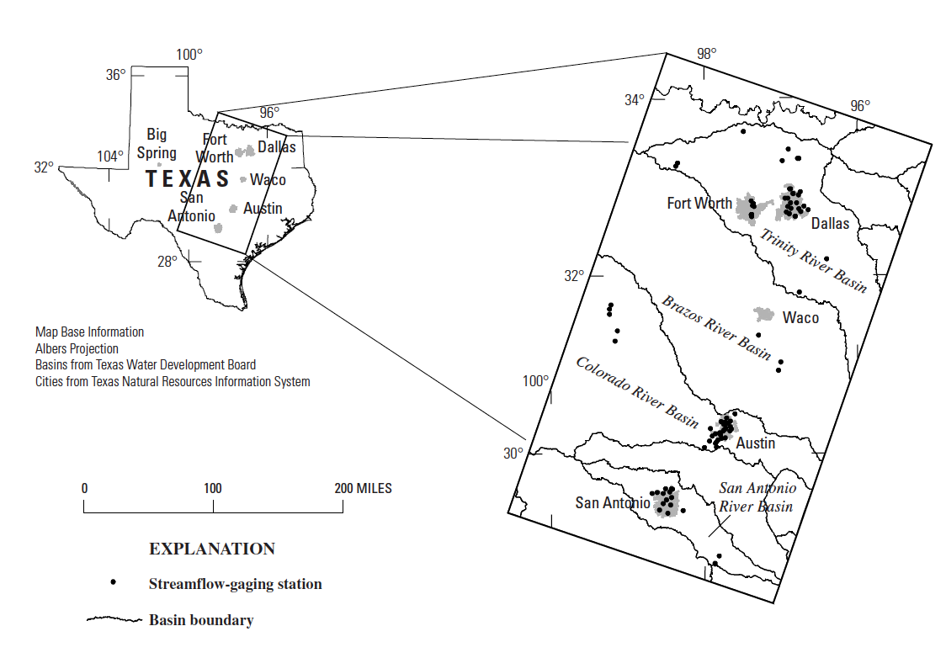
Texas Dimensionless Hyetographs
Williams-Sether et. al. (2004) analyzed data from over 1,600 runoff-producing storms at 91 USGS streamflow-gauging stations in North and South Central Texas.

Slide 7
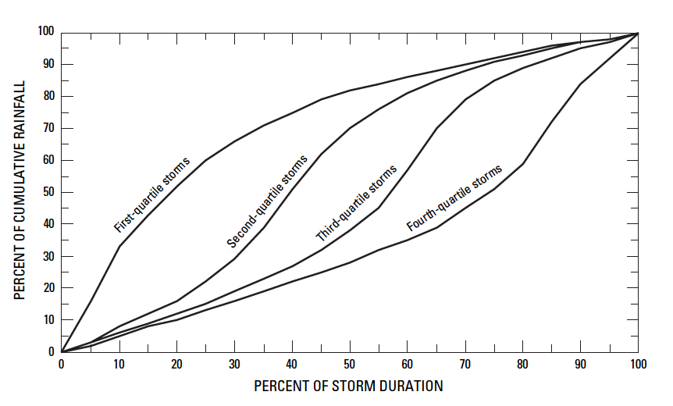
Texas Dimensionless Hyetographs
They developed empirical, dimensionless, cumulative-rainfall hyetographs.
Storm-quartile classifications were determined using Huff 1967, and 1990 type classification
Notes:
The storms were analyzed using Huff’s classification scheme. Some of the storms had long leading tails, so a 2% trimming scheme was used (the first 1% or total depth and last 1% of total depth was removed from the storm signal and the 98% “interior” part of the storm was retained for analysis. The graphs and tabulations in the Sether-Williams report reflect this trimming (except where noted din the report).
The figure is adapted from Huff 1990 for point precipitation. A gross interpretation of the classification is a1st quartile storm half the total depth is obtained in the first 25% of the duration, a 2nd quartile the 50% depth is between 25 and 50% of time, a 3rd quartile half the total depth occurs between 50 and 75% of duration, and a 4th quartile half the total depth occurs between 75-100% of total time.

Slide 8
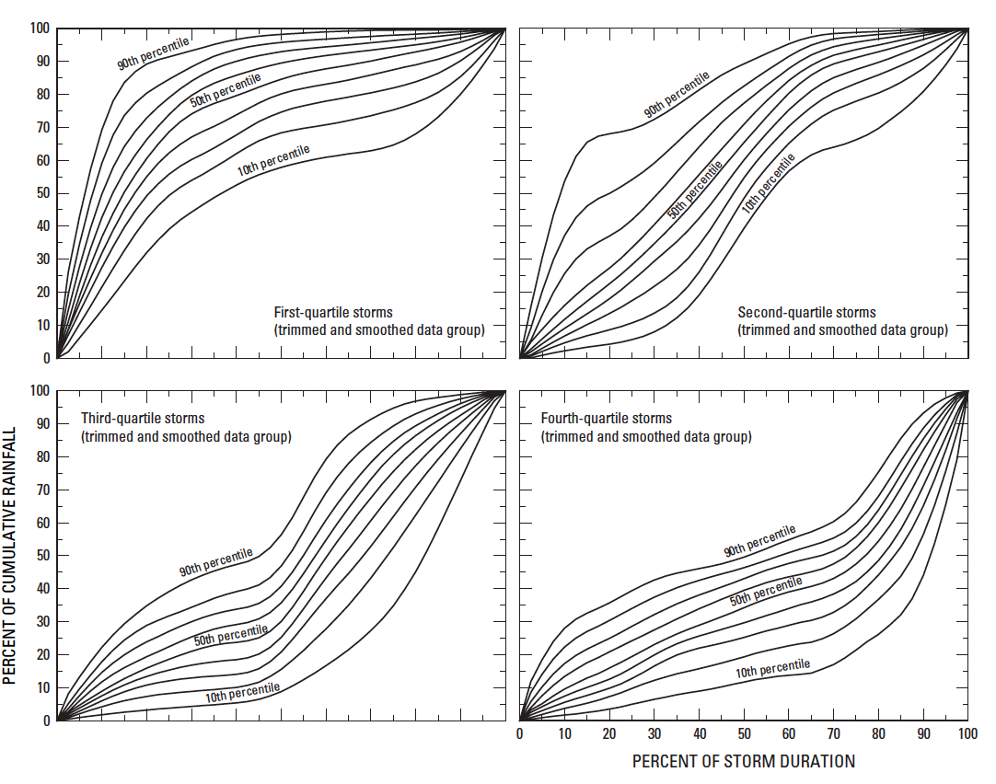
Texas Dimensionless Hyetographs
First- Quartile
Second- Quartile
Third- Quartile
Fourth- Quartile
Notes:
The various classified storms were then collected and envelopes representing 10th through 90th percentile behavior were generated from the storms. The figure shows the family of envelopes. The interpretation of these envelopes is the 90th percentile envelope represents behavior that 90% of all the observed storms exhibited; 90% of the observed storms would plot along or BELOW this envelope curve. The 10th percentile is a similar story (except 90% of the storms would plot above the 10% envelope curve).

Slide 9
Texas Dimensionless Hyetographs
A combined dimensionless family of envelopes was produced
Presented in both graphical and tabular form.
Used to estimate distributions of rainfall with time for Texas watersheds drainage areas of <160 mi².
Notes:
A combined dimensionless family of envelopes was produced – this is the Texas Hyetograph that is described herein.
It was presented in both graphical and tabular form, and was intended to be used to estimate distributions of rainfall with time for Texas watersheds (urban or rural) with drainage areas of less than 160 square miles (“small” watersheds).

Slide 10
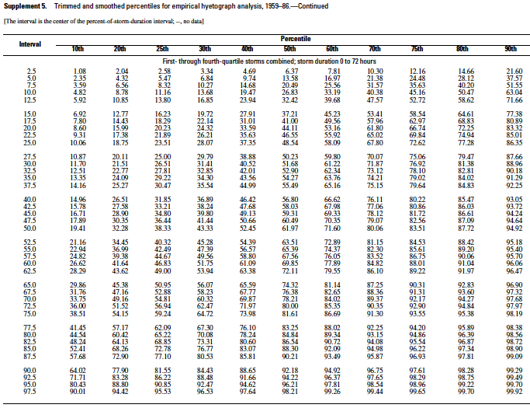
Notes:
The graphical figures in Williams-Sether were created using tabulated values from the table shown.
Impediment to using tabulation is interpolation between mapped time and depth using time and depth pairs that do not fall onto the time intervals needed.

Slide 11
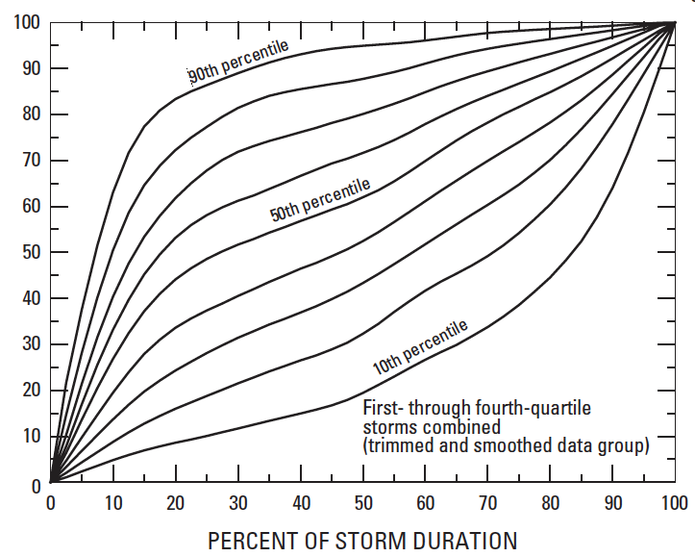
Notes:
This is the “combined” hyetograph envelope chart. The 90th and 50th percentile envelopes are annotated (blue and red, respectively). 90th percentile hyetograph=90% of observed hyetographs plot at or below this curve; 50th percentile hyetograph=median hyetograph, half the hyetographs would plot above this curve, half below. Dashed line=constant intensity storm (the slope is the average intensity that would result from the ratio of total storm depth and total storm duration) – notice that the median hyetograph lies completely above the constant intensity line.

Slide 12
Dimensionalization
Requires the user to rescale the time and percent cumulative rainfall into actual durations and total storm depth.
Engineer must determine the depth for a particular duration
Various of tools to do this in Texas:
Asquith and Roussel (2004) and Asquith (1998) (DDF Atlas)
Frederick et. Al (1997)
Hershfield (1961) (TP-40)
EBDLKUP-NEW (a campanion product for this project)
Examples of tools elsewhere:
NOAA Atlas 14

Slide 13
Example of Rescaling Axes
Example
Suppose a 4% chance (25 year) , 6 hour storm in Texas has an anticipated depth of 10 inches
After rescaling, the horizontal axis would range from 0 to 6 hours
After rescaling, the vertical axis would range from 0 to 10 inches
Notes:
Ask about order of figure, example, figure, or example figure figure

Slide 14
Rescale Depth
Rescale Time

Slide 15
10 inches
6.1 inches
5.4 inches
3.9 inches
1hrs
2hrs
3hrs
Notes:
Make bigger
If we assume the engineer is interested in the 50th percentile, values returned-
3.9 inches for 1 hour of elapsed time
5.4 inches for 2 hours of elapsed time
6.1 inches for 3 hours of elapsed time
A challenge to this method would be If smaller uniform time intervals were required (for example, 5 minutes instead of 1 hour) using the graphical method as shown in the example above would quickly become cumbersome.

Slide 16
Alternative Method-Linear Interpolation
An initial alternative method of Linear Interpolation was explored using Excel
Linear Interpolation takes specified values of depth and duration, rescales them, and exports time and depth for time steps specified by user

Slide 17
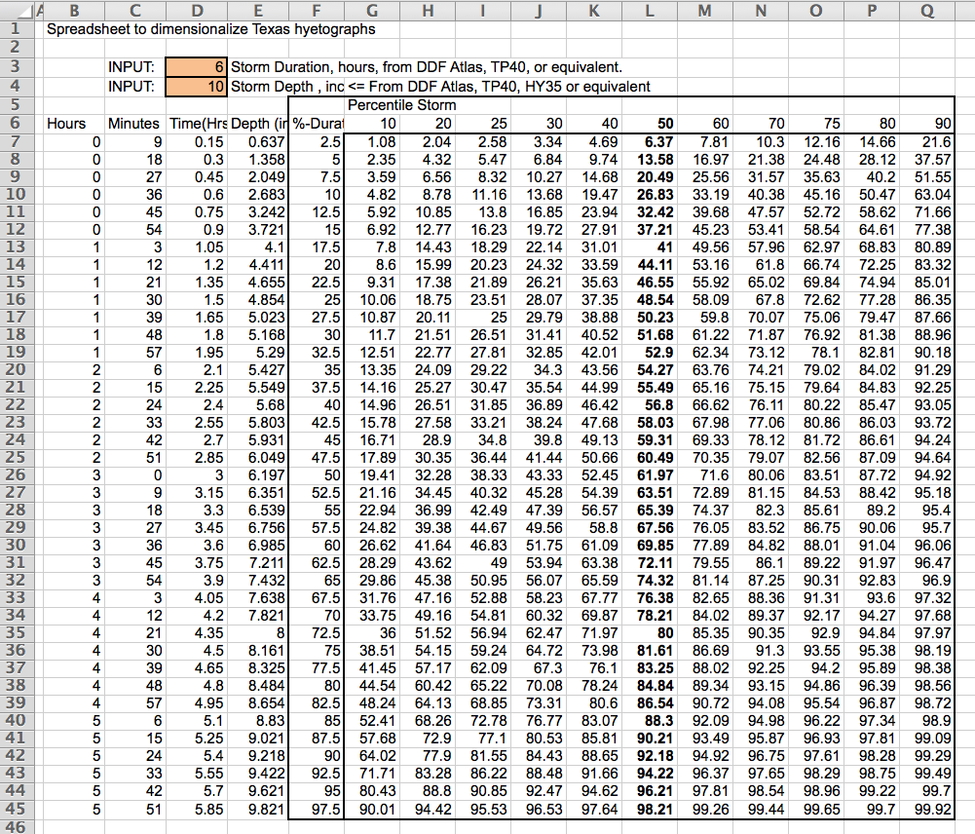
Linear Interpolation Methodology
Input desired duration and depth
Exports rescaled duration and depth to linear interpolation tab
Notes:
The specified values of duration and depth are rescaled within Excel and are used for linear interpolation.
***point out how the spreadsheet rescales the time and depth durations within the spreadsheet and note that those values are copied over to another excel spreadsheet for linear interpolation
Excel worksheet rescales duration and depth and is dynamically linked to

Slide 18
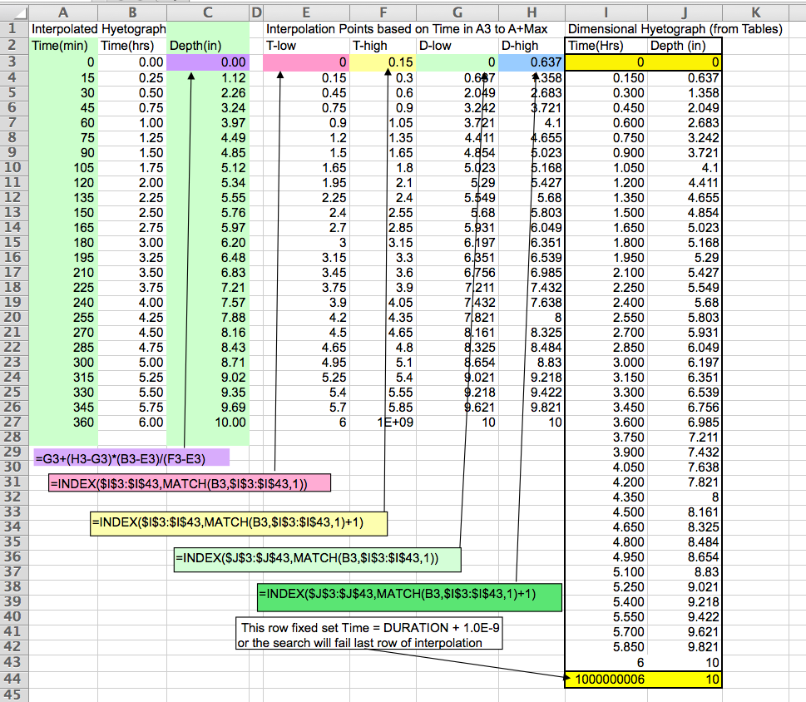
Methodology
User chooses desired time step
Reprogramming is necessary for different time steps
Notes:
The linear interpolation spreadsheet is displayed here, and is useful, but requires the designer to be able to reprogram for different desired time series. For instance, if the designer wanted 1 minute time increments, the entire worksheet to the left of the Time-Depth columns (last two) would need to be copied down to the desired length. Having to reprogram is fine for someone who built the worksheet, but probably not all that useful for the occasional user.
Using Microsoft Excel, a spreadsheet was created for linear interpolation.
The user/engineer must enter the desired time increments into column A, 15 minutes in this example.
The spreadsheet takes the rescaled dimensional values in Columns D and E of spreadsheet 1 and places them into the new spreadsheet as columns I and J. ****Does it do it automatically? Yes – it’s a tab in the same spreadsheet. Are the two spreadsheets dynamically linked or does the user have to copy and paste? Ask Dr. C**
The linear interpolation for each time value is then implemented by the formulas in columns E through H of the linear interpolation spreadsheet. – see note about reprogramming above.
Maybe add a few slides explaining the formulas behind columns E through H in the linear interpolation spreadsheet? Probably not necessary but maybe a general outline would be useful and would take up some time? < probably not necessary
The interpolation process using Microsoft Excel has one major issue:
Engineer must reprogram the linear interpolation spreadsheet for different storms
Must have a working knowledge of the Excel spreadsheets required user inputs
Example-if one minute time steps were required instead of 15 minute time steps, the engineer would have to know to enter values of 0, 1, 2,….360 (if using a 6 hour storm) into column A
The engineer must then remember to copy the interpolation formulas down to the very last time step
This is a major limitation to the linear interpolation spreadsheet.

Slide 19
Alternative Method-Distribution Mixture Model
Linear interpolation method is situation specific
Distribution-mixture model
fits smooth functions to the tabulation values from Texas Dimensionless Hyetograph
can be used to directly estimate time-depth pairs
Time depth pairs can be directly input into computer based runoff modeling software (SWMM/HECHMS)
Notes:
Because the linear interpolation method in Excel requires situation specific editing, there was desire for a more automated way to accomplish hyetograph construction
Another way to use the tabulated values from Williams-Sether is to “fit” smooth functions to the tabulation and directly estimate time-depth pairs from this smooth function.
Easier to use than the linear interpolation model

Slide 20
Distribution-Mixture Model
Several candidate functions were explored based on the shape of the 50th and 90th percentile curves
A function built from a mixture of two distributions was selected as the best fit functional form because it was able to reproduce the shape of the dimensionless hyetographs over the entire range of the dimensionless storm better than the other functions researched .
The functional form was fit using a non-linear least-squares approach where the difference between the model value and the tabulated value were minimized by changing the values of the parameters
Notes:
these two were selected as the most useful curves for a designer.
The 50th percentile is a median curve and would probably be used the most, unless the designer was concerned about consequences of failure, then might use the 90th percentile curve. The 90th percentile curve would produce incremental intensities that are large relative to the constant intensity storm, or even the 50th percentile storm (slopes of the cumulative curves is the incremental intensity)
The two most visually satisfying were a function based on the inverse tangent function, and a second based on a mixture of a cumulative beta function and a normal density function.

Slide 21
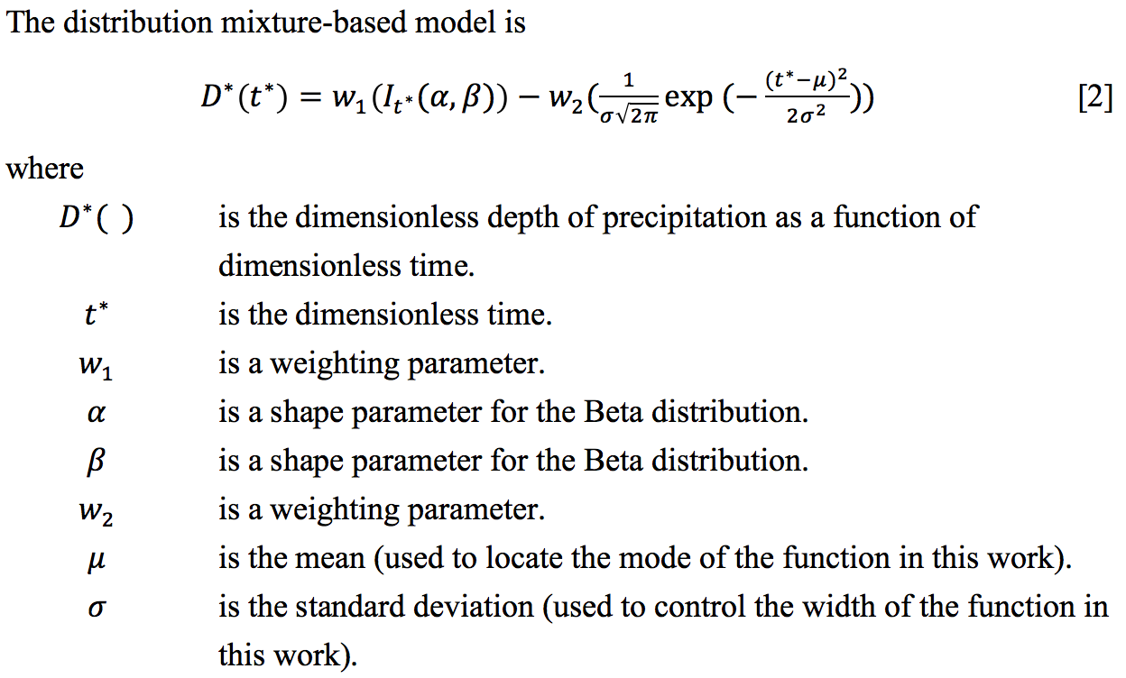
Methodology
Distribution-mixture function model
Notes:
The use of cumulative beta and normal density nomenclature is to identify the functions.
The functional forms are entirely to preserve shape, and for all practical purposes these structures are treated as ordinary continuous functions (like a logarithm) without regard to any statistical meaning of the functions or the parameters.

Slide 22
Parameter Estimation
The functional form was fit using a non-linear least-squares approach.
The difference between the model value and the tabulated values were minimized by changing the parameters.
Excel Solver (GRG Algorithm) was used.
Program defaults were used with initial estimates by trial-and-error
Notes:
(Ask Dr. C for an in depth explanation of this approach specifically as used for fitting the functional forms***)
##################
(****Ask dr. C what the GRG Algorithm is and what it does)
GRG = Generalized Reduced Gradient method. Its like the quasi-newton method I showed you guys in water systems for how a network simulator solves the loop and node equations. Think of it as a multi-dimensional “newtons” method to solve Gradient(Error) = 0 Where Error is sum of squared errors between the tabulation and the function model. We find the “zero” by changing the weights, exponents, alphas and betas in the models.
In Excel the GRG algorithm is one of several methods built into the solver.
Another way to think of it is GRG is like Goal Seek , but for a bunch of variables at once instead of just one.

Slide 23
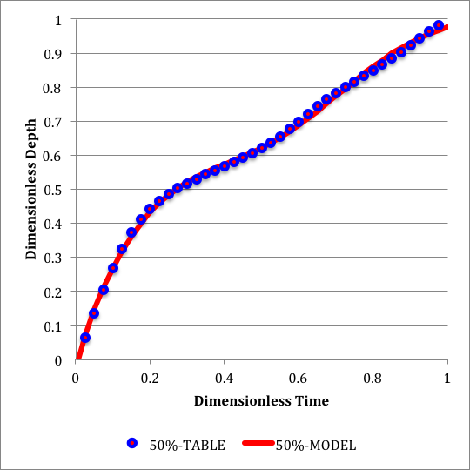
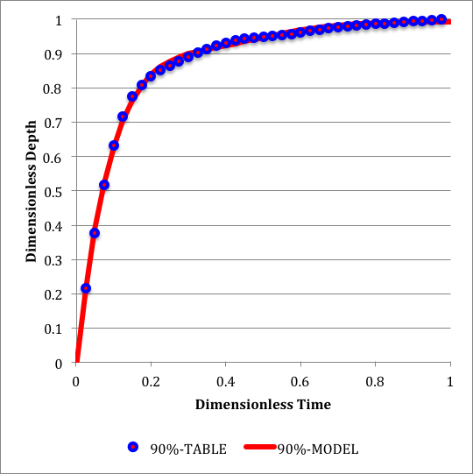
Distribution-Mixture Model
Comparison of Williams-Sether tabulated values to distribution-mixture model function
Notes:
Once the parameters are identified the tabulation is completely replaced by the functions
The figure on the left is the visual comparison of the tabulation values from Williams-Sether (2004) and the functional form for the 50% median storm.
The blue markers are the tabular values from Williams-Sether (2004) and the solid red line is the fitted function.
These figures are still in dimensionless form, but the tabulation is now replaced with a continuous function.
The figure on the right is a similar figure for the 90th percentile storm.
The spreadsheet programmer had to build the functions to force 0 and 1 dimensionless depth at these two particular time values

Slide 24
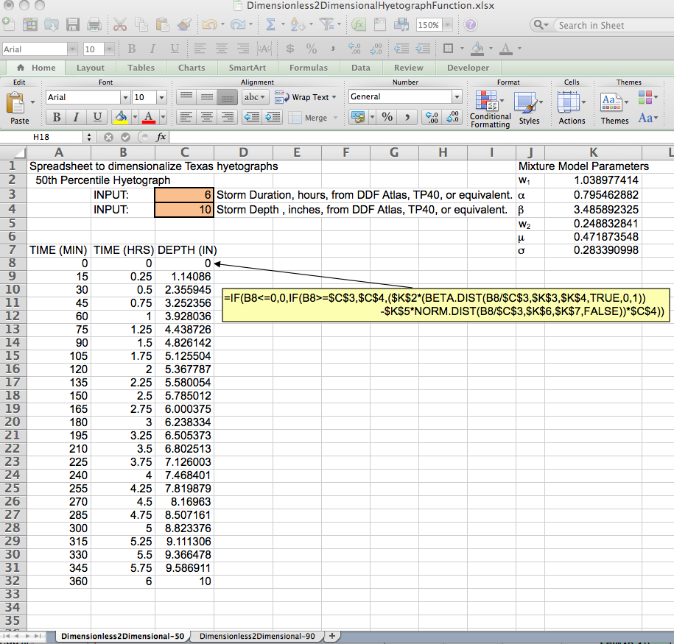
TXHYETO.XLS
Notes:
This is the spread sheet recommmended for the easist dimensionalization of hyetographs etc. etc. fix tomorrow
With the functional form built, the rescaling is accomplished using a spreadsheet with two tab-sheets, one for 50th percentile and one for 90th percentile.
Now instead of reprogramming the interpolation spreadsheet, the designer simply specifies the time increments of interest then simply copies the function call to the row –
Advantages are-
reprogramming is still occuring, but it is far simpler to remember to copy a single column rather than six.
The TXHYETO provisional tool implements smooth functions through distribution-mixture model rather than the tabulation of Williams-Sether (2004)
Engineering inputs are storm length and storm depth
Once these values are supplied, the engineer only needs to supply the desired time values and copy the single function to recover the dimensional hyetograph
The authors believe that these requirements are easier to do than to copy the interpolation functions using the linear-interpolation spreadsheet

Slide 25
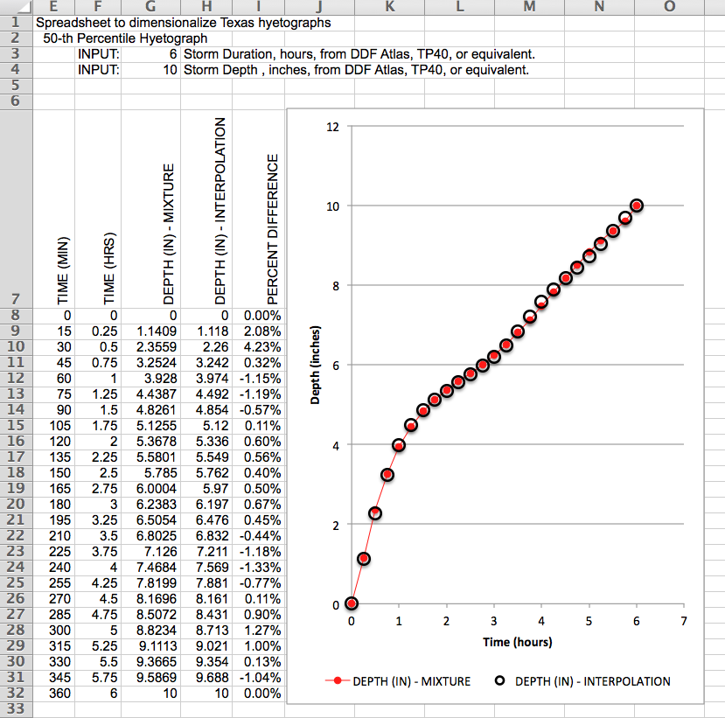
Comparison
Compare the interpolation and distribution-mixture model – less than 5% difference
Notes:
Using the example previously explained in this presentation
25 year, 6 hour storm
When mapped in dimensional space using distribution-mixture method, maximum relative error was less than 5%
TXHYETO is a more user friendly interface due to autonomous interpolation for different time steps
Using the hyetograph produced from a 6hour storm duration with a depth of 10 inches, as seen on the figure, I will provide a step-by-step explanation of how to utilize the tabular information with a rainfall-runoff software. In this example, it will be HEC-HMS.

Slide 26
HEC-HMS Example

Slide 27
HEC-HMS
TXHYETO.XLS efficiently supplies design storms for Texas into HEC-HMS or SWMM
Example for 6-hour storm with 15 min. increments
Input desired time increments (15 min. for this example)

Slide 28
HEC-HMS
The purpose of the tool is to simplify supplying design storms for Texas into HEC-HMS or SWMM.
Input desired storm duration (6-hour storm)

Slide 29
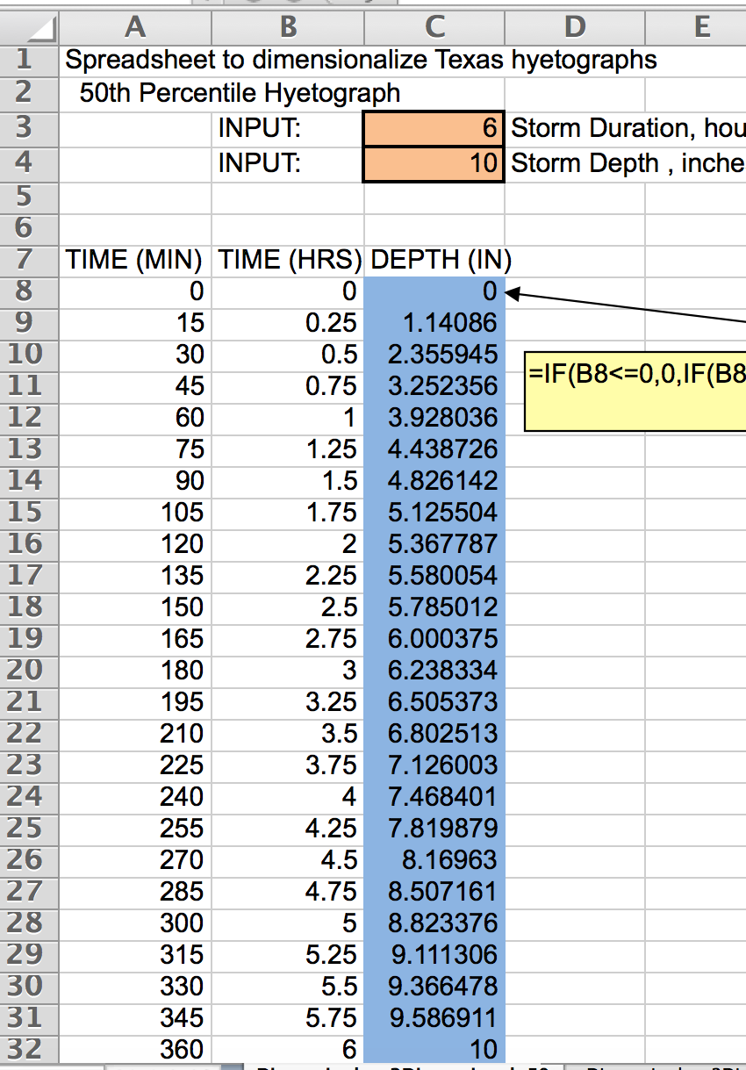
HEC-HMS
Input tabulated depths from TXHYETO.XLS

Slide 30
HEC-HMS
Notes:
To build this MHS model (the rainfall part)
The designer needed to:
Select depth and duration – use TP40, DDF Atlas, EBDLKUP,
Input these values into the spreadsheet (50th percentile this example)
Decide to use 15 minute increments (could have chosen other ones)
Build the elapsed time column to add up to the 60 hours. In this example 360 minutes.
Copy/paste the function to build the rescaled cumulative depths
Copy the results of this column into HMS raingage
DONE!

Slide 31
Conclusions
The provisional tool, TXHYETO.XLS, dimensionalizes the Texas dimensionless hyetographs for use in rainfall-runoff models
Tool uses a distribution-mixture function to approximate the shape of the Texas Dimensionless Hyetograph
Distribution-mixture model utilized in TXHYETO.XLS replicates estimates made using linear interpolation with a relative error of <5%
Notes:
While provisional versions of the tool are currently available, it should be noted that the finalized and state approved versions of TXHYETO.XLS will not be available until the 4th quarter of 2015

Slide 32
References
Williams-Sether, Tara, Asquith, W.H., Thompson, D.B., Cleveland, T.G., and Fang, Xing, 2004, Empirical, dimensionless, cumulative-rainfall hyetographs developed from 1959–86 storm data for selected small watersheds in Texas: U.S. Geological Survey Scientific Investigations Report 2004–5075, 125 p.
Asquith, W.H., 1998, Depth-duration frequency of precipitation for Texas: U.S. Geological Survey Water-Resources Investigations Report 98–4044, 107 p., http://pubs.usgs.gov/wri/wri98-4044/ .
Asquith, W.H., and Roussel, M.C., 2004, Atlas of depth-duration frequency of precipitation annual maxima for Texas: U.S. Geological Survey Scientific Investigations Report 2004–5041, 106 p.
Frederick, R.H., Meyers, V.A., and Auciello, E.P., 1977, Five to 60-minute precipitation frequency for the eastern and central United States: Silver Springs, Md., U.S. Department of Commerce, National Oceanic and Atmospheric Administration, National Weather Service, NOAA Technical Memorandum NWS HYDRO–35, 36 p.
Hershfield, D.M., 1961, Rainfall frequency atlas of the United States for durations from 30 minutes to 24 hours and return periods from 1 to 100 years: Washington, D.C., U.S. Weather Bureau Technical Paper 40, 61 p.
Huff, F.A., 1967, Time distribution of rainfall in heavy storms: Water Resources Research, v. 3, no. 4, p. 1,007–1,019.
Huff, F.A., 1990, Time distributions of heavy rainstorms in Illinois: Champaign, Illinois, Illinois State Water Survey Circular 173, 18 p.

